Slide 1
Personalized Prior for Image Restoration
Sam Kang
k.kaiyuan@wustl.edu

Slide 2
Project Overview
Preprocessing
Face Alignment
Training
Add noise to a clear image and train a model to estimate the noise
Fine Tuning
Use personal album or generated album to constrain features to increase accuracy
Restoration

Slide 3
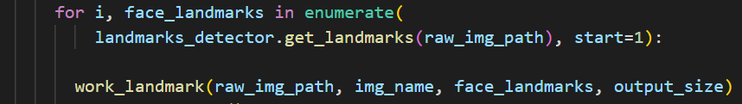
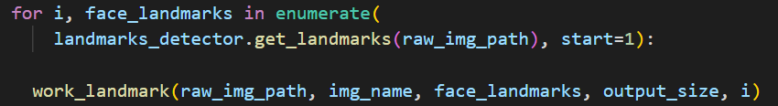
Face Align
Extract face from input, align based on facial landmarks
Use dlib to extract 68 face landmarks (eyes and mouth)
Calculate face orientation and scaling
Rotate to level, scaling to equal size, make it to center
Script is unable to extract multiple faces from a single image
  Naming issue: new aligned photo overwrite older ones of the same photo

Slide 4
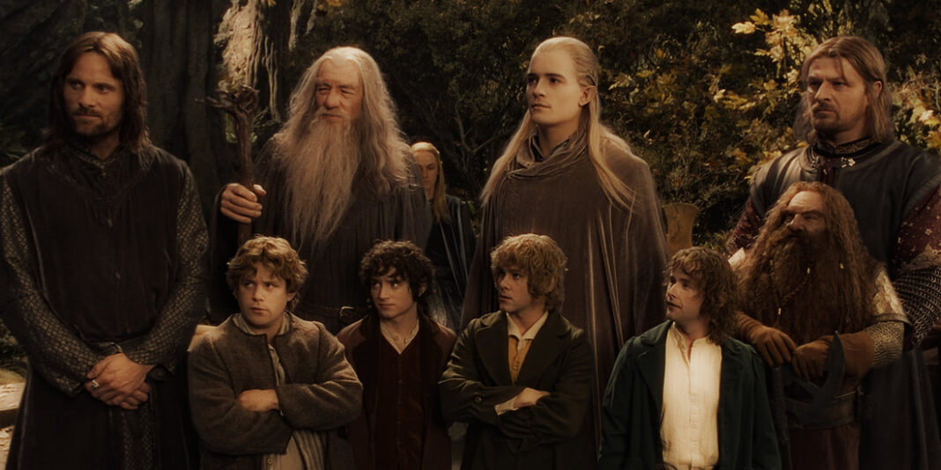

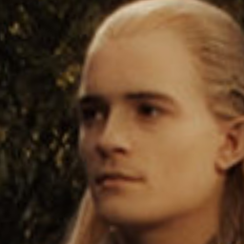



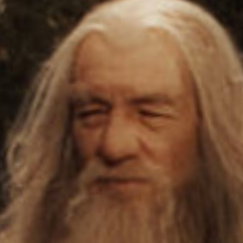

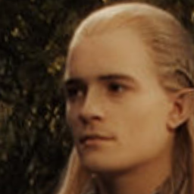

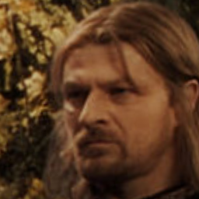

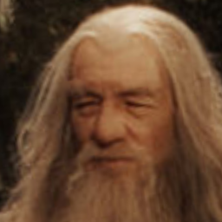
Face Align
Rewrite the Face align process based on dlib
  Able to extract multiple faces from one image and rotate/rescale it
  More efficient while keeping accuracy
Extracted faces using previous script:
Extracted faces using newalign.py:

Slide 5
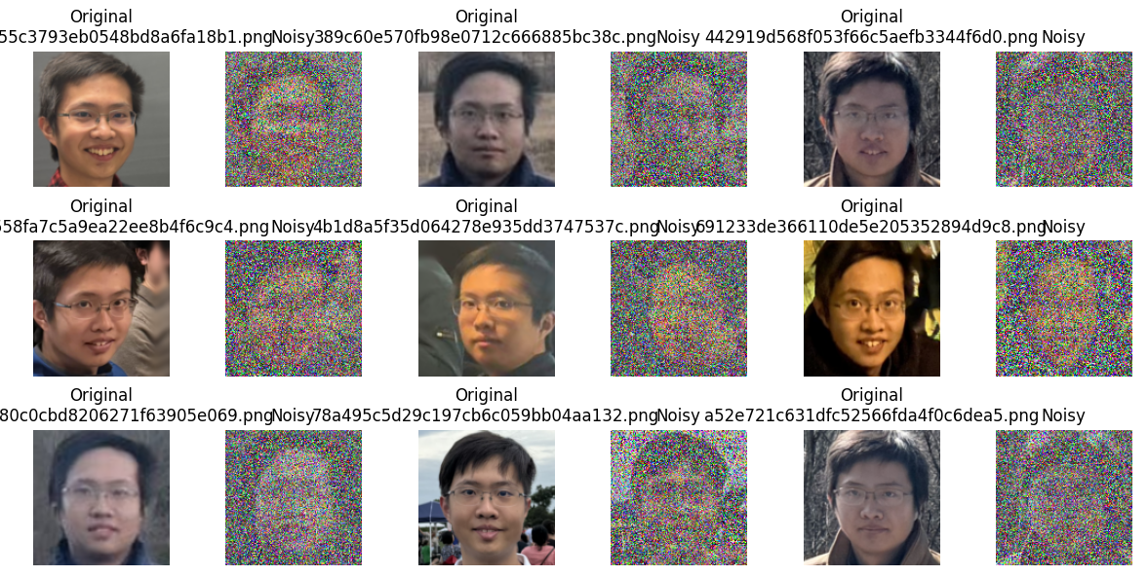
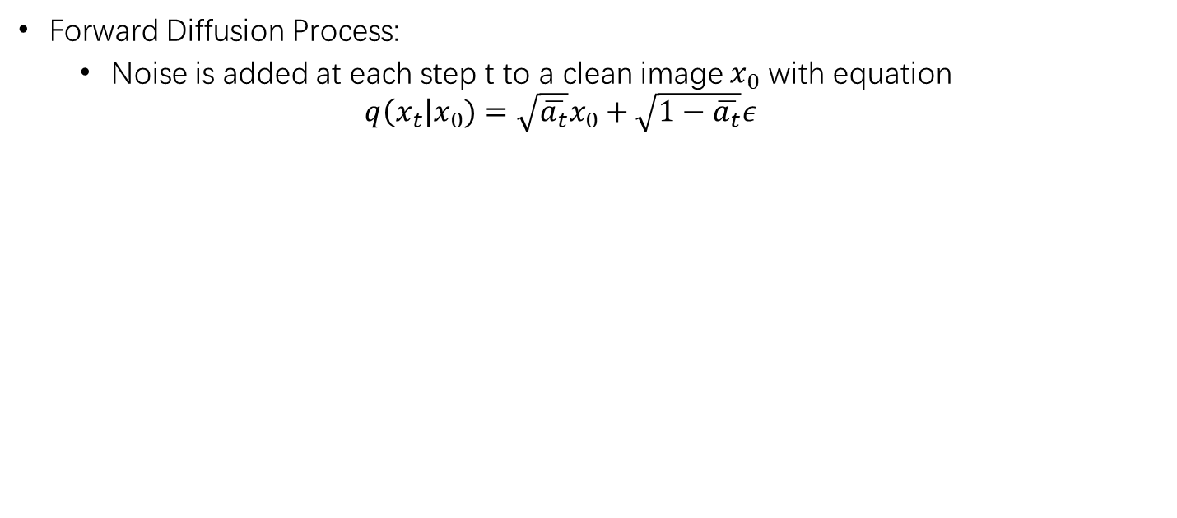
Training Process
Forward Diffusion Process:
  Noise is added at each step t to a clean image $x_{0}$ with equation
  $q\left(x_{t}\right|x_{0})=\sqrt{\overline{a_{t}}}x_{0}+\sqrt{1−\overline{a_{t}}}ε$
Notes:
$a_{t}$ was transformed from $β_{t}$ generated with function get_named_beta_schedule(), which support linear and cosine noise schedules
A1 represents the cumulative product of the noise schedule.
New script ForwDiff.py replicas the whole forward diffusion process with the same noise addition equation

Slide 6
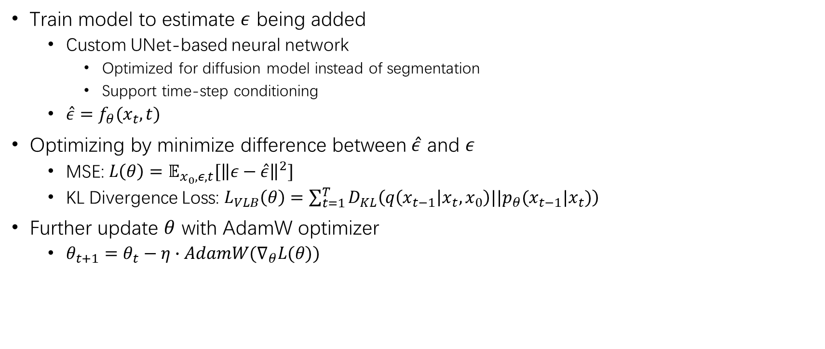
Training Process
Train model to estimate $ε$ being added
  Custom UNet-based neural network
    Optimized for diffusion model instead of segmentation
    Support time-step conditioning
  $\hat{ε}=f_{θ}(x_{t},t)$
Optimizing by minimize difference between $\hat{ε}$ and $ε$
  MSE: $L\left(θ\right)=𝔼_{x_{0},ε,t}[{\left\|ε−\hat{ε}\right\|}^{2}]$
  KL Divergence Loss: $L_{VLB}\left(θ\right)=\sum_{t=1}^{T}{D_{KL}\left(q\left(x_{t−1} | x_{t},x_{0}\right)||p_{θ}(x_{t−1}|x_{t})\right)}$
Further update $θ$ with AdamW optimizer
  $θ_{t+1}=θ_{t}−η∙AdamW(∇_{θ}L(θ))$
Notes:
encoder-decoder with skip connections structure
Hugging Face’s diffusers.UNet2DModel
Variational Lower Bound (VLB) Loss

Slide 7
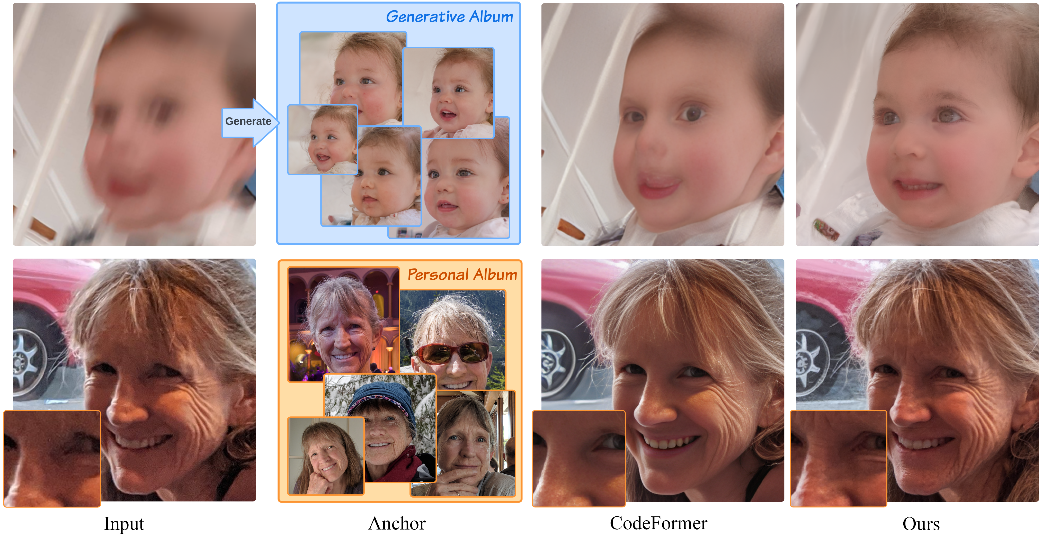
Fine Tuning Process
Improve restoration for a specific subject
  Update weights with high-quality reference imgs of the target subject
  Same training process with a pre trained checkpoint
  Small learning rate & EMA update to preserve previous learning features
  If personal album unavailable, use a generated album restored from noisy img with base model
    Different result from sampling variation and guidance skip
Notes:
Originally training diffusion model on generic dataset, finetune for specific subject/dataset
Adjust model weights to better understand the structure detail of the new thing
Loading a Pre-Trained Model: The resume_checkpoint parameter allows continuing training from a previous checkpoint (dist_util.load_state_dict() in train_util.py).
exponential moving average

Slide 8


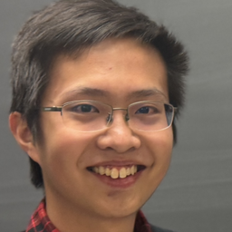
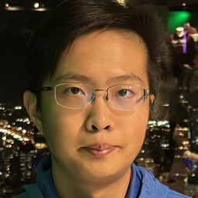




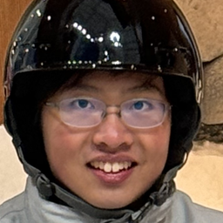
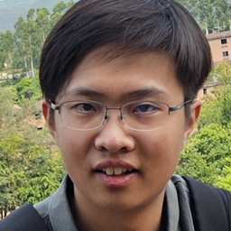


Image Blurring
Gaussian Blur
Motion Blur
Gaussian Blur + noise
Gaussian Blur Kernal Size=15
Original
Motion Blur Kernal Size=15

Slide 9
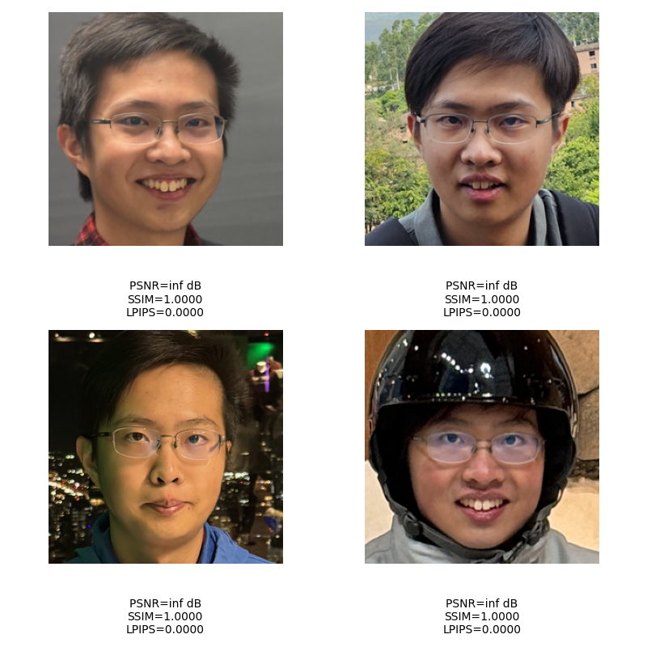
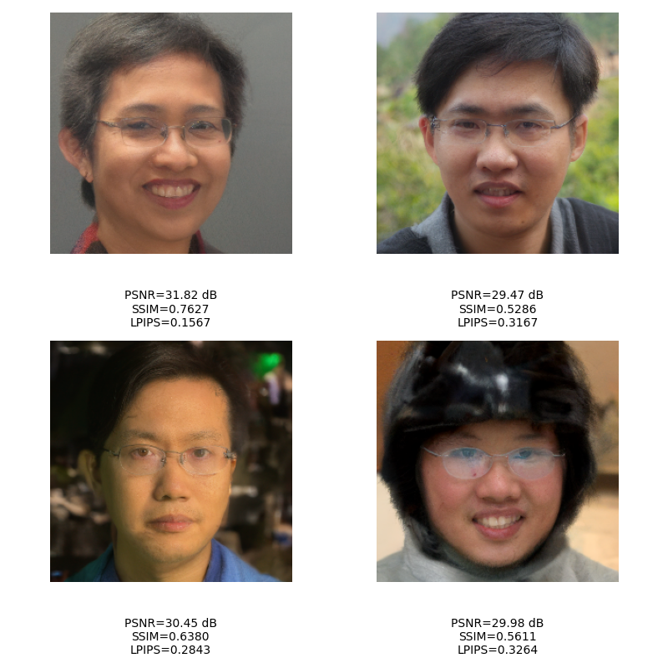
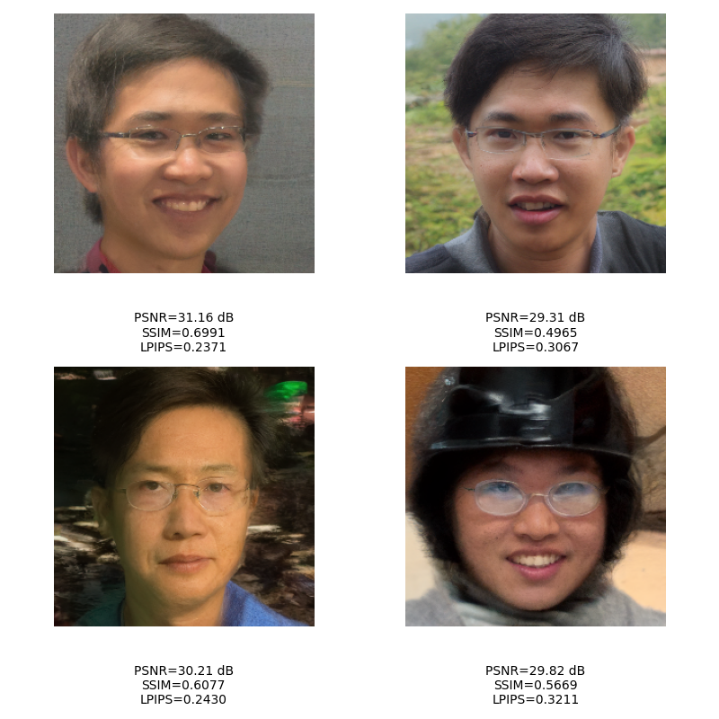
Restoration
Restoration with base model without using personal constrain
Original
Restored from Gaussian Blur
Restored from Motion Blur

Slide 10
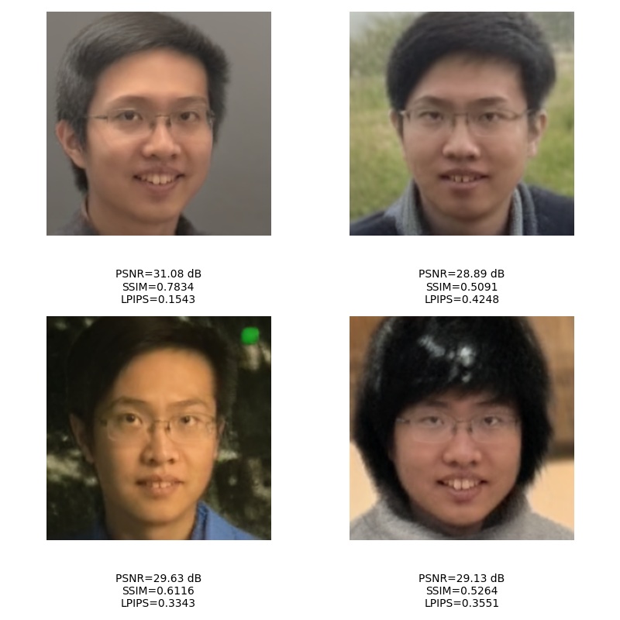
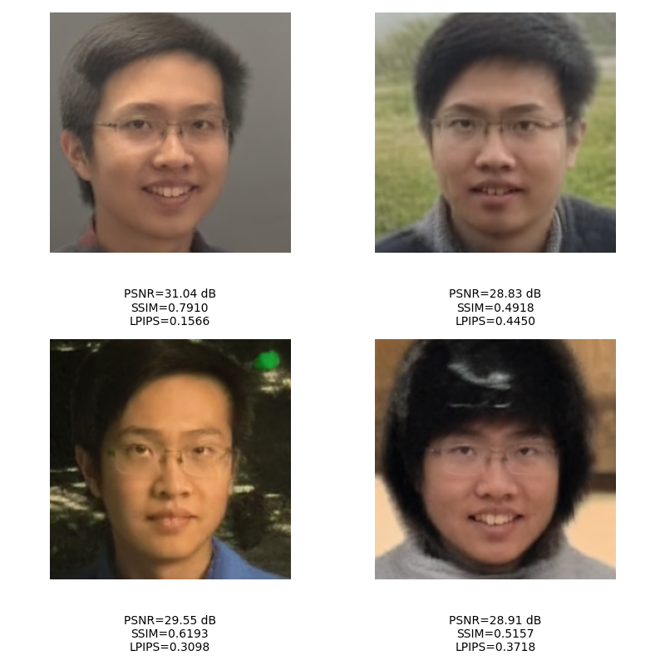
Restoration
Restoration with model tuned with small size personal album (5)
Original
Original
Restored from Gaussian Blur
Restored from Motion Blur

Slide 11
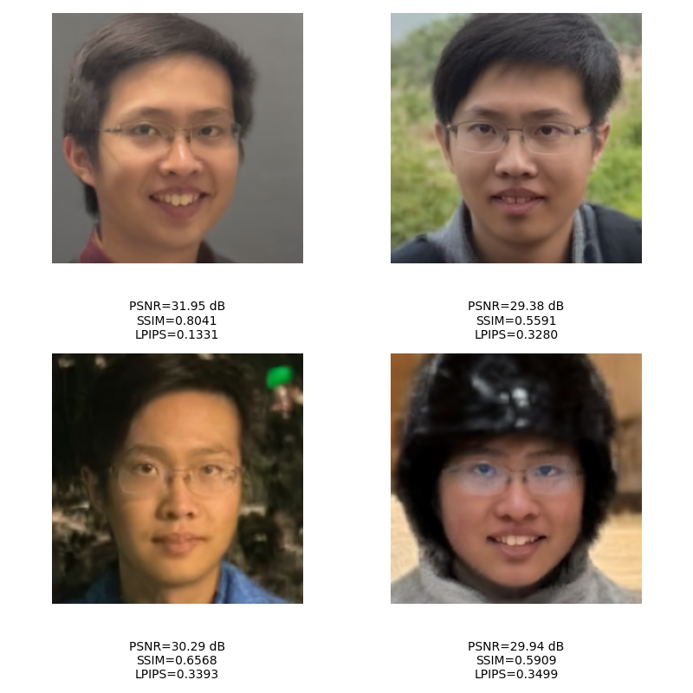

Restoration
Restoration with model tuned with median size personal album (15)
Original
Original
Restored from Gaussian Blur
Restored from Motion Blur

Slide 12


Restoration
Restoration with model tuned with large size personal album (40)
Original
Original
Restored from Gaussian Blur
Restored from Motion

Slide 13
Comparison and Results
PSNR
SSIM
LPIPS
 | img1 | img2 | img3 | img4
Gaussian Blurred img | 34.23 | 30.47 | 32.06 | 31.25
Restored img AS=0 | 31.82 | 29.47 | 30.45 | 29.98
Restored img AS=5 | 31.08 | 28.89 | 29.63 | 29.13
Restored img AS=15 | 31.95 | 29.38 | 30.29 | 29.94
Restored img AS=40 | 32.51 | 29.6 | 30.52 | 30.12
 | img1 | img2 | img3 | img4
Gaussian Blurred img | 0.8677 | 0.644 | 0.7512 | 0.7053
Restored img AS=0 | 0.7627 | 0.5286 | 0.638 | 0.5611
Restored img AS=5 | 0.7834 | 0.5091 | 0.6116 | 0.5264
Restored img AS=15 | 0.8041 | 0.5591 | 0.6568 | 0.5909
Restored img AS=40 | 0.8122 | 0.5739 | 0.6659 | 0.5991
 | img1 | img2 | img3 | img4
Gaussian Blurred img | 0.3019 | 0.4981 | 0.4126 | 0.4236
Restored img AS=0 | 0.1567 | 0.3167 | 0.2847 | 0.3264
Restored img AS=5 | 0.1543 | 0.4248 | 0.3343 | 0.3551
Restored img AS=15 | 0.1331 | 0.328 | 0.3393 | 0.3499
Restored img AS=40 | 0.103 | 0.3018 | 0.3746 | 0.3406
 | img1 | img2 | img3 | img4
Motion Blurred img | 33.6 | 30.17 | 31.79 | 30.91
Restored img AS=0 | 31.16 | 29.31 | 30.21 | 29.82
Restored img AS=5 | 31.04 | 28.83 | 29.55 | 28.91
Restored img AS=15 | 31.98 | 29.25 | 30.3 | 29.76
Restored img AS=40 | 32.34 | 29.38 | 30.42 | 29.99
 | img1 | img2 | img3 | img4
Motion Blurred img | 0.8454 | 0.6081 | 0.7313 | 0.6572
Restored img AS=0 | 0.6991 | 0.4965 | 0.6077 | 0.5669
Restored img AS=5 | 0.791 | 0.4918 | 0.6193 | 0.5157
Restored img AS=15 | 0.8082 | 0.5372 | 0.6607 | 0.5692
Restored img AS=40 | 0.8069 | 0.5435 | 0.6587 | 0.5935
 | img1 | img2 | img3 | img4
Motion Blurred img | 0.2601 | 0.4093 | 0.3209 | 0.3624
Restored img AS=0 | 0.2371 | 0.3067 | 0.243 | 0.3211
Restored img AS=5 | 0.1566 | 0.445 | 0.3098 | 0.3718
Restored img AS=15 | 0.1168 | 0.3094 | 0.2965 | 0.3443
Restored img AS=40 | 0.1112 | 0.2873 | 0.3141 | 0.306
As AS increases, PSNR generally rises, indicating better image quality with less distortion and noise.
For small AS (5), PSNR is lower than AS = 0, possibly due to underfitting.
In conclusion, the personalized model generates a more precise restored image, with accuracy generally increasing as AS increases. However, underfitting and overfitting may occur, requiring further fine-tuning.
As AS increases, SSIM generally rises, making the image more similar to the original.
Small AS (5) may have a lower SSIM than the generalized model, possibly due to underfitting.
With large AS (40), SSIM may decrease, possibly due to overfitting.
As AS increases, LPIPS generally decreases, the image appears more similar to the original in human perception.
While the values fluctuate, they show that reconstructed images with large AS generally achieve better results.
Both underfitting and overfitting occur.
Notes:
PSNR stands for Peak Signal-to-Noise Ratio. It's a measurement of how much distortion or noise affects the quality of an image or video
As reconstruct, distortion occurs, but the effect is getting better
SSIM Structural Similarity Index similarity between the images
More similar as SSIM value increase
A "LPIPS" value, which stands for "Learned Perceptual Image Patch Similarity", represents a measure of how similar two images are perceived by humans, with a lower LPIPS score indicating that the images are more visually similar according to human perception, while a higher score means they are more different.
AS=5 is sometimes worse than AS=0

Slide 14
Future Work
Use better finetune method for personalized facial reconstruction
  Use LoRA fine tune instead of full parameter update
    Increase efficiency
    Useful for different subjects with adapter matrices + base model
    Maintain generalization
    Add LoRA layer to the UNet Model
    Enable LoRA checkpoint
    Experiment & Optimization
Hu, E. J., Shen, Y., Wallis, P., Allen-Zhu, Z., Li, Y., Wang, S., ... & Chen, W. (2022). Lora: Low-rank adaptation of large language models. ICLR, 1(2), 3.

