Slide 1

SoftRing: Taming the Reactive Model for Software Defined Networks
Chengchen Hu, Kaiyu Hou, Hao Li, Ruilong Wang
Peng Zheng, Peng Zhang, Huanzhao Wang
MOE KLINNS Lab
Xi’an Jiaotong University

Slide 2
Match-Action Abstraction
Software Defined Networking (SDN) employs a Match-Action model as processing abstraction
A packet: ① match a rule in switches
② execute the related actions
Forward, Drop, Modify
Flow entry stored in Flow Table

Slide 3
Proactive vs. Reactive
Proactive
Pre-install flow entry in switches
Anticipate the network issues in advance
Reactive
Switches invoke the controller on network event
Controller pushes corresponding flow entry
Notes:
To push the flow rules

Slide 4
Proactive Model Only?
Limited flow entry memory in switch
TCAM, up to 5000~ flow entries
Limited flexibility, finer-grained control
Unawareness of data plane
Controller cannot be aware of failures
Flow entry removed: bugs, attacks
Continuously drop packets
Notes:
Therefore, we believe the Proactive model should work together with reactive model

Slide 5
Overhead in Reactive
Reactive introduces communicate overhead between controller and switches (South-Bound Interface)
Table-miss event
One common trigger of reactive
Example: OpenFlow
Controller
Switch
Notes:
Generally, we believe the reactive model should coexist with proactive model as a complement,

Slide 6
Table-miss
New incoming packet doesn’t match any flow entry
Raise a Table-miss event
Controller
Packet
Switch
Notes:
Generally, we believe the reactive model should coexist with proactive model as a complement,

Slide 7
Table-miss
Switch buffers the packet
Sends a Packet-in message to controller
first 128 bytes of the packet
Controller
Packet-in
128 Byte
Packet-out
Buffer Id
Switch
Packet
Buffer Packet in Switch

Slide 8
Table-miss
The buffer overflows
Switch has to send the entire packet through the Packet-in message
Controller
Packet-in
1500 Byte
Packet-out
1500 Byte
SBI bandwidth overhead increases
Latency to install the new entry increases
(5ms to 100ms)
Packet
Packet
Packet
Switch
Packet
Packet
Packe
Notes:
If too many new flow arrived on a short period of time,
Which finally affect the performance of whole network systems.

Slide 9
When Does Reactive Happen?
1
Small flows come successively.
20% traffic occupies 80% of total flows.
Limited flow entry memory, replacement
E.g., LRU Policy
Subsequent packets of TCP can trigger Table-miss
Subsequent packets also trigger Table-miss
Before related new rule installed
2
3
Notes:
Generally, we believe the reactive model should coexist with proactive model as a complement,

Slide 10
Where to buffer the Table-miss packet?
Keep in Switch
Buffer overflow: new flow exceeds 0.26% of switch capacity
Send to Controller
Only 0.06% of the traffic consume all the control bandwidth
Brand | Model | Port | Buffer | Control BW
Pica8 | AS7712-32X | 100GbE*32 | 16MB | 1000Mbps
Brocade | ICX7750-26Q | 40GbE*26 | 12.2MB | 1000Mbps
Dell | Z9100-ON | 100GbE*32 | 16MB | 1000Mbps
Huawei | CE8860 | 100GbE*32 | 16MB | N/A
Netgear | M5300-52G | 48+10GbE*4 | 4MB | 10Gbps
Notes:
Generally, we believe the reactive model should coexist with proactive model as a complement,

Slide 11
Goal of SoftRing
Reduce Buffer Reduce Bandwidth
Less Packet Drop Compatibility
1
2
3
4
Notes:
Generally, we believe the reactive model should coexist with proactive model as a complement,

Slide 12
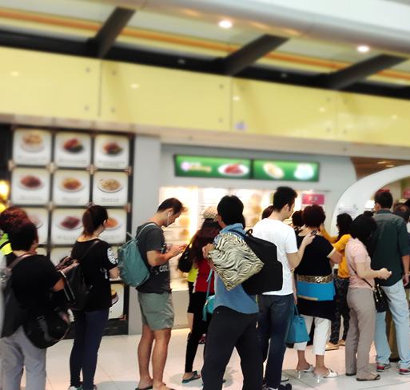
Popular Restaurant Policy
Popular restaurant cannot have enough tables to serve everyone (“table-miss”)
Waiters: record the customer，arrange a waiting number
Customers: walk away and back later when the seat availability.

Slide 13
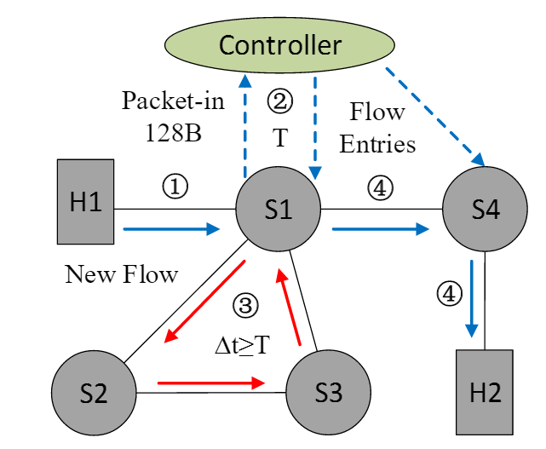
Basic Idea
Extend loops in network
Remaining bandwidth and memory in dataplane
Internet: > 50%
Data Center: > 75%
Accurate control of packet forwarding

Slide 14
Three Challenges
Seek and Select waiting-loops
Enforce waiting-loop policy in switches
Dynamically adjust waiting-loops
1
2
3
Notes:
Generally, we believe the reactive model should coexist with proactive model as a complement,

Slide 15
Seek and Select
1
Loop Seeking Algorithm
(collect enough loops as waiting-loop candidate)
Loop Selection Algorithm
(select a loop subset to cover all the switches)

Slide 16
Loop Seeking Algorithm
Based on Johnson’s loop searching algorithm
Directed graph
Accelerate
Graph partition
Loop length and scale control
Random shuffle
Virtual Loop
𝑣1→𝑣2→…→𝑣2→𝑣1
Waiting-loop
Candidate Set
Notes:
Graph partition: calculation simultaneously
Random shuffle: increase loop diversity

Slide 17




Loop Selection Algorithm
Select a loop subset to meet the requirements:
Cover all the switches
Minimize the extra delay
Bandwidth in Data Plane
Minimize the extra flow entries
Map to weighted set cover problem
Notes:
Graph partition: calculation simultaneously
Random shuffle: increase loop diversity

Slide 18
Switch Enforcement
2
 | Priority | Match | Action | Timeout
OpenFlow | 0 | * | ① Buffer Table-miss packet in switch ② Send Packet-in with 128 Bytes | 0
ES (Entry Switch) | 0 | * | ① Send Packet-in with 128 Bytes ② Push VLAN = 1 ③ Set TTL = β ④ Send to next switch by queue | 0
LS (Loop Switch) | 1 | VLAN = 1 in-port = pre-switch | ① Set TTL = TTL -1 ② Send to next Switch by queue | 0

Slide 19
Switch Enforcement
2
 | Priority | Match | Action | Timeout
OpenFlow | 0 | * | ① Buffer Table-miss packet in switch ② Send Packet-in with 128 Bytes | 0
ES (Entry Switch) | 0 | * | ① Send Packet-in with 128 Bytes ② Push VLAN = 1 ③ Set TTL = β ④ Send to next switch by queue | 0
LS (Loop Switch) | 1 | VLAN = 1 in-port = pre-switch | ① Set TTL = TTL -1 ② Send to next Switch by queue | 0
VLAN tag: distinguish waiting-loop packet

Slide 20
Switch Enforcement
2
 | Priority | Match | Action | Timeout
OpenFlow | 0 | * | ① Buffer Table-miss packet in switch ② Send Packet-in with 128 Bytes | 0
ES (Entry Switch) | 0 | * | ① Send Packet-in with 128 Bytes ② Push VLAN = 1 ③ Set TTL = β ④ Send to next switch by queue | 0
LS (Loop Switch) | 1 | VLAN = 1 in-port = pre-switch | ① Set TTL = TTL -1 ② Send to next Switch by queue | 0
VLAN tag: distinguish waiting-loop packet
Priority: never affect normal traffic

Slide 21
Switch Enforcement
2
 | Priority | Match | Action | Timeout
OpenFlow | 0 | * | ① Buffer Table-miss packet in switch ② Send Packet-in with 128 Bytes | 0
ES (Entry Switch) | 0 | * | ① Send Packet-in with 128 Bytes ② Push VLAN = 1 ③ Set TTL = β ④ Send to next switch by queue | 0
LS (Loop Switch) | 1 | VLAN = 1 in-port = pre-switch | ① Set TTL = TTL -1 ② Send to next Switch by queue | 0
VLAN tag: distinguish waiting-loop packet
Priority: never affect normal traffic
TTL: avoid endless loop

Slide 22
Switch Enforcement
2
Controller-to-Switch Message: OpenFlow
Type | Priority | Match/Data Field | Action | Timeout
Packet-out | / | Buffer ID or Entire Packet | Forwarding | /
Flow-add | >2 | ip_src ip_dst etc. | Forwarding | normal
Controller-to-Switch Message: SoftRing
Type | Priority | Match/Data Field | Action | Timeout
Flow-add | >2 | VLAN = None ip_src ip_dst etc. | Forwarding | normal
Flow-add | >2 | VLAN = 1 ip_src ip_dst etc. | ① Pop VLAN ② Reset TTL ③ Forwarding | short

Slide 23
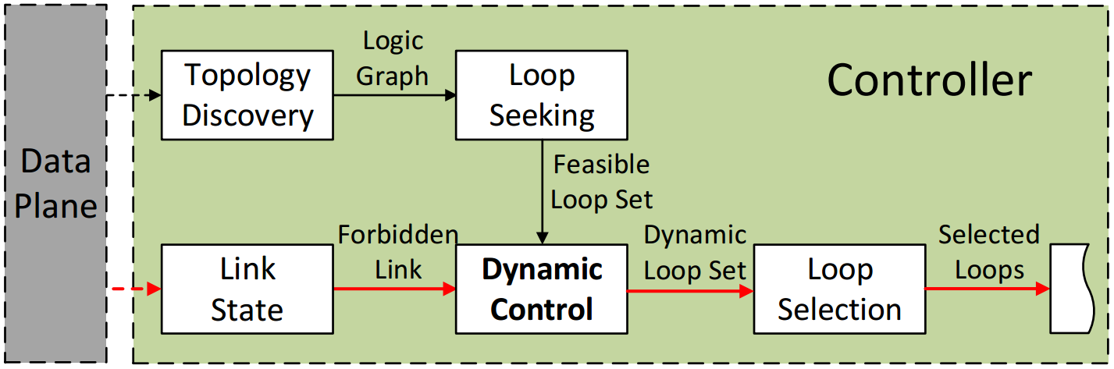
Handling the Dynamic
3
Forbidden Link: overloaded or failed links
Re-execute: Only Loop Selection Algorithm (< 1s)

Slide 24
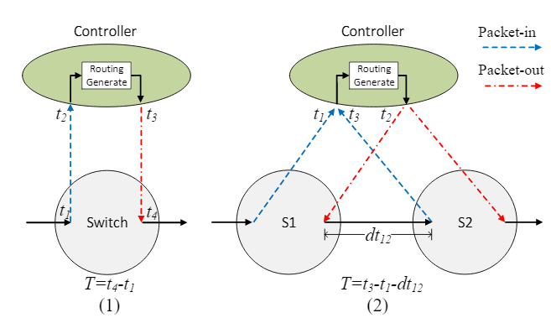
Handling the Dynamic
3

Slide 25
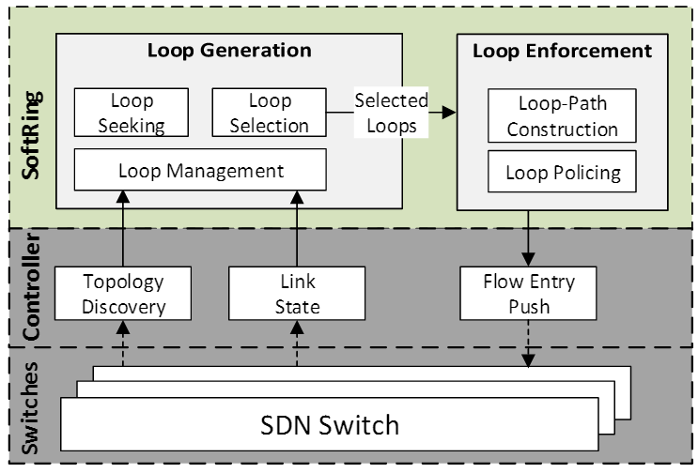
SoftRing: Implementation

Slide 26
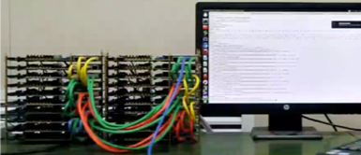
SoftRing: Implementation
Fattree(4) with 20 ONetSwitch
Controller:
Floodlight
Switch:
Open vSwitch: Software Switch
ONetSwitch 30: Hardware Switch

Slide 27
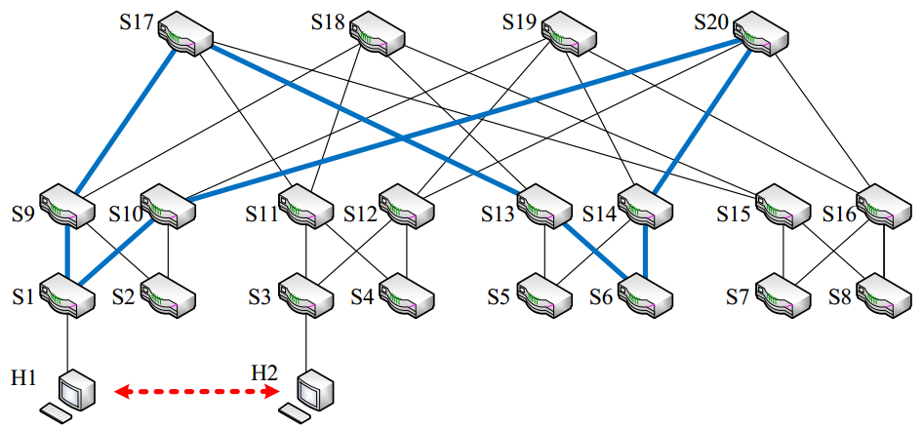
SoftRing: Implementation
Loop ID | Switch ID |  |  |  |  |  |  |  | Loop Length
1 | 1 | 10 | 20 | 14 | 6 | 13 | 17 | 9 | 8
2 | 2 | 9 | 17 | 13 | 5 | 14 | 19 | 10 | 8
3 | 3 | 12 | 19 | 16 | 8 | 15 | 18 | 11 | 8
4 | 4 | 11 | 18 | 15 | 7 | 16 | 20 | 12 | 8

Slide 28
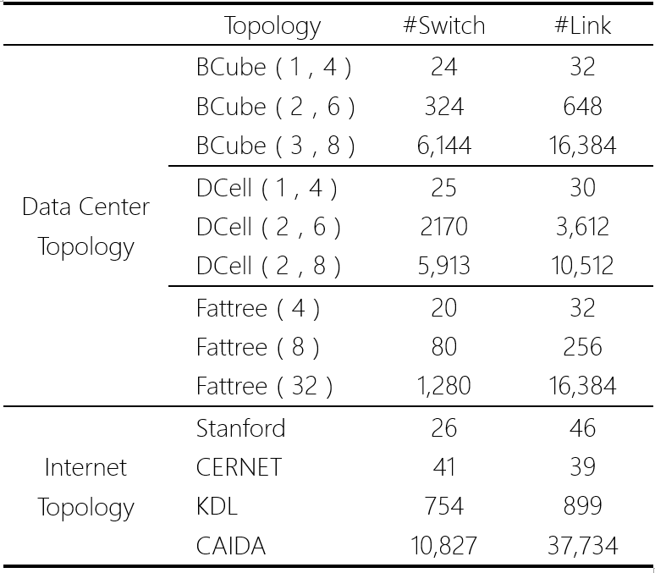
Evaluation

Slide 29
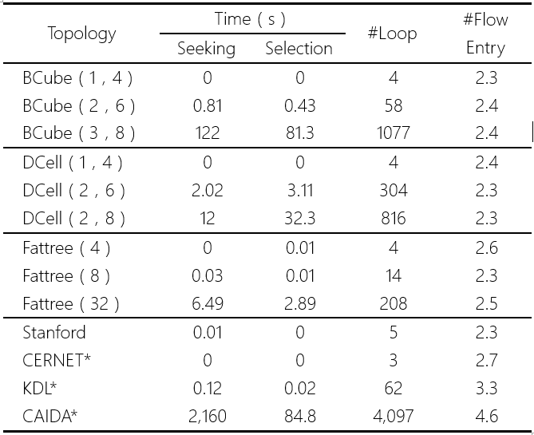
Evaluation
100% Coverage,
Virtual Loop used in last three topology

Slide 30
Evaluation

Slide 31
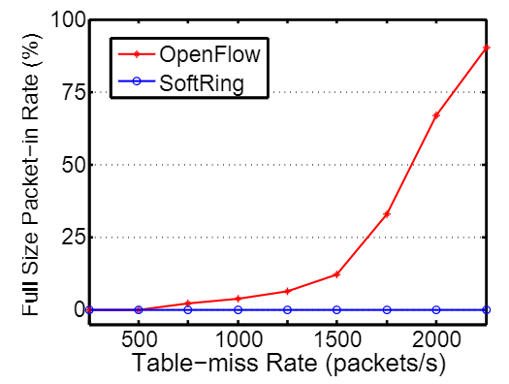
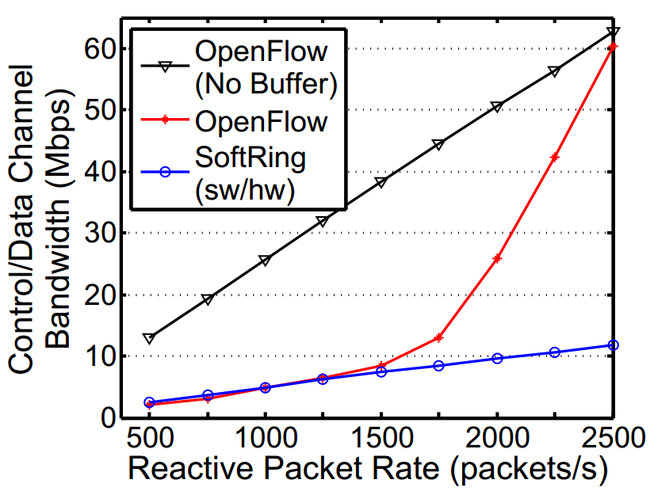
Benefit of SoftRing

Slide 32
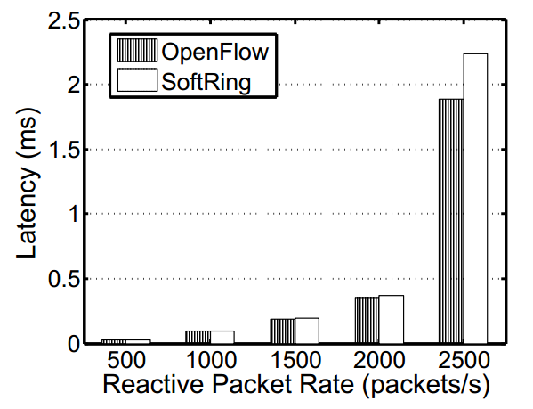
Cost of SoftRing
Average Packet Delay in Different Reactive Packet Rate
0.2%
2.9%

Slide 33
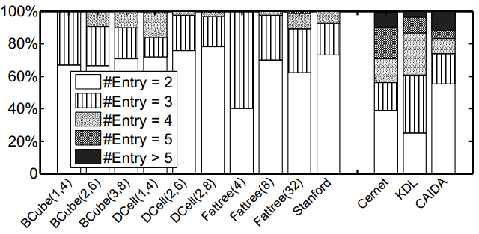
Cost of SoftRing
Static Flow Entries Used in One Switch

Slide 34
Conclusion
Claim
We advocate the coexistence of proactive model and reactive model.
SoftRing
A reactive packet goes through a pre-computed waiting-loop before get related rules from controller.
Reduce the control channel bandwidth up to 80%.
With the cost of 3 flow entries, minor latency.
Evaluation

Slide 35
Questions ?
Thank You

