Slide 1
DIGITAL SIGNAL PROCESSING
PROJECT WORK
IMAGE SEGMENTATION USING K-MEANS CLUSTERING
GUIDED BY – DR. ANURAG SINGH
MADE BY – SHIVAM NARWARE PUNIT KUNJAM
CSE CSE
ROLL NO. 17100052 ROLL NO. 17100037

Slide 2
OBJECTIVE
THE OBJECTIVE IS TO USE K-MEANS CLUSTERING ALGORITHM TO DIVIDE OR SEPARATE THE IMAGE INTO REGIONS OF SIMILAR ATTRIBUTES.

Slide 3
motivation
Not every information is evidence.
To obtain a compact representation from an image.
I need K-means clustering because the world is noisy. Photos aren’t the result of color-by-numbers, so I believe that a person’s skin or hair would seldom have a fixed intensity or color, because of lighting, shades and other interferences.
Clustering similar intensities together gives me a more robust segmentation. Clustering is also used in many other domains for grouping similar customers, words or documents together.

Slide 4
Image segmentation
image segmentation is the process of partitioning a digital image into multiple segments (sets of pixels, also known as super-pixels). The goal of segmentation is to simplify and/or change the representation of an image into something that is more meaningful and easier to analyze.
Image segmentation is typically used to locate objects and boundaries (lines, curves, etc.) in images. More precisely, image segmentation is the process of assigning a label to every pixel in an image such that pixels with the same label share certain characteristics.

Slide 5
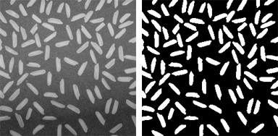
Image segmentation techniques
Thresholding methods such as Otsu’s method.

Slide 6
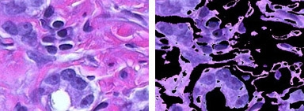
Color-based Segmentation such as K-means clustering.

Slide 7
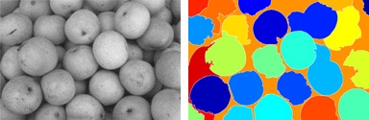
Transform methods such as watershed segmentation.

Slide 8
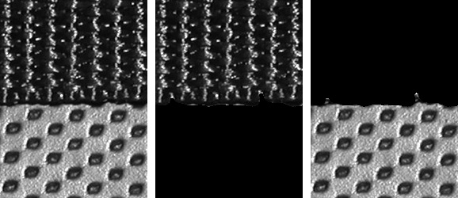
Texture methods such as texture filters.

Slide 9
K-means clustering
The goal of this algorithm is to find groups in the data, with the number of groups represented by the variable K.
The algorithm works iteratively to assign each data point to one of K groups based on the features that are provided. Data points are clustered based on feature similarity.
The K-means algorithm basically consists of three steps:
1. Initialization: K chosen, an initial set of K so-called centroids, i.e.
virtual points in the data space is randomly created,
2. Every point of the data set is assigned to its nearest centroid and
3. The position of the centroid is updated by the means of the data points
assigned to that cluster. In other words, the centroid is moved towards the center of its assigned points.

Slide 10
algorithm
Choose k data points to act as cluster centers.
Until the cluster centers are unchanged.
Allocate each data point to cluster whose center is nearest.
Now ensure that every cluster centers has at least one data point ;
Possible techniques for doing this include supplying empty clusters with a point chosen at random from points far from their cluster center.
Replace the cluster centers with the mean of the elements
in their clusters.
end

Slide 12
conclusion
K-Means Algorithm is useful for undirected knowledge discovery and is relatively simple.
K-Means has found wide spread usage in lot of fields, ranging from unsupervised learning of neural network, Pattern recognitions, Classification Analysis, Artificial intelligence, image processing, machine vision and many others.

Slide 13
THANK YOU

