Slide 1

Real-Time Moving Object Segmentation and Classification from HEVC Compressed Surveillance Video
Name- Sumit Parwal
Registration no - 14BCE0338
Guide- Prof. Shalini L

Slide 2
Problem statement
Intelligent Video Surveillance is the need of the hour.
H.264 which is generally used for video encoding is not so efficient so we will use HEVC compressed technique.
In the existing system, only motion vector is used where it cannot estimate large displacements because of the limited effectiveness of the first order Taylor series expansion.
In H.264 there are no “bag of words” to classify moving object.

Slide 3
AIM :
To perform Segmentation and Classification on Real-Time Moving Object from HEVC Compressed Surveillance Video.
OBJECTIVE :
To perform segmentation, blocks with non-zero motion vectors are clustered into the connected foreground regions using the four connectivity component labeling algorithm.
To use Person-Vehicle model which will classify the objects in surveillance video.
To use Machine learning concepts that will make implementation of the project easier and with higher Accuracy .

Slide 4
Abstract
In the age of technological advancements, where high end cars are creating lot of ruckus on the roads and number of thefts have exponentially increased video surveillance is the need of the hour to classify moving objects. In intelligent surveillance of compressed HEVC video the segmentation and classification of moving objects plays a crucial and highly important role.
Highly efficient video coding (HEVC) incorporates a number of new coding functions that can be used to segment and classify moving objects in a more efficient way as compared to H.264 / AVC .
In the approach we followed, first, the interpolation of motion vectors (MV) take place for the intra-coded prediction unit (PU) and then the elimination of outliers of MV are used for preprocessing.

Slide 5
Cont…
Second, all blocks having motion vectors greater than zero are merged and grouped in foreground areas using the four-connectivity component labeling algorithm.
Third, we use temporal consistency tracking areas included in the connected foreground areas to eliminate the noise areas. Size of both coding and prediction unit are used to further define the boundary of the moving object.
Lastly, for training, we use a model named person-vehicle classification that uses a bag of HEVC syntax words that help categorize the moving object as people or vehicles. The final results show that the system can efficiently classify between person and vehicle.

Slide 6
Related works/Existing System
This reliability information along with the MV magnitude is used to segment foreground objects from the background.
MVs are classified into multiple types, such as background, edge, foreground, and noise. Then, the MVs and their associated class information are used to segment each blocks.
Global motion is first removed from the motion vector field, and moving object segmentation process is performed on the compensated motion vector filed.

Slide 7
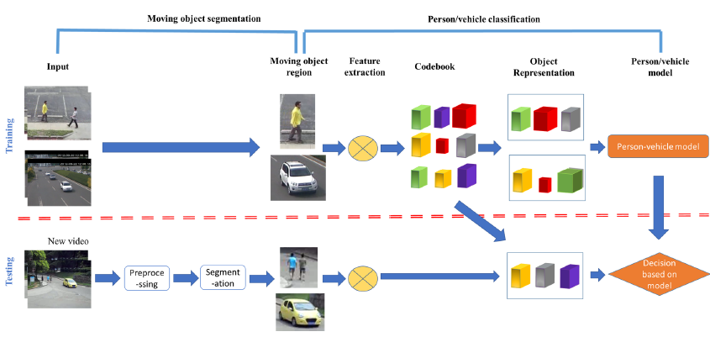
Architecture of proposed work

Slide 8
Frame works and Design Methodologies followed
The segmentation of Moving object is done by calculating Motion Vector and than using Four connectivity algorithm.
For person-vehicle classification, it involves a training phase to learn the person-vehicle model using “bag of spatiotemporal HEVC syntax words” and a testing phase to apply the learned model to test videos.
For the testing phase, we first extract the spatial and temporal information of each 4×4 block to obtain the feature descriptor. Then, the descriptors of all blocks are clustered into a number of codeword. The foreground object is represented by a histogram of the codeword.
Finally, for the segmented moving object, we apply the learned person-vehicle model to determine which category to assign.
In the proposed system, three techniques :Motion Vector Interpolation, Four connectivity component labeling algorithm, Temporal consistency.

Slide 9
Module Diagram
INPUT VIDEO
FEATURE EXTRACTION
CLASSIFICATION
MOVING OBJECT DETECTION
PREPROCESSING

Slide 10
Advantages of the Proposed system
The computational complexity is so low, many in the Video Coding field have used the technique to estimate a motion vector at each pixel.
This is done so that there is less chance of the ‘motion averaging’ effect of block-wise manipulations. The approach is of limited use because some finite support region must always be employed to set up the necessary equations.
Lastly, the accuracy of system is coming out to be very good so this system will work for lot of HEVC videos.

Slide 11
REQUIREMENTS(hardware and software)
Hardware Requirements
Software Requirements
MATLAB 8.6 Version R2015b
VLC media player
CPU | Pentium Dual Core 2.00GHZ(minimum)
Memory | 4 GB(minimum)
Disk Space | 80 GB

Slide 12
Result obtained
Preprocessing Object Region Tracking

Slide 13
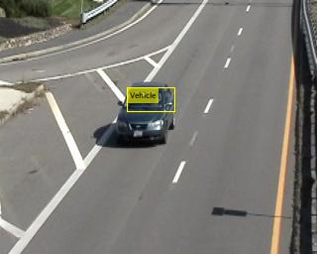
CONT…
Segmentation Classification

Slide 14
SKILLS LEARNT DURING THE TENURE OF THE PROJECT
MATLAB
Image processing
Software Process Management
Machine Learning

Slide 15
Conclusion
The project has been tested rigorously and can be extremely beneficial for various Government and security agencies in maintaining security and save people from any terrorist activities.
Moreover, it reduces the load of security officials as the system classifies various moving object.
The project can be marketed to various governments of various countries for greater good of humanity after incorporating a few more functionalities to the project.

Slide 16
Future scope
The system can be linked to “AADHAR” database or with the INTERPOL terrorists list .
The system can be linked to Transport departments database.
The project can be implemented for live videos as well so that they can do all the things on the live videos itself.

Slide 17
References
Weblinks
http://ieeexplore.ieee.org/document/7801078/?reload=true
Journals
M. Grundmann, V. Kwatra, M. Han, and I. Essa, “Efficient hierarchical graph-based video segmentation,” in Proc. IEEE Conf. Comput. Vis. And Pattern Recognit., pp. 2141–2148, Jun. 2010.
S. Chien, W. Chan, Y. Tseng, and H. Chen, “Video object segmentation and tracking framework with improved threshold decision and diffusion distance,” IEEE Trans. Circuits Syst. Video Technol., vol. 23, no. 6, pp. 921–634, Jun. 2013.
Real-Time Moving Object Segmentation and Classification from HEVC Compressed Surveillance Video by Liang Zhao, Zhihai He, Fellow, IEEE, Wenming Cao, and Debin Zhao, Member, IEEE.
Books
Computer Vision : Model, Learning, and Inference by Simon Prince

Slide 18
THANK-YOU !

