Slide 1
How to find Easy GEs
Yi Zu Tan
Krystal Xu

Slide 2
Motivation
Students want to get good grades for GEs
  Good grades achieving a GPA of 4.0
Earlier studies use Course Difficulty as an indicator
  Hence the term “easy GE”
But good grades are also determined by other factors
Student Aptitude
Class Size
Term Quarter
What we want to predict
What we can find from our data
What we cannot find from our data
Grade
Professor Leniency
Course Difficulty
Department

Slide 3
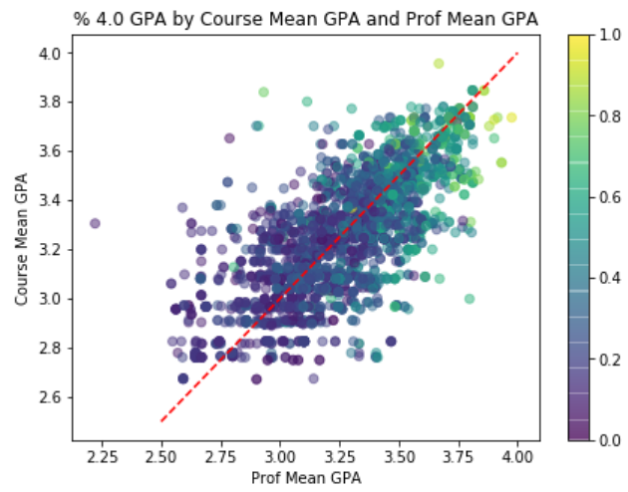
Exploration
Used data from Bruinwalk.com
Used mean GPA as numeric indicator of
  Professor Leniency
  Course Difficulty
Important Variables
  A professor’s mean GPA
  A course’s mean GPA
  Department
  Term Quarter

Slide 4
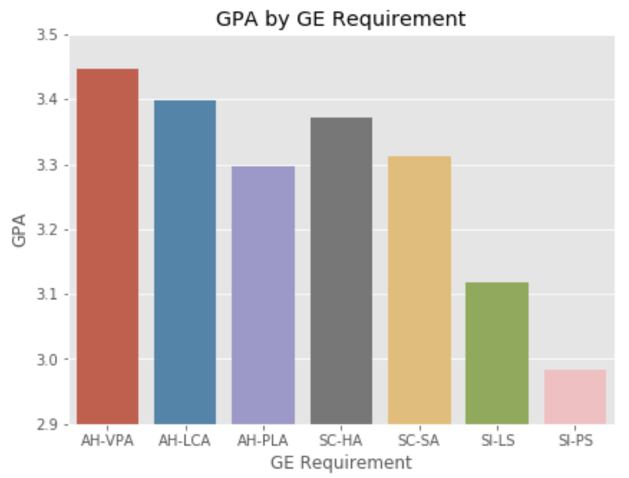
Modeling
Used % of 4.0 GPAs as outcome variable
  If % 4.0 GPA is in the top 25% of all GEs, the course was “easy”
  Otherwise, the course was “not easy”
Predictor Variables
  Department
  Professor Leniency
  Course Difficulty
  Term Quarter
  Professor Frequency
  Class Size
Performed supervised classification using Random Forest
  Limited GE dataset to Foundations of Scientific Inquiry

Slide 5
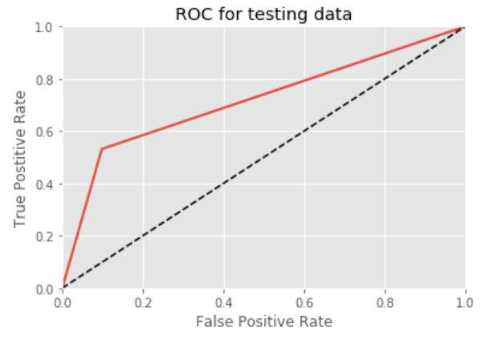
Results
Our model correctly labeled 80.53% of test cases
  Correctly labeled 90.12% of “non-easy” science GEs
  Correctly labeled 53.16% of “easy” science GEs
Significance scores revealed top 3 factors:
  Professor Leniency
  Course Difficulty
  Class Size

Slide 6
Further Research
Expanding to include all GEs
Adding student characteristics to the model
  Student major
  Student GPA
  Student race/gender
  Student class unit load
Model selection by adding/dropping predictors
Verify causal relations between the predictors

