Slide 1
How to find Easy GEs
Yi Zu Tan
Krystal Xu

Slide 2
Motivation
Students want to get good grades for GEs
  Good grades achieving a GPA of 4.0
Earlier studies use Course Difficulty as an indicator
  Hence the term “easy GE”
But good grades are also determined by other factors
Student Aptitude
Class Size
Term Quarter
What we want to predict
What we can find from our data
What we cannot find from our data
Grade
Professor Leniency
Course Difficulty
Department

Slide 3
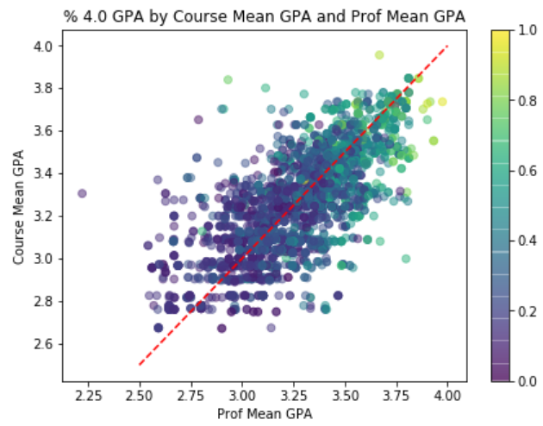
Exploration
Used data from Bruinwalk.com
Used mean GPA as numeric indicator of
  Professor Leniency
  Course Difficulty
Important Variables
  A professor’s mean GPA
  A course’s mean GPA
  Department
  Term Quarter

Slide 4
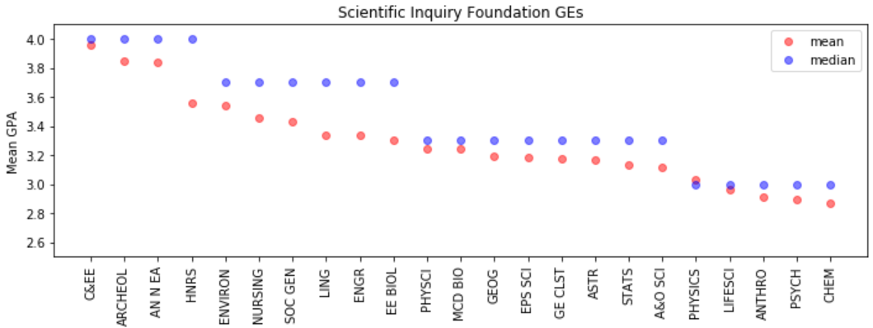
Modeling
Used % of 4.0 GPAs as outcome variable
  If % > Q3, we designated it as “good grades”
  Otherwise, it was “bad grades”
Predictor Variables
  Department
  Professor Leniency
  Course Difficulty
  Term Quarter
  Professor Frequency
  Class Size
Performed supervised classification
  Limited GE dataset to Foundations of Scientific Inquiry

Slide 5
Results
Our model was accurate with F1-score of 0.583
  Correctly labeled 73.6% of test cases
  Superior model that accounts for more factors
Most significant factors were (in order):
  Professor Leniency (0.25)
  Course Difficulty (0.20)
  Class Size (0.12)
  Professor Frequency (0.07)

Slide 6
Further Research
Adding student characteristics to the model
  Student major
  Student GPA
  Student race/gender
  Student class unit load
Model selection by adding/dropping predictors
Verify causal relations between the predictors
How can UCLA help students achieve success?

