Slide 1

EVENTURA: One
Platform for Campus Events
College Event & Club Management Platform

Slide 2
Introduction and Problem Statement

Slide 3






Title And Vision
02
Introduction and Problem Statement
EVENTURA
College Event & Club Management Platform
Tagline: One Platform. Every Campus Event.
Centralized campus ecosystem
Connects College Admin, Clubs, Organizers, Students, Volunteers
Single source of truth across every event lifecycle
The challenge: event chaos
Fragmented tools create delays, errors, and duplicated work
Low visibility into approvals, engagement, volunteers, and finances
What the hero dashboard shows
Event cards + analytics, QR attendance, finance, certificates

Slide 4



THE PROBLEM
03
Introduction and Problem Statement
Fragmented tools everywhere
Registrations in forms; attendance on paper; budgets in spreadsheets
Volunteers in separate lists; certificates and reports made manually
No real-time visibility
Approvals, spending, and turnout are tracked after the fact
Data sits in silos across clubs and college administration
High admin burden, low coordination
Repetitive re-entry, follow-ups, and version confusion slow teams
College events are growing; management must not stay fragmented

Slide 5
Eventura Platform Overview and Workflow

Slide 6
THE SOLUTION : Eventura
05
Eventura Platform Overview and Workflow
Event creation and approval
Draft to submit; Admin approve/request changes
Operations: volunteers and finance
Assignments, tasks, budget vs spend, expenses
College setup and roles
RBAC: Admin, Club, Organizer, Student, Volunteer
Club management
Clubs, coordinators, teams, reusable templates
Registration to QR attendance
Public signup, QR pass, scan-based check-in
Close the loop
Feedback, auto certificates, analytics as truth source

Slide 7
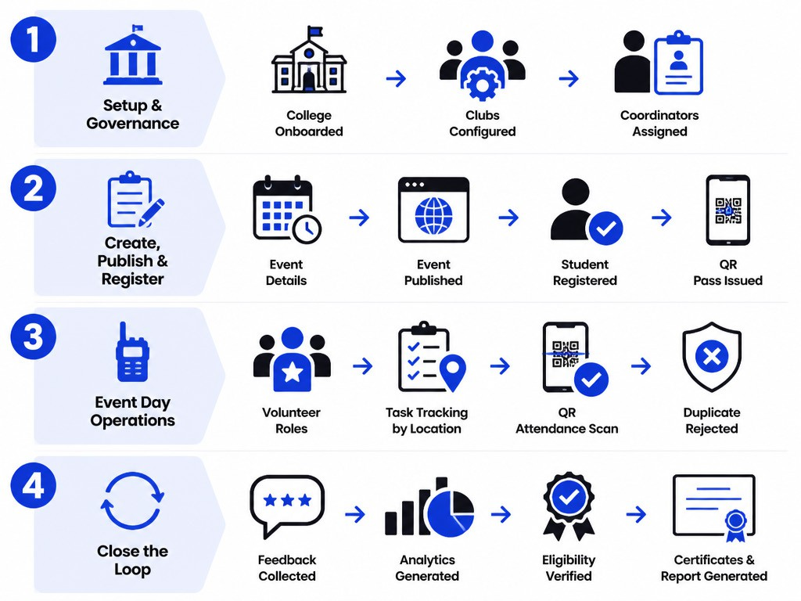
END-TO-END WORKFLOW
06
Eventura Platform Overview and Workflow
Setup and governance
College onboarding, clubs configured, coordinators assigned
Organizer submits event; Admin approves or requests changes
Create, publish, register
Event details: schedule, venue, capacity, volunteers, budget
Public page goes live; students register; QR pass issued
Run operations on event day
Volunteers assigned roles; tasks tracked by time and location
QR attendance scan validates entry; duplicates rejected
Close the loop automatically
Feedback collected; analytics generated; eligibility verified
Certificates generated; final report updates college analytics

Slide 8



ROLE-BASED DASHBOARDS
07
Eventura Platform Overview and Workflow
College Admin Console
Organizer Command Center
Approvals queue, club overview, and campus-wide event KPIs
Finance visibility, certificate issuance, and governance analytics
Active events, registrations, and live QR check-in progress
Volunteer roster, budget vs spend, feedback and certificates
Student Event Hub
Volunteer Ops View
Discover and register; manage QR passes in-app
Attendance history, feedback, and personal certificate vault
Assigned roles, duty timings, locations, and task status
Built-in QR scanner for fast, accurate attendance capture

Slide 9
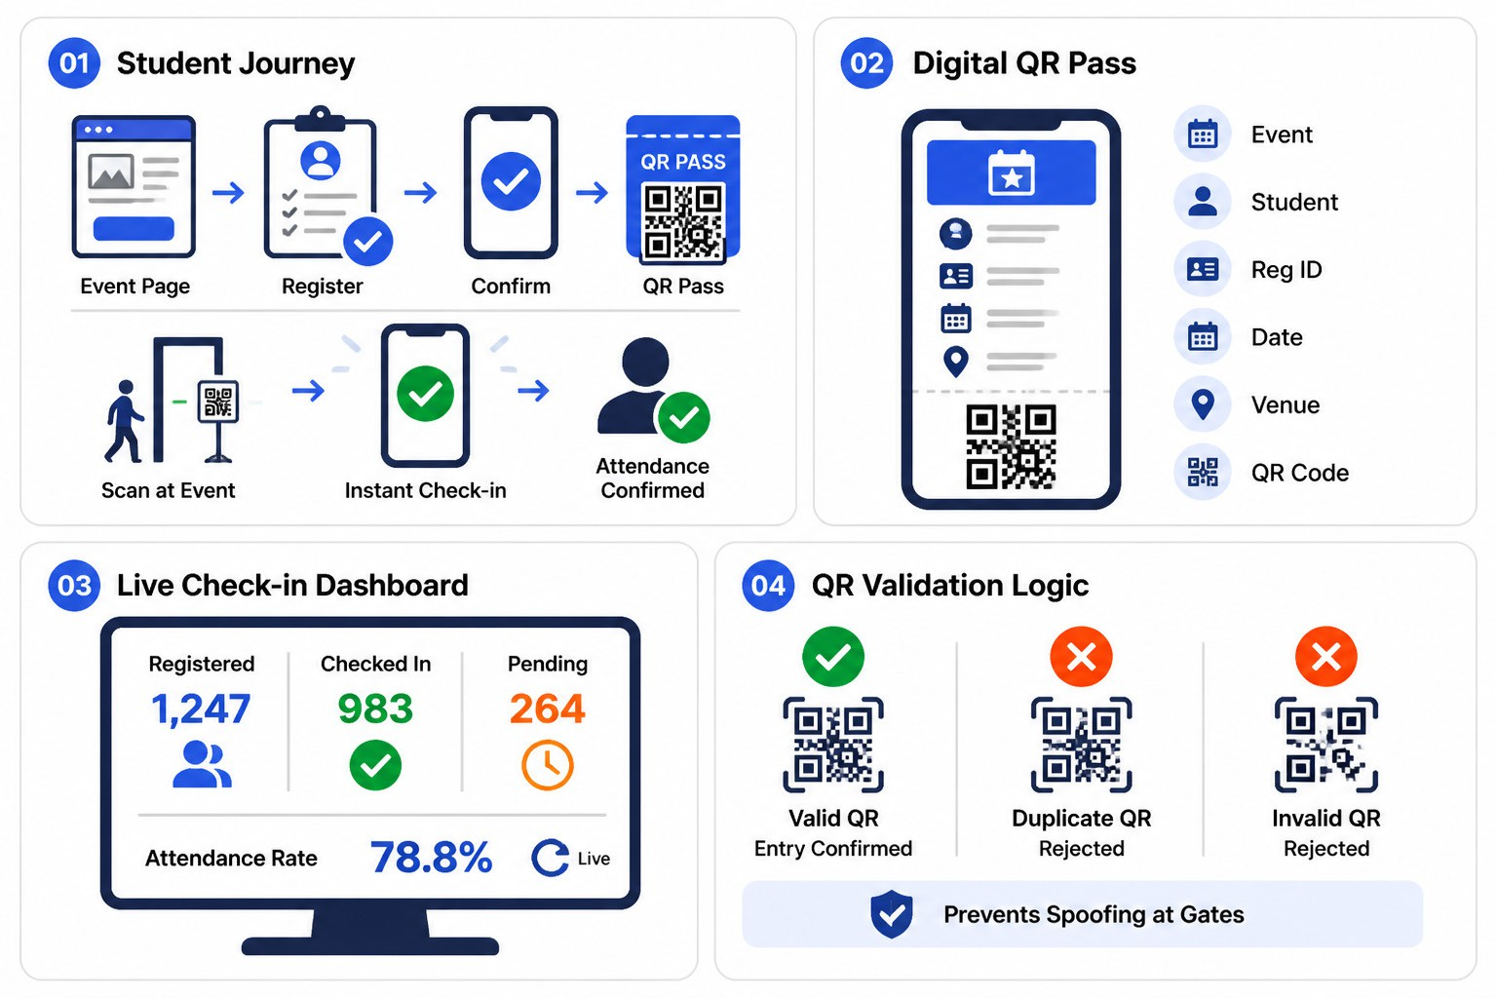
STUDENT REGISTRATION & QR ATTENDANCE
08
Eventura Platform Overview and Workflow
Student journey (end-to-end)
Event page, register, confirm, receive unique QR pass
Event day scan, instant check-in, attendance confirmed
Digital QR pass (mobile)
Includes event, student, Reg ID, date, venue, QR
Works as a single, verifiable entry credential
Organizer live check-in dashboard
Registered: 1,247; Checked In: 983; Pending: 264
Attendance Rate: 78.8% with real-time refresh
QR validation logic
Valid QR: entry confirmed; duplicate: rejected
Invalid QR: rejected; prevents spoofing at gates

Slide 10
SMART EVENT CREATION & APPROVAL
09
Eventura Platform Overview and Workflow
3) Registration Setup
Deadline, solo/team, custom fields, limits
5) Certificates Rules
Template, type, eligibility, release date
1) Basic Details
Name, category, poster, description
2) Schedule & Venue
Date, time blocks, venue, capacity per slot
4) Ops: Volunteers & Budget
Roles, shifts, tasks + estimate & categories
6) Review, Submit, Approve
Organizer submit; Admin approve/changes; go live

Slide 11
Operations, Feedback, and Closing

Slide 12




FINANCE, VOLUNTEERS & ANALYTICS
11
Operations, Feedback, and Closing
Finance dashboard (live)
Volunteer command center
Analytics for decisions
Core message
Allocated ₹1,00,000; Spent ₹69,700; Remaining ₹30,300
Budget vs actual, category spend, and expense trends
Roles: Registration, QR Attendance, Hospitality, Technical, Media, Crowd
Duty timings, task status, and accountability per volunteer
Registration trends, attendance %, and satisfaction scores
Participation by dept/year; club performance; event growth
Eventura replaces spreadsheets with real-time visibility

Slide 13
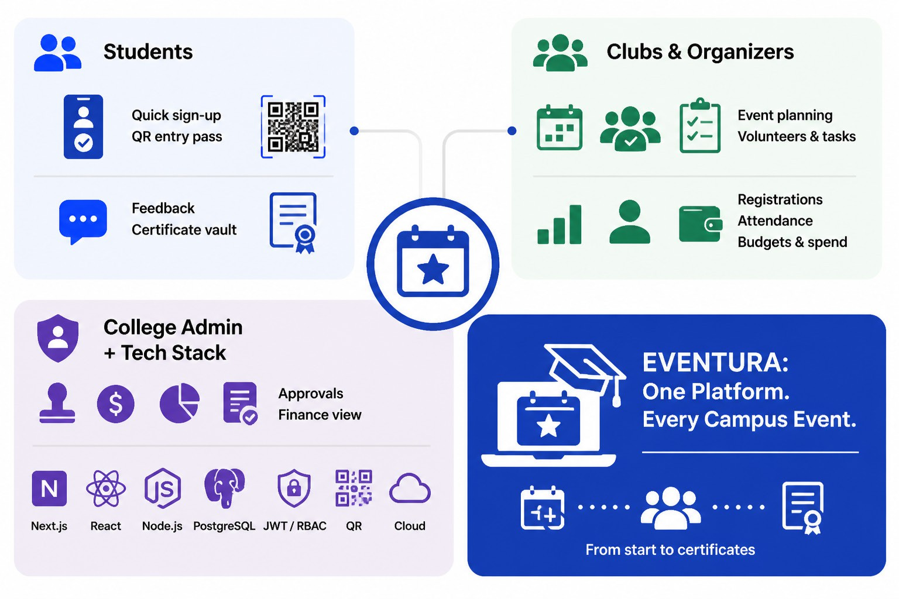
Impact & Technology
12
Operations, Feedback, and Closing
Students
Register in seconds; get a QR pass for entry.
Submit feedback; store certificates in one vault.
Clubs and Organizers
Plan events, manage volunteers, track tasks in real time.
Monitor registrations, attendance, budgets, and expenses live.
College Admin + Tech Stack
Approvals, finance visibility, analytics, and audit-ready reports.
Next.js/React, Node.js, PostgreSQL, JWT/RBAC, QR, Cloud.
EVENTURA: One Platform. Every Campus Event.
Single source of truth from creation to certificates.

Slide 14

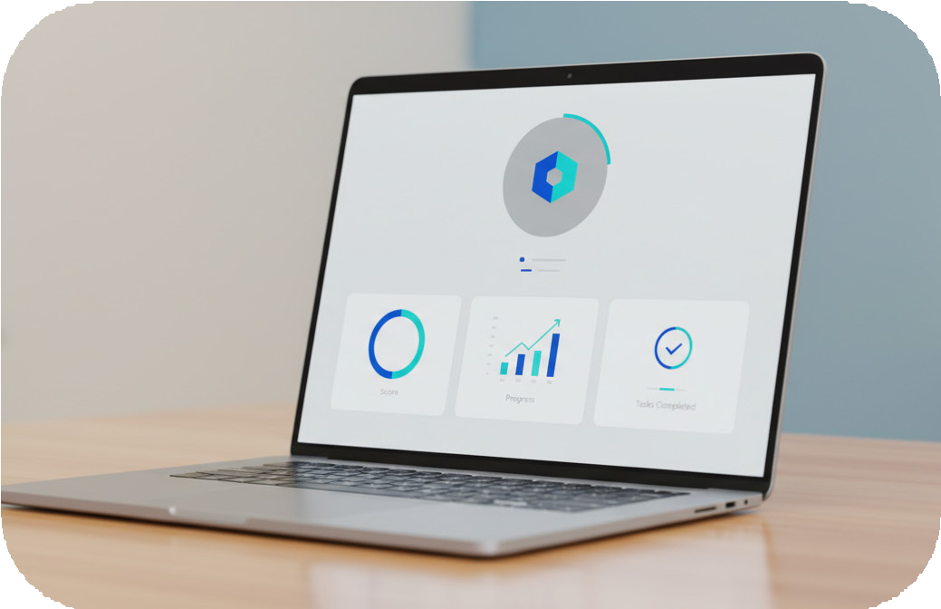
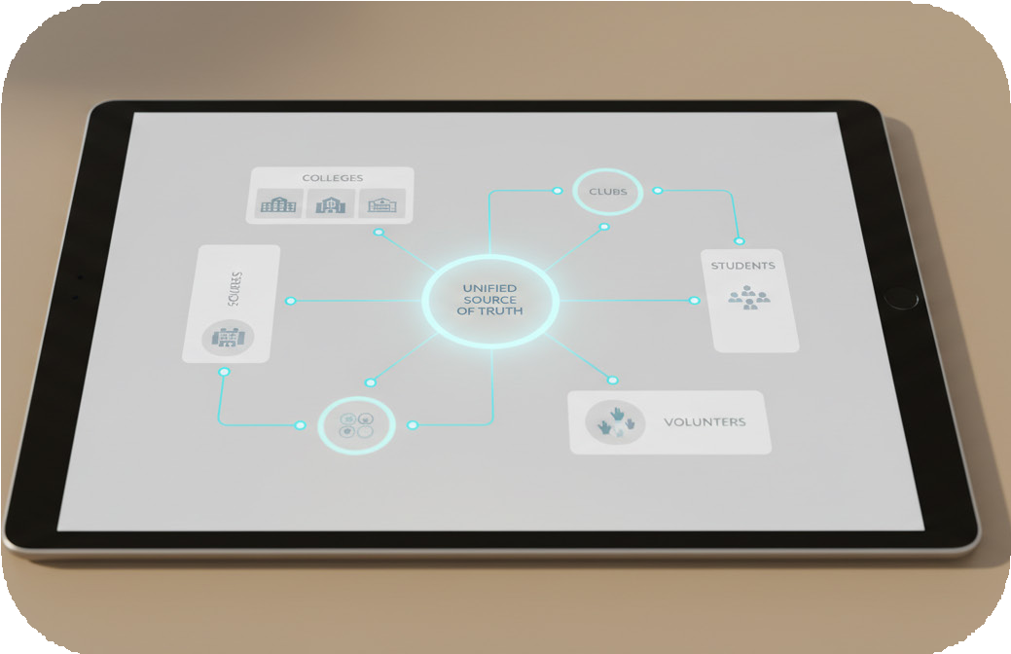
Thank You
13
Operations, Feedback, and Closing
EVENTURA
One Platform. Every Campus Event.
Centralized lifecycle: create, approve, run, analyze events.
Presentation By
Team : CodieX
Members : Prathmesh Chaudhari
Rishika Dhamak
For : TEJAS India Hackathon 2026
Conecpt
Built for colleges, clubs, students, and volunteers.
One source of truth for every campus event.

