Slide 1

PUBLIC SAFETY INITIATIVE
STOP
CYBER
SCAMS
DIAL 1930
3 RULES TO STAY SAFE
Banks NEVER call for OTP /PIN
Don’t click unknown SMS links
Lost money? Report in 1 hour
Fraudsters create panic.
Stay clam. Verify first.
Your OTP is your bank’s lock.
National Cyber Crime Helpline 24x7 | Toll-Free
A Public Service Message By Kajal Pandita

Slide 2
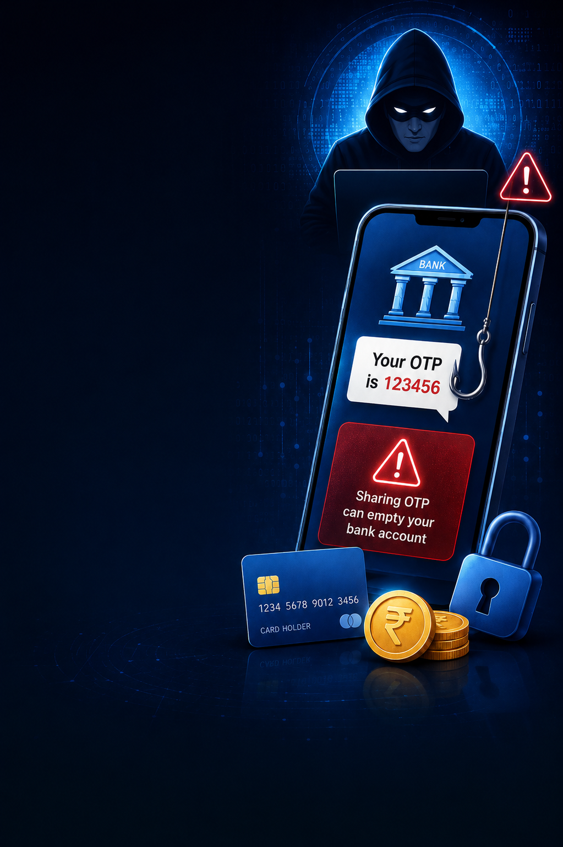









-----PUBLIC SAFETY INITIATIVE ----
STOP
CYBER
SCAMS
BE ALERT , BE SAFE ,BE SECURE
3 RULES TO STAY SAFE
AVOID
Clicking on unknown links.
---------------------------------
NEVER
Share OTP/ PIN with anyone .
-------------------------------
REPORT
Any fraud or suspicious activity on 1930
Keep your your banking into confidential
Use secure
Networks for
Transactions.
Verify before you trust , call your bank if unsure
National Cyber Crime Helpline 24x7 | Toll-Free
A Public Service Message By KAJAL PANDITA

