Slide 1



WEB DESIGNER
Kajal Dabhi

Slide 2
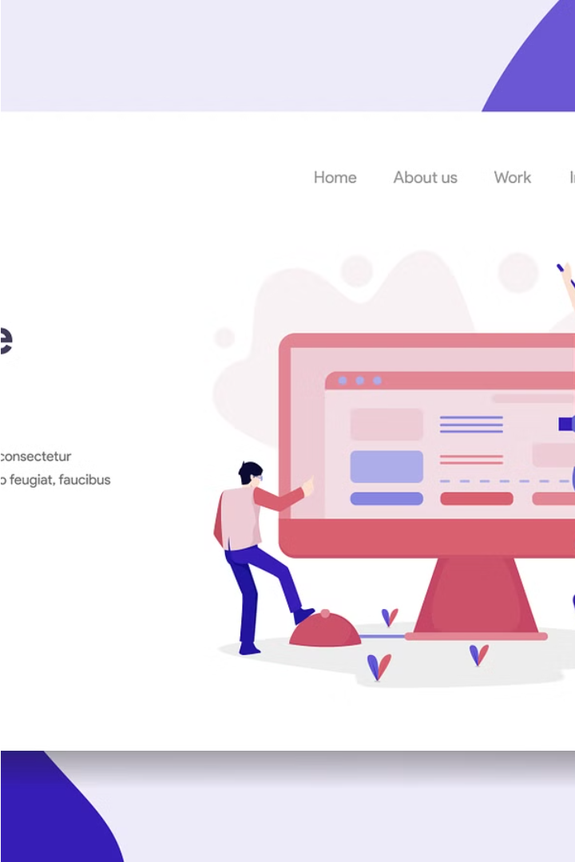
INTRODUCTION
Web Designers plan, create, and build websites and web pages, many of which combine a number of visual elements including text, photos, graphics, and video clips. A Web Designer also oversees the design and layout, which can mean working on a brand new website or updating existing pages.

Slide 3
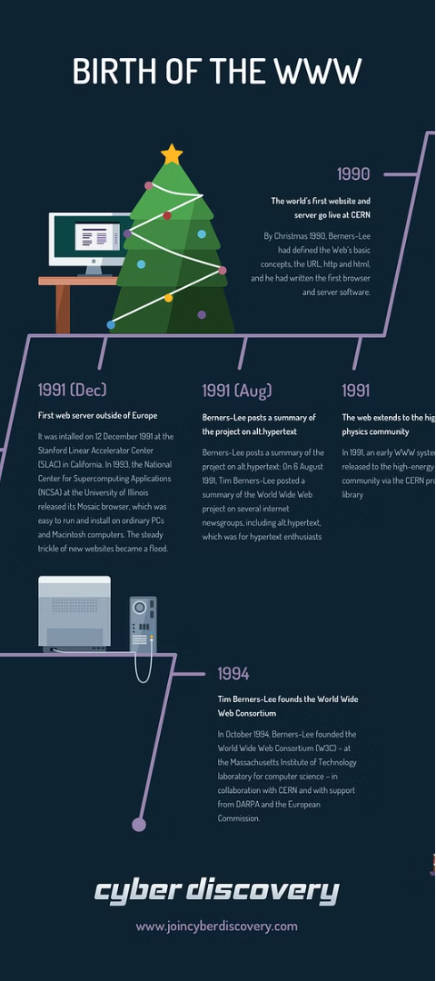
Start of the Web and Web Design
1
Proposal for a Global Hypertext
In 1989, Tim Berners-Lee, working at CERN, proposed creating a global hypertext project that would later become known as the World Wide Web.
2
Birth of the World Wide Web
From 1991 to 1993, the World Wide Web was born, allowing users to view text-only HTML pages using a simple line-mode web browser.
3
Humble Beginnings
The early web consisted of basic, text-based HTML pages, laying the foundation for the dynamic, multimedia-rich websites we know today.

Slide 4

What is a Website?
A website is a collection of digital files, written in HTML (HyperText Markup Language), that are hosted on a computer connected to the internet. This allows the website to be accessible to anyone in the world with an internet connection.
The computer that hosts the website files is known as a Web Server. It ensures the website is available and accessible 24/7 to users who want to view its content.

Slide 5
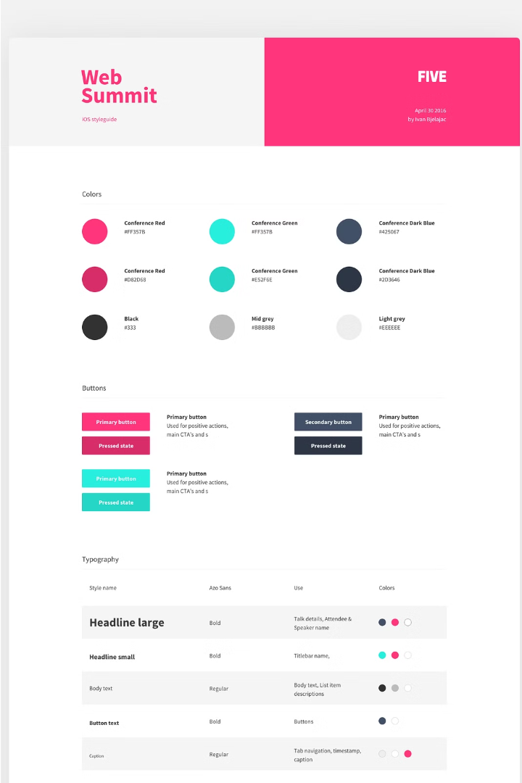
Use of web design
Web design plays a main role in helping companies establish and maintain a strong brand identity. By ensuring a consistent brand expression across a company's website, web design makes it easier for customers to navigate and recognize the visual elements that define the business and its products or services.

Slide 6

Use of Languages in Web Design
These languages provide web designers with a robust toolkit for creating interactive websites.
HTML (Hyper Text Markup Language)
2. CSS (Case Ceding Stylesheet)
JavaScript
jQuery
Bootstrap

Slide 7
Current Trends in Website Design
Modern & Clean
Dark Mode
Responsive Design
Modern website design emphasizes simplicity and clean aesthetics, continuing to be popular in 2024. This minimalist approach creates a polished, user-friendly experience.
The implementation of dark mode continues to gain traction, offering visual appeal and reduced eye strain for users browsing websites.
Responsive and mobile-friendly designs remain crucial, catering to the widespread use of smartphones and ensuring optimal viewing across devices.

Slide 8
Growth Opportunities
Rising Demand
Diverse Career Paths
As more businesses seek to establish a strong online presence, the demand for skilled web designers continues to rise.
Web design offers a wealth of growth opportunities, from UX/UI design to front-end development and digital marketing.
Continuous Learning
Entrepreneurial Potential
The dynamic digital landscape requires web designers to continuously learn new skills and technologies to stay competitive.
Skilled web designers can leverage their expertise to start their own agencies or freelance businesses.

Slide 9

Learning at Tops Technology
As the IT sector continues to evolve rapidly, web designers must stay ahead of the curve by continuously learning new skills. Enhancing coding proficiency in HTML and CSS is essential for creating modern, responsive websites. Additionally, designers should develop expertise in digital marketing, time management, and advanced coding techniques to remain competitive in the industry.

Slide 10

Why web designing
Challenging Person
Creative
Learn Something new

Slide 11

Any Question

Slide 12
THANK YOU

