Slide 1
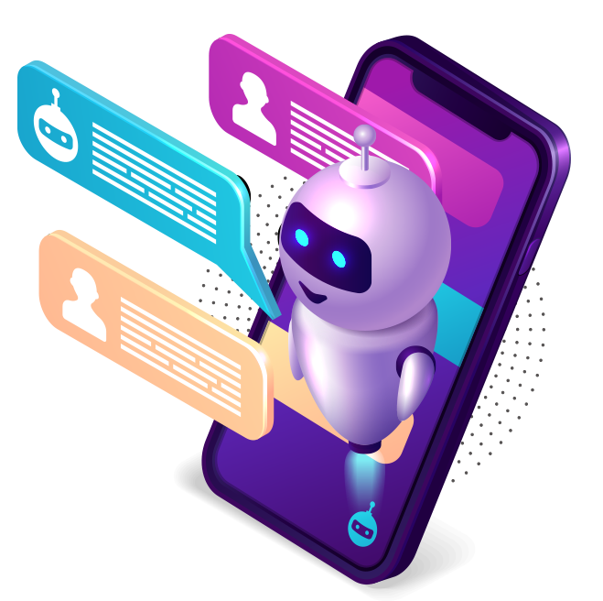
Contents :
Introduction to Chatbots
Abstract
Types of Chatbots
Literature survey
Existing system
Problem definition
System Requirements
Analysis
Design of chatbot
Workflow
Conclusion
Chatbot
Elevating engagement, Efficiency and Satisfaction

Slide 2

Contents :
Introduction to Chatbots
Abstract
Types of Chatbots
Literature survey
Existing system
Problem definition
System Requirements
Analysis
Design of chatbot
Workflow
Conclusion
Chatbot

Slide 3
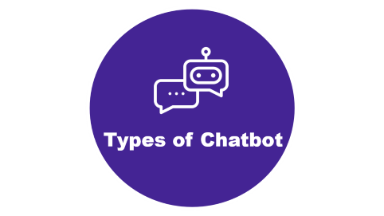
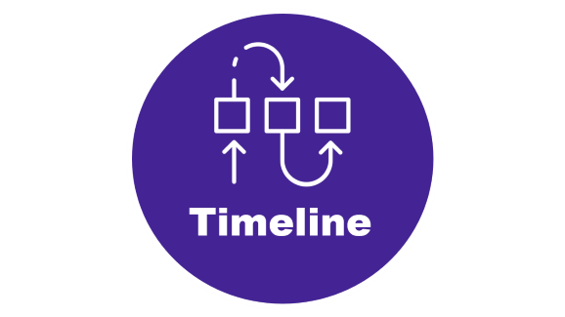



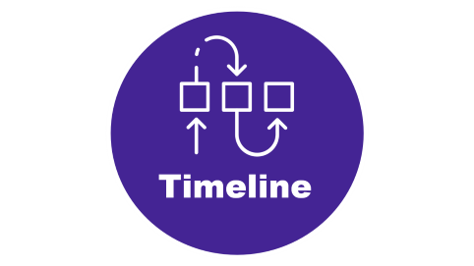

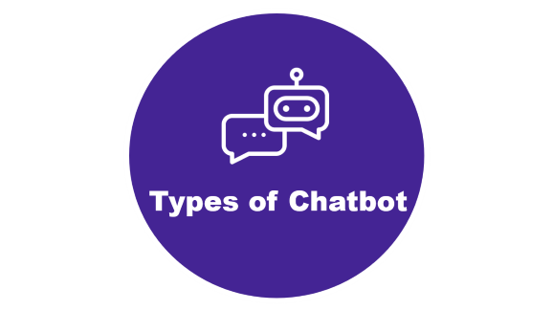



Slide 4

Introduction

Slide 5
Introduction
Chatbots are computer programs that simulate human conversation, using artificial intelligence to interact with users and provide assistance.
The first chatbot, named Eliza, was created by Joseph Weizenbaum in 1966.

Slide 6

Abstract

Slide 7
Abstract
It also known as conversational interfaces getting answers from software involved search engines or form-filling.
Chatbots allow users to ask questions naturally, just like they would address a human.
The core technology behind chatbots is Natural language processing (NLP).

Slide 8

Types of Chatbot

Slide 9
Types of chatbot
Menu-Based Bots: Offer predefined options for users to choose from.
Rule-Based Bots: Follow predefined rules or keywords to provide responses.
NLP (Natural Language Processing) Bots: Use AI to understand natural language and context.
ML (Machine Learning) Bots: Adapt based on user interactions and learn over time.
Hybrid Bots: Combine rule-based and AI approaches.
Voice Bots: Interact via voice commands.

Slide 10

Timeline

Slide 11
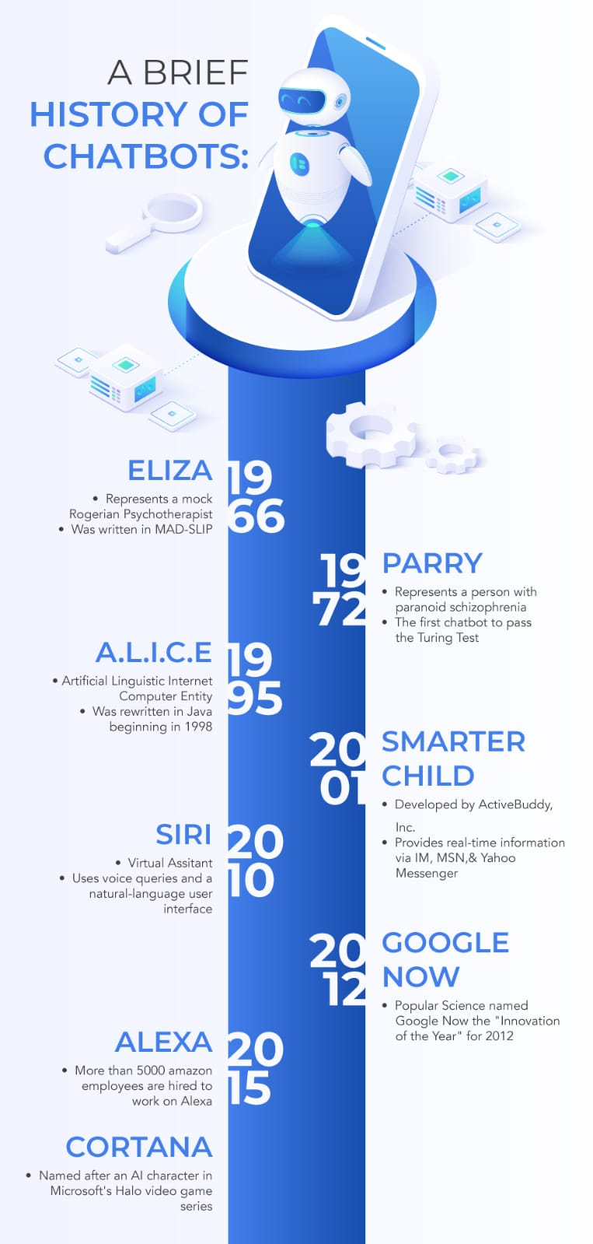
Timeline

Slide 12

Literature survey

Slide 13
Literature survey
Emerging Trends: Highlighting advancements in NLP, AI integration, user-centric design, and ethical considerations.
Methodological Insights: Providing guidance on search strategies, inclusion criteria, and analysis methods for conducting robust literature surveys.
Practical Implications: Offering insights for future research, addressing challenges, and informing the design of chatbots for specific applications.

Slide 14
Existing system of chatbot
01
02
03
04
User Interface: Platform for interaction, like messaging apps or website widgets.
NLU: Analyzes input to understand intent and context.
NLG: Generates coherent responses based on context.
Backend Systems: Accesses databases or APIs for tasks.
Integration: Extends functionality with external services or APIs.
Analytics: Monitors interactions to enhance performance.
Dialogue Management: Controls conversation flow based on input and context.
Error Handling: Manages errors or uncertainties in user input.

Slide 15
Existing system of chatbot
01
02
03
04
User Interface: Platform for interaction, like messaging apps or website widgets.
NLU: Analyzes input to understand intent and context.
NLG: Generates coherent responses based on context.
Backend Systems: Accesses databases or APIs for tasks.
Integration: Extends functionality with external services or APIs.
Analytics: Monitors interactions to enhance performance.
Dialogue Management: Controls conversation flow based on input and context.
Error Handling: Manages errors or uncertainties in user input.

Slide 16
Existing system of chatbot
01
02
03
04
User Interface: Platform for interaction, like messaging apps or website widgets.
NLU: Analyzes input to understand intent and context.
NLG: Generates coherent responses based on context.
Backend Systems: Accesses databases or APIs for tasks.
Integration: Extends functionality with external services or APIs.
Analytics: Monitors interactions to enhance performance.
Dialogue Management: Controls conversation flow based on input and context.
Error Handling: Manages errors or uncertainties in user input.

Slide 17
Existing system of chatbot
01
02
03
04
User Interface: Platform for interaction, like messaging apps or website widgets.
NLU: Analyzes input to understand intent and context.
NLG: Generates coherent responses based on context.
Backend Systems: Accesses databases or APIs for tasks.
Integration: Extends functionality with external services or APIs.
Analytics: Monitors interactions to enhance performance.
Dialogue Management: Controls conversation flow based on input and context.
Error Handling: Manages errors or uncertainties in user input.

Slide 18
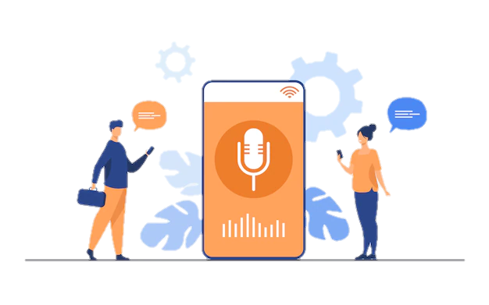
Problem Defination
Limited Understanding: Chatbots struggle with accurately interpreting natural language, causing user frustration.
Handling Complex Queries: They struggle with nuanced or complex queries, providing inadequate responses.
Lack of Context Awareness: Chatbots often lack the ability to understand context, resulting in repetitive or irrelevant responses.
Emotional Intelligence: Lack of empathy or emotional understanding hampers user engagement.
Security and Privacy: Concerns arise over mishandling sensitive data or vulnerabilities.
Inflexibility: Chatbots rigidly follow scripts, making them unable to handle unexpected queries.
Maintenance Challenges: Keeping chatbots updated with evolving needs requires ongoing resources and effort.
Integration Issues: Difficulty integrating with existing systems limits their effectiveness.

Slide 19
Problem Defination
Limited Understanding: Chatbots struggle with accurately interpreting natural language, causing user frustration.
Handling Complex Queries: They struggle with nuanced or complex queries, providing inadequate responses.
Lack of Context Awareness: Chatbots often lack the ability to understand context, resulting in repetitive or irrelevant responses.
Emotional Intelligence: Lack of empathy or emotional understanding hampers user engagement.
Inflexibility: Chatbots rigidly follow scripts, making them unable to handle unexpected queries.
Security and Privacy: Concerns arise over mishandling sensitive data or vulnerabilities.
Integration Issues: Difficulty integrating with existing systems limits their effectiveness.
Maintenance Challenges: Keeping chatbots updated with evolving needs requires ongoing resources and effort.

Slide 20
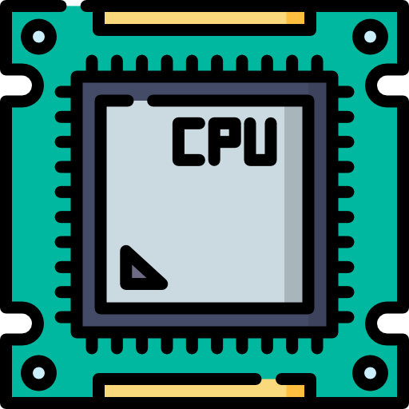

System Requirements
Hardware Requirements :
Software Requirements :
Operating System : Windows or Linux
IDE : Visual Studio Code
Library: Tensorflow, Json, nltk, numpy.
Processor: Pentium IV (minimum)
Hard Disk: 40GB
RAM: 256MB(minimum)

Slide 21
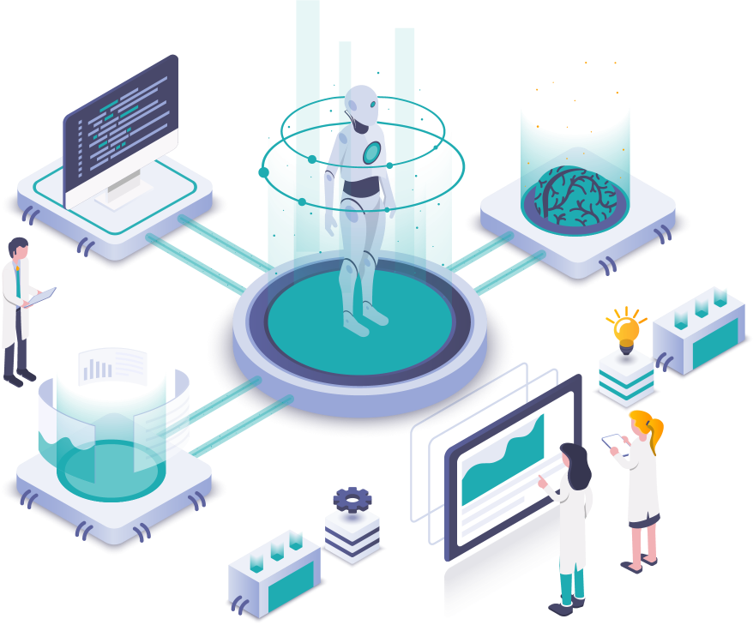
Analysis On Chatbot
User Needs Analysis :
Identify the target audience and understand their language, skills, and interaction motives.
Requirement Gathering :
Determine all functionalities the chatbot should support, like FAQ handling or booking processes.
Limitations Understanding :
Acknowledge that rule-based chatbots can only respond to predefined inputs and cannot learn from interactions.

Slide 22
Design of the Chatbot
1. Rule Development :
Create keyword or command-based triggers for specific responses.
2. System Architecture Design :
Design both the front-end user interface and the back-end processing (rule engine and databases).
3. User Experience Design :
Implement clear error handling protocols and options for user escalation to human support.
4. Scalability and Maintenance :
Regularly review interaction logs to refine and update rules based on common issues or new requirements.

Slide 23
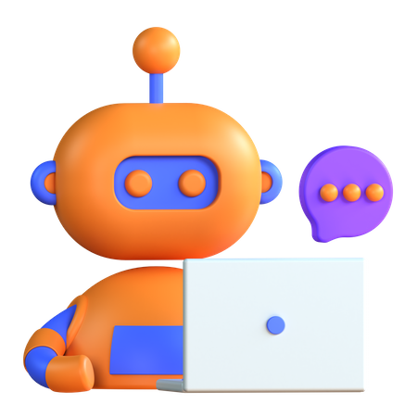
Workflow of Chatbot:
1. Data Preparation: Load and preprocess intent data.
2. Model Training: Build, compile, and train a neural network model.
3. Chatbot Interaction: Load trained model and resources, process user input, predict intents, and generate responses.
4. Web Interface: Set up a web application using Flask to provide a user-friendly interface for interacting with the chatbot.

Slide 24
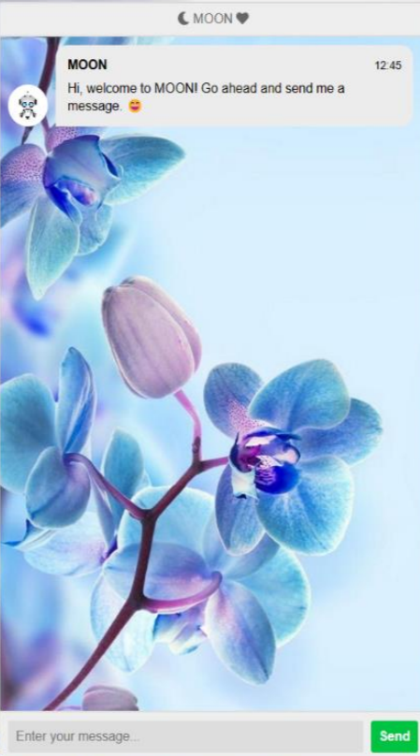
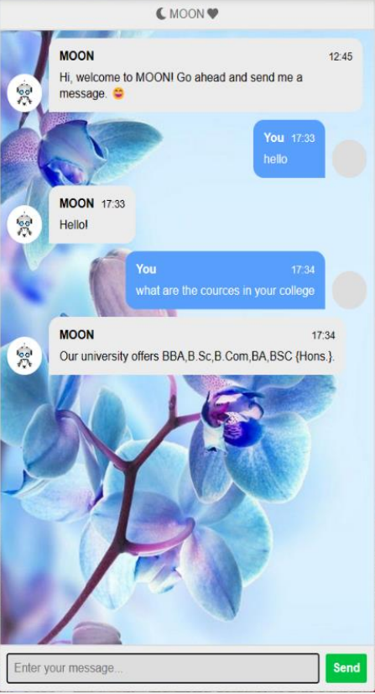
output

Slide 25

Conclusion
Integration with Voice Assistants: Chatbots will increasingly integrate with voice assistants like Siri, Alexa, and Google Assistant to provide multimodal interactions.
Chatbots are increasingly present in businesses and often are used to automate tasks that do not require skill-based talents.
Rather than replacing humans, chatbots can complement our abilities.
They handle repetitive tasks, answer common queries, and free up human agents for more complex issues.
A study by Forrester (June 2017) predicted that 25% of all jobs would be impacted by AI technologies by 2019.

Slide 26


Presented By :
Kajal Singh
Priyanka Mandal
Vaishali Nagarahalli

