Slide 1
NETFLIX MOVIES AND TV SHOWS
A RESEARCH PROJECT

Slide 2
Data description show-id , Type ,Title ,Director ,cast ,country ,Data added , Release year, duration, Ratings ,listed-in, Description.
Data analysis
Total number of rows-8807
Total number of columns-12
Total number of Movies-6131
Total number of TV shows- 2676

Slide 3
Objective
Analyse the movies and TV shows present on Netflix using various excel tools.
We will try to answer some business questions like-
To find the information about a particular show-id.
Percentage of type.
Total number of release of movies and tv shows per year,
Ratings of movies and TV shows.
Top 5 actors of movies and TV shows.
Top 10 countries of movies and TV shows.
Top 10 genre of movies and TV shows.
Top 10 directors on Netflix.

Slide 4
LOOKUP
To find the information about a particular show-id.To findits title,director ,cast,rating,release year using vlookup and match.
Conditional formatting
We have applied conditional formatting on the column release_year.
Year:2000-2021:yellow colour
Year:1980-2000:green colour
Year:Less than 1980:pink colour

Slide 5
Business questions to be answered using pivot table and dashboard
Percentage of type
Release per year
Ratings
Top 5 actors of movies and TV show
Top 10 countries of movies and TV show
Top 10 genre of movies and TV show
Top 10 directors on Netlix

Slide 6
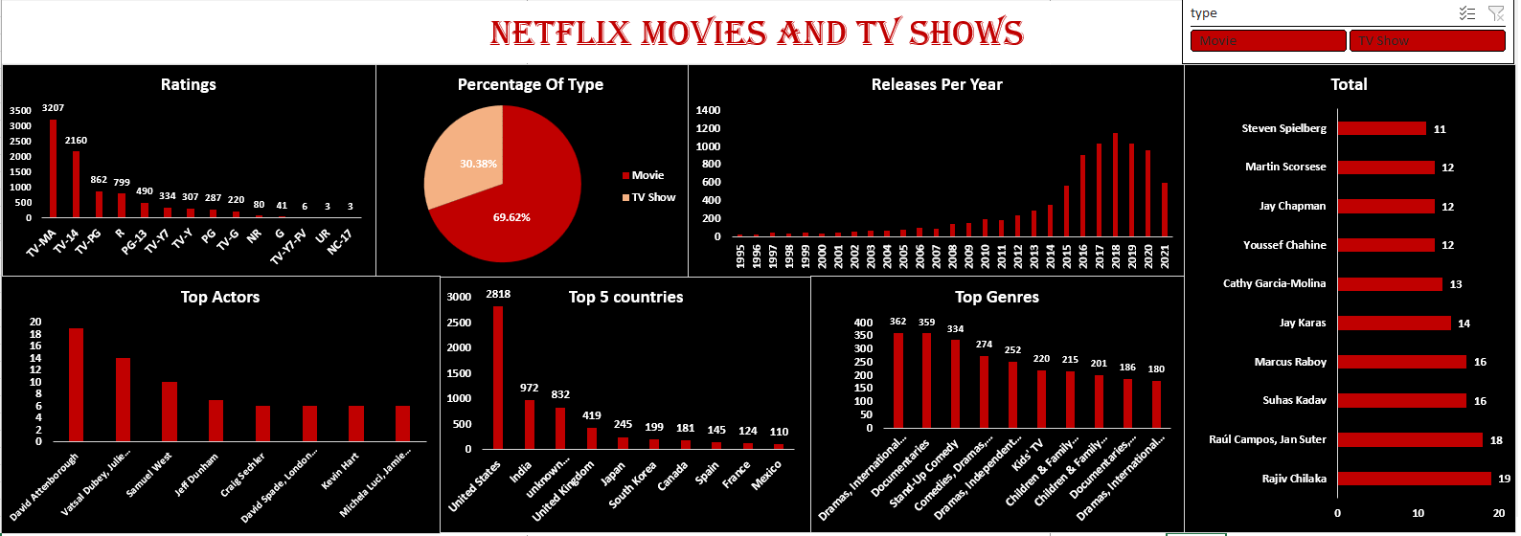

Slide 7
Findings from pivot table and dashboard
Slicer:
Type
Percentages per type:
TV show:30.38% Movie:69.62%
Releases per year :
2017 and 2018 has the highest number of release in terms of movie
2020 has the highest number of release in terms of TV show
Ratings:
The majority of the content is categorized as “TV-MA”,which means that most of the content available is intended or viewing by mature and adult audiences.

Slide 8
TOP 5 ACTORS
Vastsal Dubey,Julie Tejwani,Rupa Bhimani,Jigna Bhardwaj,Rajesh Kava,Mousam,Swanil
Samuel west
Jeff dungham
Kevin hart
Craig sechler
David Attenborough
Michela Luci.Jamie Watson,Anna Clarie Bartlam,Dante Zee,Eric Peterson
Dave Chappelle
Peter Coyote
Bob Brisbane
MOVIE
TV show

Slide 9
TOP 10 COUNTRIES
Movie
TV show
United States
India
United Kingdom
United States
United Kingdom
Japan
Canade
Spain
Egypt
South Korea
India
Taiwan
Nigeria
Indonesia
Turkey
Canda
France
Australia
Japan
Spain

Slide 10
TOP 10 GENRE
Dramas, International Movies
Movie
TV shows
Dramas,international movies
KidS’ TV
Comedies,dramas,international movies
Stand-up comdey
Dramas,independent,international movies
Documentaries
International TV shows,TV Dramas
Crime TV shows,International TV shows,TV dramas
Kids’ TV,TV comedies
Reality TV
Documentries,international movies
Children & family movies,comedies
Dramas,international movies,romantic movies
Children & family movies
Anime Serirs,international TV shows
International TV shows,Romatic TVshows,TVdramas
Docuseries
Internatinal TV shows,romantic TV shows,TV comedies
Comedies,international movies
TV comedies

Slide 11
Top 10 directors
Rajiv Chilaka
Raúl Campos, Jan Suter
Suhas Kadav
Marcus Raboy
Jay Karas
Cathy Garcia-Molina
Youssef Chahine
Jay Chapman
Martin Scorsese
Steven Spielberg

Slide 12
Conclusion:
The plateform predominately offers movies,with 2017 and 2018 being peak
year.however, 2020 saw a surge in TV Show releases.most content falls under
TV_MA,suggesting a focus on mature audience preferences.

