Slide 1
Artificial Intelligence and Machine Learning
Project Name: E-MAIL Spam Classifier
Team Members:
Kajal(2210990469)
Kashish(2210990494)
Kunal (2210990527)
Kartik Verma(2210990490)
Faculty Coordinator: Ms. Shagun Sharma
Chitkara University Institute of Engineering and Technology,
Chitkara University, Punjab

Slide 2
Table of Contents
Introduction
Problem Statement
Technical Details
Key Features
Project Highlights
Conclusion
References/Links used

Slide 3
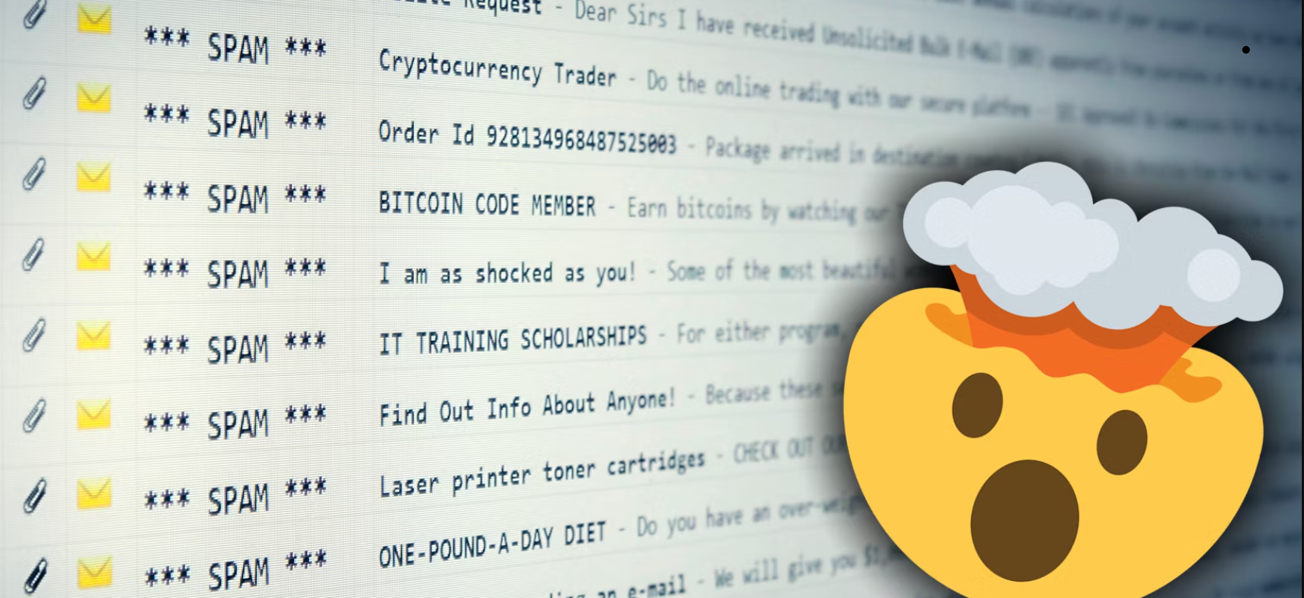
Introduction
In this project, we have created a email spam classifier. In today's digital age, the influx of emails has become overwhelming, with a significant portion being unwanted spam. To tackle this issue, we've developed a sophisticated solution that leverages the power of machine learning to automatically identify and filter out spam emails, thereby enhancing productivity and minimizing the risk of falling victim to malicious content.

Slide 4
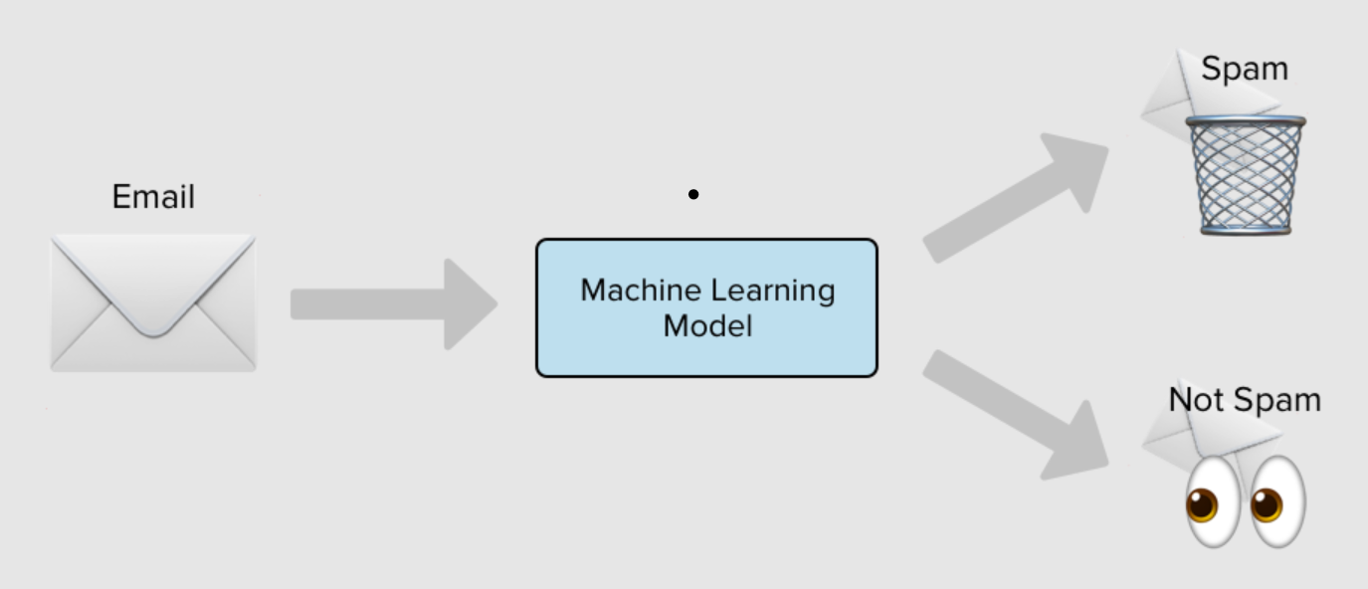
Problem Statement
Spam emails are flooding our inboxes, causing annoyance and potential risks like scams or malware. Current filters aren't great at stopping them. We want to build a smart system using machine learning that can quickly and accurately tell the difference between spam and ham emails, making our inboxes safer and easier to manage.

Slide 5
Technical Details
Data Collection and Preprocessing: Gather a dataset containing a combination of spam and legitimate (ham) emails.
Feature Extraction: Extract relevant features from the preprocessed email data, such as:
Word frequency: Count the occurrence of each word in the email.
TF-IDF (Term Frequency-Inverse Document Frequency): Measure the importance of a word in the email relative to the entire dataset.
Model Selection: Choose a machine learning algorithm suitable for binary classification, such as logistic regression .Logistic regression is often preferred due to its simplicity, efficiency, and interpretability
Training the Model: Split the dataset into training and testing sets (e.g., 70-30 or 80-20 split).Train the selected model using the training data.During training, the model learns the relationship between the input features (e.g., word frequencies) and the target labels (spam or ham).
Model Evaluation: Evaluate the trained model's performance using the testing set.Metrics for evaluation may include accuracy, precision, recall, F1-score, and ROC-AUC.

Slide 6
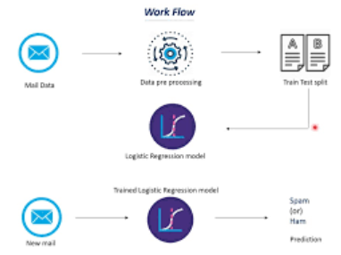

Slide 7
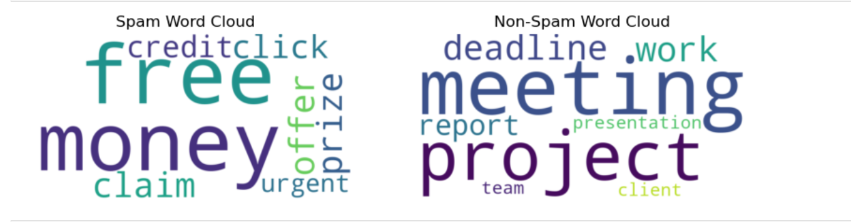
Key Features
Accuracy: Our model achieves high accuracy in distinguishing between spam and legitimate emails, minimizing errors and ensuring reliable results.
Efficiency: It efficiently processes large volumes of emails in real-time, enabling swift spam detection without causing delays in email delivery or inbox management.
Adaptability: The model continuously learns and adapts to new spam patterns and techniques, ensuring robust performance even against evolving spam tactics.
Privacy and Security: We prioritize user privacy and data security, ensuring that all email content is processed securely and confidentially, with no compromise on sensitive information

Slide 8
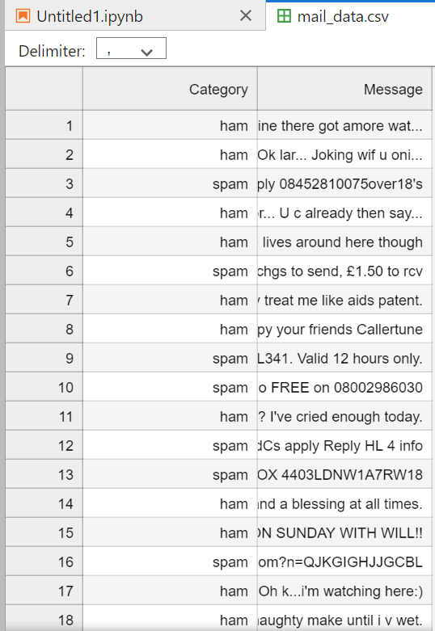
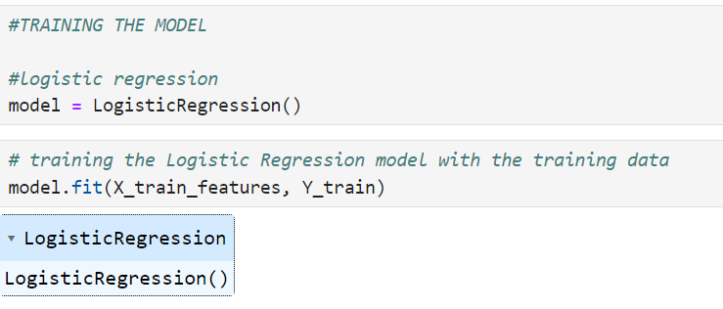
Project Highlights
Fixed Data Set Utilization: Leveraging a curated dataset comprising labeled spam and legitimate emails for training and testing purposes, ensuring consistent and reliable performance.
Logistic Model Implementation: Employing logistic regression, a robust machine learning algorithm, for its simplicity and effectiveness in binary classification tasks like spam detection.
Model Training and Evaluation: Thoroughly training the logistic regression model on the dataset to learn the underlying patterns distinguishing spam from legitimate emails, followed by rigorous evaluation to ensure optimal performance.

Slide 9
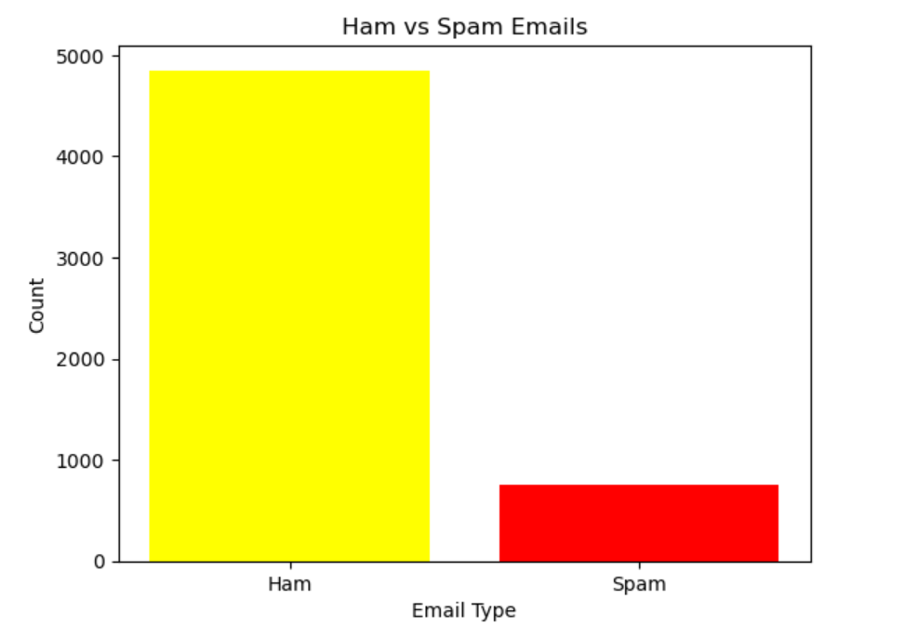
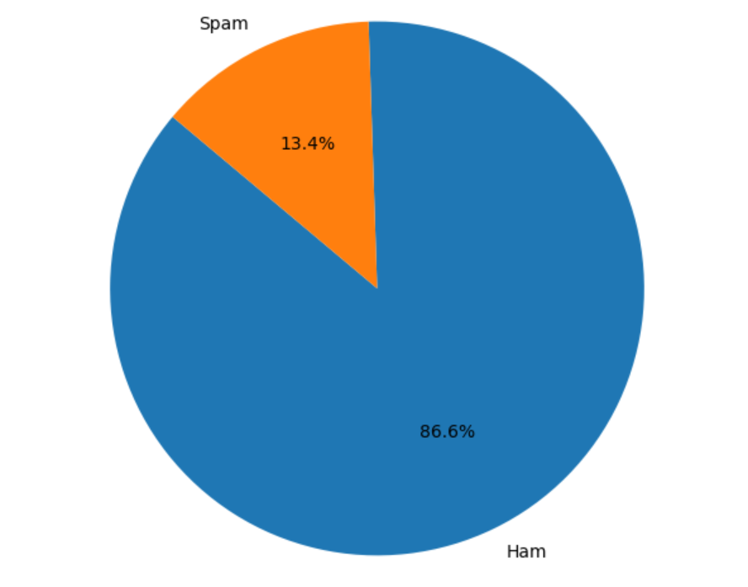
BAR PLOT
PIE CHART

Slide 10

Conclusion
In conclusion, our spam classifier model efficiently distinguishes spam from legitimate emails using machine learning. It's accurate, adaptable, and minimizes false positives and negatives. Continuous improvement is key to keep pace with evolving spam tactics. It's a valuable tool for enhancing email security and productivity.

Slide 11
References/Links used
1. https://medium.com/search?q=+github+references+lin
https://colab.research.google.com/dri...
3. https://drive.google.com/file/d/1uzbh...

Slide 12


