Slide 1
Front End Engineering-II Project
Music Player
SUBMITTED TO:
Dr. Baljit Kaur
Mr. Vikas Patel
SUBMITTED BY :
Kajal (2210990469)
Jatin Sihag (2210990456)
Jatin Goel (2210990457)
Kashish (2210990494)

Slide 2
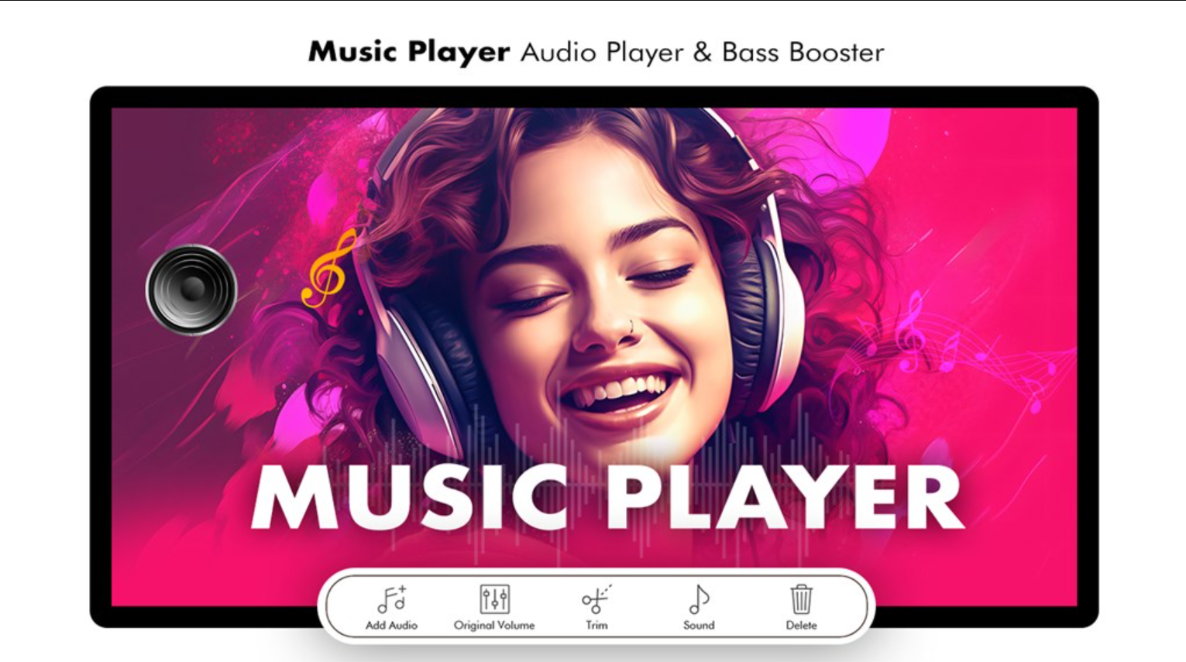
Table of Contents
Introduction
Problem Statement
Technical Details
Key Features
Project Highlights
Bonus Feature(optional)
Conclusion
References/Links used

Slide 3
Introduction
In this project, we will be creating a music player. In an era where digital music consumption dominates, the need for efficient, user-friendly music players is ever-growing. This project aims to develop a cutting-edge music player that not only delivers high-quality audio playback but also incorporates a range of features designed to enhance the user experience. The project will include different technical details such as react and Javascript.

Slide 4
Problem Statement
Even though we have music player in our androids yet we require online streaming of songs? Why?
Problem:
Downloading each song can be pretty space consuming.
Creating albums according to our song requirements is time consuming.
Song range is limited.
Downloading songs can lead to virus threats.
Playlists created by user1 can’t be shared directly to some other user.
We cant find artists of our favourite genre
Playlist is not upto date.
Song management is not smooth

Slide 5
Technical Details
Built with React.js
Our music player leverages the power of React.js, a popular JavaScript library, to deliver a smooth and responsive user experience.
Scalable and Modular
The application's modular design and scalable architecture allow for easy integration and future expansions.
Optimized Performance
With efficient data handling and seamless playback, our music player ensures a lag-free and enjoyable listening experience.

Slide 6
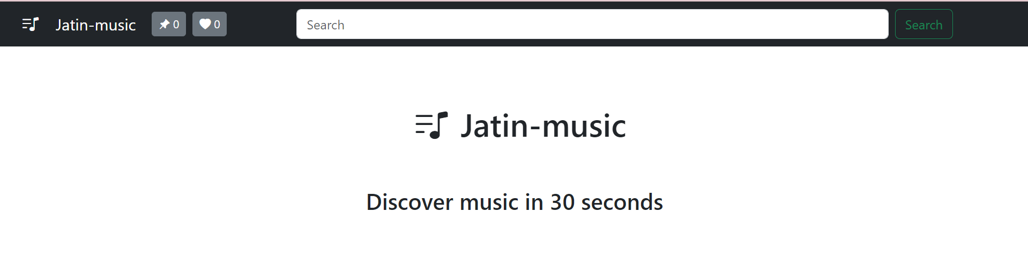
HOME PAGE

Slide 7
Key Features
Play/Pause Button: Initiates playback of the selected track and pauses playback when pressed again.
Forward Button: Skips forward to the next track in the playlist or moves forward within the current track.
Backward Button: Skips backward to the previous track in the playlist or moves backward within the current track.
Seek Bar: Displays the progress of the currently playing track and allows users to jump to specific parts of the song
Metadata Display: Shows basic information about the currently playing track, such as title, artist, and duration..

Slide 8
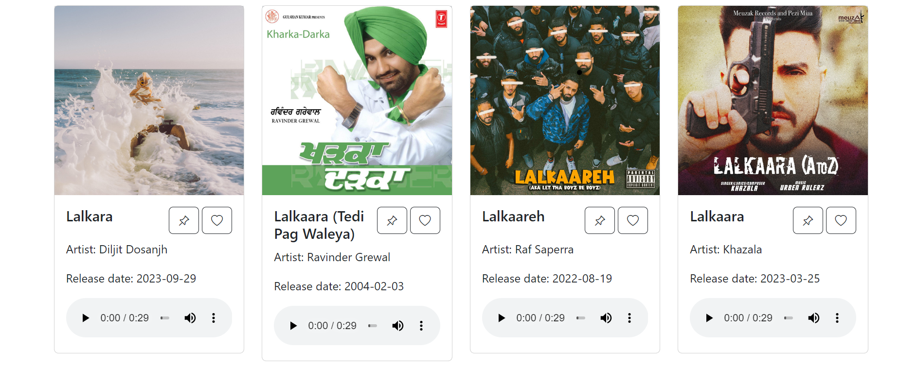

Slide 9
Project Highlights
User-Friendly Interface: The music player boasts a clean and intuitive user interface, making it easy for users to navigate and enjoy their music collection effortlessly.
Agile Development
Our team embraced an agile approach, ensuring quick iterations and rapid feature deployment to deliver a polished product.
User-Centric Design
We prioritized user experience throughout the development process, incorporating feedback and iterating on the design.
Continuous Improvement
The music player is designed for ongoing updates and enhancements, ensuring it stays at the forefront of the industry.

Slide 10
Conclusion
In conclusion, a music player project with basic features offers a straightforward yet functional platform for playing and managing audio files. By incorporating essential elements such as play/pause buttons, progress bars, and forward/backward controls, users can easily navigate their music library and enjoy their favorite tracks with convenience. Overall, a music player with basic features serves as a practical solution for users seeking simplicity and ease of use in their music playback experience.

Slide 11
References/Links used
React.js Documentation
https://reactjs.org/docs/getting-started.html
Music Player UI Inspiration
https://dribbble.com/tags/music_player
Audio Processing Libraries
https://developer.mozilla.org/en-US/docs/Web/API/Web_Audio_API

Slide 12


