Slide 1

GROUP 62 · CAPSTONE
Maya
An evidence-based companion for pregnancy and early motherhood
Built for real questions between appointments, Maya combines each mother’s confirmed context with reviewed maternal health guidance. It delivers clear answers, coordinated weekly plans and safer next steps.
PRODUCT OVERVIEW
PERSONAL JOURNEY
GOVERNED INTELLIGENCE
SAFETY AND EVALS
Stage, preferences and records shape each response.
Reviewed evidence, RAG and eight specialists work together.
Deterministic routing and frozen tests protect every step.
2026
Notes:
The cover positions Maya as a complete product, architecture and evaluation case study. The hero is an original presentation composition inspired by the implemented landing page at http://localhost:5173/: its soft orbital language is retained without reproducing the website interface, and the actual Maya flower mark anchors the centre. Architecture claims are grounded in the repository architecture and execution plan.

Slide 2



THE PROBLEM + PRIMARY USER
Maternal information is fragmented —
and context changes what matters.
01
Guidance lives in different places
02
Generic answers miss personal context
Reports, prescriptions, appointments and daily advice rarely stay connected.
Stage, symptoms, allergies and confirmed records change what is relevant.
03
Safety needs a deterministic route
04
New facts can invalidate old plans
Ambiguous symptoms require safety classification before generation.
A changed restriction or record can make previous guidance stale.
WHO WE DESIGNED MAYA FOR
An English-speaking expecting or new mother in India, already under qualified care.
WORKING MOTHER
MOTHER AT HOME
Limited time · changing schedules · appointment days
Household routines · family advice · uneven rest
Relevant now
Personal when confirmed
Trust made visible
Safety before fluency
week / postpartum stage
allergies / restrictions / records
evidence / limits / uncertainty
urgent routing first
GROUP 62
02

Slide 3
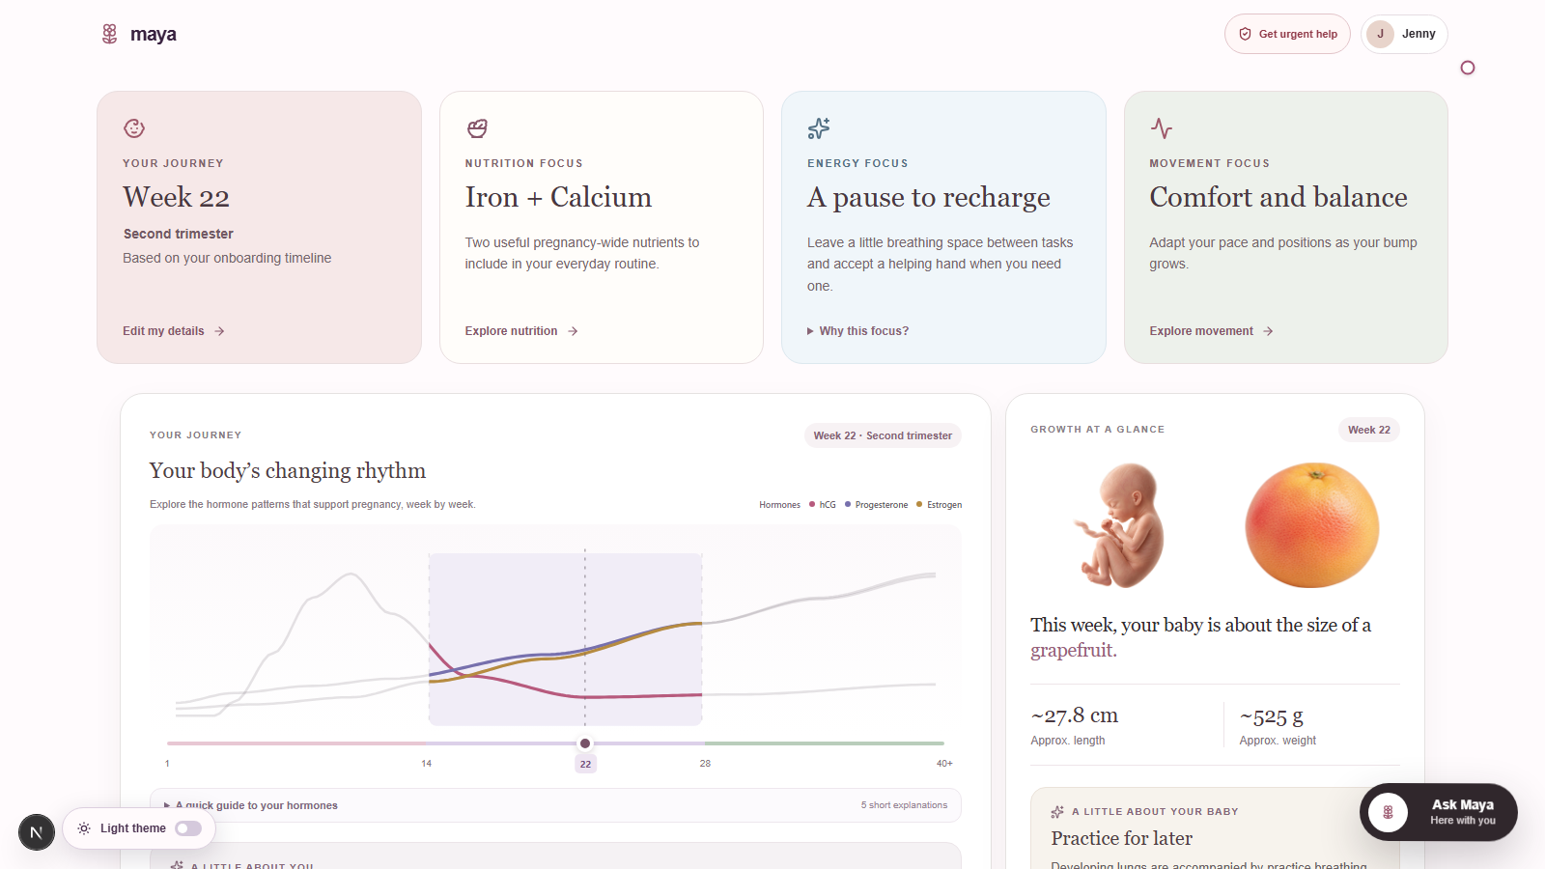
MEET MAYA IN ACTION
A calmer week, one conversation away.
Follow one mother’s journey from
her first details to a more personal week.
01
Begin with her context
Stage, preferences and concerns.
02
Make the week tangible
A dashboard and a weekly plan.
03
Keep the conversation going
Ask Maya, follow up and find clarity.
Watch the 2-minute demo
Click to open the video in Google Drive.
THE MAYA DASHBOARD
GROUP 62
03
Notes:
Introduce the recorded Maya walkthrough, then click “Watch the 2-minute demo”. Video URL: https://drive.google.com/file/d/1ZPV1fXbu57OIT5IvDuibPqoZ0_IiEKDy/view?usp=sharing
This slide links to the user-supplied Drive video; it does not embed or download it. Confirm audience viewing permission before presenting. Screenshot: actual local Maya dashboard from reports/local/demo-video-20260917-v2/take-03/capture/kpis.png. The local recorded walkthrough is 119.77 seconds. Do not claim public deployment or clinical approval.

Slide 4
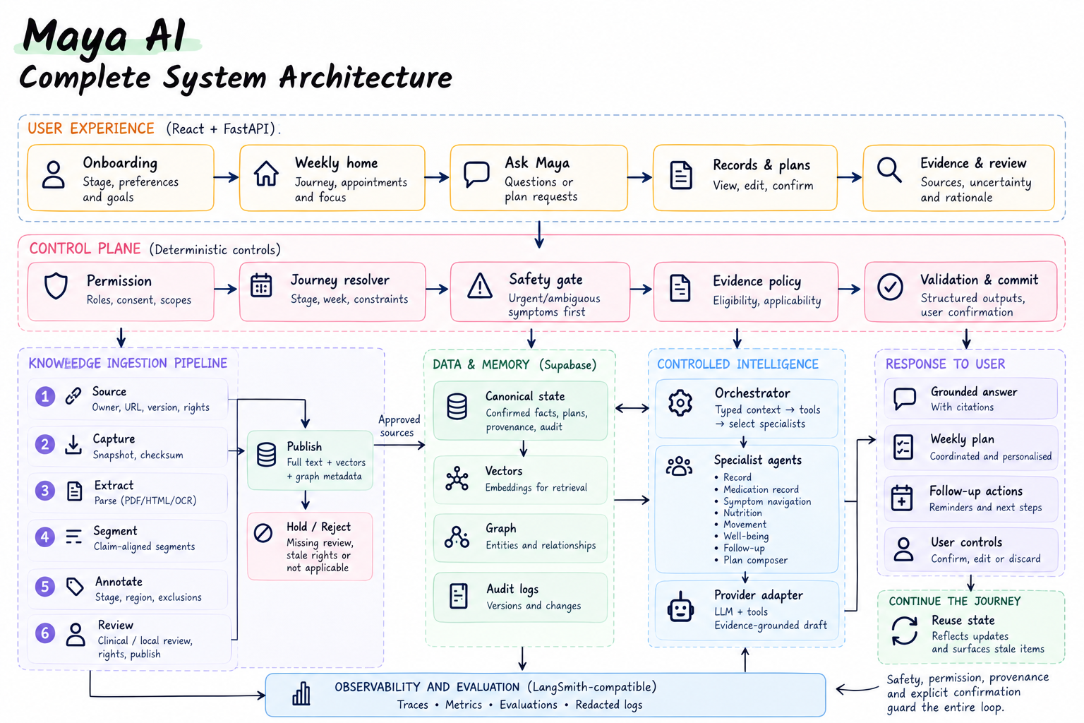
GROUP 62
04

Slide 5
OBSERVABILITY + EVALUATIONS
Trust needs more than a fluent answer.
We inspect how an answer was built, then test the boundaries it must respect.
What we can trace
What we checked
Context and routing
Personalisation
Journey, reported constraints and the selected specialist.
Allergy context, vegan follow-up and heartburn support.
Evidence and validation
Planning
Retrieved source IDs, citations and claim checks.
Live generation of a complete seven-day schedule.
Runtime behaviour
Safety boundaries
Provider calls, response time and local cost accounting.
Urgent-help routing and refusal to reveal secrets.
847
regression tests passed
315
subtests passed
44
tests skipped
Recorded local checks · 17 September 2026 · 5 chat exchanges + 1 balanced plan
Engineering verification, not clinical validation. Next: richer meal specificity and broader coverage.
GROUP 62
05
Notes:
Evidence: docs/MAYA-PLAN-FIX-AND-COMPACT-DASHBOARD-20260917.md and reports/local/ui-integration/compact-journey-plan-regression.xml in the maya-ai-product-preview repository. Backend: 847 passed, 44 skipped, 315 subtests passed, six warnings. Frontend: 37 tests passed; TypeScript passed in that recorded run.
Live evidence: reports/local/demo-video-20260917-v2/DELIVERY-VERIFICATION.json records HTTP success for a balanced seven-day plan plus five exchanges: allergy, vegan follow-up, heartburn, urgent and secrets. Plan and the three routine health exchanges have real retrieval, source/context traces and live generation without fixture fallback. Urgent and secret requests use deterministic boundaries. These execution checks are not a measured medical-accuracy score. Known limitation: meal replies still favour food groups over concrete meal options.
Local traces record routing, source IDs, applied context, provider requests, validation, elapsed time and estimated cost receipts; no hosted LangSmith dashboard is claimed as verified. Source: app/services/grounded_runtime.py and local integration reports. Test results are existing dated records, not a new suite run for this presentation.

Slide 6
IMMEDIATE ACTIONS + FUTURE SCOPE
The next chapter of care.
Make the current experience deeper. Then make support easier to reach.
IMMEDIATE ACTIONS
FUTURE SCOPE
Deepen answer quality
A WhatsApp companion
Expand evidence coverage, specific meal options
and real-question evaluation.
Bring the same context-aware support into
a familiar, opt-in conversation.
Bring a human into the loop
More languages and voice
A consent-based clinician handoff, with urgent
help that never waits for a review queue.
Make guidance easier to access across
languages, literacy and connectivity needs.
Add secure document intake
Broader maternal support
Extract prescriptions and appointment details;
confirm facts before personalising guidance.
Extend postpartum and recovery coverage
through clinical review and user pilots.
Planned capabilities · clinical review, privacy safeguards and real-world evaluation guide each release.
GROUP 62
06
Notes:
Roadmap, not a claim of completed features. Immediate priorities: richer grounded answer coverage and meal specificity; consent-based clinician/care-coordinator handoff with explicit response expectations (never delay urgent help); private document upload/extraction with user confirmation of medicines, clinician instructions and appointments. Do not promise direct doctor connectivity or secure record storage as already implemented. Future proposals: opt-in WhatsApp, Indian-language and voice access, broader postpartum/recovery support, governed by clinical review and user pilots. These priorities follow the user’s requested future-scope discussion.

Slide 7
Thank you
Group 62
Notes:
Thank the audience. Group 62.

