Slide 1



ATLIQ MART
ANALYSIS OF SALES AND PROMOTIONS

Slide 2

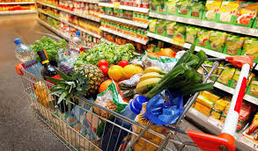
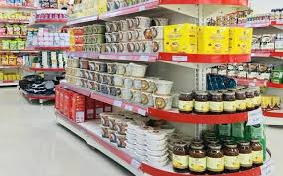
PROBLEM STATEMENT
ATLIQ MART
AtliQ Mart is a retail giant with over 50 Supermarkets in southern region of India.
All their 50 stores ran a massive Promotions during Diwali 2023 and Sankranti 2024 on their AtliQ branded Products.
Now the Sales Director Bruce Hariyali wants to understand which promotions did well and which did not.
so that this report built to help Sales Director So that they can make informed decisions for their next promotional period.

Slide 3
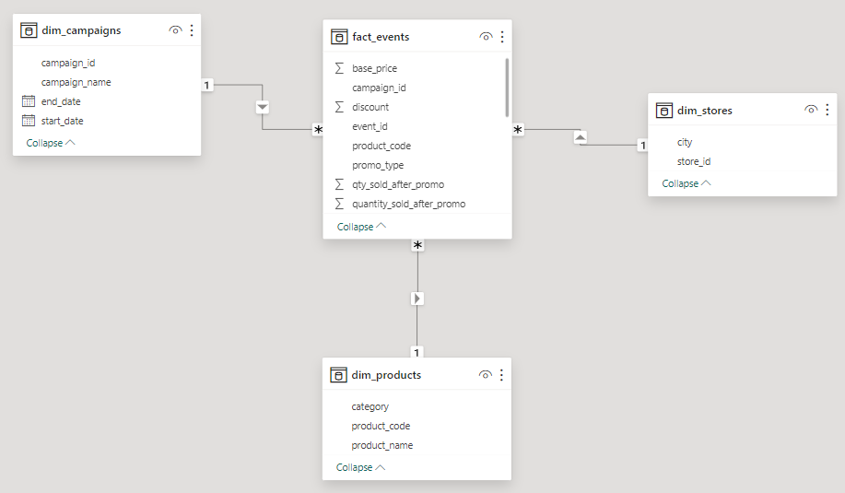


OUR
DATASET
Dataset--
dim_Products
dim_stores
dim_compaigns
Fact_events
Data Modelling--
StarSchema

Slide 4

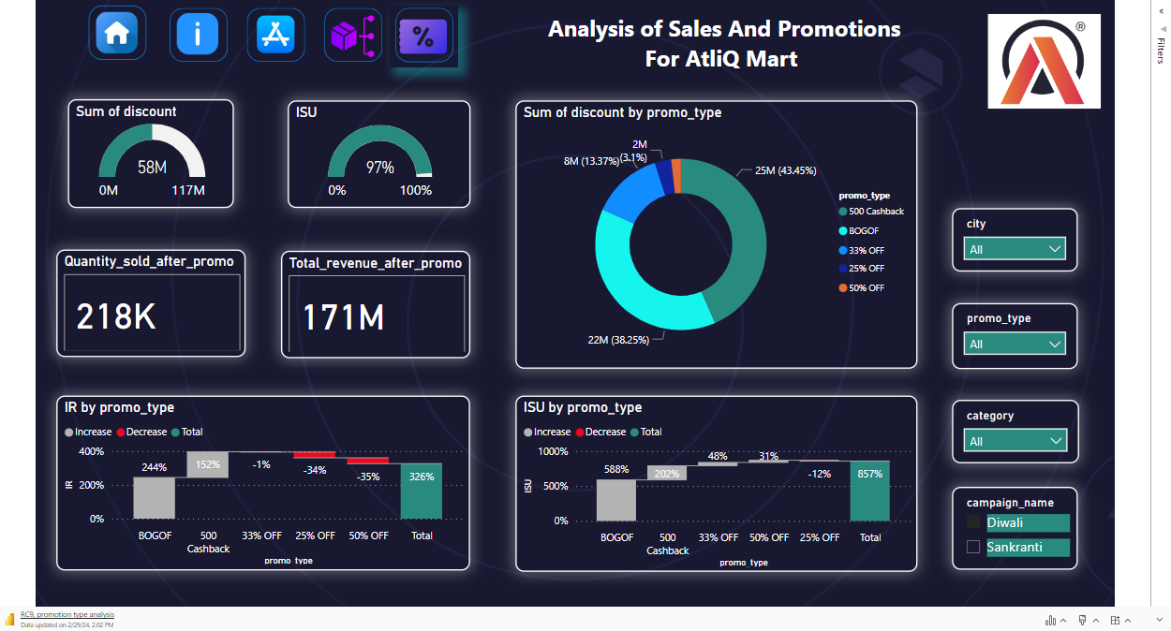
Microsoft Power BI

Slide 5
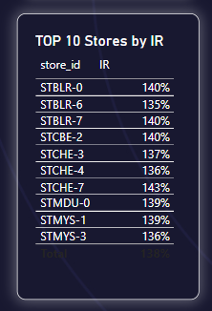
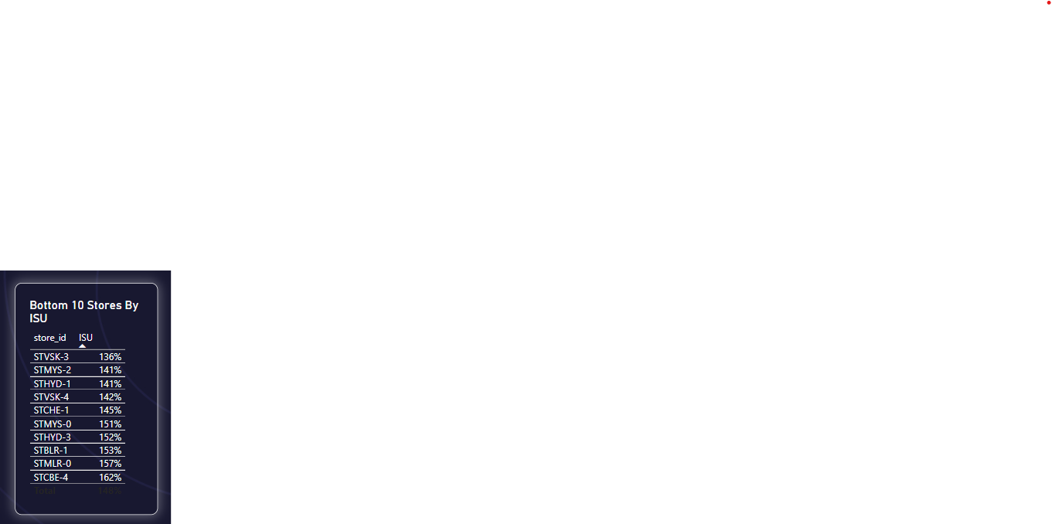

STORES BY IR AND ISU
Top 10 stores By IR -
the Highest Incremental revenue is 140%
Bottom 10 Stores By ISU -
the Lowest Incremental Sold Quantity is 136%

Slide 6
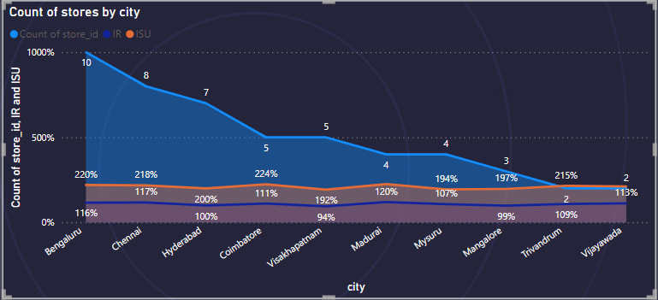
PERFORMANCE OF STORES
VARY BY CITY
It shows us performance of stores with respect to IR and ISU in different cities
This grapgh shows us count of stores in different cities
bengalore has highest stores 10 and Viaywada has very low store count 2

Slide 7
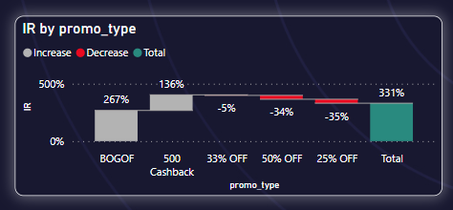

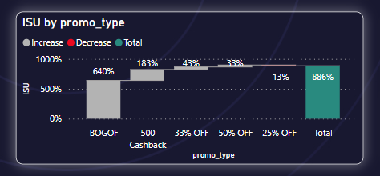
PROMOTION TYPE ANALYSIS
Top 2 Promo type are BOGOF and 500 Cashback and others have negative IR that means Decrease in IR
ABOUT ISU
Top 2 Promo Type are BOGOF and 500 Cashback and 25% off have negative value means decrease in ISU .

Slide 8

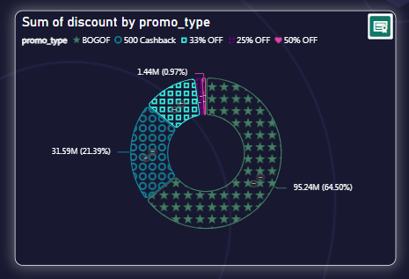
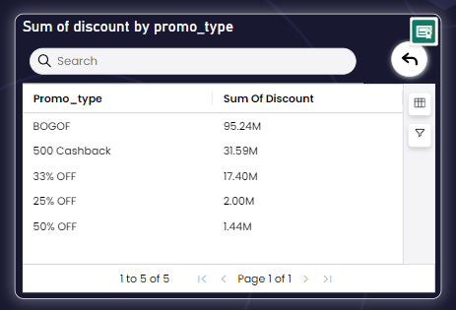
DISCOUNTS IN DIFFERENT PROMO TYPE

Slide 9
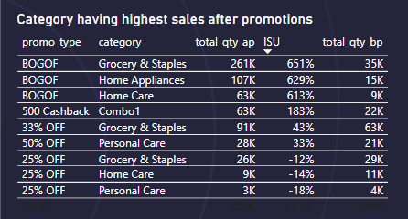
CATEGORY WITH HIGHEST SALES
Grocery and Staples have highest ISU value so it has highest sales lift after promotions and it has promo type BOGOF
AFTER PROMOTIONS

Slide 10
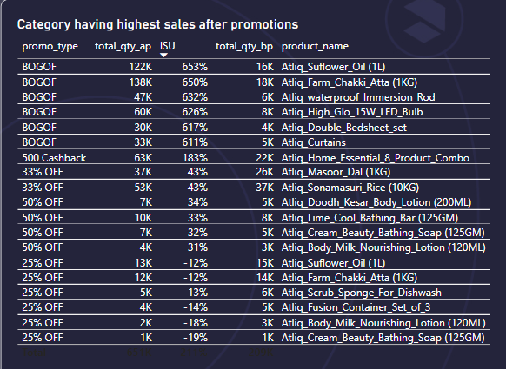
PRODUCTS WITH HIGH SALES AFTER PROMOTIONS
Atliq Sunflower oil Have highest ISU value hence it has highest sales growth after promotions.
Some products have negative ISU hence they have decrease their sales after promotions.

Slide 11



DHAVAL PATEL
HEMANAND VADIVEL
THANK YOU

Slide 12


THANKS FOR WATCHING
Your Feedback is highly appreciated please share your thoughts in comment section below
karnikravina10@gmail.com

