Slide 1
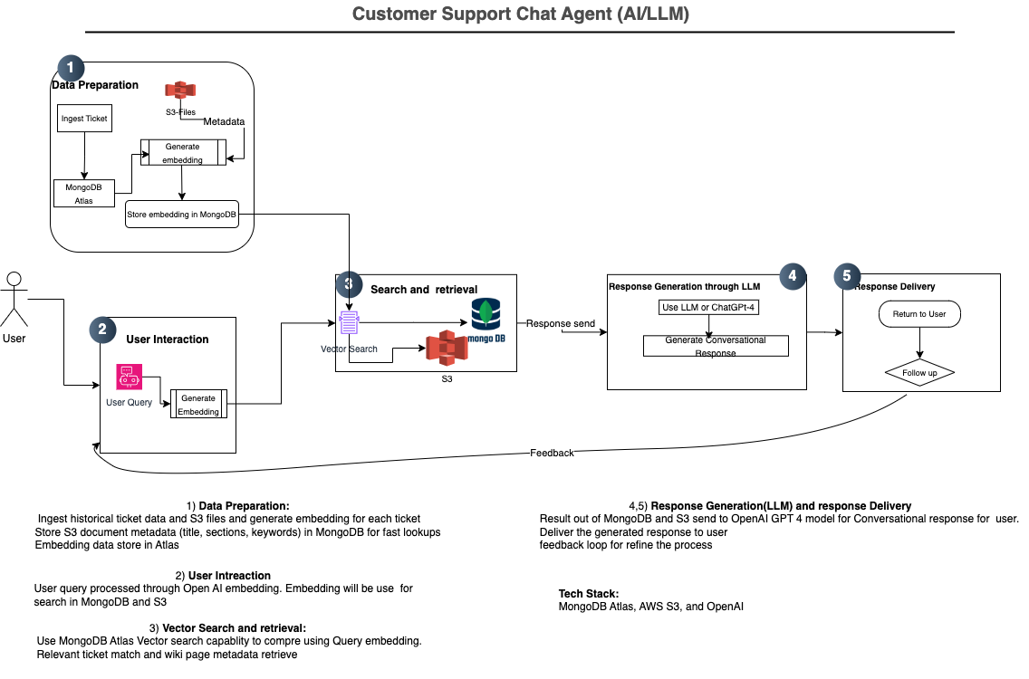

Slide 2
Architecture overview
Data Ingestion and embedding:
Generate embedding for both ticket history and S3 wiki pages during data ingestion.
Store embedding directly in atlas alongside original historical and metadata of S3 object
User query
Processed user query using NLP or openAI techniques
Embedding user query through openAI text embedding
Vector Search, compare and retrieve
Using mongodb Atlas search capability to compare the query embedded
The search will bring top N similar list (similarity match)
Augmenting by similarity search,system prompts
Response Generation
Prompt pass to LLM (chat gpt model 4) for generate conversational response
Due to similarity item or result pass to LLM, response won’t hallucinate
Technical consideration:
Embedding storage in Mongodb and configure MongoDB Atlas Search to index . If MongoDB not scale up, Milvus or other vector db
can be consider
Considering OpenAI’s embedding model( text-embedding-ada-002)
Response generation GPT-4
React for web interface(chatbot UI) and API request(FastAPI)
For performance and scalability, we can consider cache(Radis)
To cover domain specific language,Hugging Face can be consider.
References:
Retrieval-Augmented Generation for Knowledge-Intensive NLP Tasks(https://arxiv.org/abs/2005.11401)- understand how RAG improve factual accuracy and reduce hallucinations.
And other LLM and RAG content in WEB (medium etc)

