Slide 1
UBER
Cab Analysis Project
End-to-End Data Analysis Project Using BI & SQL
Power BI
SQL Server
Data Modeling
DAX
Analytics
Resume Project | Data Analyst Portfolio | Tools: Power BI + SQL Server

Slide 2
PROJECT OVERVIEW
A complete end-to-end data analytics project analyzing Uber ride operations using SQL Server as the backend database and Power BI for interactive visual dashboards built for real-world business insights.
Business Goal
Technical Stack
Key Outcome
Analyze ride performance across vehicle types, locations, time slots and payment methods to drive data-driven decisions.
SQL Server for ETL and data modeling. Power BI + DAX for KPI dashboards, visuals and interactive reports.
56K+ bookings, 31M revenue insights with customer segmentation, payment trends and operational dashboards.
Uber Cab Analysis | Power BI + SQL Project

Slide 3
KEY PERFORMANCE INDICATORS
56K
34K
31M
Completed Bookings
Lost Bookings
Total Revenue
Successfully completed rides
Cancelled and incomplete
Gross revenue generated
1.51M km
24.67 km
4.41
Total Distance
Avg Distance
Customer Rating
Cumulative all rides
Per ride average
Average customer rating

Slide 4
VEHICLE TYPE PERFORMANCE
Vehicle | Bookings | Revenue
Auto | 23,128 | 12.9M
Go Mini | 18,529 | 10.3M
Go Sedan | 15,200 | 9.5M
Bike | 14,026 | 7.8M
Premier | 9,800 | 6.2M
Uber XL | 4,449 | 3.5M
Auto leads | Go Mini = top sedan

Slide 5
CUSTOMER SEGMENTATION
42%
First Time Rider
New users on their first ride. Prime target for retention offers and referral campaigns.
28%
Return Rider
Took exactly two rides. Convert them to regular riders with loyalty rewards.
30%
Regular Rider
Power users with 3+ rides. Core revenue drivers — prioritize VIP service.

Slide 6
PAYMENT METHODS & BOOKING TRENDS
UPI Dominates - 55%+ of all payments
Stable Revenue - ~2.5M every month
Cash Still Relevant - 28% of transactions

Slide 7
TECHNICAL ARCHITECTURE
Raw Data
SQL Server
Data Model
Power BI
Insights
CSV / Excel
Source Files
ETL, Cleaning
& Modeling
Star Schema
DAX Measures
Dashboard
& Visuals
Business
Decisions
SQL Server — Key Work
Power BI — Key Work
- Imported and cleaned raw CSV source data
- Connected live to SQL Server database
- Created relational tables with primary/foreign keys
- Designed star schema relational data model
- Built stored procedures and complex JOIN queries
- Created 15+ DAX measures for business KPIs
- Aggregated KPIs: revenue, distance, booking counts
- Built 4 interactive dashboard report pages

Slide 8
DASHBOARD HIGHLIGHTS
01
Overview Dashboard
02
Booking Analysis
Top-level KPIs: 56K bookings, 31M revenue, 1.51M km. Quarterly trend chart and vehicle-wise revenue breakdown.
Monthly booking value trends, peak time slot analysis (12AM-3AM), and top customer IDs by booking volume.
03
Customer Dashboard
04
Revenue & Payments
Rider segmentation (First Time, Return, Regular), customer ratings 4.41 avg, location-wise ride performance.
Payment method breakdown (UPI 55%+), pickup location by payment type, and cancelled vs incomplete analysis.
All 4 dashboards are fully interactive with slicers for Vehicle Type, Date and Driver

Slide 9
KEY BUSINESS INSIGHTS
Auto Dominates
UPI is King
High Satisfaction
Auto-rickshaw top vehicle with 23,128 bookings — 40% of all completed rides.
Over 55% of all payments via UPI — strong digital payment adoption.
Customer rating 4.41 and driver rating 4.23 — strong service quality.
Lost Booking Risk
Night Peak Hours
Consistent Revenue
34K lost bookings out of 90K total (38%). Reducing this is top revenue opportunity.
12AM-3AM is busiest slot with 74,747 bookings — late-night demand is huge.
Stable 2.5M per month with strong Q4 surge — seasonality is key factor.

Slide 10
Thank You
Uber Cab Analysis — End-to-End Data Analysis Project Using BI & SQL
Tools & Technologies Used:
- Microsoft SQL Server — Data Storage & ETL
- Power BI Desktop — Interactive Dashboards
- DAX — Data Analysis Expressions for KPIs
- Data Modeling — Star Schema Design
- ETL Pipeline — Extract, Transform, Load
Portfolio Project | Data Analyst Role | [Your Name] | [email@example.com]

Slide 11
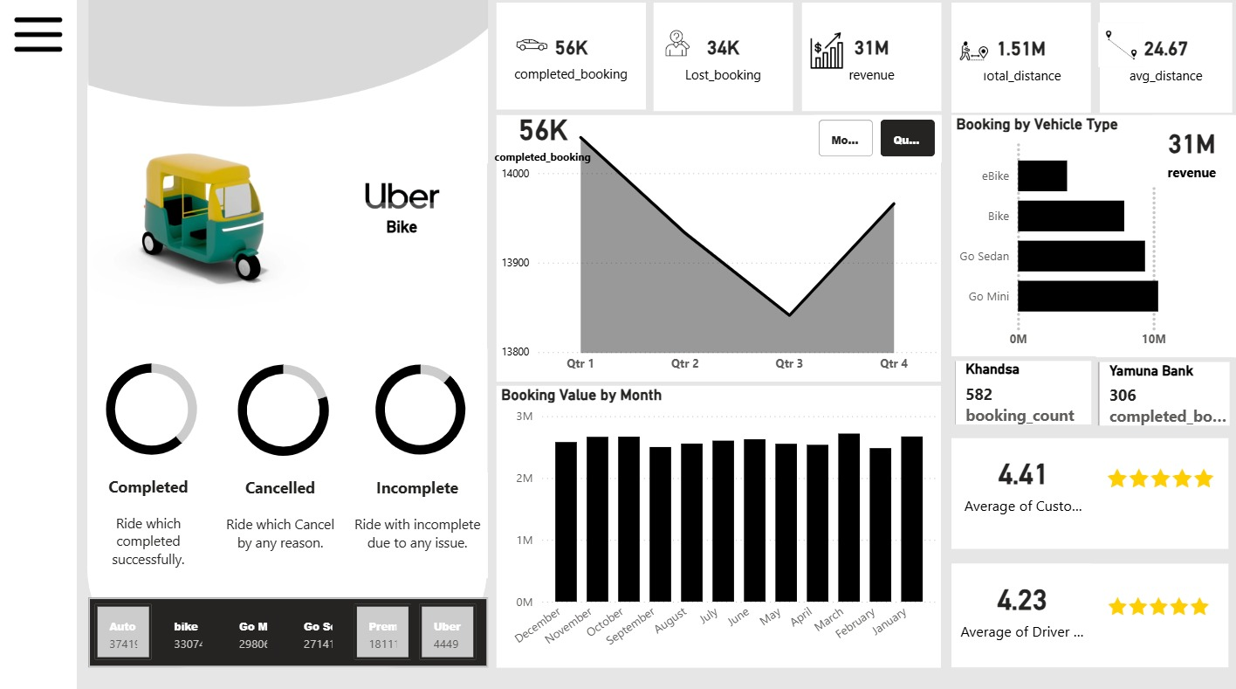
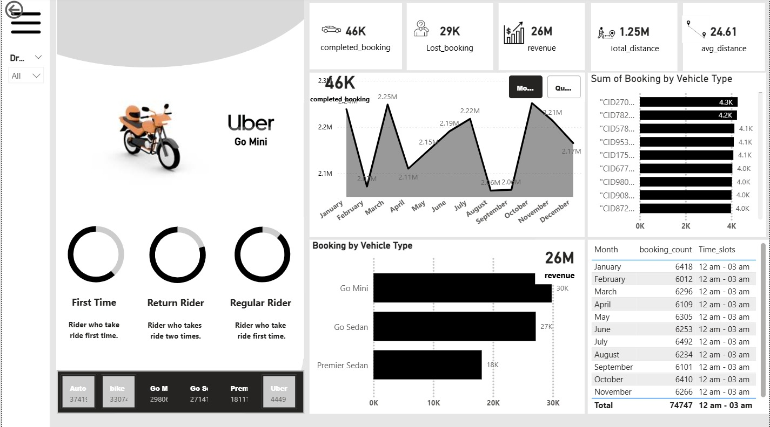
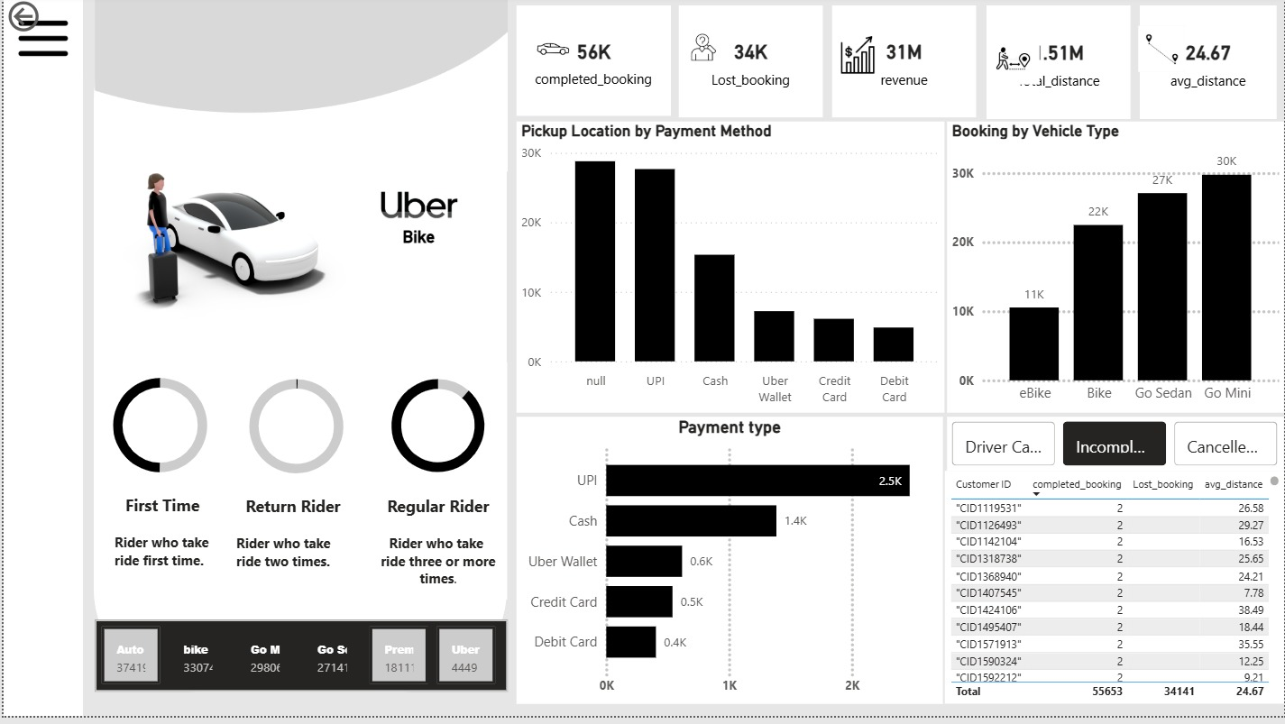
POWER BI DASHBOARD SCREENSHOTS
Live Dashboards
Overview Dashboard
Driver & Vehicle Analysis
Payment & Location Analysis
Connected to SQL Server Database | Built with Power BI Desktop | 4 Interactive Dashboard Pages | 15+ DAX Measures

