Slide 1
SECURE DATA HIDING IN IMAGE USING STEGANOGRAPHY
CAPSTONE PROJECT
Presented By
Student Name : Kajal Deelip Patil
College Name & Department : Pimpri Chinchwad College Of Engineering And Research, Computer Department

Slide 2
OUTLINE
Problem Statement
Technology used
Wow factor
End users
Result
Conclusion
Git-hub Link
Future scope

Slide 3
Problem Statement
Data security is critical in the digital age.
Traditional encryption methods make data presence clear, increasing security issues.
Steganography conceals data within images to provide privacy without detection.
However, many approaches are inefficient against compression and attacks.

Slide 4
Technology used
Programming Language: Python
- Libraries: OpenCV, NumPy, Cryptography, Stegano

Slide 5
Wow factors
Improved security by encrypting before embedding
Lossless data retrieval.
Compression-resistant
Multi-format support (PNG, JPEG,)
Steganalysis resistance.

Slide 6
End users
Government and military – for securing communications
Journalists – hiding critical information
Businesses – protecting trade secrets, specially business partners
Individuals – securing messages, watermarking

Slide 7
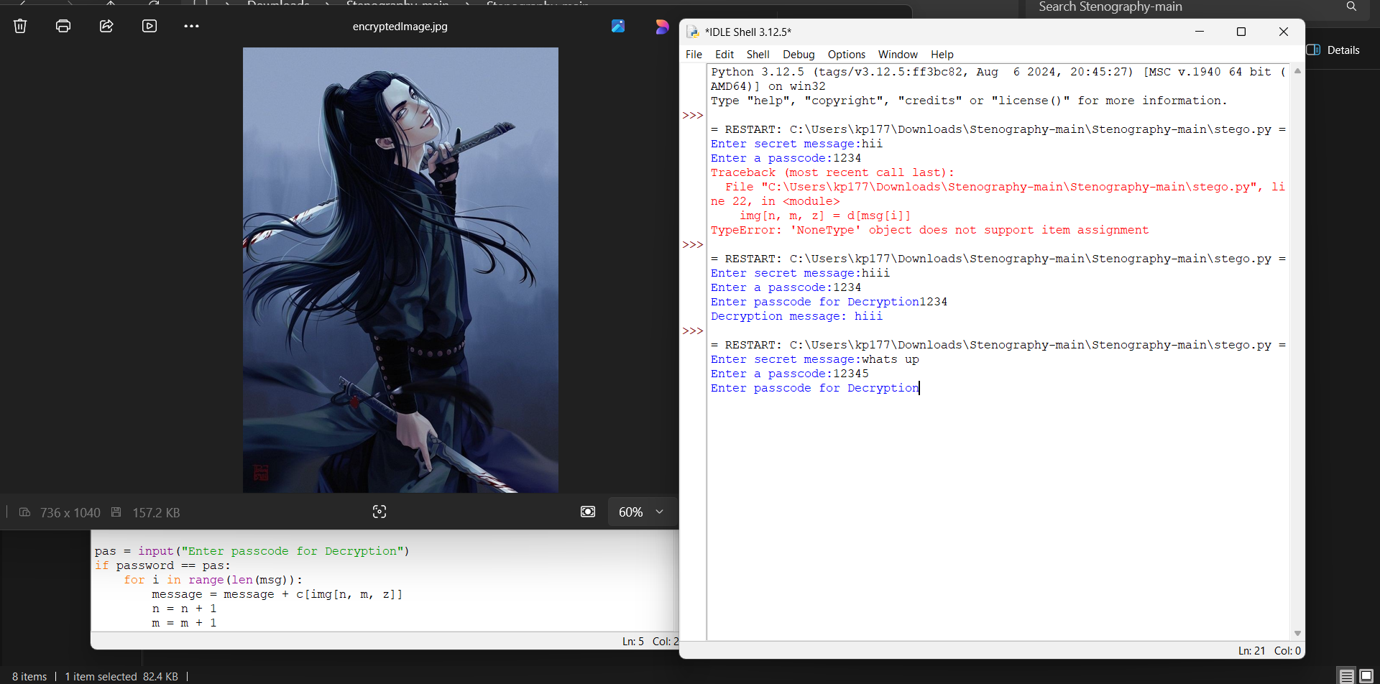
Results

Slide 8
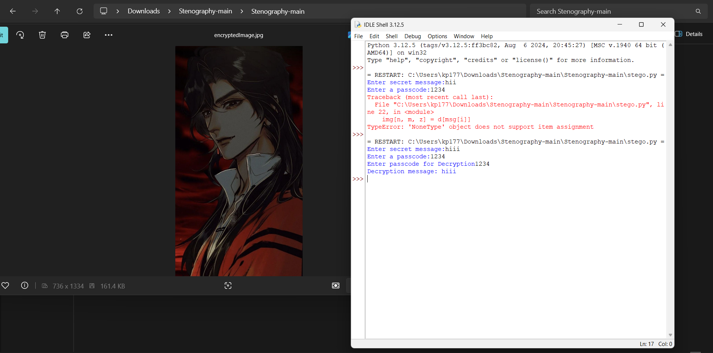
Results

Slide 9
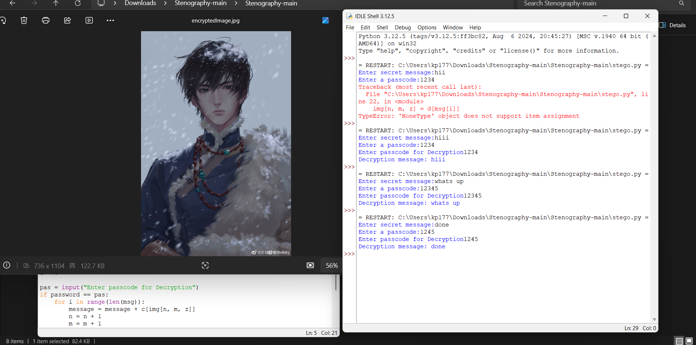
Results

Slide 10
Conclusion
Steganography enables secure, covert communications
Methods or algorithms provide imperceptibility
Encryption improves security
Suitable for government, corporate, and personal use

Slide 11
GitHub Link
https://github.com/kajalp713/AICTE_STEGO_PRJCT

Slide 12
Future scope(optional)
AI powered detection prevention
Increased encoding capacity
Mobile apps security reasons integration

Slide 13
THANK YOU

