Slide 1
SLA

Slide 2
SLA
What is a SLA??
SLAs define a set of service level objectives that is agreed on by both cloud provider and consumer
SLAs define a set of service level objectives that is agreed on by both parties.
Primary objective documented in SLA : Availability
Other objectives part of SLA: Performance, Security and Compliance/privacy
SLA will also have the information on the remedies offered if the objectives are not met
SLAs should align with the business needs and performance requirements of the consumer.
Consumer has to review and understand SLAs accurately.

Slide 3
Status of SLA
To control how service level agreements are used, user can change the status of a service level agreement to :
Draft - When user create a SLA, the status is set to draft. The status can be left to draft status until it is ready for approval or use. Once a draft service level agreement is set to active or inactive, it cannot be reset to draft.
Active – User set a service level agreement to active when they are ready for the service level agreement to be used.
Inactive - User set a service level agreement to inactive if they do not want users to be able to apply the service level agreement to a record.

Slide 4
Types of SLA
A customer SLA is an agreement between you and an external customer.
An internal SLA is an agreement between you and an internal customer
A vendor SLA is an agreement between you and the vendor.

Slide 5
KPIs of SLA
A key performance indicator is a metric that tracks critical performance variables over time.
Key performance indicators are created in the Key Performance Manager application.
Define the value to be calculated
Select a calculation type
Define the time you want calculated
Define the thresholds that define the red, yellow, and green limits on the key performance indicator display
Define the degree to which users can drill down through the key performance indicator to get more information, such as response time by department

Slide 6
KPIs of SLA
The following list describes the color code for the graphs for key performance indicators:
The gray arrow represents the number in the Target field.
The orange arrow represents the number of records found for the query.
The green area represents the target zone.
The yellow area represents the warning zone.
The red area represents the alert or danger zone

Slide 7
SLA –Service Commitments/ Service guarantee
It is the % of time the cloud services will be available for normal commercial use.
Service availability usually varies across different service models and different vendors.
Uptime percentage usually ranges from 99.0 % to 99.9%, 99.95% and even 100%.
Service guarantee time period: Most common time period is a billing month.
It can also be small for eg an hour
Smaller the time period, the more stringent is the service guarantee

Slide 8
SLA –Service Commitments/ Service guarantee
Service guarantee granularity: Scale on which provider specifies a service guarantee
Different vendors measure the uptime percentage is different ways.
Downtime can mean any of the below
The total amount of time the service is not available during one billing cycle(e.g., per month)
The total number of service errors encountered divided by total number of requests during a specific time interval
Duration between service down issue is filed and the service is reinstated
Amazon has 99.95 % service guarantee for its compute and storage services during any monthly billing cycle.
This means that it expects its service to be fully functional for > 99.95% of the time in a month

Slide 9
SLA –Service Commitments/ Service guarantee
Consumer need to understand and analyze meaning of uptime/down time mentioned by different vendors
Understand the business impact of single outage that corresponds to the maximum down time that can happen.
Example of other service commitment statements, related to performance:
There should not be more than 10 pending requests
Response for a request should be within 2 seconds
Data streaming for a read request should start within 2 seconds

Slide 10
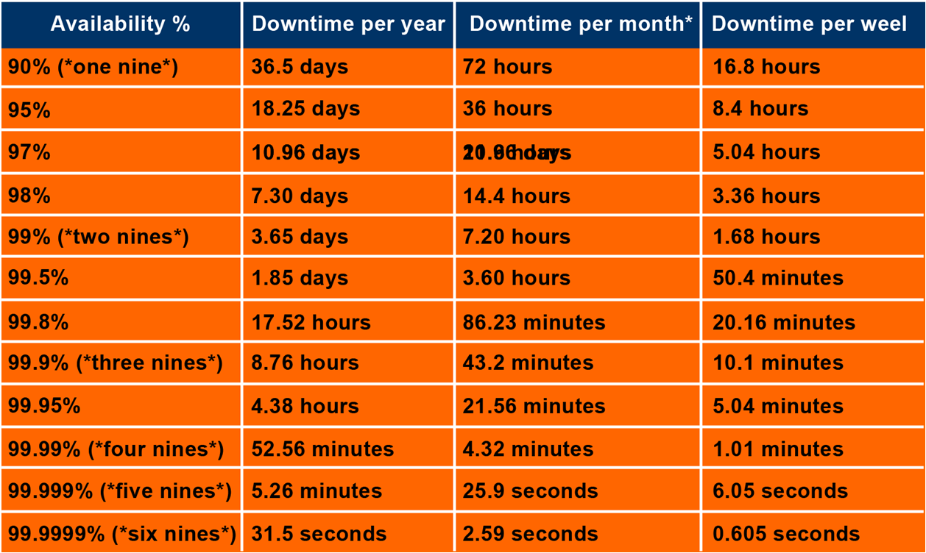
Service Commitment

Slide 11
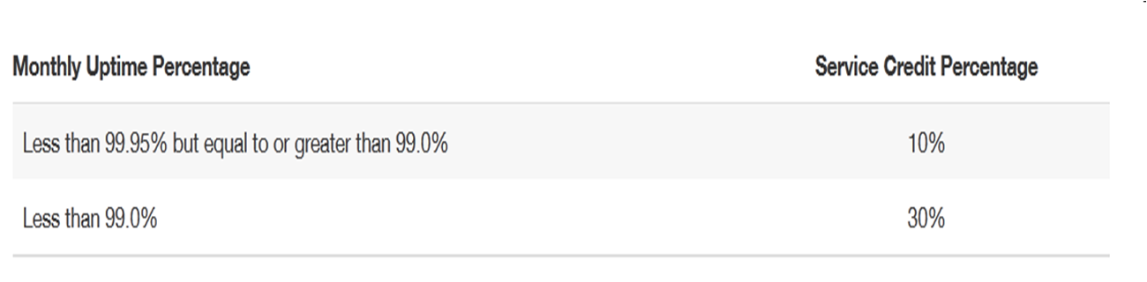
Credits / Compensation terms
Credits are the way the cloud vendors compensate for missed service commitment beyond acceptable levels.
It differs from vendor to vendor.
Generosity of the outage credit is an indicator of how serious a vendor is about service availability.
Amazon EC2 service credit statement

Slide 12
SLA –Credit Process
It is responsibility of consumer to identify and report the service outage
Also consumer has to provide proof of the problem
The time frame for reporting failure varies significantly from vendor to vendor.
It could be 48 hours/5days/7days/30days/10 business days after service is restored
Cloud provider reviews the claims and makes a final, unilateral judgment on service credits
Consumers can automate the process for detecting and logging service outages

