Slide 1

Virtualization
Presented by:
Vivek Sharma
Assistant Professor

Slide 2
Types of Virtualization
Server Virtualization.
Desktop Virtualization.
Application Virtualization.
OS Virtualization.
Network Virtualization.
Storage Virtualization.

Slide 3
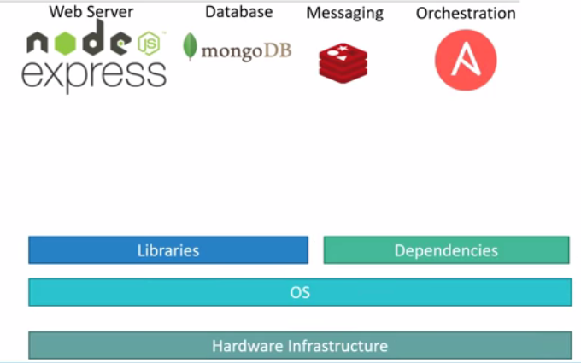
OS Virtualization

Slide 4
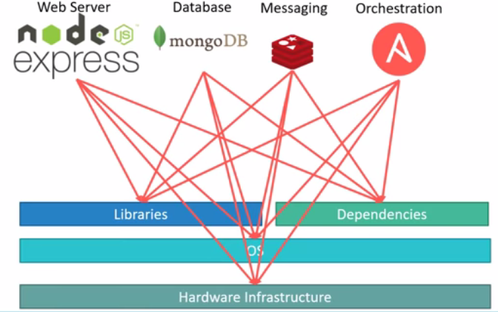
OS Virtualization

Slide 5
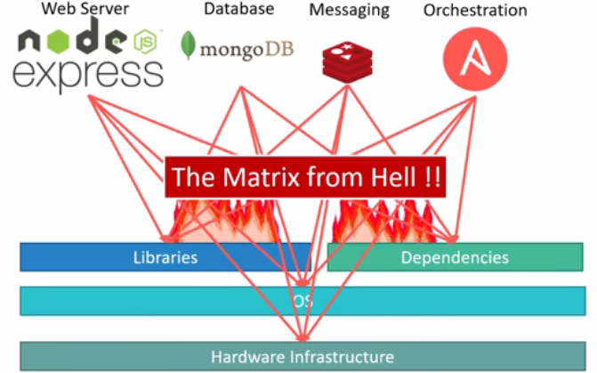
OS Virtualization

Slide 6
OS Virtualization
Compatibility/ Dependency.
Long Setup Time.
Different Dev/ Test/ Prod environments.

Slide 7
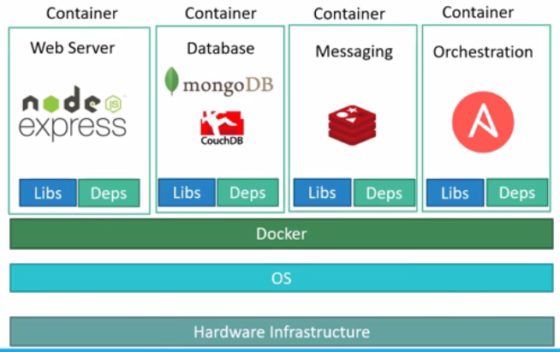
OS Virtualization

Slide 8
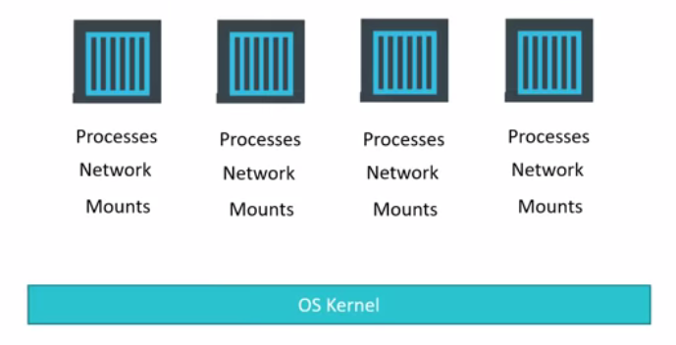
OS Virtualization

Slide 9
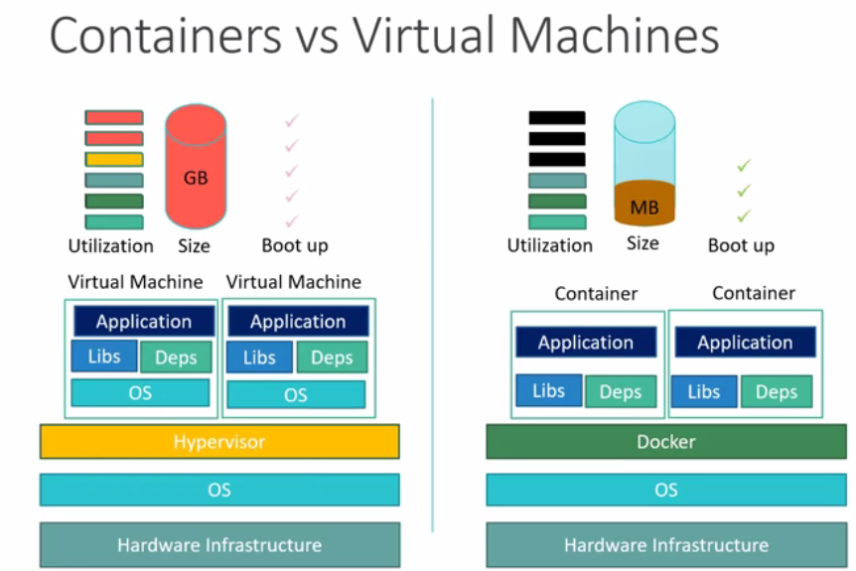
OS Virtualization

Slide 10
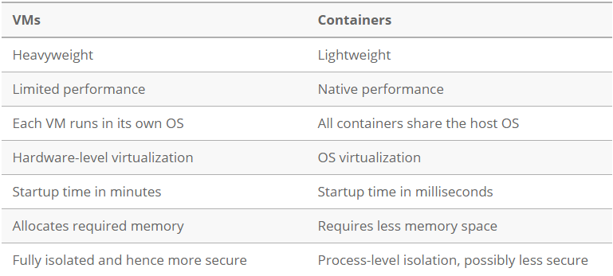
OS Virtualization

Slide 11
OS Virtualization
Benefits of Containers
Reduced IT management resources
Reduced size of snapshots
Quicker spinning up apps
Reduced & simplified security updates
Less code to transfer, migrate, upload workloads.
LXC, LXD, Docker, Windows Server Containers.

Slide 12
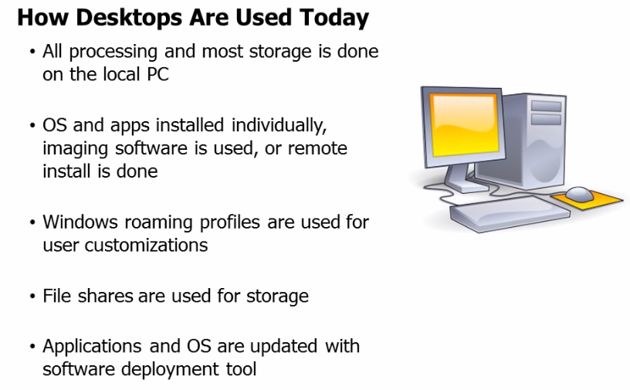
Desktop Virtualization

Slide 13
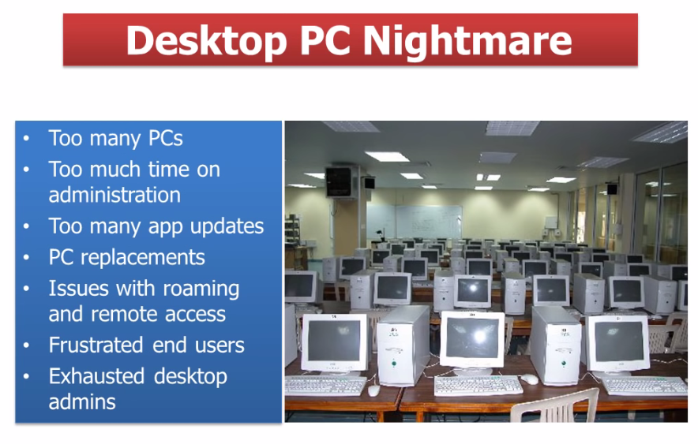
Desktop Virtualization

Slide 14
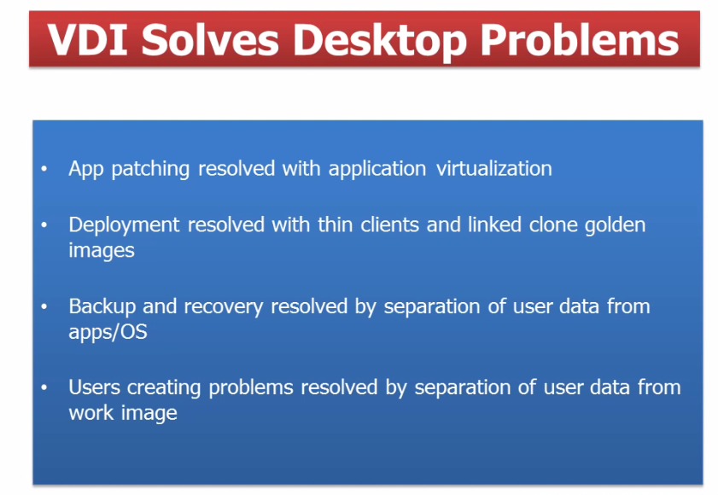
Desktop Virtualization

Slide 15
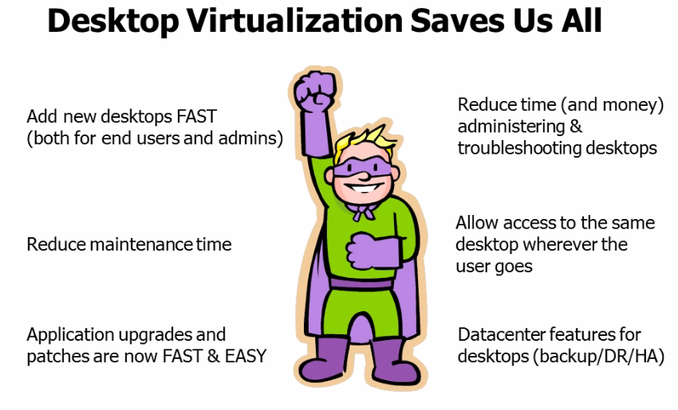
Desktop Virtualization

Slide 16
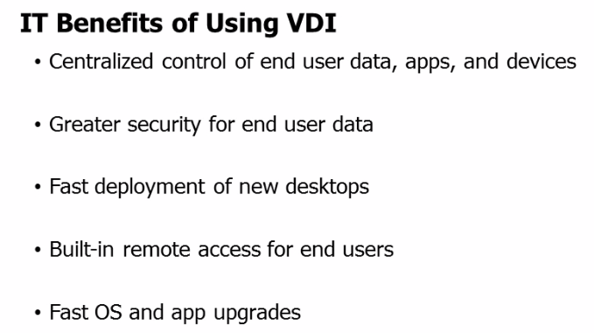
Desktop Virtualization

Slide 17
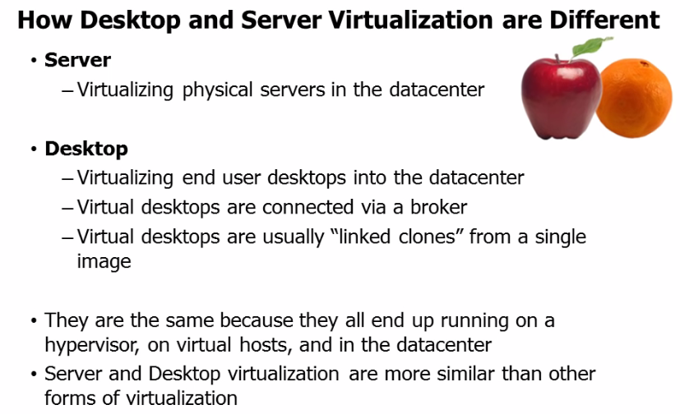
Desktop Virtualization

Slide 18
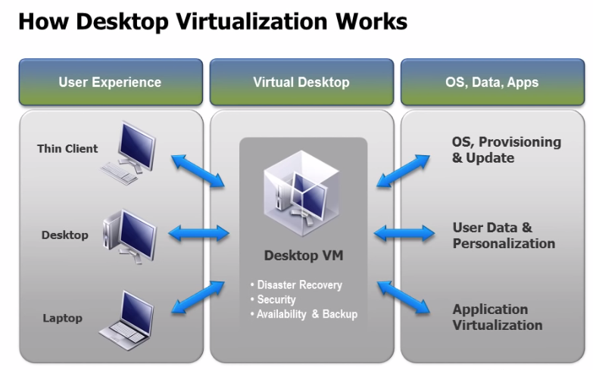
Desktop Virtualization

Slide 19
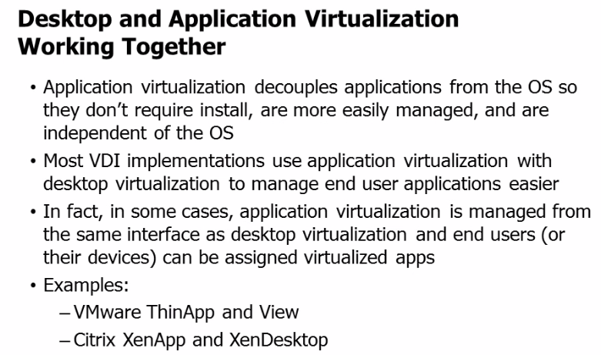
Desktop Virtualization

Slide 20
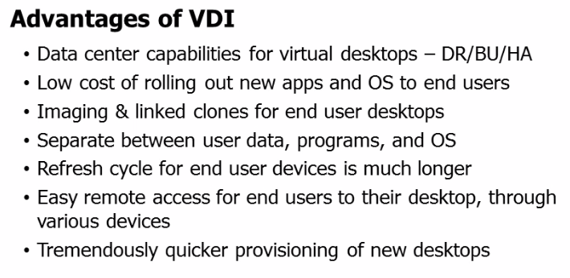
Desktop Virtualization

Slide 21
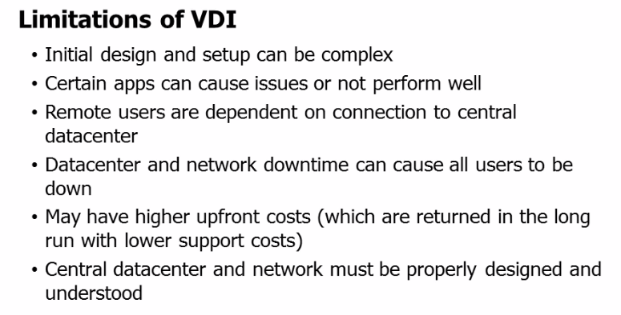
Desktop Virtualization

Slide 22
Application Virtualization
Encapsulates computer programs from the underlying operating system on which they are executed.
A fully virtualized application is not installed in the traditional sense.
The application behaves at runtime like it is directly interfacing with the original operating system and all the resources managed by it, but can be isolated or sandboxed to varying degrees.

Slide 23
Application Virtualization
The layer intercepts all disk operations of virtualized applications and transparently redirects them to a virtualized location, often a single file.
The application remains unaware that it accesses a virtual resource instead of a physical one.

Slide 24
Application Virtualization
Since the application is now working with one file instead of many files spread throughout the system, it becomes easy to run the application on a different computer and previously incompatible applications can be run side by side.
Cameyo, Ceedo, Citrix XenApp, Microsoft App-V, VMWare ThinApp.

Slide 25
Application Virtualization Benefits
Allows applications to run in environments that do not suit the native application.
Reduces system integration and administration costs by maintaining a common software baseline across multiple diverse computers in an organization.
Lesser integration protects the operating system and other applications from poorly written or buggy code.

Slide 26
Application Virtualization Benefits
It allows incompatible applications to run side by side.
Isolating applications from the operating system has security benefits as well, as the exposure of the application does automatically entail the exposure of the entire OS.
Application virtualization uses fewer resources than a separate virtual machine.

Slide 27
Application Virtualization Limitations
Not all computer programs can be virtualized. Some examples include applications that require a device driver .
Anti-virus programs and applications that require heavy OS integration, such as WindowBlinds or StyleXP are difficult to virtualize.

Slide 28
Application Virtualization Implementation
Application streaming: Pieces of the application's code, data, and settings are delivered when they're first needed, instead of the entire application being delivered before startup. Running the packaged application may require the installation of a lightweight client application. Packages are usually delivered over a protocol such as HTTP, CIFS

Slide 29
Application Virtualization Implementation
Remote Desktop Services (formerly called Terminal Services) is a server-based computing/presentation virtualization component of Microsoft Windows that allows a user to access applications and data hosted on a remote computer over a network. Remote Desktop Services sessions run in a single shared-server operating system (e.g. Windows Server 2008 R2 and later) and are accessed using the Remote Desktop Protocol.

Slide 30
Application Virtualization Implementation
Desktop virtualization software technologies improve portability, manageability and compatibility of a personal computer's desktop environment by separating part or all of the desktop environment and associated applications from the physical client device that is used to access it. A common implementation of this approach is to host multiple desktop operating system instances on a server hardware platform running a hypervisor. This is generally referred to as "virtual desktop infrastructure" (VDI).

