Slide 1
Data Visualization of Bird Strikes Between 2000 - 2011
Presentation by Kajal Raut

Slide 2
INTRODUCTION
Welcome to our detailed analysis report of bird strikes between 2000 to 2011. In this report, we will analyze the key highlights of the bird strikes data, unveiling the patterns of aviation safety and wildlife conservation and discuss sustainable measures to protect wildlife.

Slide 3
PROBLEM STATEMENT
Transport and communication are in the crucial domain in the field of analytics. Environmental impacts and safety are, nowadays, two major concerns of the scientific community with respect to transport scenarios and to the ever-growing urban areas. These issues gain more importance due to the increasing amount of vehicles and people. Seeking new solutions is reaching a point where available technologies and artificial intelligence, especially MAS, are being recognized as ways to cope with and tackle these kinds of problems in a distributed and more appropriate way.

Slide 4
OBJECTIVE
The main objective of the project is to provide detailed analysis on bird strikes happened between 2000-2011, to shed light on patterns of bird strikes and access their impact on aviation and wildlife safety.

Slide 5
PROJECT WORKFLOW
Data Collection and Data Cleaning
Exploratory Data Analysis with Python
Interactive Dashboard in Tableau
Insights and Conclusion

Slide 6
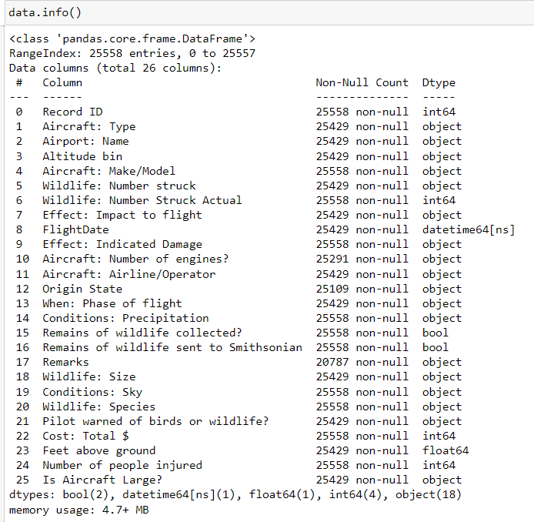
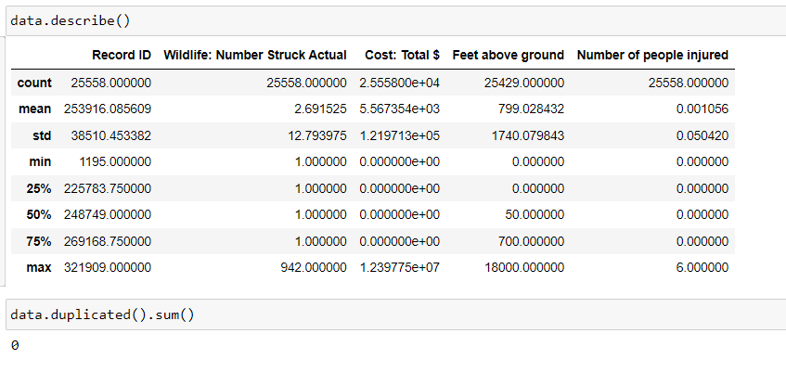
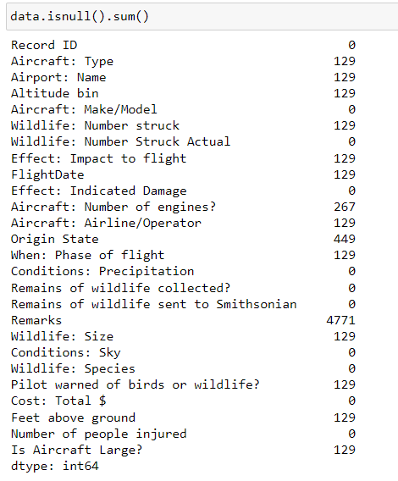

Data Collection and Data Cleaning Steps:
The data for bird strikes analysis is collected in excel format. Imported necessary libraries in jupyter notebook. Loaded the excel file to the system.
The dataset contains 26 columns and 25558 rows in total. Checked the duplicated and null values for all the columns of the dataset.

Slide 7
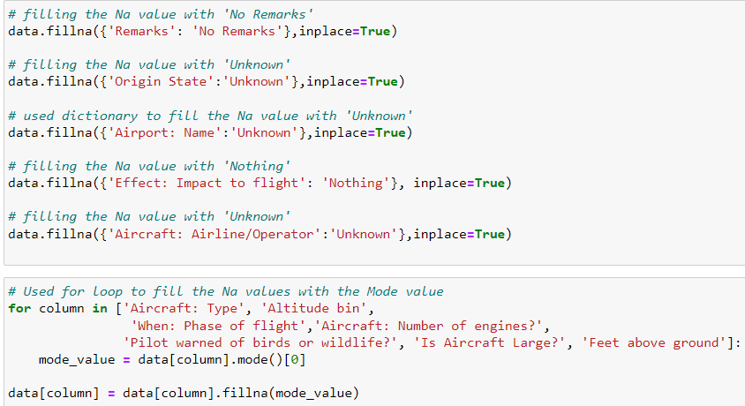
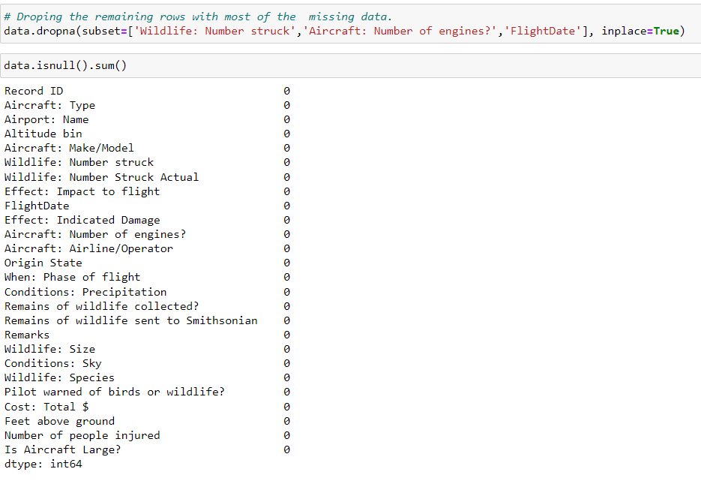
Replacing/Dropping the null/NA values. Adjusted the dtypes of the date and time columns. Dropped the unnecessary columns from the data.

Slide 8
Exploratory Data Analysis in Python:
After performing cleaning steps, we visualized the plots using seaborn and matplotlib libraries with python. Steps performed in EDA task are:
Yearly Analysis of Bird Strikes in US
Top 10 US Airlines by Bird Strikes
Top 10 Airports by Bird Strikes
Yearly Cost Incurred due to Bird Strikes
Bird Strikes by Conditions: Precipitations
Effect of Bird Strikes & Impact on Flight
Effect of Strikes at Different Altitude
Prior Warning and Effect of Strike Relation

Slide 9
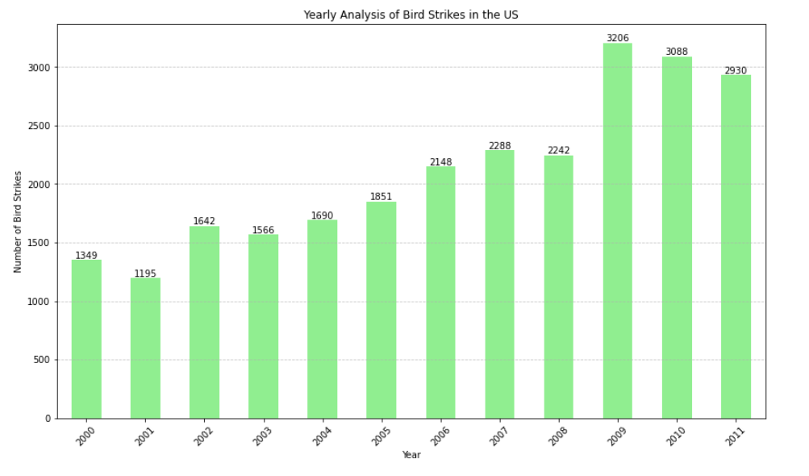
Yearly Analysis of Bird Strikes in US:
From the given graph, Yearly analysis of bird strikes has been shown from which year '2009' showing the highest count of Bird strikes i.e., '3206' following with the year '2010' & '2011'.

Slide 10
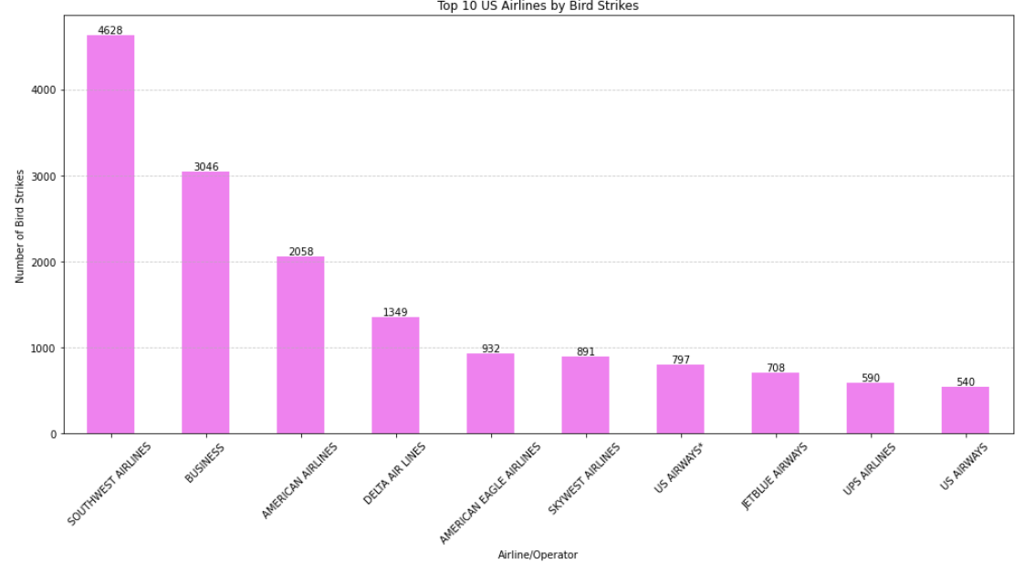
Top 10 US Airlines by Bird Strikes:
From the given graph, the maximum number of bird strikes happened by Southwest Airlines with ‘4628’ followed by Business & American Airlines.

Slide 11
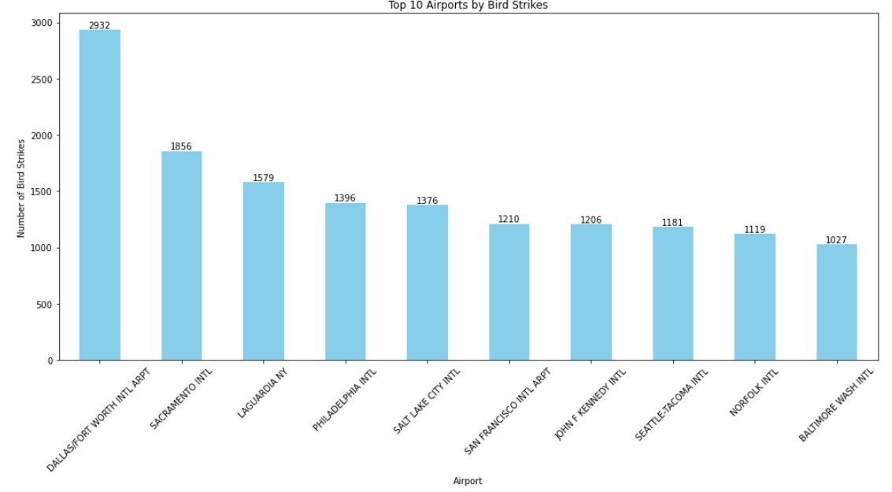
Top 10 Airports by Bird Strikes:
From the above graph, the highest number of bird strucks happens at 'DALLAS/FORT WORTH INTL ARPT' with a count of '2932' following with other Airports with their bird struck count.

Slide 12
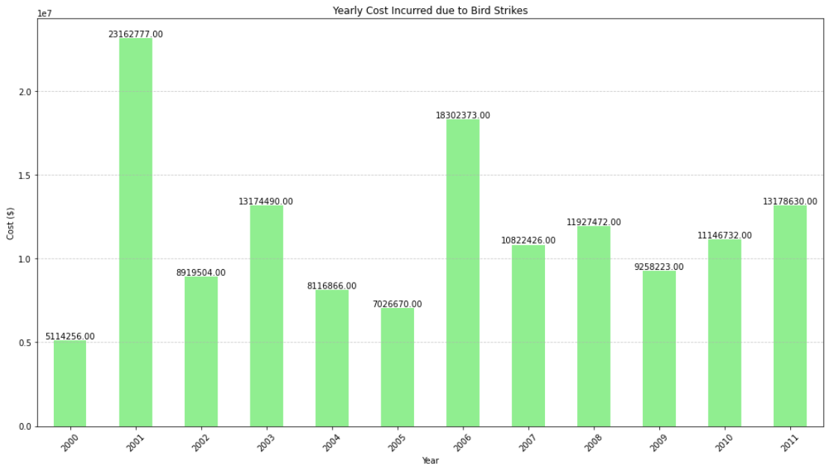
Yearly Cost Incurred due to Bird Strikes:
From the above graph, the maximum cost incurred in the year '2001' following with year '2006' i.e., "23162777.00" & "18302373.00" respectively.

Slide 13
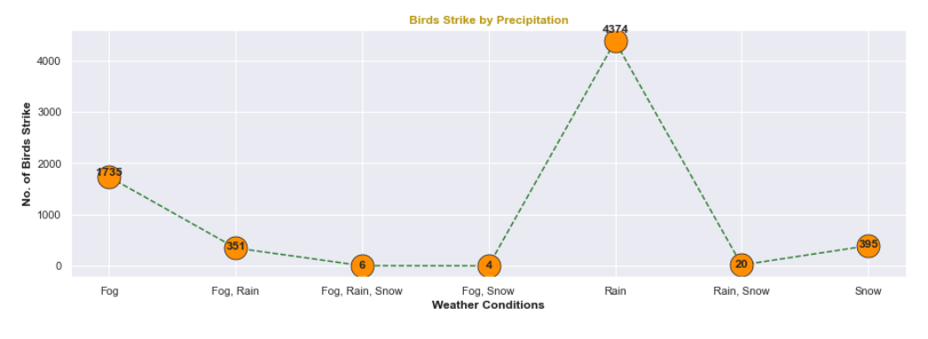
Bird Strikes by Conditions: Precipitations:
The graph shows the total no. of birds struck by different weather conditions, the highest no. of birds struck was when the weather condition was "Rain" with the total of "4374" and lowest when "Fog, Snow" with the total of "4".

Slide 14
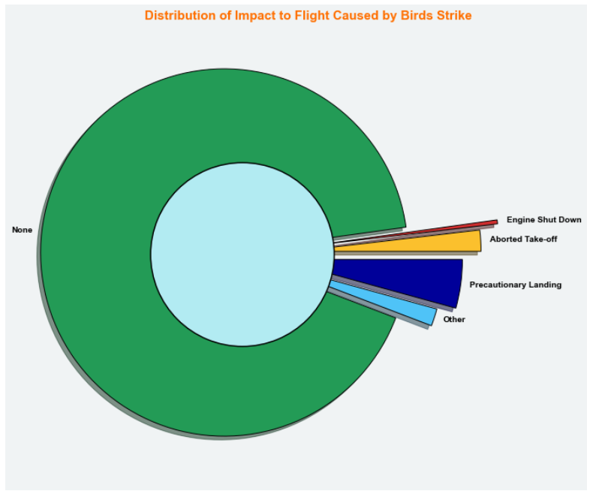
Effect of Bird Strikes & Impact on Flight:
The Pie chart plots that the impact to the Aircraft was vey less or "Nothing" where as there was few portions shown in the pie chart the impact was caused like "Engine Shut Down, Precautionary Landing & Others”

Slide 15
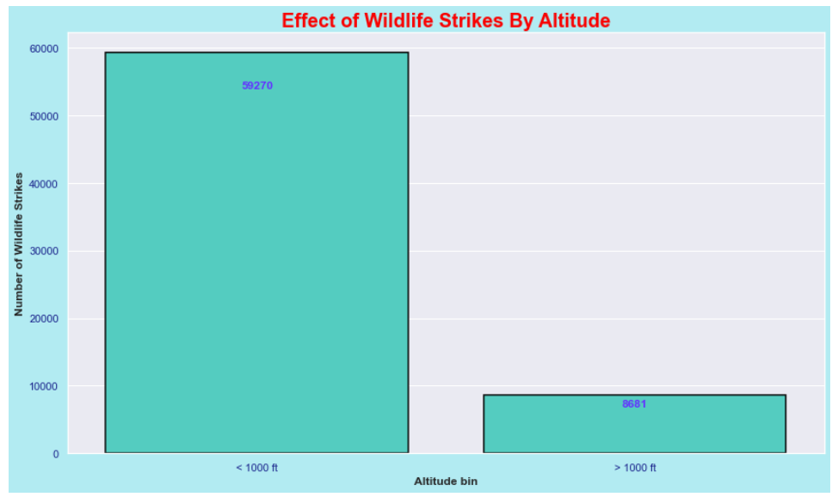
Effect of Wildlife Strikes at Different Altitude:
From the above graph, The barplot shows the frequency of the Bird strucks on different altitude as the highest count is shown by the altitude less then 1000ft with a count of "59270" on the Range of one decade.

Slide 16
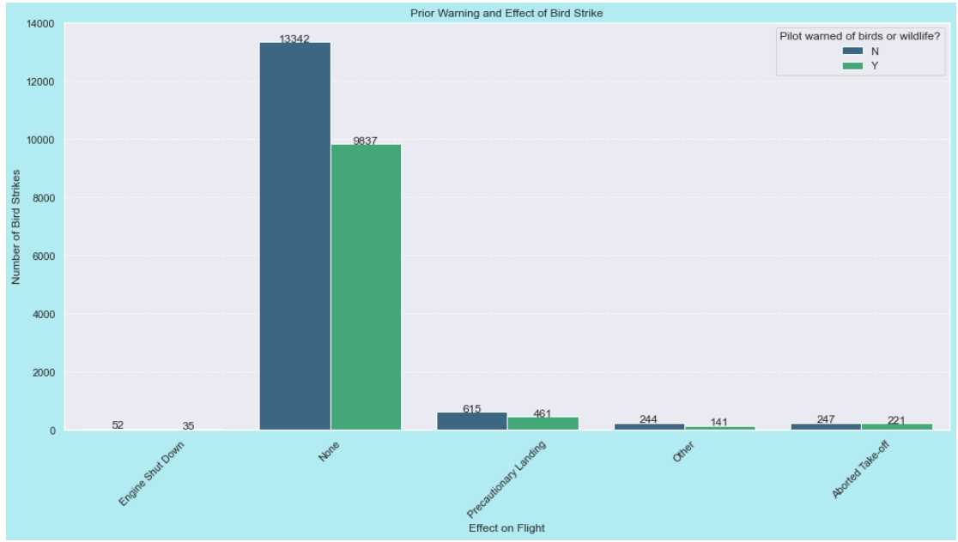
Prior Warning and Effect of Strike Relation:
The maximum times pilot warned of birds or wildlife comes from the " No" category with "None" Effect on flight with the count of '13342' & '9837' from "Yes" category. The least number of wildlife strucks comes under "Engine shut down" with the count of "52" & "35" from "No" & "Yes" categories respectively.

Slide 17



MY TABLEAU DASHBOARDS

Slide 18
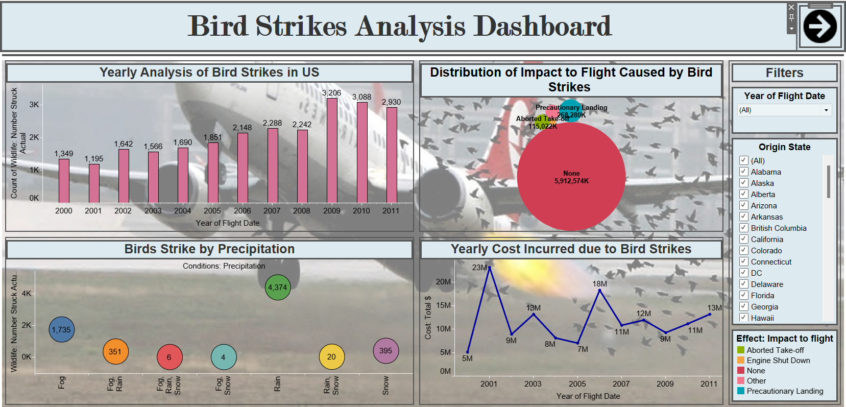

Slide 19
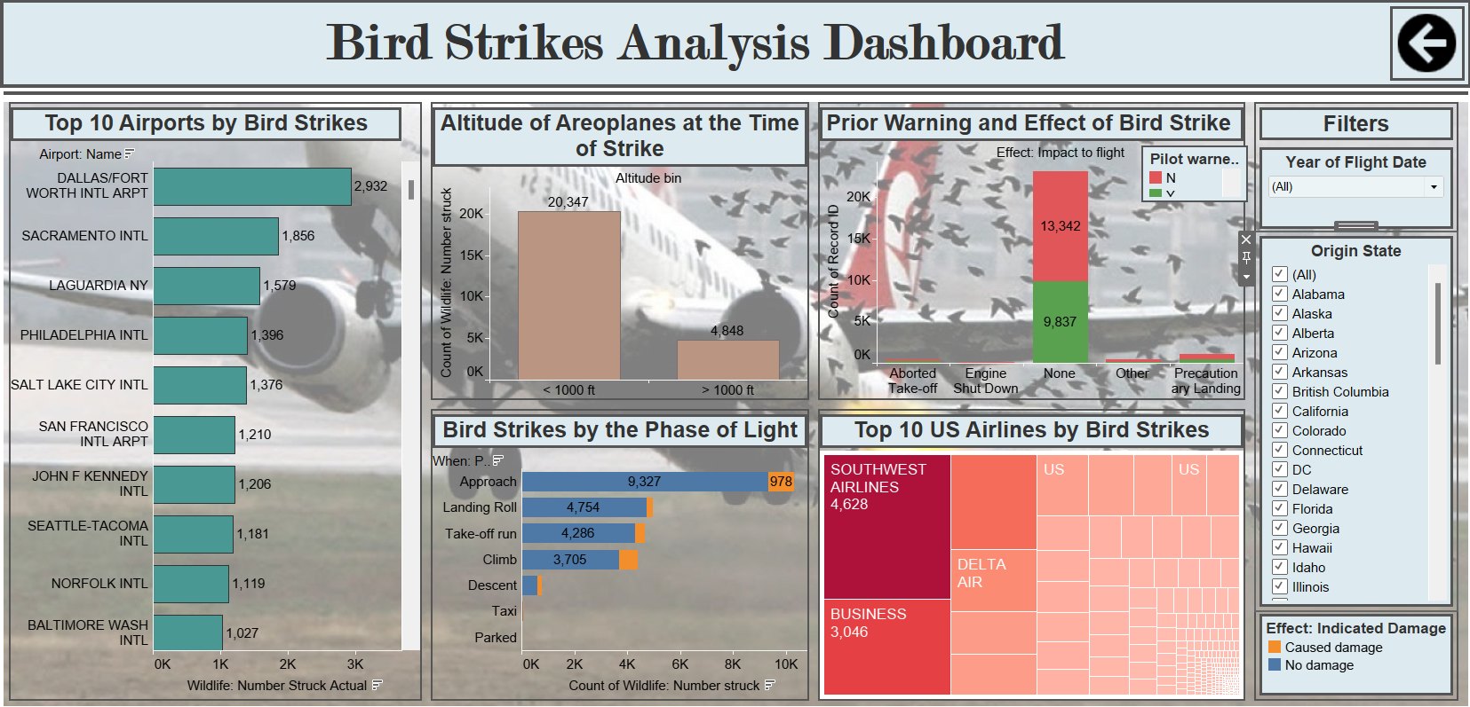

Slide 20
INSIGHTS
The highest no. of Birds strucks on the Airports was DALLAS/FORT WORTH INTL ARPT with an count of "2932", as the bar plot show the other Airports with there birds struck's count.
Southwest Airlines has encountered most number of bird strikes followed by Business and American Airlines.
The frequency of bird struck’s on different altitude as the highest count is shown by the altitude <1000 ft with the count of ‘59270’ as compared to when altitude was >1000 ft with the count of ‘8681’.
Most of the Damage caused during Climb and Approach phase.
The impact to the Aircraft was vey less or "Nothing" where as there was few portions shown in the pie chart the impact was caused like "Engine Shut Down, Precautionary Landing & Others”
The total no. of birds struck by different weather conditions, the highest no. of birds struck was when the weather condition was "Rain" with the total of "4374" and lowest when "Fog, Snow" with the total of "4".

Slide 21
CONCLUSION
The analysis of bird strike data highlights a critical balance between safety and wildlife conservation. As strikes pose risks to both aircraft and birds, it is imperative to prioritize sustainable practices to protect avian species. Without intervention, we risk not only endangering these species but potentially leading them to extinction. Proactive measures must be taken to safeguard their populations for the ecological balance and the well-being of our shared environment.

