Slide 1
EDA of Mushroom Dataset

Slide 2
Meet the Team
Yash Dhoble
Kajal Raut
Sambodhi Gaikwad
Tiyaasha Meshram
Vaishnavi Chavan

Slide 3
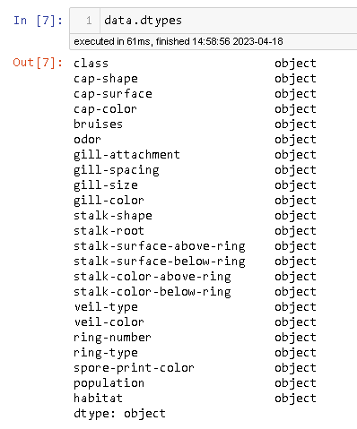
Introduction to the Mushroom Dataset
The mushroom dataset is a collection of information about various types of mushrooms and whether they are poisonous or edible.
The dataset consists of 8124 observations and 23 variables, including the target variable "class", which indicates whether the mushroom is edible or poisonous.
Data is purely categorical.

Slide 4
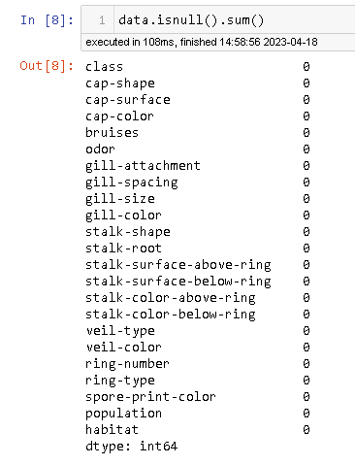
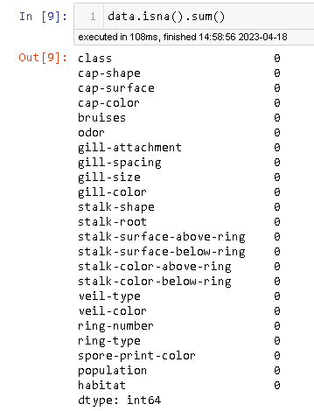
Data Cleaning
First we checked for Null and Nan Values.
Before we could analyze the dataset, we needed to clean it by handling missing values.

Slide 5
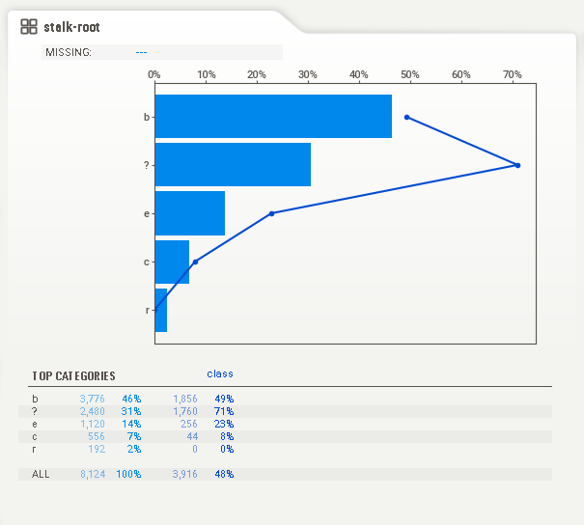
Missing values
Stock root variable has 2480 unknown values..
Applying imputation for this column would not be correct as the unknown values account for 31% of the data.
We will treat this as a different category called unknown.

Slide 6
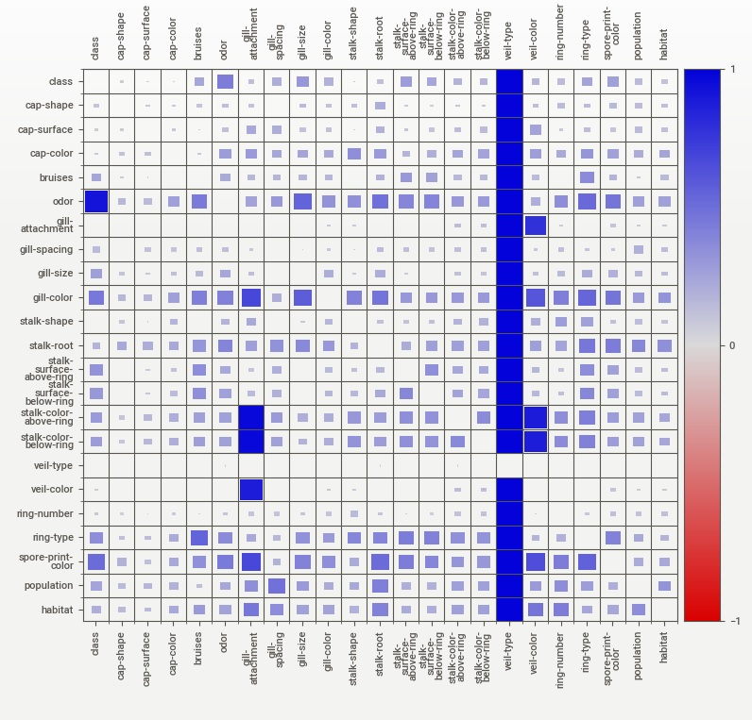
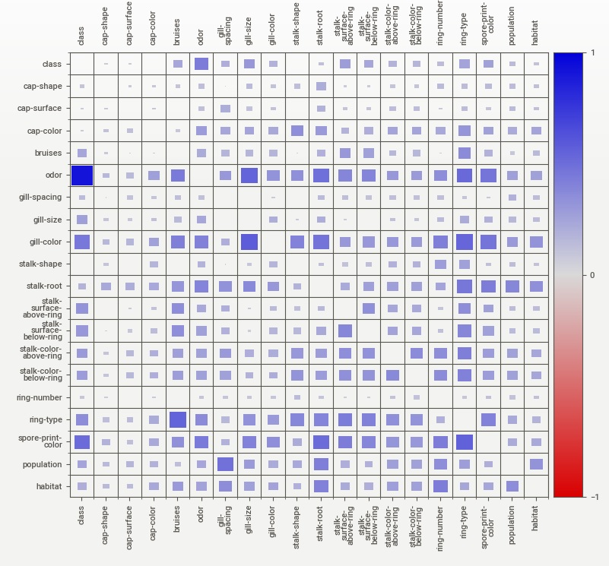
Correlation between variables
As veil-type, veil-color, gill-attachments have a very low correlation, we drop these from the data

Slide 7
EDA
EDA is primarily used to see what data can reveal beyond the formal modeling or hypothesis testing task and provides a provides a better understanding of data set variables and the relationships between them. It can also help determine if the statistical techniques you are considering for data analysis are appropriate.

Slide 8
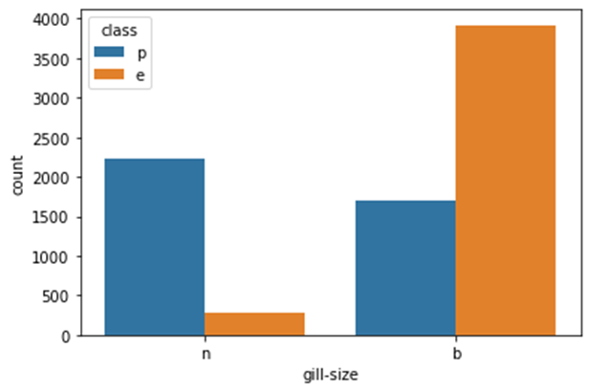
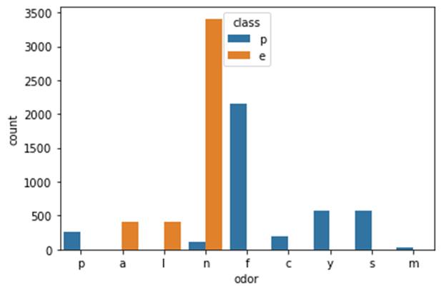
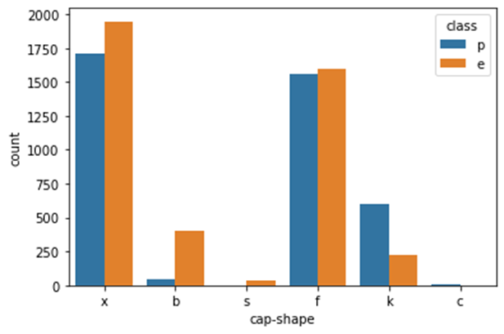
EDA and Insights
Edible mushrooms mostly have a broad gill size and do not have conical caps.
Edible mushrooms do not have any kind of bad like foul, fishy, pungent odor.

Slide 9
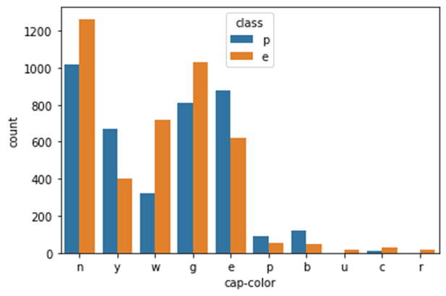
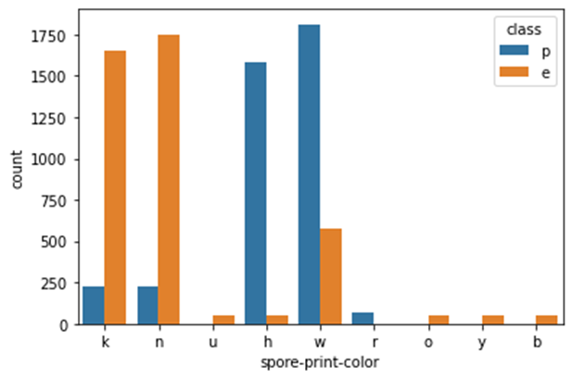
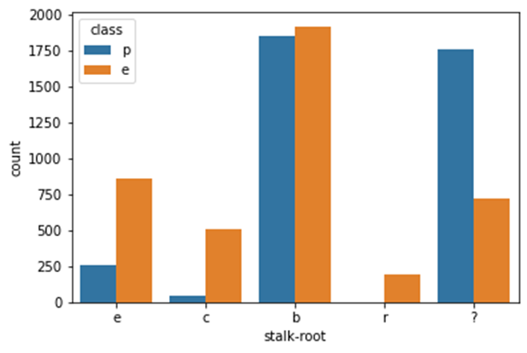
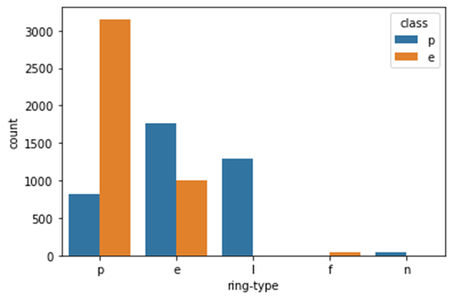
Every red and orange colored cap of a mushroom is edible
The stalk roots of edible mushrooms don't look like rhizomorphs.
All flaring ring types are edible and large and none ring types are definitely poisonous.
Mushrooms with the spore print buff, yellow, orange, and purple are always edible in nature. While green is for poisonous.

Slide 10
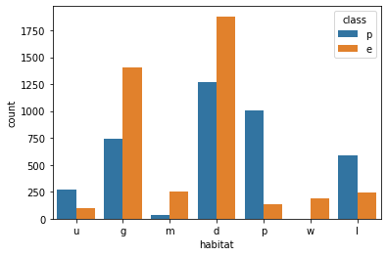
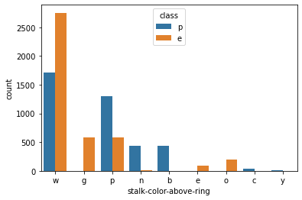
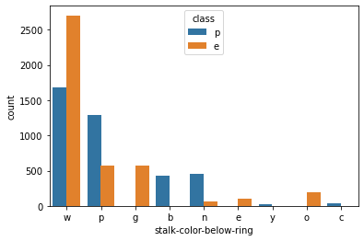
Edible mushrooms can grow in all population types where as poisonous cannot grow in waste
If the stalk color above or below the ring is red, orange or grey it is definitely an edible mushroom. With stalk color cinnamon, yellow, buff it has to a poisonous mushroom.

Slide 11
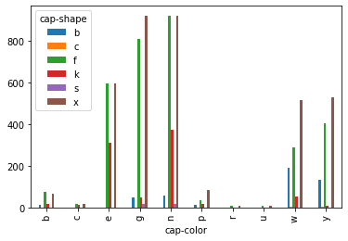
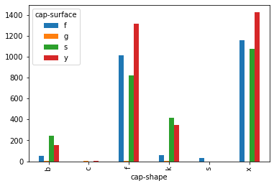
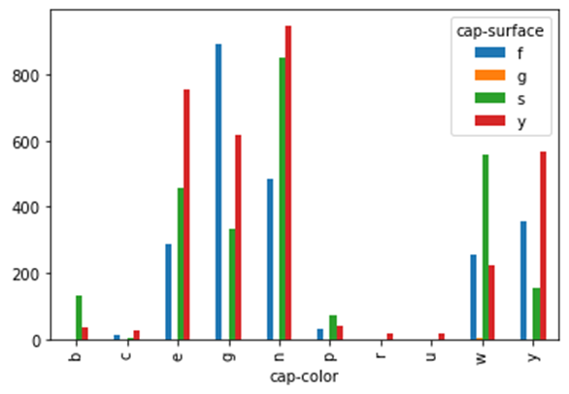
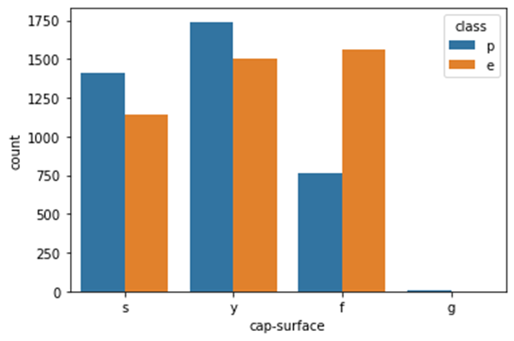
If the cap shape is sunken then its surface is always fibrous.
The mushrooms with conical-shaped caps with surface of cap as grooves are poisonous in nature.
Conical cap-shaped mushrooms are only white and yellow, and Mushrooms whose cap surface is groove are only white in color.

Slide 12
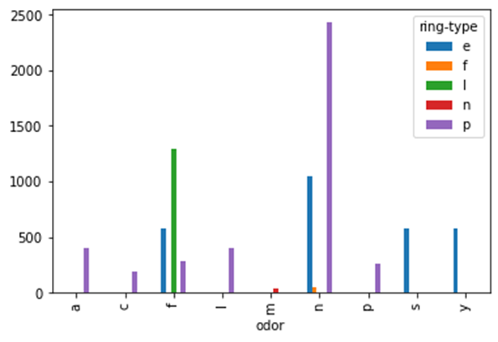
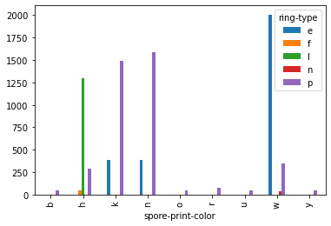
The large ring type has only a foul odor and the Flaring ring type does not have an odor.
Mushrooms which having large rings have a spore print color of chocolate. When there are no rings then the spore print color is white

Slide 13

If the mushroom has a spicy and fishy odor then it will have an evanescent ring type. Whereas, almond, creosote, anise, and pungent odor have a pendant ring type.
Poisonous mushrooms aren't rooted.

Slide 14
Feature Engineering
Feature engineering is the pre-processing step of machine learning, which is used to transform raw data into features that can be used for creating a predictive model using Machine learning or statistical Modelling. Feature engineering in machine learning aims to improve the performance of models.
Feature Engineering
Splitting the data into target and independent variables
Using Dummies on independent Variable and label encoder on target variable
Train test split of the data set

Slide 15
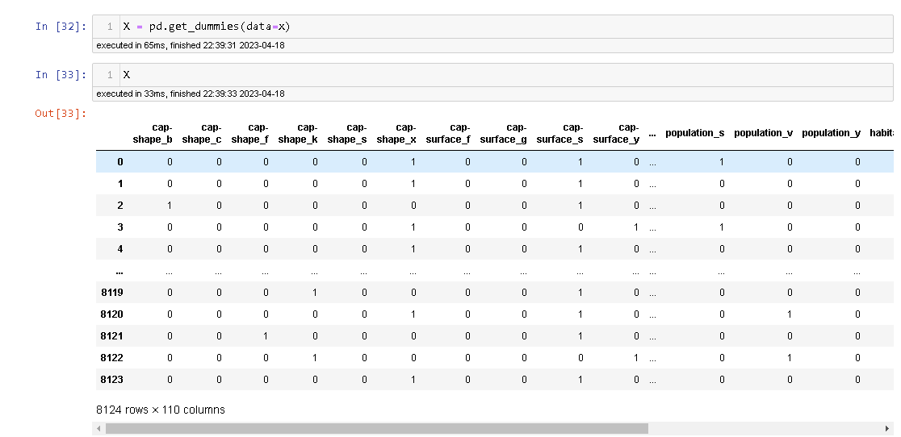
Dummies
The get_dummies function is used to convert categorical variables into dummy or indicator variables. A dummy or indicator variable can have a value of 0 or 1.

Slide 16
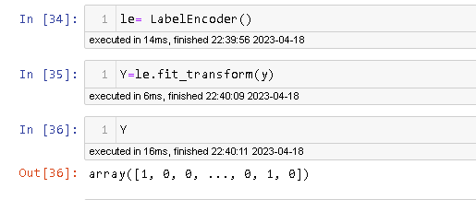
Label Encoder
Label Encoding is a technique that is used to convert categorical columns into numerical ones so that they can be fitted by machine learning models which only take numerical data.
Most Machine Learning algorithms require numerical features. However, the dataset is composed of categorical features. We now must proceed to convert these to numerical data types.
We are using label encoder for target variable (class)

Slide 17
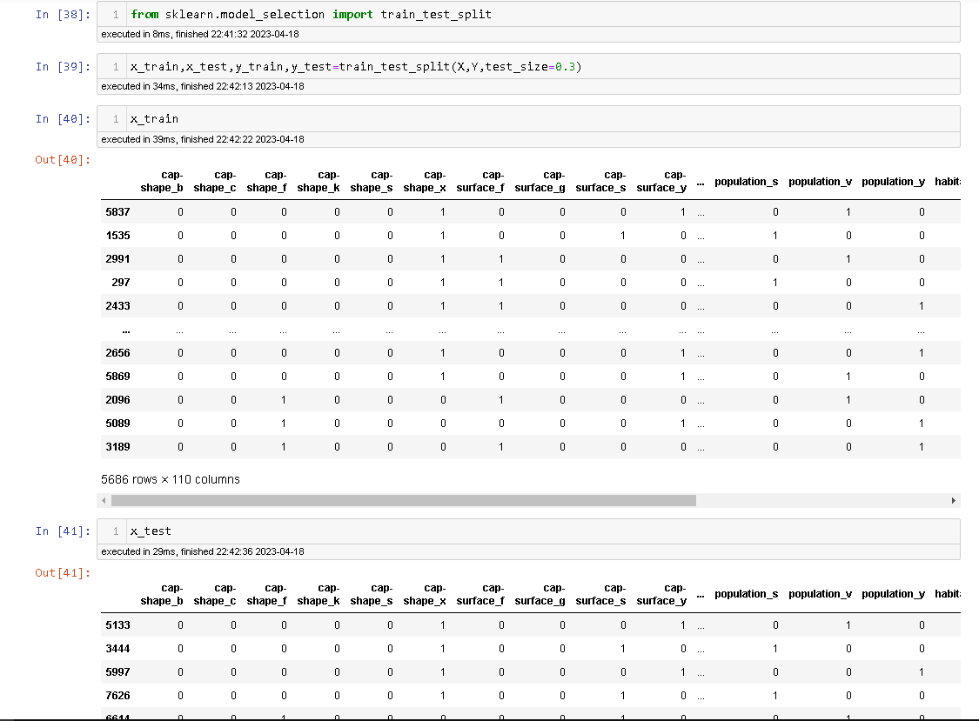
Train test Split
Train test split A train test split is when you split your data into a training set and a testing set. The training set is used for training the model, and the testing set is used to test your model. We use 70% for training and 30% for testing. This ensures that both sets are representative of the entire dataset.
Train dataset: used to fit the machine learning model
Test Dataset: is used to evaluate the fit machine learning model .
The objective is to estimate the performance of the machine learning model on new data: data not used to train the model.

