Slide 1
Sales Dashboard Design
Data Analyst Internship
Task 4 - Designed using Power BI
Presented By Kajal Singh

Slide 2
Objective
To design an interactive sales dashboard that provides key insights for business stakeholders.
The dashboard tracks performance across Sales, Profit, and Growth KPIs.

Slide 3
Dataset Overview
Dataset: sales_clean.csv (Sales-Financial Data)
Key Columns: Date, Region, Category, Product, Sales, Profit, Quantity, Discount, Segment
Used for: KPI calculations and visual insights.

Slide 4
Key Performance Indicators (KPIs)
1. Total Sales – Overall revenue generated.
2. Total Profit – Net earnings from all transactions.
3. Profit Margin (%) – Profit divided by Sales × 100.
4. Sales Growth (%) – Month-over-month or year-over-year increase.
5. Top Products/Regions – Highest performing areas.

Slide 5
Dashboard Design Features
KPI Cards: Display Total Sales, Profit, and Growth.
Charts: Line chart for time-series trends, bar charts for category comparisons.
Filters/Slicers: Region, Date, Product Category, Segment.
Navigation: Buttons for Sales, Profit, and Region views.
Consistent Theme: 2–3 color palette, uniform fonts (Segoe UI).

Slide 6
Insights from Dashboard
• Region A shows the highest total sales.
• Product Category X yields the best profit margins.
• Sales increased by 20% in Q3 compared to Q2.
• Some regions show low-profit despite high sales – optimization needed.

Slide 7
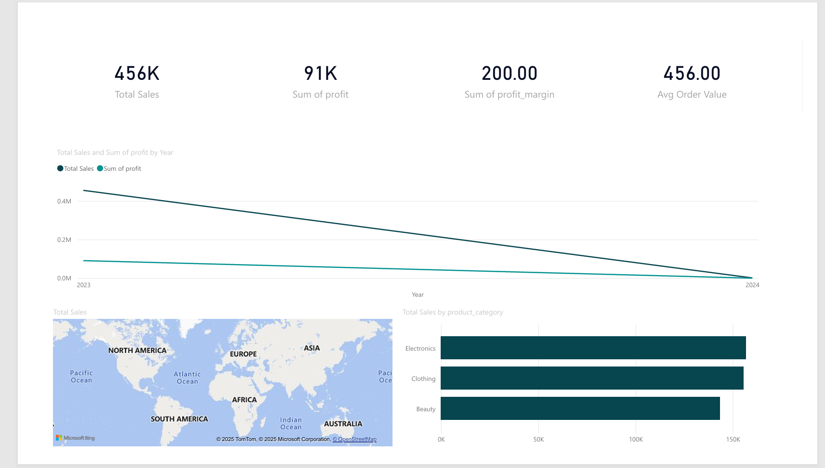
Dashboard Snapshot
This dashboard highlights key business insights:
• KPI Cards for Sales, Profit, Margin, and Order Value
• Line chart showing Sales and Profit trends (2023–2024)
• Map displaying Sales distribution by region
• Bar chart for Sales by Product Category

Slide 8
Conclusion
The dashboard enables management to:
• Monitor key performance metrics in real-time.
• Identify growth opportunities and weak regions.
• Make data-driven business decisions efficiently.

