Slide 1

BRAIN2SPEECH: A Deep Learning Homework
Team: Me, Myself and (A)I – Katica Bozsó –

Slide 2
Introduction, goal, motivation
Speech synthesis from brain activity is an intriguing field ⇒ help people with disabilities
Turn neural features (using iEEG¹ data) to speech
Pave the path to Brain-Computer interfaces (BCIs)
1 intracranial Electroencephalography

Slide 3
Previous solutions
Dataset of Speech Production in intracranial Electroencephalography [1] ⇒ repository: https://github.com/neuralinterfacinglab/SingleWordProductionDutch (more info on slide 4)
Scripts to work with the intracranial EEG data
Simple linear regression model
1 Verwoert, M., Ottenhoff, M.C., Goulis, S. et al. Dataset of Speech Production in intracranial Electroencephalography. Sci Data 9, 434 (2022).https://doi.org/10.1038/s41597-022-01542-9

Slide 4
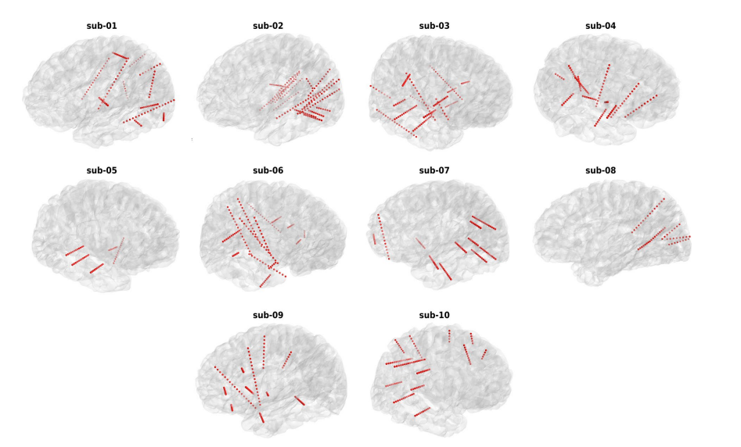
Dataset
‘SingleWordProductionDutch’:
10 participants reading out individual words in Dutch
intracranial EEG measured from a total of 1103 electrodes
from each participant's iEEG measurement:
electrode details
features
audio file of words read
wordlist
spectrogram
features: multi-step feature extraction process provided by authors - filters, windowing, normalization
spectrogram: compression into a log-mel spectrogram ⇒ correspondence between audio and neural feature vectors, but the log-mel spectrogram loses the phase information

Slide 5
System design, architecture design
Use: corresponding neural feature - spectrogram pairs
Input: neural feature, Output: predicted spectrogram (⇒ spect2voice)
Loss: MSE between original and predicted spectrograms
Simple CNN - 1D convolutional, linear, pooling and activation layers.
Technologies: Pytorch Lightning framework, Tensorboard logging, Dockerization

Slide 6
Training and evaluation
PyTorch Lightning implementation
50 epochs with EarlyStopping
optimizer: Adam, lr: 0.001
MSE was measured - train,val,test set

Slide 7
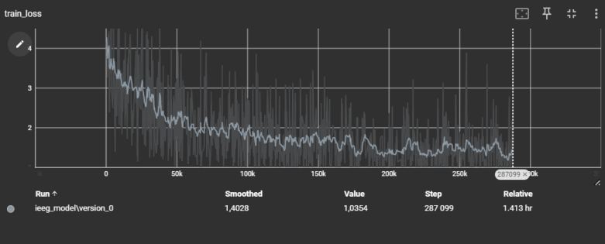
DEMO
MSE values indicated that the model was learning
However, spectrogram2voice component was not working correctly, only noise :(
Tested the authors ‘reconstruction_minimal.py’ script, but same result, just noise

Slide 8
Results
Data downloading, feature extraction was reproduced
CNN Model was implemented, losses indicated successful learning
spectrogram2voice component was the point of failure, needs further refinement

Slide 9
Summary
- Brain2Speech terminology, existing data sources and code bases were overviewed
- A compact, modular Pytorch Lightning based repository was prepared - aids efficient future development on this domain
- Spectrogram prediction from neural features was achieved, but voice reconstruction failed
Next steps:
- MultiTask model could be an interesting approach
- spectrogram2voice component needs to be fixed

Slide 10
Thank you for your attention!

