Slide 1
Ch. 12
Tables and Priority Queues
Static data sets
  Data do not change once constructed
Dynamic data sets
  Data sets can grow or shrink
  Dictionary (table)
    A dynamic data set that supports
    insertion, deletion, and membership test
  Priority queue
    A dynamic data sets that supports
    insertion, deletion, and retrieval of max element

Slide 2
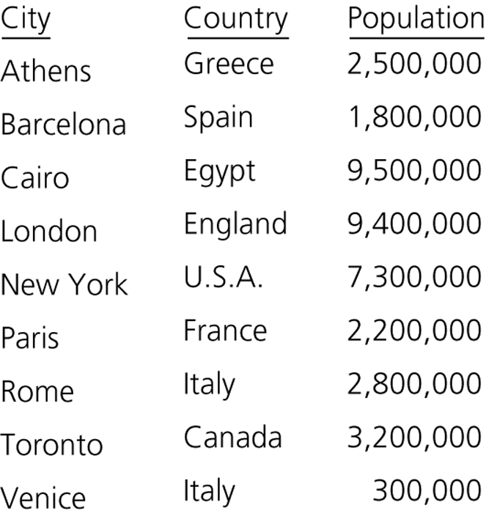
Figure 1.
An ordinary table of cities

Slide 3
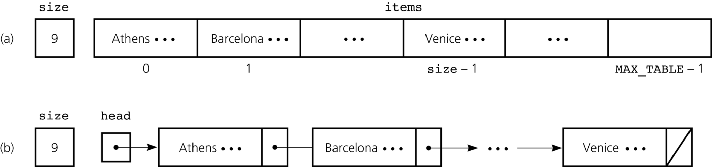
Figure 2.
The data fields for two sorted linear implementations of the ADT table for the data in Figure 1: a) array based; b) reference based

Slide 4
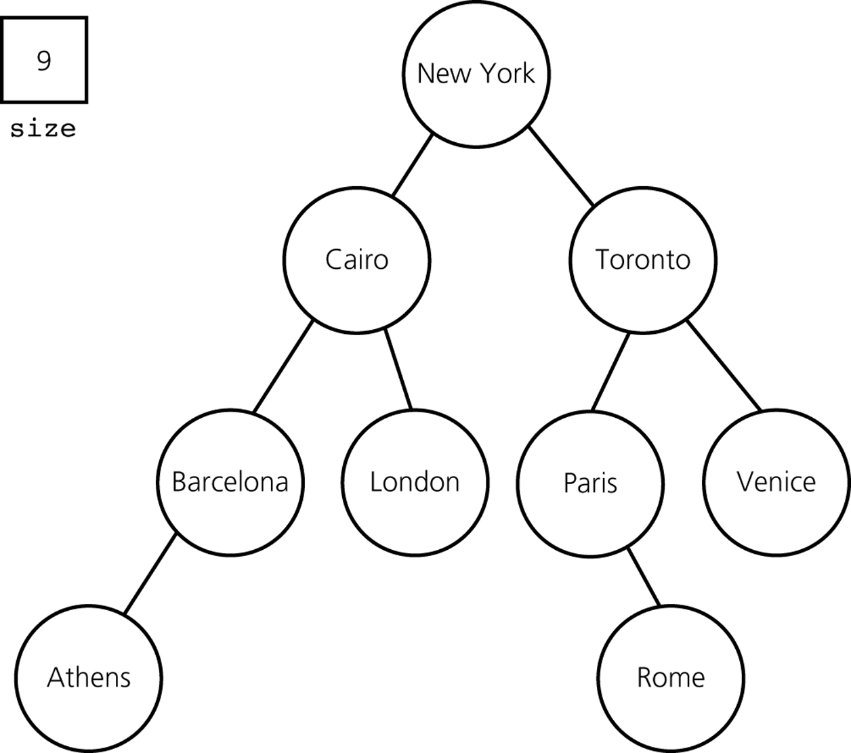
Figure 3.
The data fields for a binary search tree implementation of the ADT table for the data in Figure 1

Slide 5
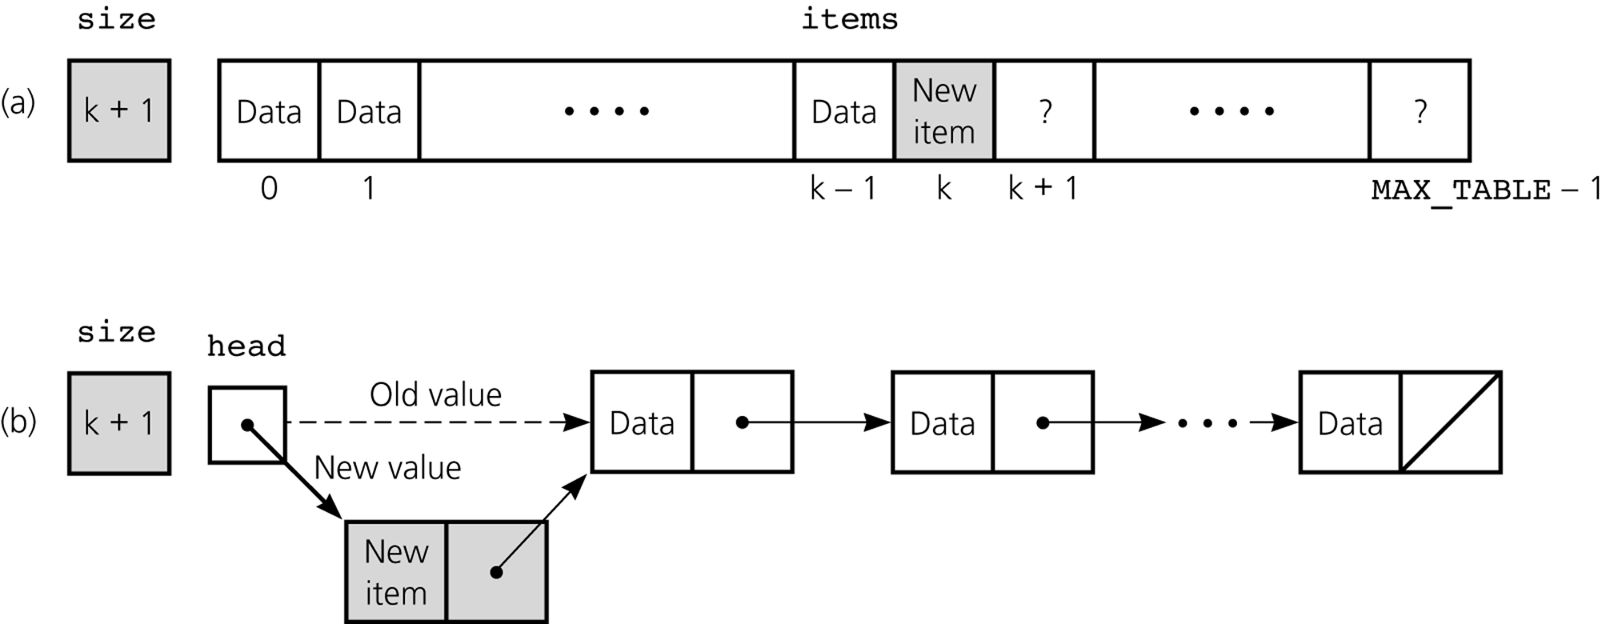
Figure 4
Insertion for unsorted linear implementations:
a) array based; b) reference based

Slide 6
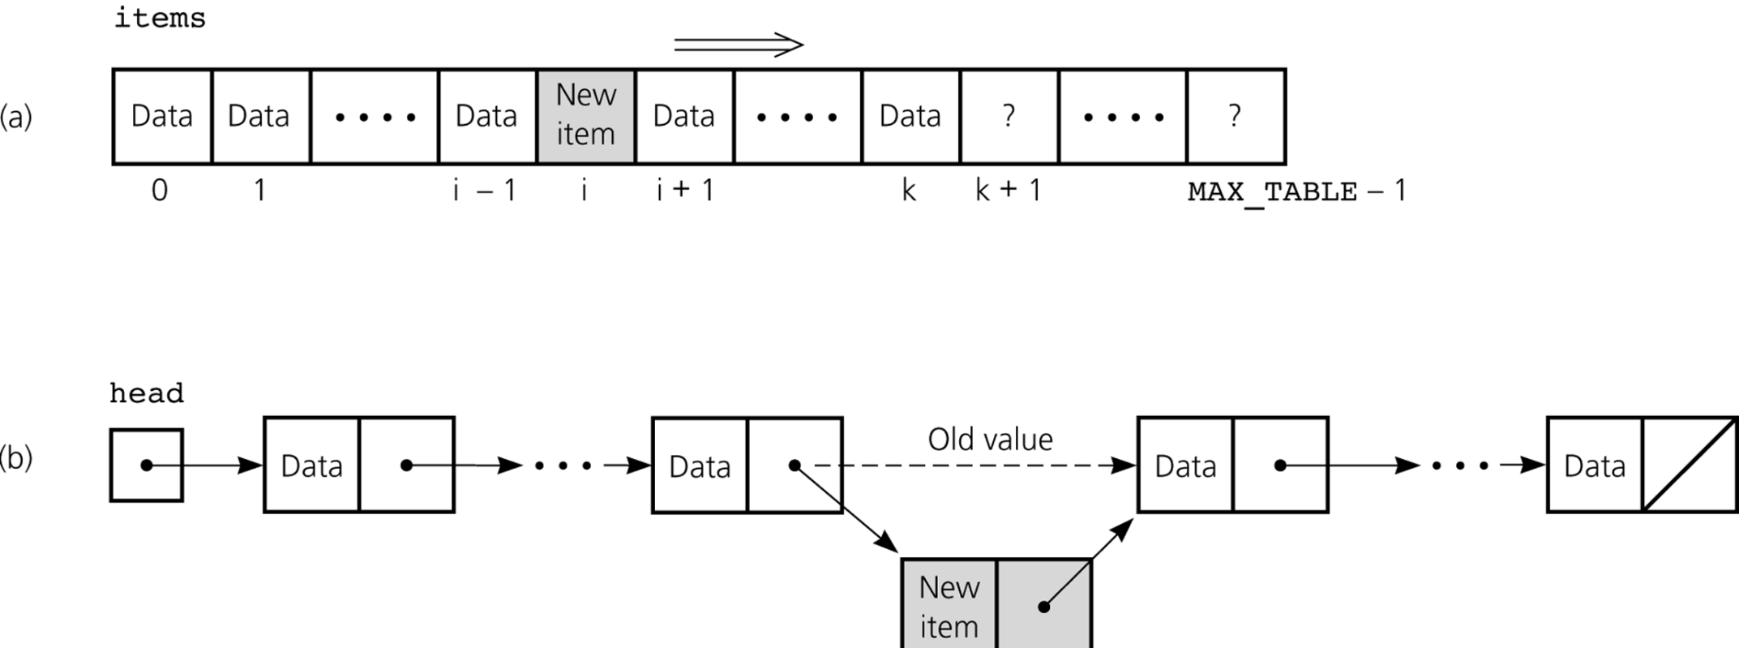
Figure 5
Insertion for sorted linear implementations: a) array based; b) reference based

Slide 7
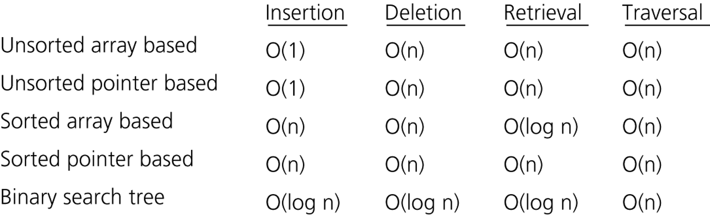
Figure 6
The average-case order of the operations of the ADT table for various implementations

Slide 8
ADT Table Operations
Create an empty table
Determine whether the table is empty
Determine the number of items in the table
Add a new item to the table
Remove the item w/ a given search key from the table
Retrieve the item w/ a given search key from the table
Traverse the items in the table in sorted search-key order

Slide 9
Sorted Array-Based Implementation
public class TableArrayBased {
final int MAX_TABLE = 100;
protected Comparable[ ] items;
private int size;
public TableArrayBased( ) {
items = new Comparable[MAX_TABLE];
size = 0;
}

Slide 10
public boolean tableIsEmpty {
return size == 0;
}
public int tableLength( ) {
return size;
}
public void tableInsert(Comparable newItem) {
if (size < MAX_TABLE) {
int spot = position(newItem);
if ((spot < size) && items[spot].compareTo(newItem) == 0) {
exception 처리 for “duplicated items”;
} else {
for (int i = size-1; i >= spot; --i) { // shift right
items[i+1] = items[i];
}
items[spot] = newItem; // insert
++size;
} else {
exception 처리 for “table full”;
}
}

Slide 11
public boolean tableDelete(Comparable searchKey) {
int spot = position(searchKey);
boolean success = (spot < size) &&
(items[spot].compareTo(searchKey) == 0);
if (success) {
size--;
for (int i = spot; i < size; ++i) { // shift left
items[i] = items[i+1];
}
}
}
public Comparable tableRetrieve(Comparable searchKey) {
…
}
protected int position(Comparable searchKey) {
int pos = 0;
while ((pos < size) && (searchKey.compareTo(items[pos]) > 0) {
pos++;
}
return pos;
}
} // end TableArrayBased

Slide 12
Binary Search Tree-Based Implementation
public class TableBTBased {
private int size;
public TableBTBased( ) {
bst = new BinarySearchTree( );
size = 0;
}

Slide 13
public boolean tableIsEmpty {
return size == 0;
}
public int tableLength( ) {
return size;
}
public void tableInsert(Comparable newItem) {
if (bst.retrieve(newItem) == null) {
bst.insert(newItem);
size++;
} else {
exception 처리 for “duplicated items”;
}
}
public Comparable tableRetrieve(Comparable searchKey) {
return bst.retrieve(searchKey);
}
public boolean tableDelete(Comparable searchKey) {
if (bst.deleteItem(searchKey) is successful) {
size--;
return true;
} else { return false; }
}
} // TableBTBased

Slide 14
ADT Priority Queue Operations
Create an empty priority queue
Determine whether the priority queue is empty
Add a new item to the priority queue
Retrieve and then remove the item w/ the highest priority value

Slide 15
비교
Deletion
  Table은 search key 제공
  Priority queue는 search key 사용 안함
    Priority가 가장 높은 item만 delete 가능함
Insertion
  Table과 priority queue 둘 다 key 사용함
Key 값 중복
  Table은 불허
  Priority queue는 허용

Slide 16
Heap :
A Representative Priority Queue
A heap is a complete binary tree
  that is empty
  or
  the key of each node is greater than or equal to the keys of both children (if any)
The root has the largest key
Maxheap : minheap
  The root has max key : min key

Slide 17
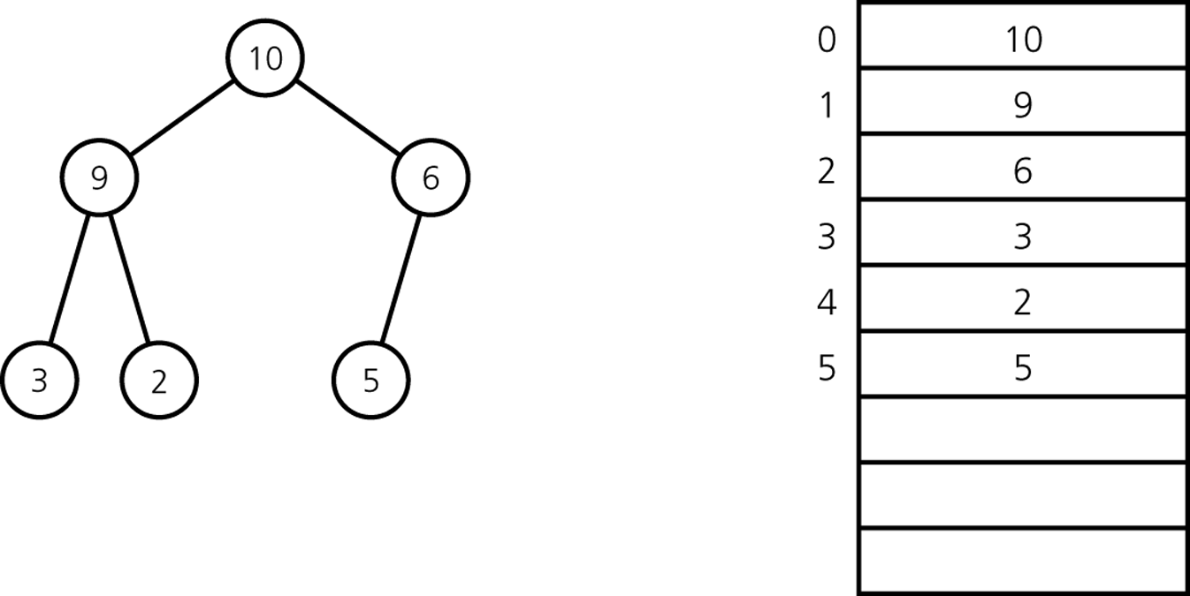
A Heap w/ Array Representation
1
1
2
3
4
5
6
2
3
4
5
6
indices
Node i’s children: 2i, 2i+1
Node i’s parent: i/2

Slide 18
Deletion
Return the root item
Remove the last node and move it to the root
Percolate down until the heap is valid

Slide 19
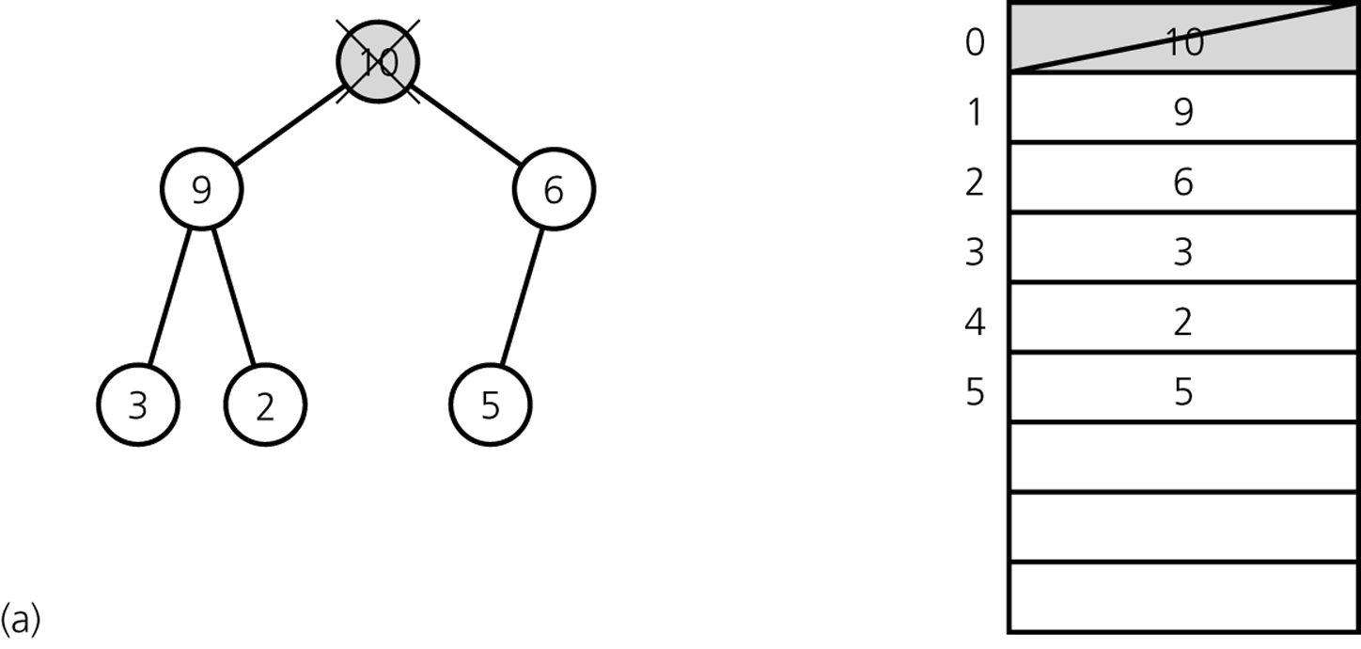
1
2
3
4
5
6

Slide 20
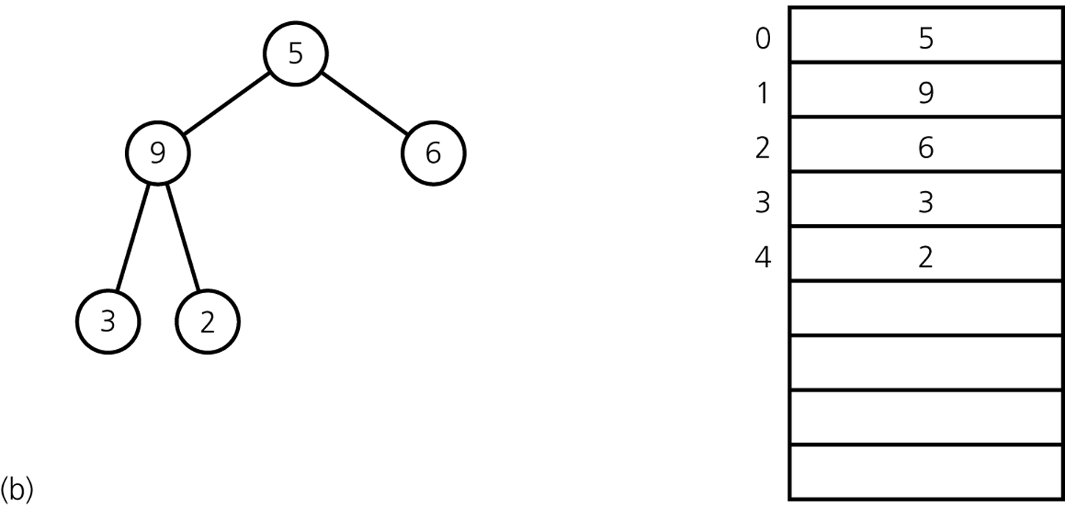
1
2
3
4
5
6

Slide 21
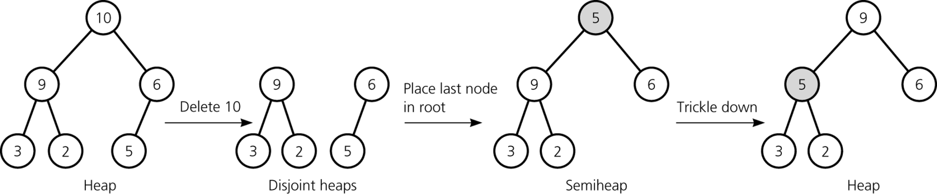
Percolate down

Slide 22
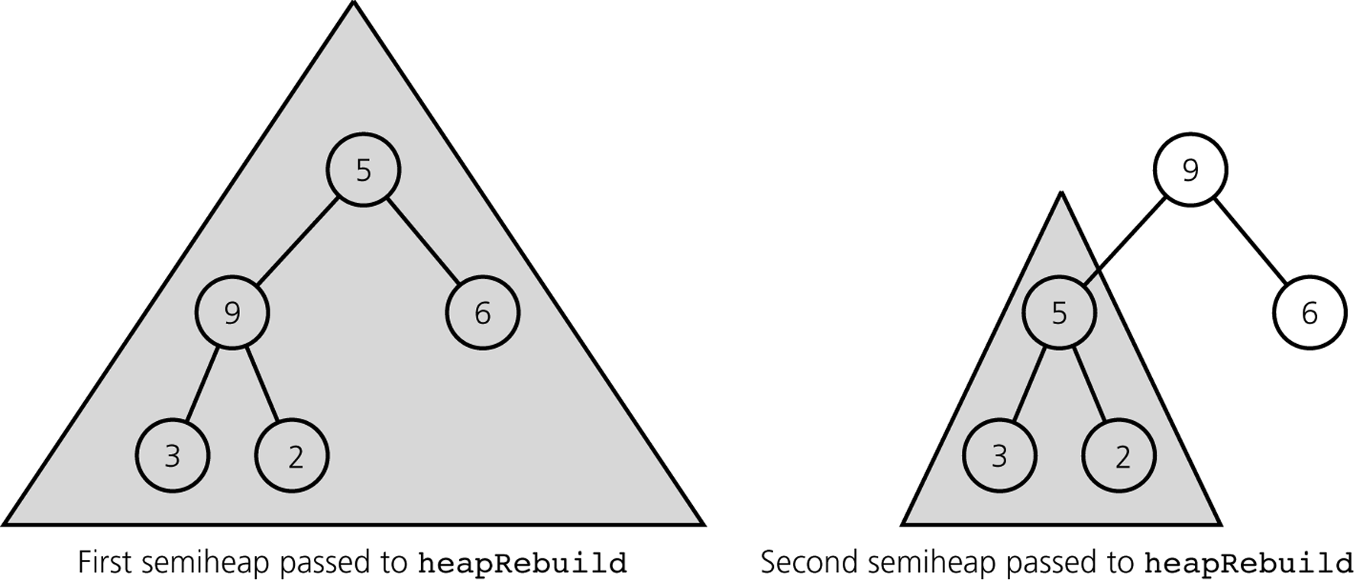
Figure 7
Recursive calls to heapRebuild
percolateDown
percolateDown
percolateDown

Slide 23
heapDelete( ) {
  // Keys are in key[1]…key[size]
  if (!heapIsEmpty( )) {
  rootItem = key[1];
  key[1] = key[size]; // move the last node
  size--;
  percolateDown(1);
  return rootItem;
  } else {
  return null;
  }
}

Slide 24
percolateDown (int i) {
child = 2*i ; // left child
rightChild = 2*i + 1; // right child
if (child <= size) {
if ((rightChild <= size) && (key[child] < key[rightChild])) {
child = rightChild; // index of larger child
}
if (key[i] < key[child]) {
Swap key[i] and key[child];
percolateDown(child);
}
}
}

Slide 25
Insertion
Insert an item into the bottom of the complete tree
Percolate up until the heap is valid

Slide 26
heapInsert(newItem) {
i = size+1;
key[i] = newItem;
parent = i/2;
while ((parent >= 1) && (key[i] > key[parent])) {
Swap key[i] and key[parent];
i = parent;
parent = i/2;
}
}

Slide 27
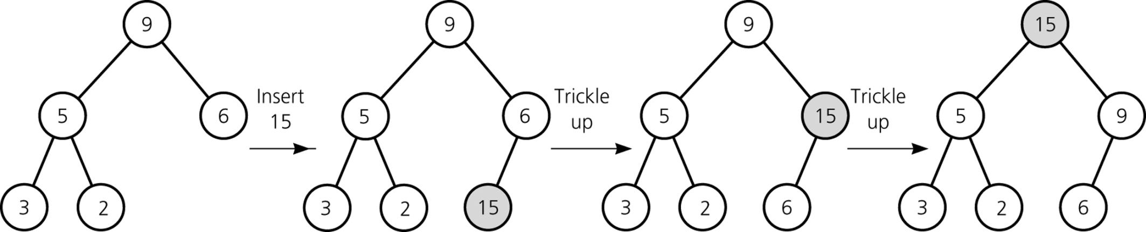
percolate
percolate

Slide 28
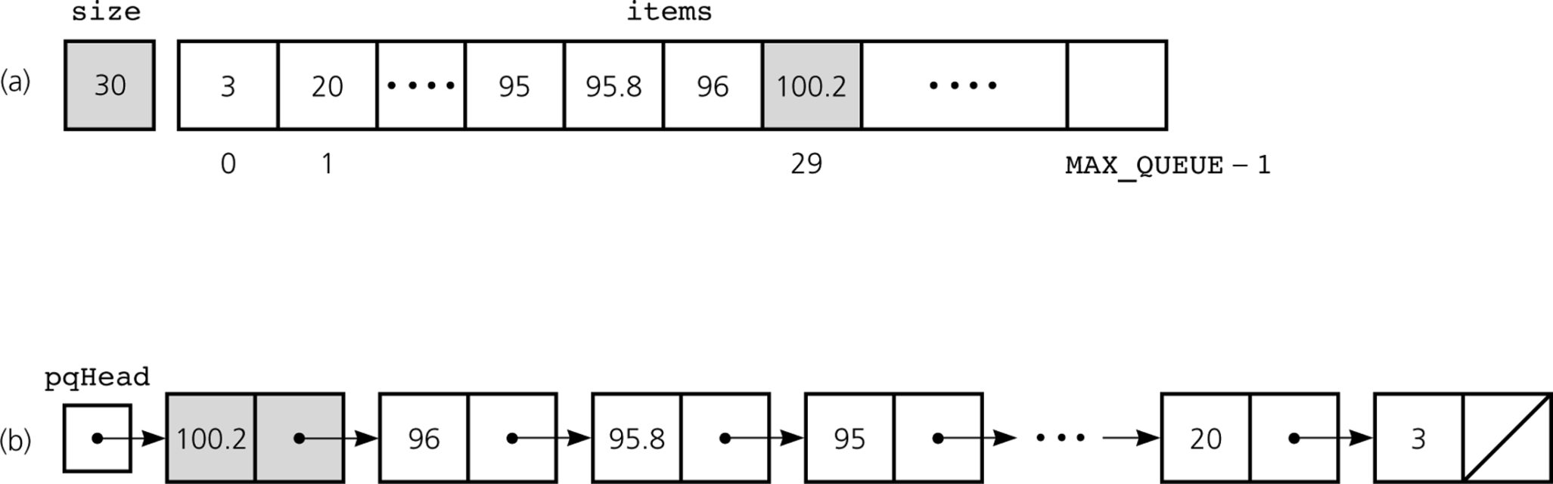
Figure 8-1
Some non-efficient implementations of the ADT priority queue:
a) array based; b) reference based

Slide 29
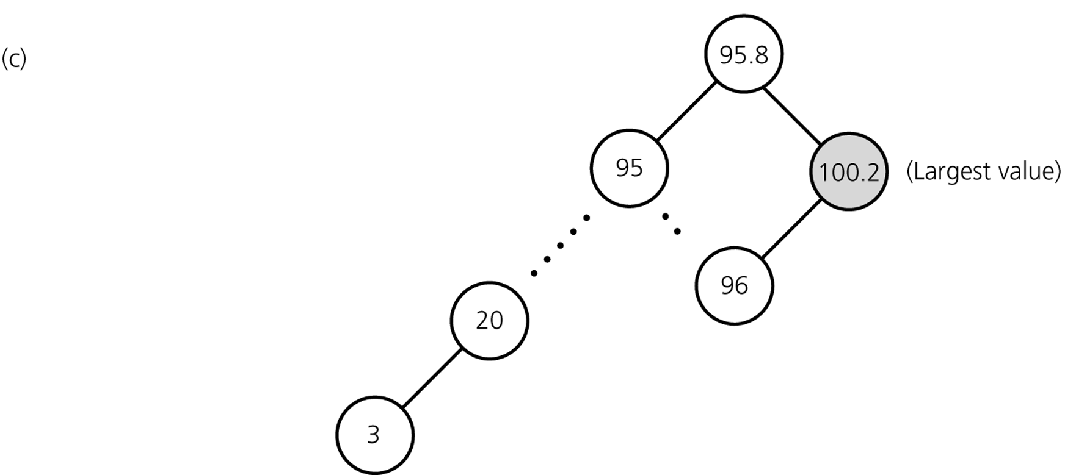
Figure 8-2
c) A non-desirable implementation of the ADT priority queue: binary search tree

Slide 30
Heapsort
Heap을 이용한 sorting
먼저 heap을 만든 다음, “Root node의 key를 빼내고, last node의 key를 root로 옮긴 다음 percolate down”하는 작업을 반복한다.

Slide 31
PercolateDown for Sorting
percolateDown (Comparable key[ ], int i, int n) {
child = 2*i ; // left child
rightChild = 2*i + 1; // right child
if (child <= n) {
if ((rightChild <= n) && (key[child] < key[rightChild])) {
child = rightChild; // index of larger child
}
if (key[i] < key[child]) {
Swap key[i] and key[child];
percolateDown(key, child, n);
}
}
}

Slide 32
Heapsort
heapsort(A, n) {
// build initial heap: A[1…n]
for i = n/2 downto 1 {
percolateDown(A, i, n);
}
// delete one by one
for size = n-1 downto 1 {
Swap A[1] and A[size+1];
percolateDown(A, 1, size);
}
// 이 지점에서 A[1…n]은 sorting되어 있다
}

Slide 33
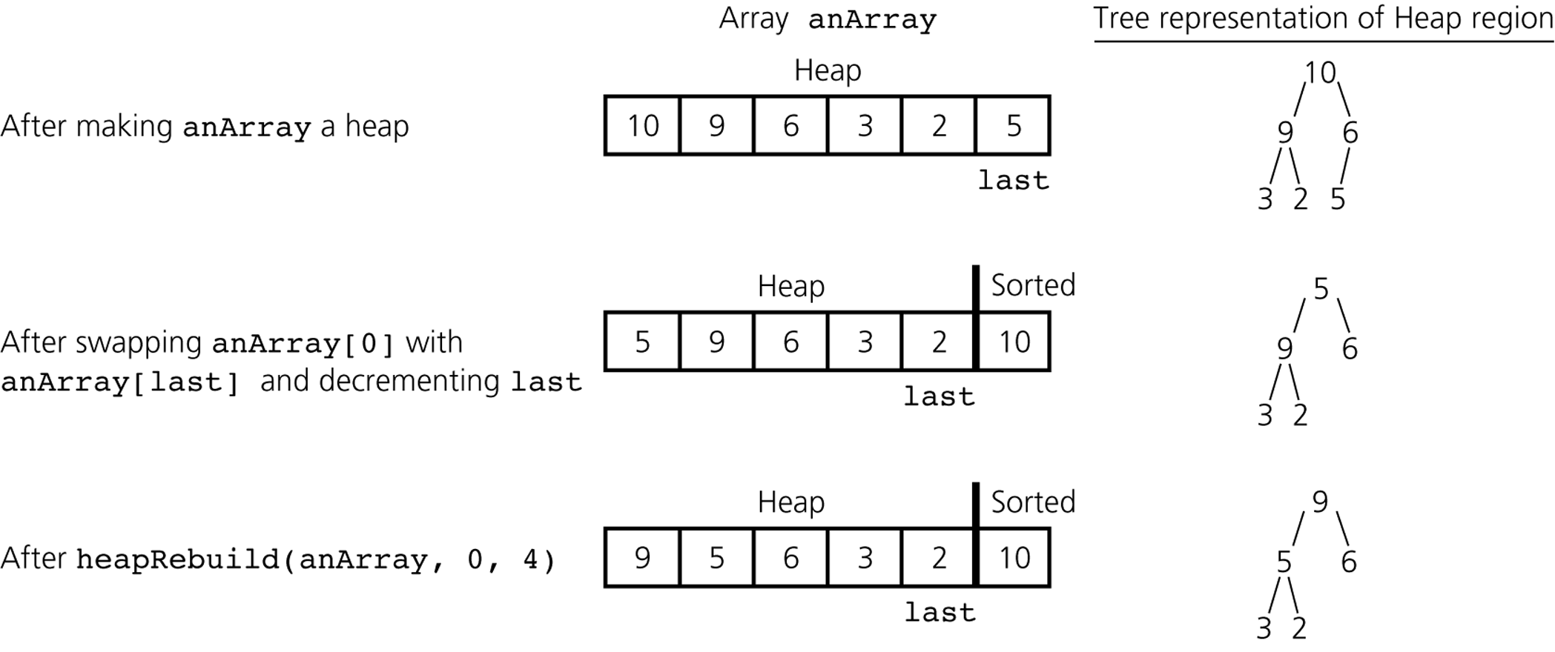
Figure 9-1
A trace of heapsort
size
1
size
size
size
percolateDown(anArray, 1, 5)
size

Slide 34
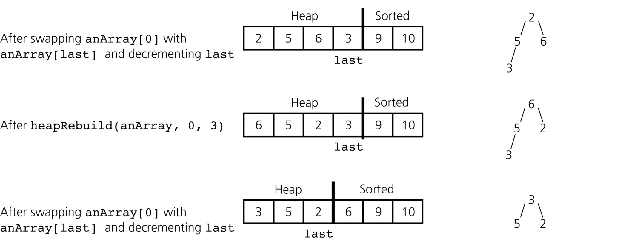
Figure 9-2
A trace of heapsort, continued.
1
size
size
size
percolateDown(anArray, 1, 4)
size
1
size
size
size

Slide 35
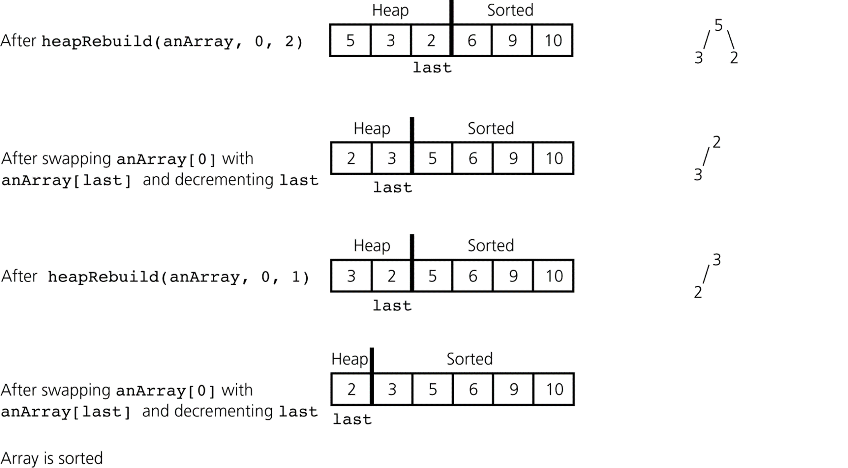
Figure 9-3
A trace of heapsort, continued.
percolateDown(anArray, 1, 3)
size
1
size
size
size
percolateDown(anArray, 1, 2)
size
1
size
size
size

