Slide 1
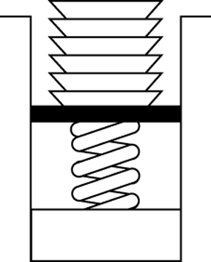
Ch. 8 Queue
Stack
  Removes the most recently added item
Queue
  Removes the least recently added item
milk
milk
milk
milk
milk
queue
stack

Slide 2
Queue Examples
오래된 우유부터 먹기
식당에서 기다리는 사람들의 열
Lotto 복권을 사려는 사람들의 열
Stack: LIFO (Last-In-First-Out)
Queue: FIFO (First-In-First-Out)

Slide 3
ADT Queue Operations
Create an empty queue
Determine whether a queue is empty
Add a new item to the queue
Remove from the queue the earliest added item
Retrieve from the queue the earliest added item
Remove all the items from the queue
본 chapter는 stack과 비교해가면서 공부할 것!

Slide 4
Queue Interface
public interface QueueInterface {
public boolean isEmpty( );
public void dequeueAll ( );
public void enqueue(Object newItem);
public Object dequeue( );
public Object peek( );
}
비교: stack
— isEmpty( );
— popAll ( );
— push( … );
— pop( );
— peek( );

Slide 5
Notable fact
  The only accessible item in the queue is
  the earliest added item

Slide 6
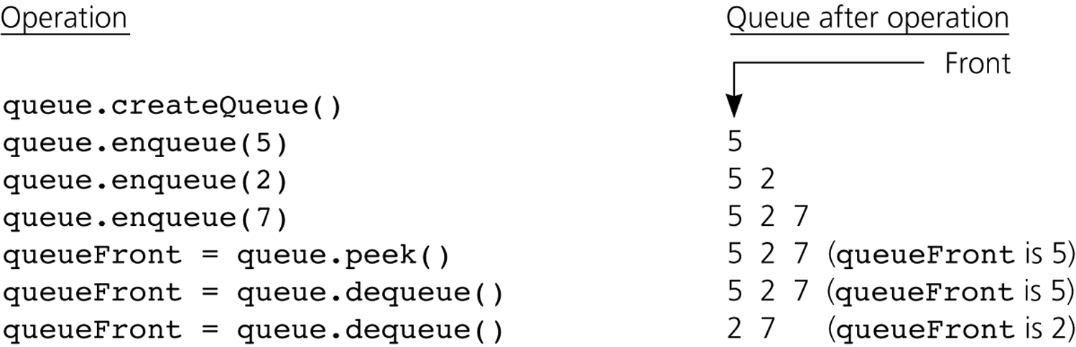
Example Queue Operations
2 7
7

Slide 7
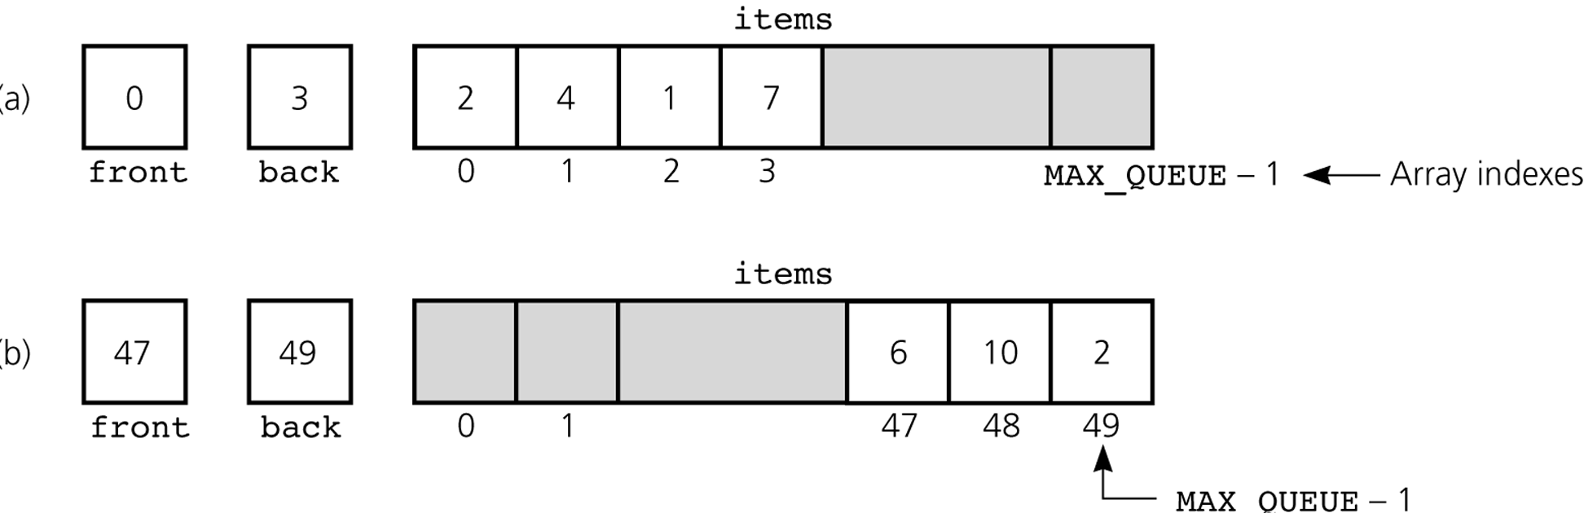
Figure 8.8
(a) A naive array-based implementation of a queue
(b) Rightward drift can cause the queue to appear full

Slide 8
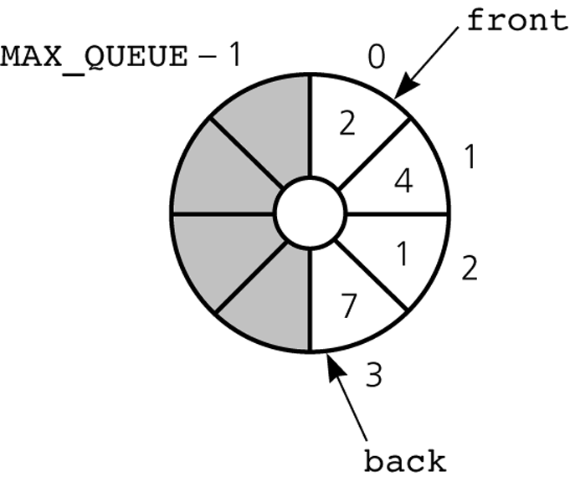
Figure 8.9
A circular implementation of a queue

Slide 9
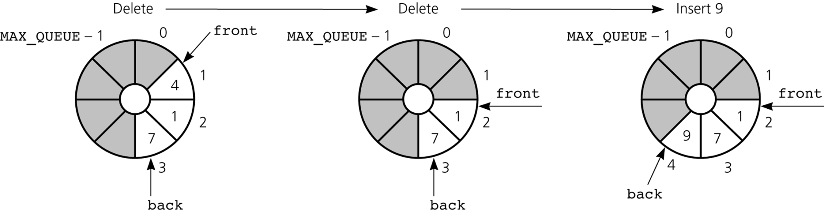
Figure 8.10
The effect of some operations of the queue in Figure 8-9

Slide 10
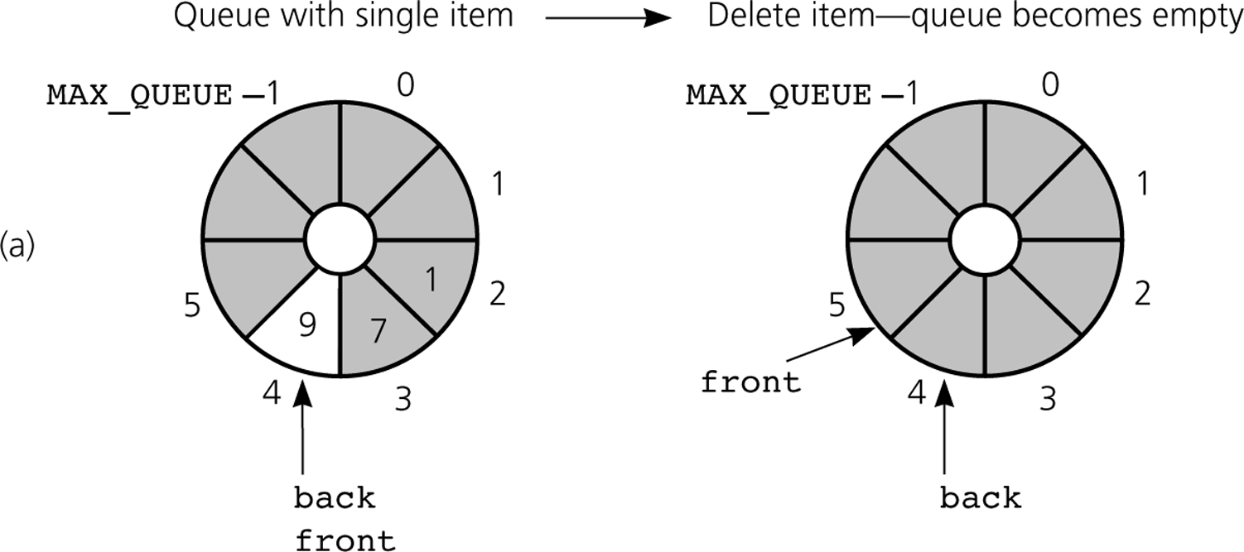
Figure 8.11a
a) front passes back when the queue becomes empty

Slide 11
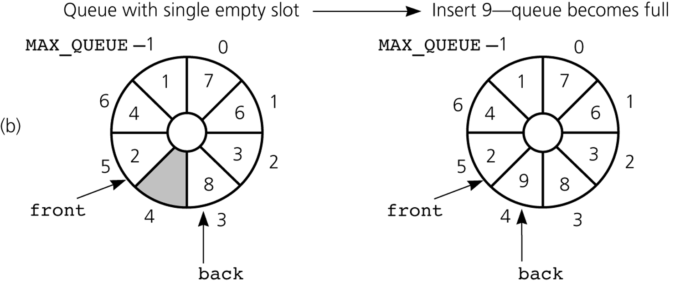
Figure 8.11b
b) back catches up to front when the queue becomes full

Slide 12
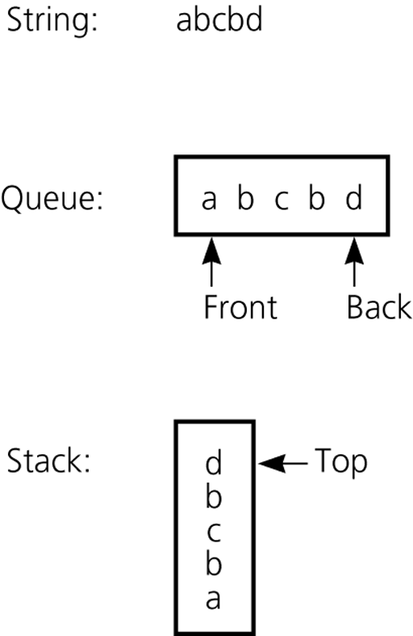
Example:Recognizing Palindromes
Palindromes =
{w | w reads the same
left to right
as right to left}

Slide 13
boolean isPal(w)
{
for i = 1 to w.length( ) {
queue.enqueue(i^{th} character of w);
stack.push(i^{th} character of w);
}
// start to compare
while (!queue.isEmpty( )) {
if (queue.dequeue( ) != stack.pop( )) return false;
}
// finished w/ empty queue (and empty stack)
return true;
}

Slide 14
Queue Implementation
public interface QueueInterface {
public boolean isEmpty( );
public void dequeueAll( );
public void enqueue(Object newItem);
public Object dequeue( );
public Object peek( );
}

Slide 15
Array-Based Implementation (Circular)
public class QueueArrayBased implements QueueInterface {
final int MAX_QUEUE = 50;
private Object items[ ];
private int front, back, numItems;
public QueueArrayBased( ) {
items = new Object[MAX_QUEUE];
front = 0;
back = MAX_QUEUE – 1;
numItems = 0;
}

Slide 16
public boolean isEmpty( ) {
return (numItems == 0);
}
public boolean isFull ( ) {
return (numItems == MAX_QUEUE);
}
public void enqueue(Object newItem) {
if (!isFull( )) {
back = (back+1) % MAX_QUEUE;
items[back] = newItem;
++numItems;
} else {exception 처리}
}

Slide 17
public Object dequeue( ) {
if (!isEmpty( )) {
Object queueFront = items[front];
front = (front+1) % MAX_QUEUE;
--numItems;
return queueFront;
} else {exception 처리}
}
public void dequeueAll ( ) {
items = new object[MAX_QUEUE];
front = 0;
back = MAX_QUEUE – 1;
numItems = 0;
}
back
front
MAX_QUEUE – 1
0
1

Slide 18
public Object peek( ) {
if (!isEmpty( )) return items[front];
else {exception 처리}
}
} // class QueueArrayBased

Slide 19
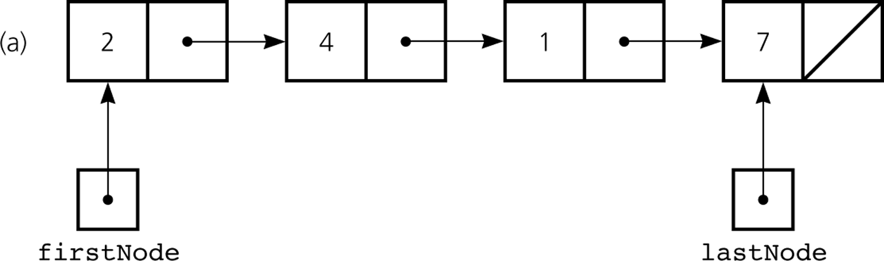
Reference-Based Implementation
A reference-based implementation of a queue:
a linear linked list with two external references

Slide 20
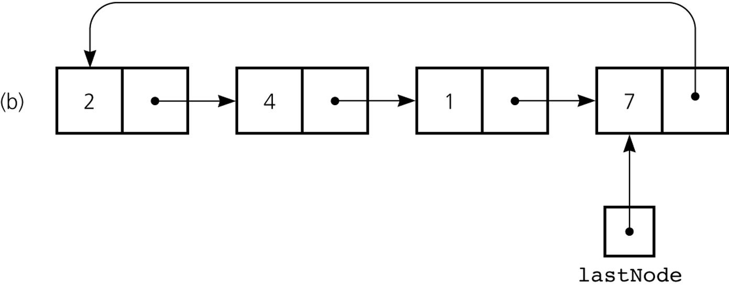
A reference-based implementation of a queue:
a circular linear linked list with one external reference

Slide 21
public class QueueReferenceBased implements QueueInterface{
private Node lastNode;
public QueueReferenceBased( ) {
lastNode = null;
}
Class Node: Ch.5, 강의 노트 P.8 참조

Slide 22
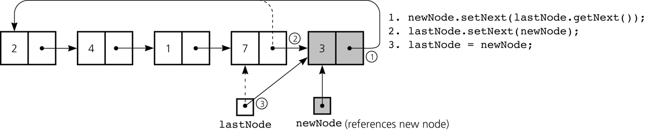
public boolean isEmpty( ) {
return (lastNode == null);
}
public void enqueue(Object newItem) {
Node newNode = new Node(newItem);
if (isEmpty( )) newNode.setNext(newNode);
else {
newNode.setNext(lastNode.getNext( ));
lastNode.setNext(newNode);
}
lastNode = newNode;
}
3
•
lastNode
•
•
lastNode
newNode

Slide 23
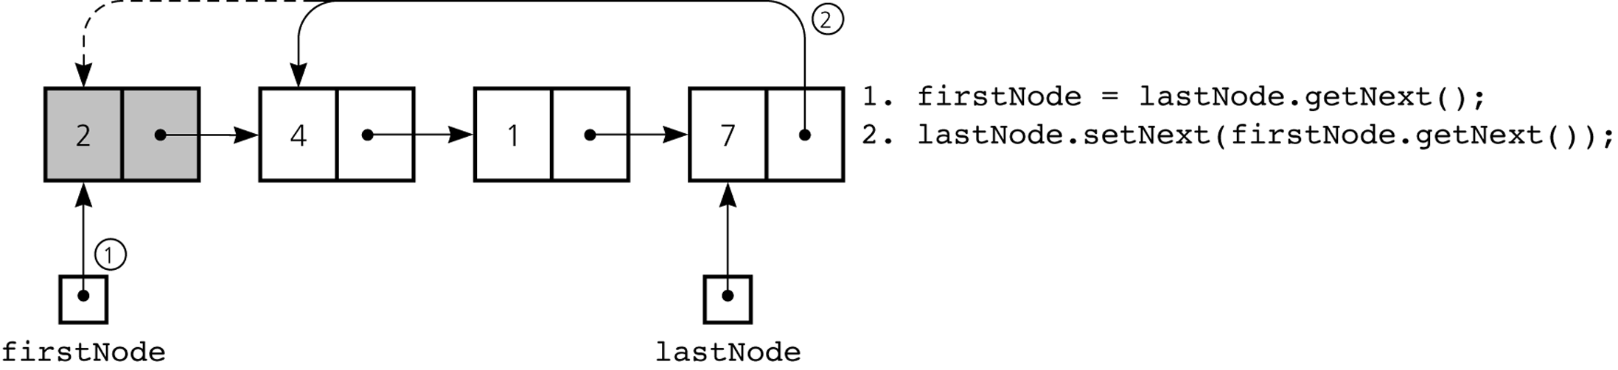
public Object dequeue( ) {
if (!isEmpty( )) {
Node firstNode = lastNode.getNext( );
if (firstNode == lastNode) { // special case?
lastNode = null; // only one node in queue
} else { // more than one item
lastNode.setNext(firstNode.getNext( ));
}
return firstNode.getItem( );
} else {exception 처리}
}

Slide 24
public void dequeueAll ( ) {
lastNode = null;
}
public Object peek( ) {
if (!isEmpty( )) {
// lastNode.getNext( ) is the first node
return lastNode.getNext( ).getItem( );
} else {exception 처리}
}
} // class QueueRefenceBased

Slide 25
ADT List-Based Implementation
public class QueueListBased implements QueueInterface {
private ListInterface list;
public QueueListBased( ) {
list = new ListReferenceBased( );
}
Class ListReferenceBased: Ch.5, 강의 노트 P.13 참조

Slide 26
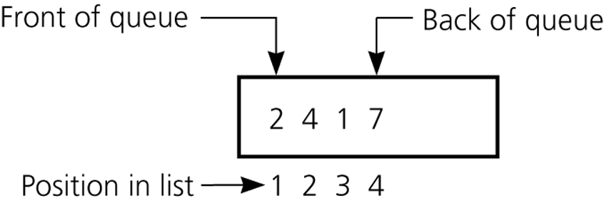
Figure 8.13
An implementation that uses the ADT list

Slide 27
public boolean isEmpty( ) {
return list.isEmpty( );
}
public void enqueue(Object newItem) {
list.add(list.size( )+1, newItem);
}
public Object dequeue( ) {
if (!list.isEmpty( )) {
Object queueFront = list.get(1);
list.remove(1);
return queueFront;
} else {exception 처리}
}

Slide 28
public void dequeueAll( ) {
list.removeAll( );
}
public Object peek( ) {
if (!isEmpty( )) return list.get(1);
else {exception 처리}
}
} // class QueueListBased

Slide 29
ADT list-based version
reuses the class ListReferenceBased.
The reuse made the code simple.

Slide 30
Queue Application
Bank queue
Search problem

Slide 31
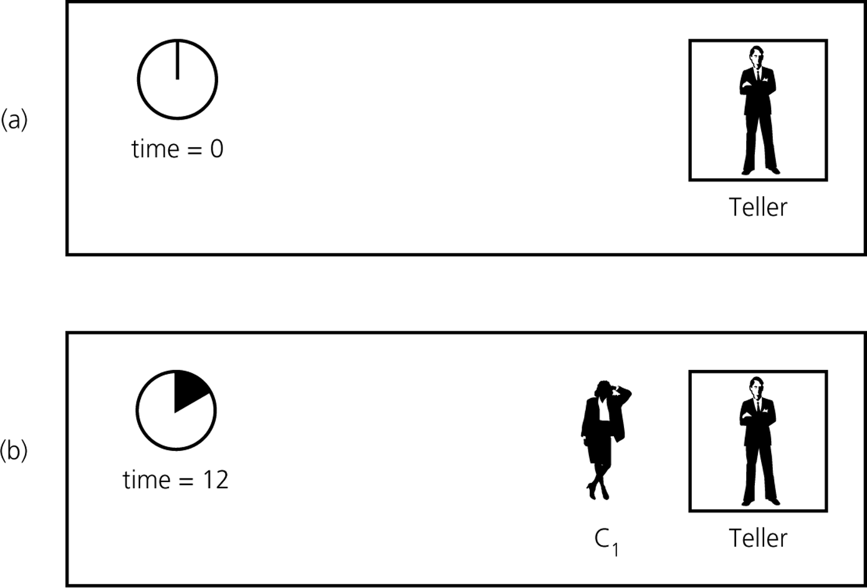
Figure 8.14a and 8.14b
A blank line at at time a) 0; b) 12

Slide 32
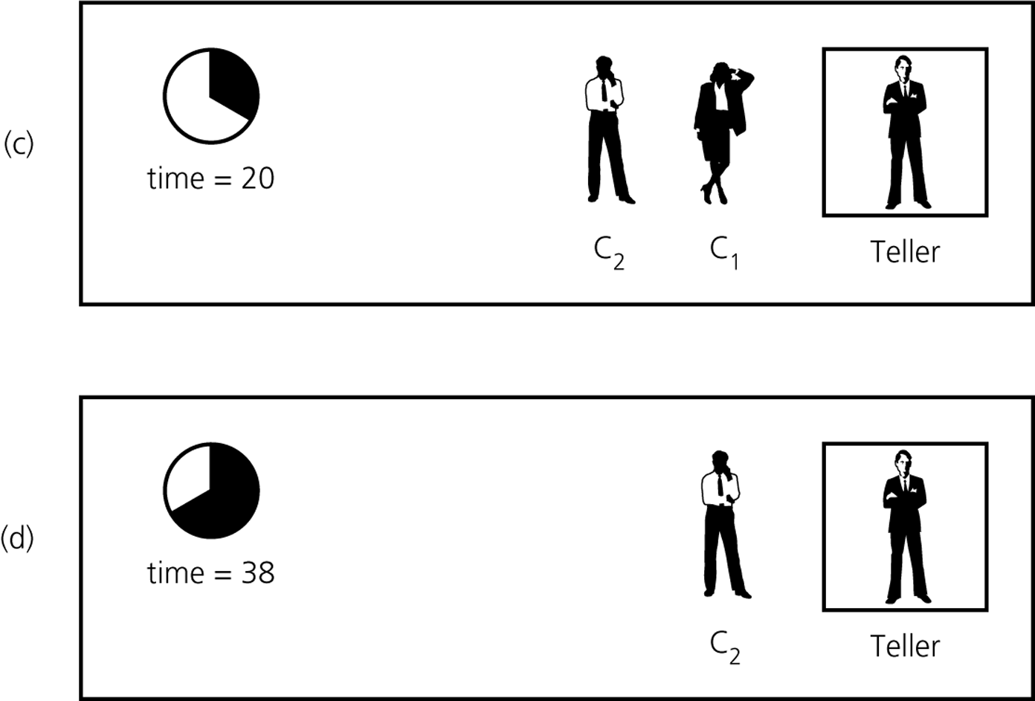
Figure 8.14c and 8.14d
A blank line at at time c) 20; d) 38

Slide 33
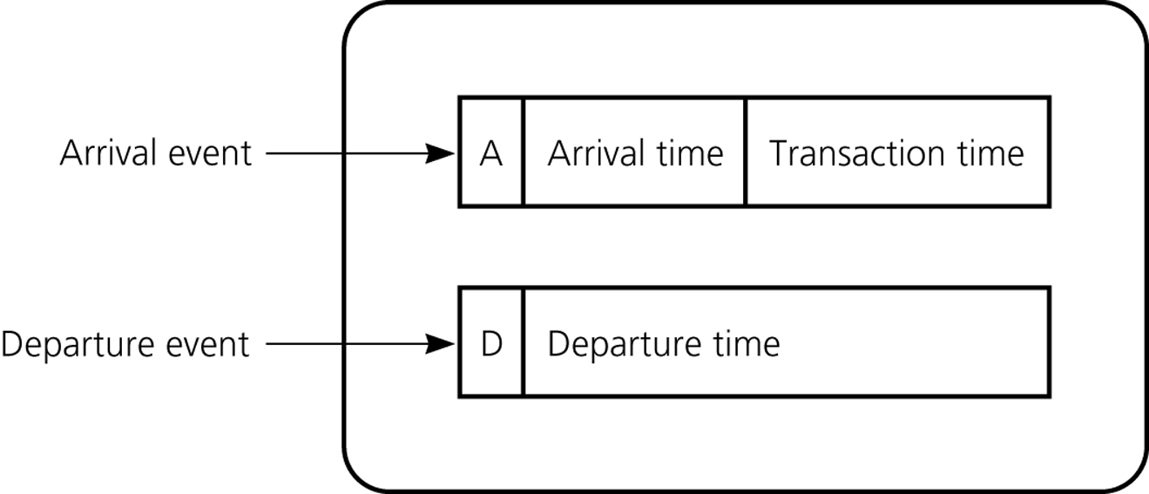
Figure 8.15
A typical instance of the event list

Slide 34
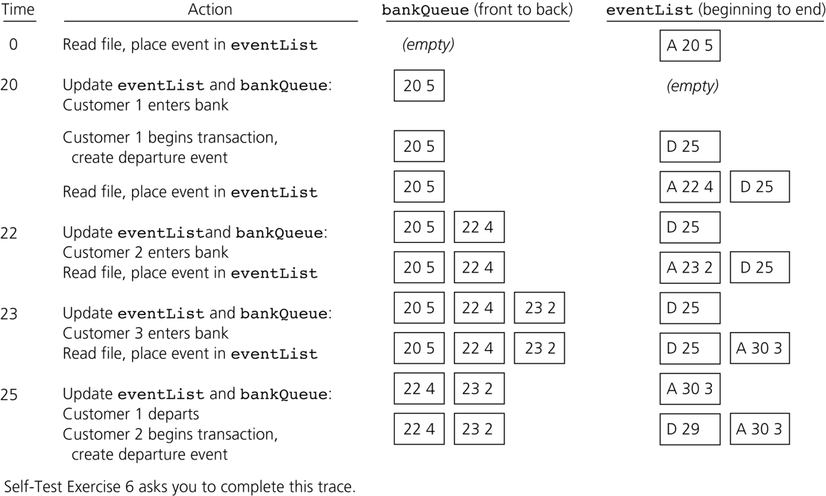
Figure 8.16
A Partial trace of the bank simulation algorithm for the data
20 5 23 2
22 4 30 3

Slide 35
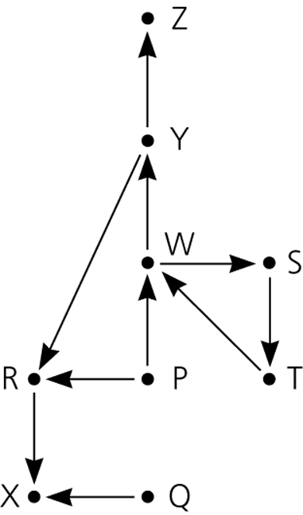
A Search Problem in Flight Map
: direct flight
Is there a path
from city A to city B?

Slide 36
searchS(originCity, destinationCity)
{ // All cities are marked UNVISITED in the beginning
queue.enqueue(originCity);
mark[originCity] = VISITED;
while (!queue.isEmpty( )) {
fCity = queue.dequeue( );
for all unvisited cities C that is directly reachable from fCity
{
if (C != destinationCity) {
queue.enqueue(C);
mark[C] = VISITED;
} else {
return true;
}
}
}
// There is no path
return false;
}

Slide 37
P
RW
WX
XSY
SY
YT
TZ
Z

Slide 38
DFS : BFS
Depth-First Search (DFS)
  앞의 stack 방식의 search
Breadth-First Search (BFS)
  앞의 queue 방식의 search
Covered in Chapter 14

