Slide 1
OS Project 4
OS Team 7

Slide 2
Demo
Team7-demo.mkv

Slide 3
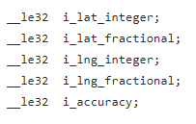
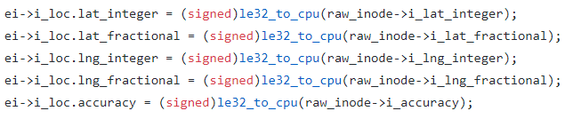
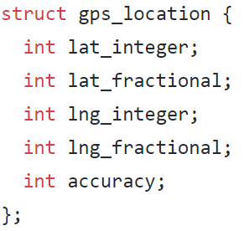
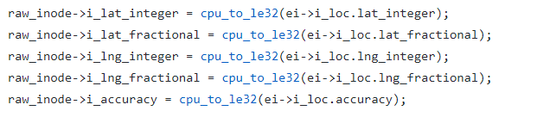
gps_location (little endian)
Define i_values in ext2_inode, ext2_inode_large (=>)
Set values using le32_to_cpu, cpu_to_le32 in ext2_iget/write_inode

Slide 4
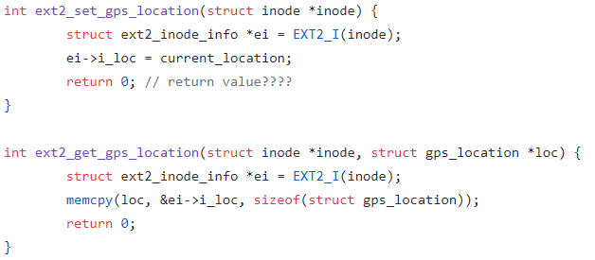
ext2_set_gps_location ext2_get_gps_location
Add set_gps_location, get_gps_location in inode_operations
Set set_gps_location = ext2_set_gps_location in ext2_file_inode_operations
Set get_gps_location = ext2_get_gps_location in ext2_file_inode_operations
Implement

Slide 5
Permission
geo_permission
Calculates distance between file's current location and device's current location
If two location can be same, returns 1. else returns 0.
ext2_permission
If geo_permission fails, returns -EACCES.
Else, calls generic_permission and returns.

Slide 6
Calculate distance
Assumptions
Earth is a perfect sphere
Earth’s perimeter is 40,000km = 4 * 10^7 m
Because we can’t use cos, sin, 64bit division, we created it!
long long Div(long long a, long long b)
Implemented basic division algorithm in binary system
int cosine(long long a), sine(long long a)
Get cosine value using taylor expansion method
Function returns cos(a / 10^6), sin(a / 10^6) value
Using above functions, we calculated (almost) correct distance between two points on earth.

Slide 7
System call(set/get_gps_location)
set_gps_location
check input is valid / Change current_location
return 0 on success / -EINVAL on invalid location input.
get_gps_location syscall
Check valid file, pathname, permission
return 0 on success
-ENOENT on invalid filepath
-EFAULT on invalid user pointer
-EINVAL on invalid path name
-EACCES on no permission
-ENODEV on invalid gps position.

Slide 8
EXTRA: Ext4
Quite similar to ext2 file system case, but there are some differences
We don’t need to explicitly add variable to inode struct: Use xattr!
xattr: Extra attributes are stored here.
ext4 file system is mainly used in booting kernel/other important parts
We have to skip location check for those cases.
When user is root/there is no location information set, skip location check process.
We can test this file system without loopback device.
Some implementations were changed:
ext4_set_gps_location
ext4_get_gps_location
ext4_permission
ext4_package_mkwrite

Slide 9
EXTRA: Ext4
Ext4_set_gps_location
Set gps_location value using ext4_xattr_set function
Ext4_get_gps_location
Get gps_location value using ext4_xattr_get function
If there was no value set, we can know it by error value returned.
Ext4_permission
Check inode’s access location permission with some exceptions.
If user is root or there is no file location set, we don’t check permission for location.
Also checks generic_permission.
Ext4_page_mkwrite
Functions(ex4_set_gps_location, ext4_get_gps_location, ext4_permission) are added here.
Added set_gps_location(inode) after update_time function called

