Slide 1
Ch. 7 Stack
도입을 위한 예
  “←” in keyboard input line
  E.g., abcd←←efgh←←←ij←km←
  abeik
한 character를 읽어 ‘←’ 이 아니면 저장하고
‘←’ 이면 최근에 저장된 character를 제거한다.

Slide 2
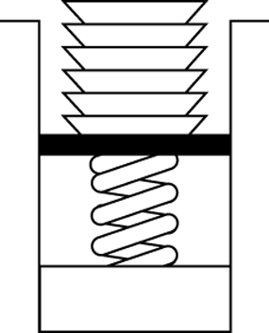
A Stack Example
최근에 쌓은 접시를 꺼낸다
Stack of cafeteria dishes

Slide 3
ADT Stack Operations
Create an empty stack
Determine whether a stack is empty
Add a new item on top of the stack
Remove from the stack the most-recently added item
Retrieve from the stack the most-recently added item
Remove all the items from the stack

Slide 4
Notable fact
  The only access to the stack is
  the most-recently added item

Slide 5
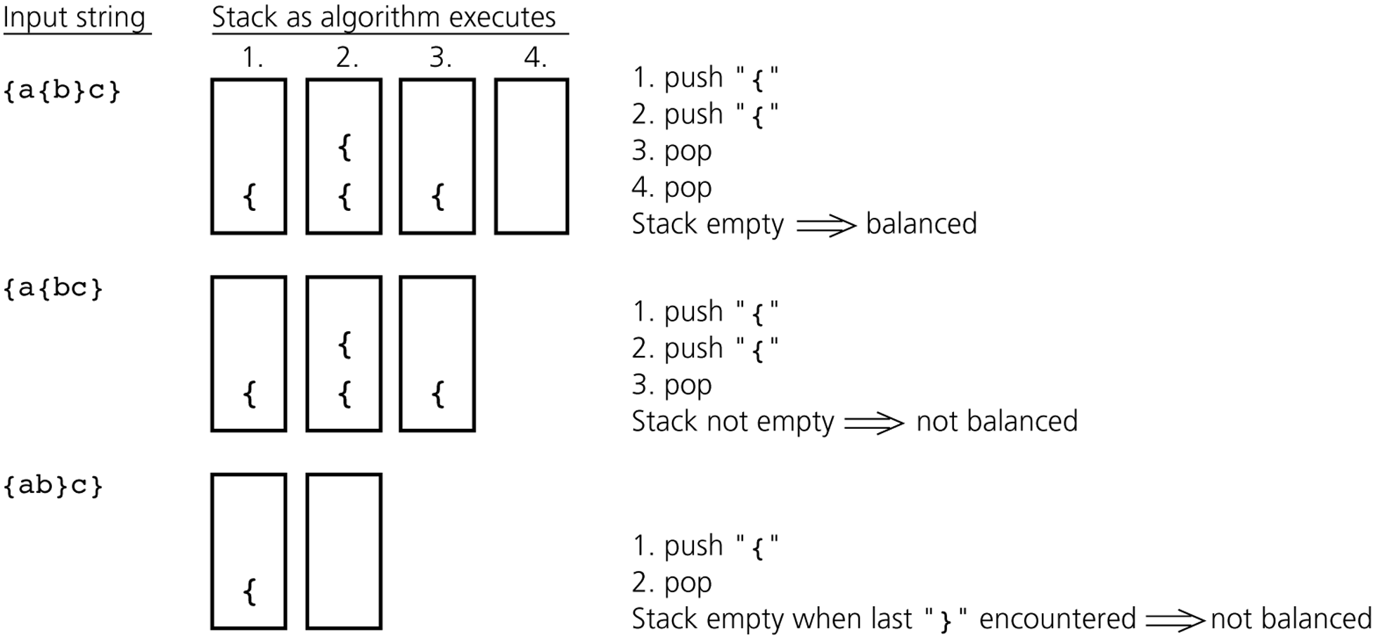
Example: Checking Balance of Braces

Slide 6
Example: Checking Symmetric Language
L = {w$w' : w is a possibly empty string w/o $,
w' = reverse(w) }
do {
ch = string.getNextCharacter( );
stack.push(ch);
} while (ch is not ‘$’)
stack.pop( );
do {
if (string.noMoreCharacter( )) { ←의미는 느낌으로 받아들일 것
if (stack.isEmpty( )) return true;
else return false;
} else {
if (stack.isEmpty( )) return false;
stackTop = stack.pop( );
ch = string.getNextCharacter( );
}
} while (ch == stackTop)
return false;
설명의 편의상
error 처리 생략

Slide 7
Stack Implementation
public interface StackInterface {
public boolean isEmpty( );
public void push(Object newItem);
public Object pop( );
public void popAll ( );
public Object peek( );
}

Slide 8
Array-Based Implementation
top
Items[ ]
–1
0 1 2 3 4 … MAX_STACK–1
public class StackArrayBased implements StackInterface {
final int MAX_STACK = 50;
private Object items[ ];
private int top; // index for stack top
public StackArrayBased( ) {
items = new Object[MAX_STACK];
top = –1;
}

Slide 9
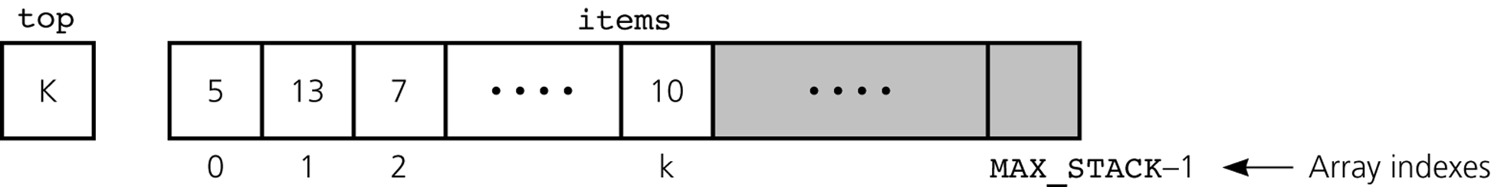
public boolean isEmpty( ) {
return (top < 0);
}
public boolean isFull ( ) {
return (top == MAX_STACK–1);
}
public void push(Object newItem) {
if (!isFull( )) items[++top] = newItem;
else {exception 처리}
}

Slide 10
public Object pop( ) {
if (!isEmpty( )) return items[top--];
else {exception 처리}
}
public void popAll( ) {
items = new Object[MAX_STACK];
top = –1;
}
public Object peek( ) {
if (!isEmpty( )) return items[top];
else {exception 처리}
}
} // end class StackArrayBased
Notes:
~3/26/2018(제7강)

Slide 11
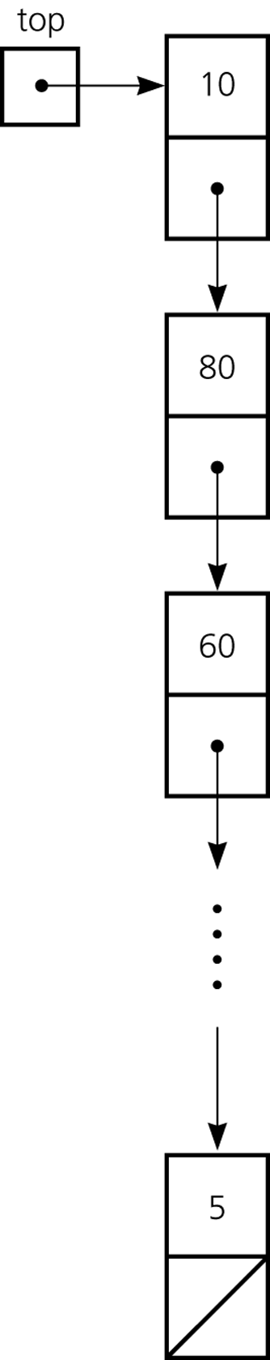
Reference-Based Implementation
public class StackReferenceBased implements StackInterface{
private Node top;
public StackReferenceBased( ) {
top = null;
}
Class Node: Ch.5, 강의 노트 P.8 참조

Slide 12
Remind: class Node (Ch. 5)
public class Node {
private Object item;
private Node next;
public Node(Object newItem) {
item = newItem;
next = null;
}
public Node(Object newItem, Node nextNode) {
item = newItem;
next = nextNode;
}
public Object getItem( ) {
return item;
}
// setItem, setNext, getNext
…
}
•

Slide 13

5
public boolean isEmpty( ) {
return (top == null);
}
public void push(Object newItem) {
top = new Node(newItem, top);
}
public Object pop( ) {
if (!isEmpty( )) {
Node temp = top;
top = top.getNext( );
return temp.getItem( );
} else {exception 처리}
}

Slide 14
public void popAll ( ) {
top = null;
}
public Object peek( ) {
if (!isEmpty( )) return top.getItem( );
else {exception 처리}
}
} // end class StackReferenceBased

Slide 15
ADT List-Based Implementation
public class StackListBased implements StackInterface {
private ListInterface list;
public StackListBased( ) {
list = new ListReferenceBased( );
}
Class ListReferenceBased: Ch.5, 강의 노트 P.13 참조

Slide 16
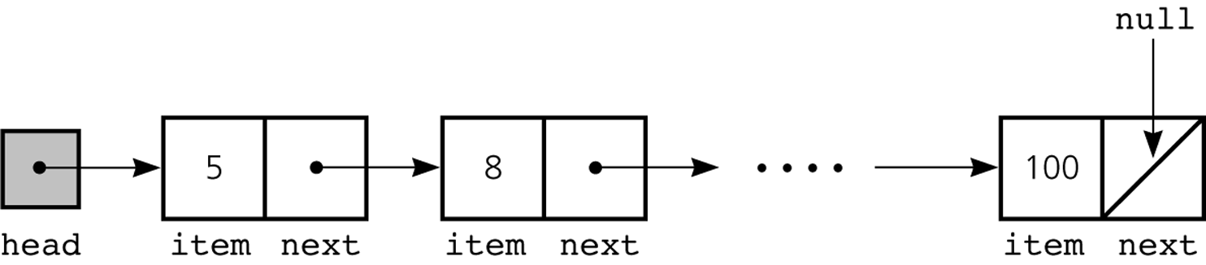
Remind: class ListReferenceBased (Ch. 5)
public class ListReferenceBased implements ListInterface {
private Node head;
private int numItems;
// constructor
public ListReferenceBased( ) {
numItems = 0;
head = null;
}
// operations
public Object get(int index) {
…

Slide 17
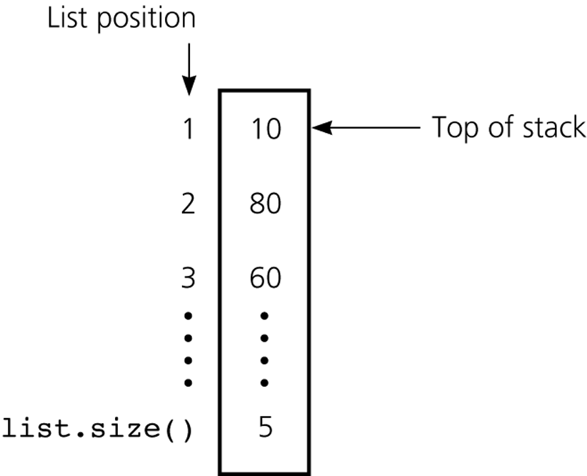
public boolean isEmpty( ) {
return list.isEmpty( );
}
public void push(Object newItem) {
list.add(1, newItem);
}
public Object pop( ) {
if (!list.isEmpty( )) {
Object temp = list.get(1);
list.remove(1);
return temp;
} else {exception 처리}
}

Slide 18
public void popAll ( ) {
list.removeAll( );
}
public Object peek( ) {
if (!isEmpty( )) return list.get(1);
else {exception 처리}
}
} // end class StackListBased

Slide 19
“ADT list”-based version
reuses the class ListReferenceBased.
The reuse made the code simple.
Reuse 비교
isEmpty( );
push(Object newItem);
Object pop( );
popAll ( );
peek( );
public Object pop( ) {
if (!list.isEmpty( )) {
Object temp = list.get(1);
list.remove(1);
return temp;
} else {exception 처리}
}
public Object peek( ) {
if (!isEmpty( )) return list.get(1);
else {exception 처리}
}
public boolean isEmpty( ) {
return list.isEmpty( );
}
public void popAll ( ) {
list.removeAll( );
}
public void push(Object newItem) {
list.add(1, newItem);
}

Slide 20
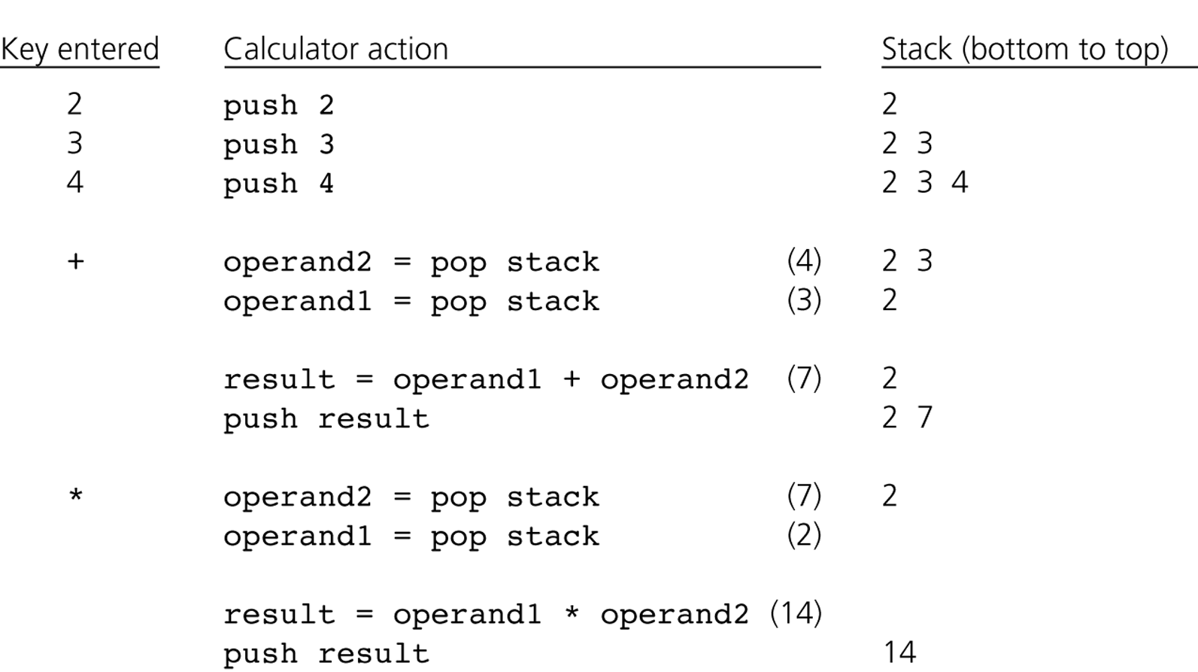
Evaluating Postfix Expressions
Stack Application
Postfix expression: 2 3 4 + *

Slide 21
for (each character ch in the expression) {
if (ch is an operand)
stack.push(ch);
else { // ch is an operator named op
operand2 = stack.pop( );
operand1 = stack.pop( );
result = operarand1 op operand2;
stack.push(result);
}
}

Slide 22
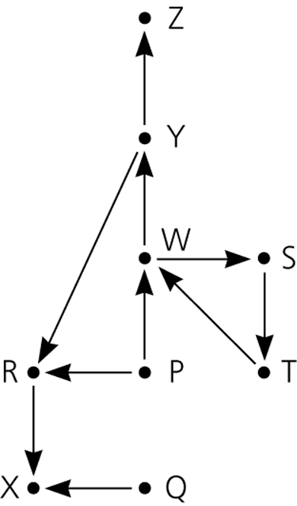
A Search Problem in Flight Map
Stack Application
: direct flight
Is there a path
from city A to city B?

Slide 23
searchS(originCity, destinationCity)
{ // All cities are marked UNVISITED in the beginning
stack.push(originCity);
mark[originCity] = VISITED;
while (!stack.isEmpty( ) && destinationCity is not at the top of stack) {
if (no flight exists from the stack-top city to unvisited cities)
temp ← stack.pop( ); // backtracking
else {
Select an unvisited city C that is directly reachable
from the stack-top city;
stack.push(C);
mark[C] ← VISITED;
}
}
if (stack.isEmpty( )) // There is no path
return false;
else // A path found
return true;
}

Slide 24
Equivalently
searchS(originCity, destinationCity)
{ // All cities are marked UNVISITED in the beginning
stack.push(originCity);
mark[originCity] = VISITED;
while (!stack.isEmpty( )) {
if (no flight exists from the stack-top city to unvisited cities)
temp ← stack.pop( ); // backtracking
else {
Select an unvisited city C that is directly reachable
from the stack-top city;
if (C = destinationCity) return true;
else {
stack.push(C);
mark[C] ← VISITED;
}
}
}
// There is no path
return false;
}

Slide 25
Recursive version
searchS(originCity, destinationCity)
{
if (originCity = destinationCity) return true;
else {
mark[originCity] ← VISITED;
arrived ← false;
for each x ∈ L(originCity) ▷ L(originCity) : originCity에 인접한 도시들
if (mark[x] = UNVISITED) {
arrived ← searchS(x , destinationCity);
if (arrived= true) return true;
}
return false;
}
}

Slide 26
Equivalently
searchS(originCity, destinationCity)
{
if (originCity = destinationCity) return true
else {
mark[originCity] ← VISITED;
for each x ∈ L(originCity) { ▷ L(originCity) : originCity에 인접한 도시들
if (mark[x] = UNVISITED and searchS(x , destinationCity) = true) return true;
}
return false;
}
}

Slide 27
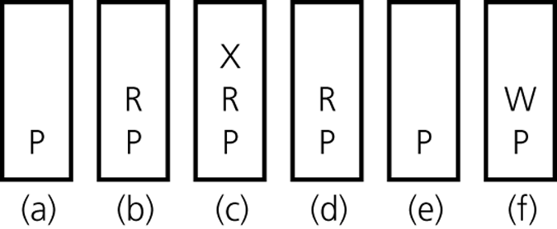
The stack of cities as you travel
from P
b) to R
c) to X
d) back to R
e) back to P
f) to W

Slide 28
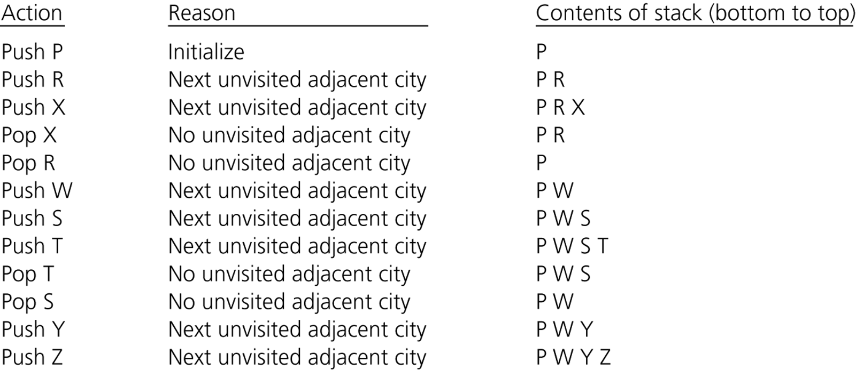
A trace of the search algorithm, given the flight map

Slide 29
Memory 분할과 Stack
Stack
active 상태의 함수 관련 parameter와 variable들
Dynamic
Heap
수행중에 사용자가 할당받는 메모리.
예; Java의 new, C의 malloc()
Data
program이 끝날 때까지 없어지지 않는 데이터. Global, static variables
Static
Code
Program
Virtual memory
(OS라는 벽을 통해 보는 메모리)

