Slide 1
Lab #4: PE controller
- Make a controller for the PE from Lab #3

Slide 2

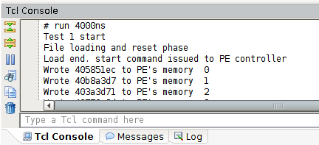
FAQ: Print log to console output
Try using $display(“output string”, ...);
Works like printf() function in C.
It prints output to TCL console.

Slide 3
Practice: PE controller implementation

Slide 4
Custom HW Example: Matrix Multiplication IP
MY_IP
PS
Processing Element (PE)
DOUT
CTRL
[32:0] REG[0:127] (BRAM inference)
Float32 MUL+ACC
DIN
A
OUT
AXI_SLAVE INTERFACE
B
ADDR
OUT
C
TRUE DP
BRAM
2-cyc
RESET
BRAM
INTERFACE
FSM
Shift(16)
DOUT
ADDR
[32:0] REG[0:127] (BRAM inference)
DIN
COUNTER

Slide 5
PE controller
Fetches 2 vectors from memory and calculate inner product.
Each vector contains 16 floating-point numbers.
Calculation is invoked by a single command (setting ‘start’ bit to 1).
When done, ‘done’ bit and ‘result’ are set by the controller.
Similar to (but not same with) FSM Example #2 in Lecture 3 (Verilog III)
PE Controller
‘start’ bit
‘done’ bit
Vector 0
Mem 0 - 15
Memory I/O
32
result
Vector 1
Mem 16 - 31

Slide 6
Overview of PE controller
Given parameters
WORD_SIZE : 32
ADDR_BW : 5
Your logic
PE from lab #3
(given)
start
clk
Control signals
reset
done
rddata[WORD_SIZE – 1 : 0]
Data ports
rdaddr[ADDR_BW - 1 : 0]
wrdata[WORD_SIZE – 1 : 0]

Slide 7
PE controller FSM
How it work?
Having 4 states
idle, load, calc, done
Idle: wait for ‘start’ signal. If it is on, it moves to ‘load’ stage.
Load: Load inputs to PE and controller’s memory.
Calc: calculate input vectors. If it is done, moves to ‘done’ stage.
Done: assign result to ‘wrdata’ port and turn ‘done’ bit on.
‘Done’ state lasts for 5 cycles. Turn ‘done’ off and shift to ‘idle’ state after 5 cycles.

Slide 8
PE controller states
Start = 0
Idle
Done = 0
Load
Done = 0
Not loaded
Start = 1
5 cycles passed
Load completed
Done
Done = 1
Calc
Done = 0
Calculation
completed
Less than
5 cycles passed
Calculating
* Reset signal (omitted) unconditionally shifts your PE controller into Idle state

Slide 9
Idle state
Wait for ‘start’ signal.
If it is on, shift to ‘load’ stage.
‘done’ bit must be turned off in this state.
Start = 0
Idle
Load
Start = 1

Slide 10
Load state
Request data to test bench
Set ‘rdaddr’ to the address of the data you request.
Requested data will be fetched to ‘rddata’ at next rising edge of the clock.
Test bench
Test bench
Test bench
rdaddr
rddata
rdaddr
rddata
rdaddr
rddata
0x13
xxxx
0x18
Data[0x13]
0x16
Data[0x18]
PE
Controller
PE
Controller
PE
Controller
Cycle 0
Cycle +1
Cycle +2

Slide 11
Load state
Store data to PE’s memory and controller’s memory.
Store vector 0 (at mem[0] to mem[15]) to PE’s memory.
Store vector 1 (at mem[16] to mem[31]) to controller’s memory.
Move to calc state if all the vectors are stored.
Vector 0 (mem[0 …15])
PE
Vector 1 (mem[16 … 31])
PE(given)
Controller
Memory
PE Memory

Slide 12
Calc state
Calculate dot product of vectors (from controller and PE memory).
Wait until dvalid is set (CAUTION: Don’t use wait() func. in module)
If calculation is done, move to ‘done’ state.
Calculate with given PE module.
Vector 0 : {a0, a1, a2, …., a15}
Vector 1 : {b0, b1, b2, …., b15}
(Vector 0) · (Vector 1) = {a0 * b0 + a1 * b1 + a2 * b2 + … + a15 * b15}
→ Takes 16 cycles with floating-point IP (Lab #2, Lab #3)

Slide 13
Done state
Assign output to ‘wrdata’ port.
Turn ‘done’ bit on.
This state lasts for 5 cycles.
Shift to ‘idle’ state after 5 cycles.
Turn off ‘done’ bit and set ’wrdata’ to zero.
Test bench
Test bench
Test bench
Wrdata :
0
Done : 0
Wrdata :
result
Done : 1
Wrdata :
0
Done : 0
PE
Controller
PE
Controller
PE
Controller
Cycle 0
Cycle 1 - 5
Cycle 6

Slide 14
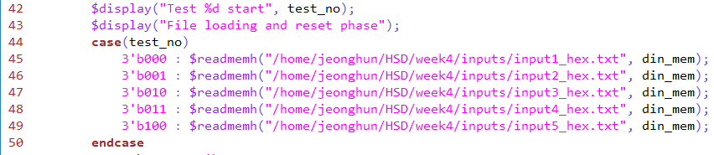
Test with given inputs
Given test bench loads and tests your controller with specified inputs.
Check pe_controller_tb.v for input file specifications.
Change the paths to your input files and run.
Test bench will automatically score your implementation

Slide 15
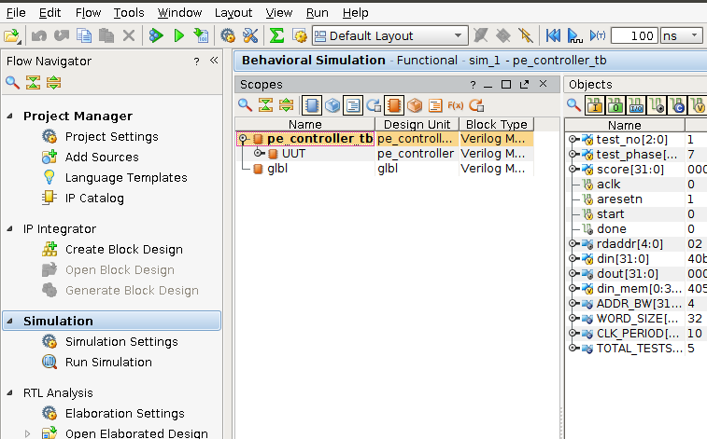
Run test bench
“Run all” to run whole test
Test bench will automatically score your implementation
If your score is 100, you can go home NOW! (Check TCL console output)

Slide 16
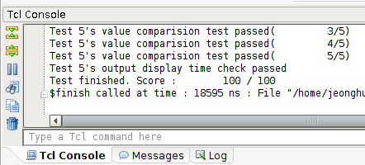
Run test bench
“Run all” to run whole test
Test bench will automatically score your implementation
If your score is 100, you can go home NOW! (Check TCL console output)

Slide 17
Grading policy
Check lists
Correct calculation result. (8 points)
‘done’ bit should turned on for 5 cycles (1 point per cycle(2~5 cycle only))
After 5 cycles, ‘done’ bit should be set to zero. (8 points)
This score will not be given if you set ‘done’ bit to zero earlier.
Also, result should be set to zero too.
Submit only “pe_controller.v” on eTL.
Due : 4/3 (Tue) PM 11:59
Late submission will result in penalty

Slide 18
Appendix: Test with more cases (optional)
Test file generator(written in C) is uploaded at eTL.
You can generate random input vector. (32 floating-point numbers)
You can also convert your own input to hexadecimal form.
For more details, please refer to enclosed readme.txt.
Please use with caution.
Some generated values may be differ from Xilinx IP result by precision loss.
In that case, please re-generate numbers.
TA has verified that given inputs work correctly with Xilinx IP.

Slide 19
Appendix: Detailed description of TB
Load input
To TB memory
Less than
5 cycles passed
Start
Reset
start = 0
reset = 0
start
start = 1
reset = 1
5 cycles passed
Unconditional
shift
5 cycles passed
Finish
Print your score
Donestart = 0
reset = 1
Proc
start = 0
reset = 1
All test finished
Done = 1
Done = 0
Less than
5 cycles passed

