Slide 1
Ch. 11 Trees
사실을 많이 아는 것 보다는
이론적 틀이 중요하고,
기억력보다는
생각하는 법이 더 중요하다.
- 제임스 왓슨

Slide 2
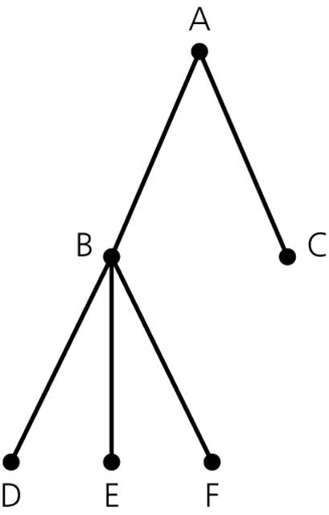
A general tree
Terminology
node or vertex
edge
parent
child
siblings
root
leaf
ancestor
descendant
subtree

Slide 3
Definition of Tree
General tree T is partitioned into disjoint subsets:
  Empty or
  Root node + sets of general trees

Slide 4
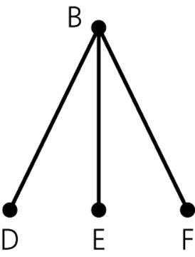
A subtree

Slide 5
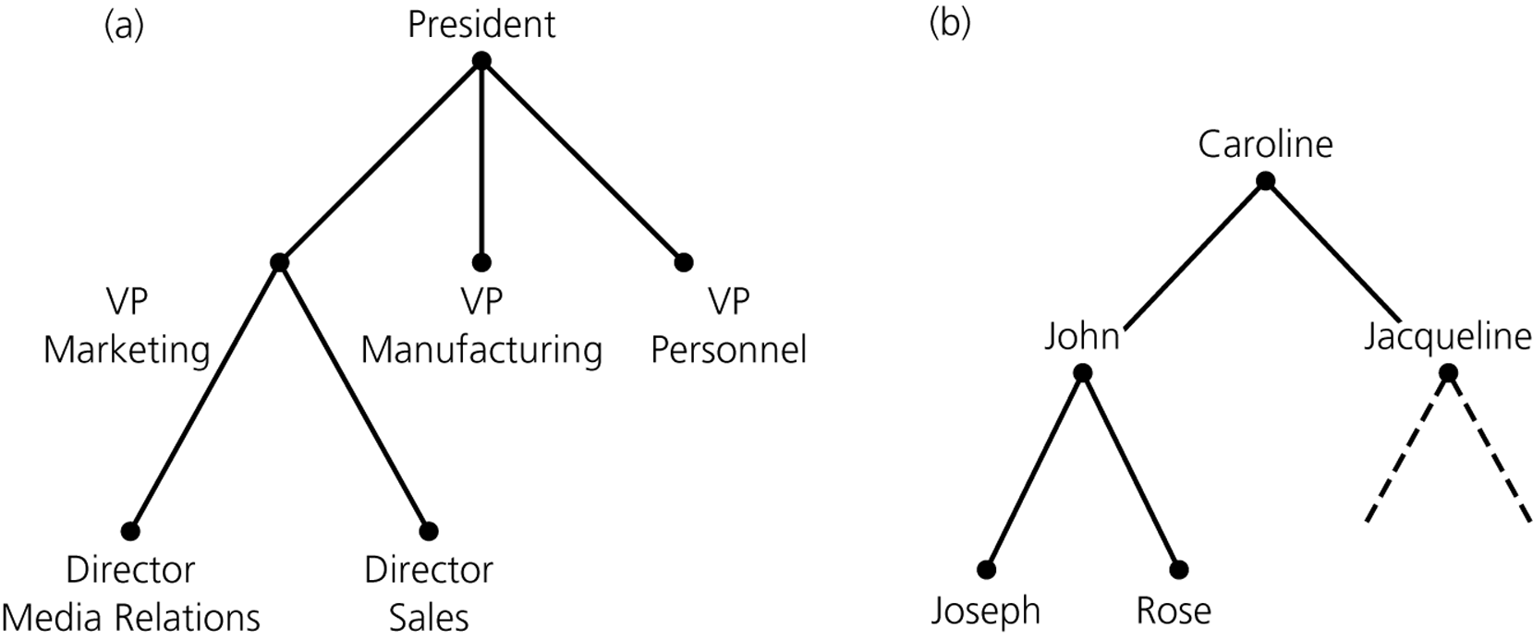
An organization chart
A family tree

Slide 6
Binary Tree
T is empty, or
T is partitioned into three disjoint subsets:
  A single node r, the root
  Two sets of binary trees, called left and right binary (sub)trees of r
r
T_{L}
T_{R}
Notes:
T = <empty> | T root T

Slide 7
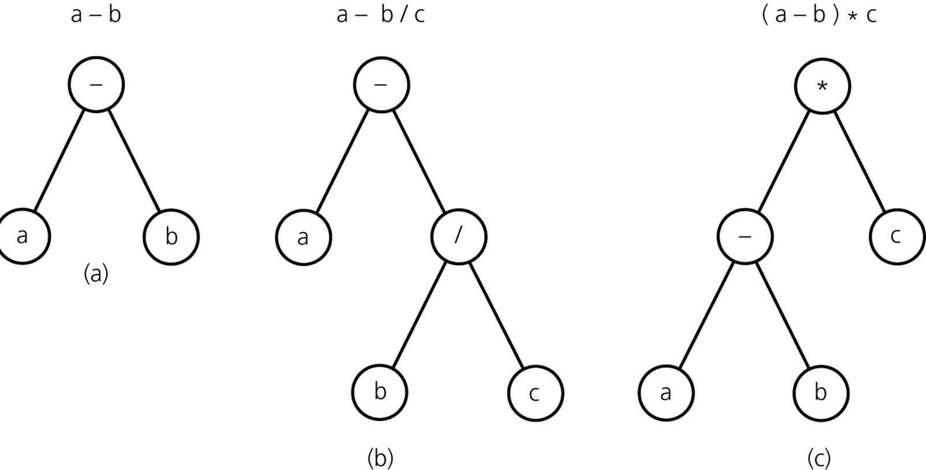
Binary Trees for Algebraic Expressions

Slide 8
Binary Search Tree
A binary tree that is in a sense sorted
according to the values in its nodes
For each node n, it satisfies:
  n’s value is greater than all values in its left subtree T_{L}
  n’s value is less than all values in its right subtree T_{R}
  Both T_{L} and T_{R} are binary search trees

Slide 9
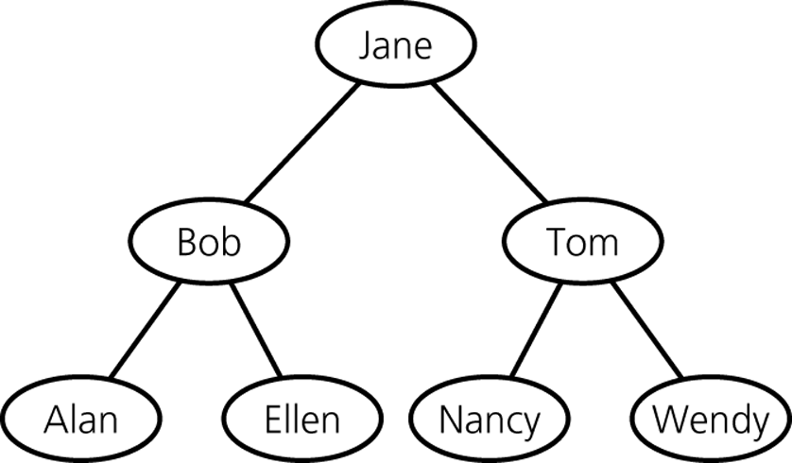
A Binary Search Tree of Names

Slide 10
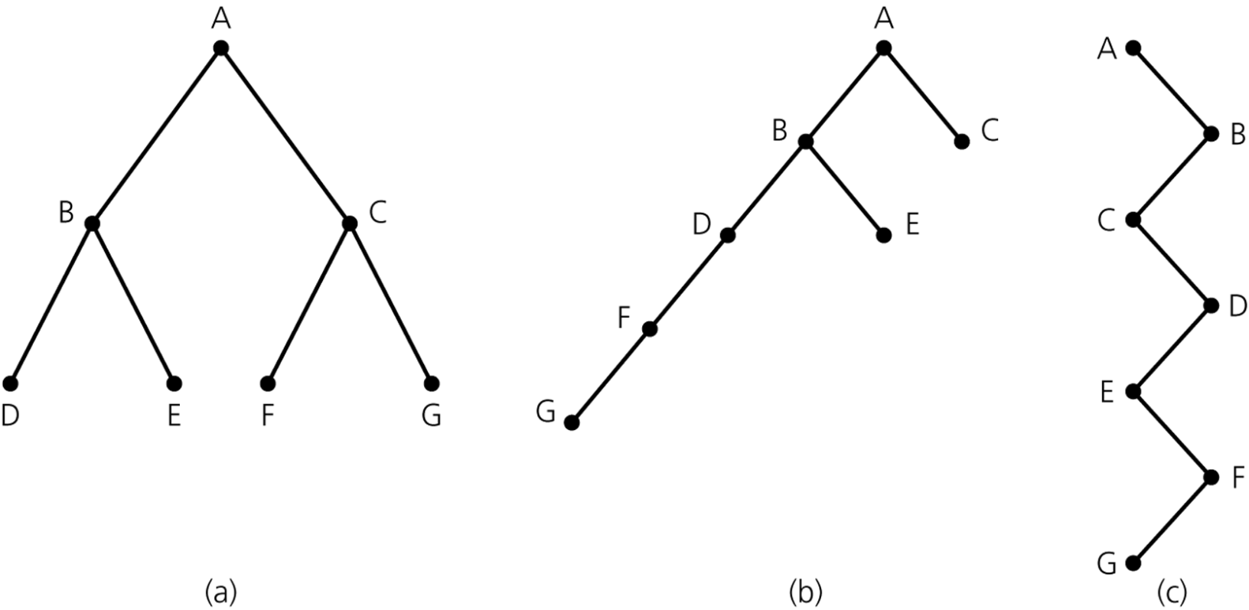
Height of a Tree
The number of nodes on the longest path from the root to a leaf
Height 3
Height 5
Height 7

Slide 11
Full Binary Tree
If T is empty,
T is a full binary tree of height 0
If T is not empty and has height h,
T is a full binary tree
if the root’s subtrees are both full binary trees of height h–1

Slide 12
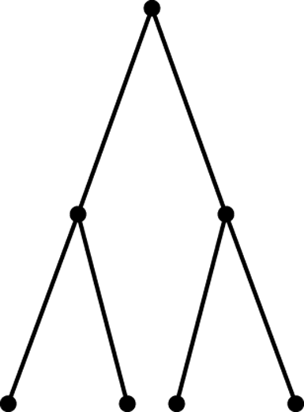
A Full Binary Tree of Height 3
root
full
full
subtrees

Slide 13
Complete Binary Tree
A complete binary tree of height h is
a binary tree
that is full down to level h–1
with level h filled in from left to right

Slide 14
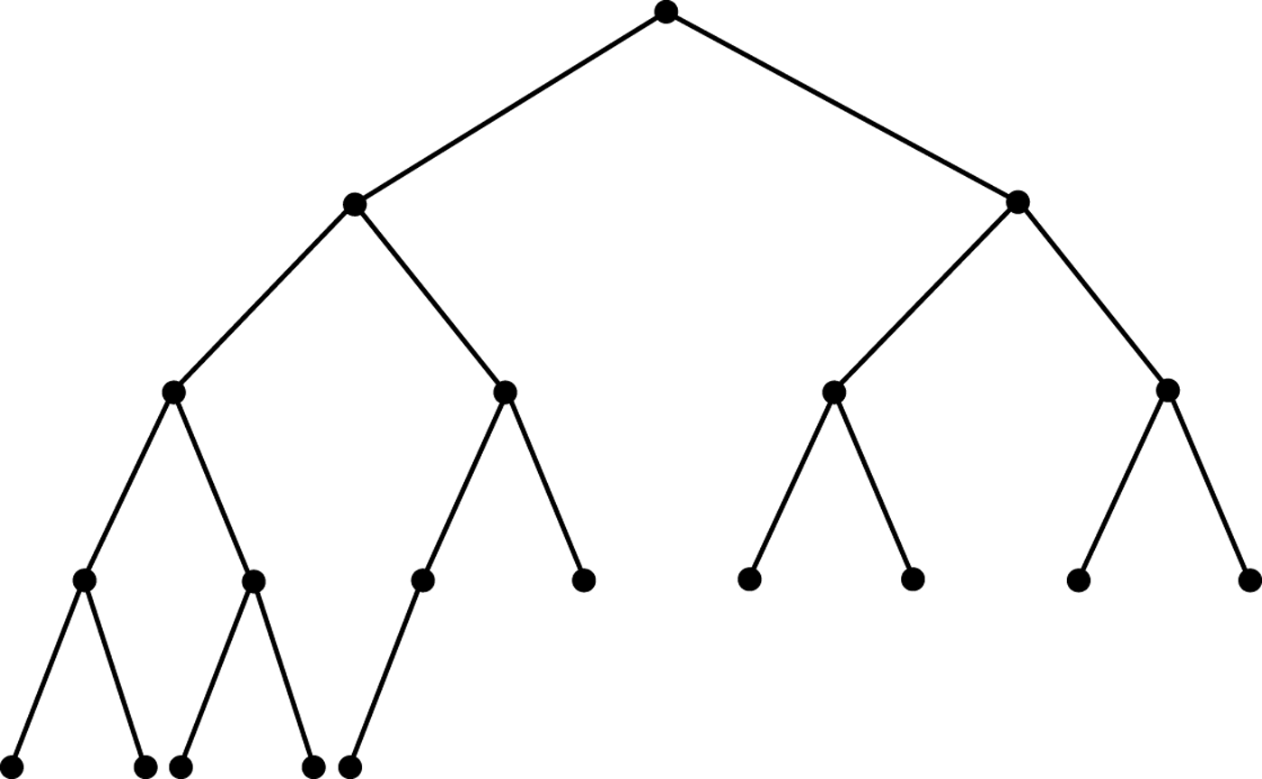
A Complete Binary Tree
full
left to right

Slide 15
ADT Binary Tree Operations
Create an empty binary tree
Create a one-node binary tree
Remove all nodes from a binary tree
Determine whether a binary tree is empty
Determine what data is the binary tree’s root
Incomplete!

Slide 16
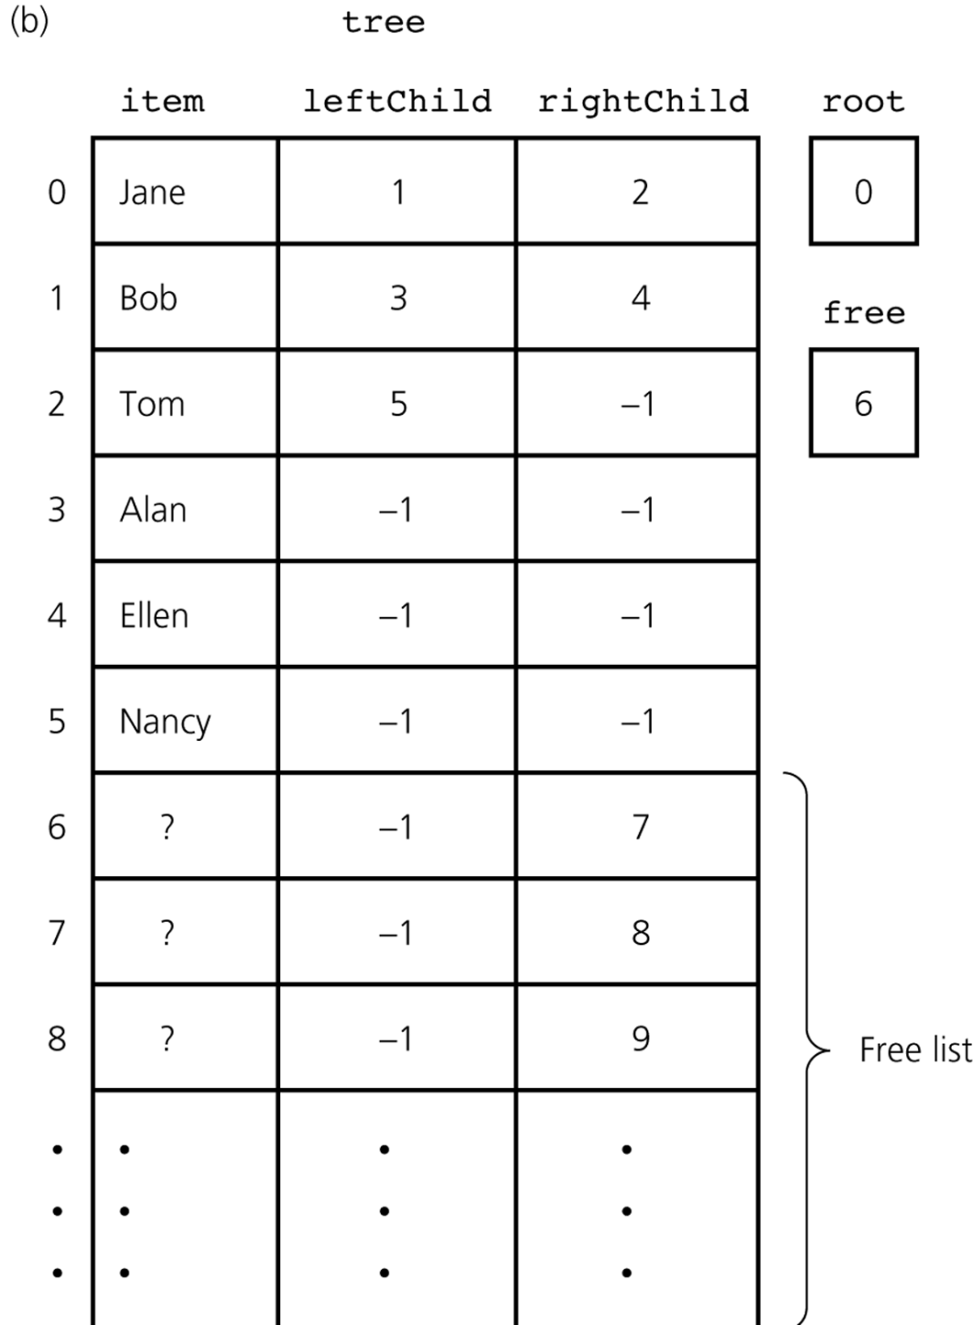
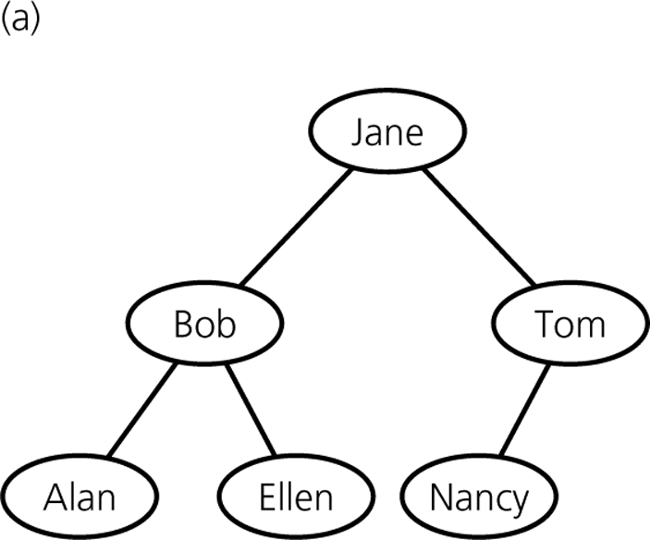
Array-Based Representation
-1
4
0
Nancy
1
2
?
3
4
4

Slide 17
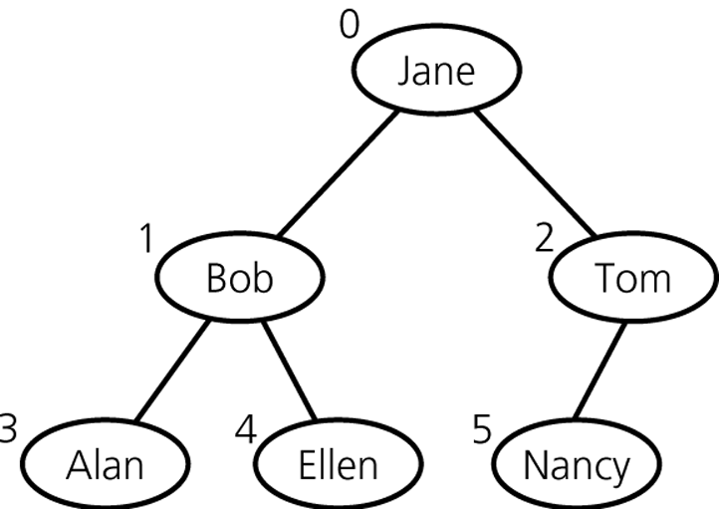
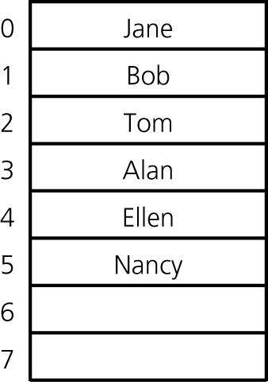
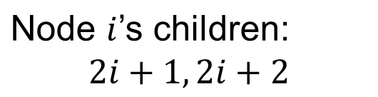
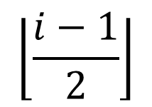
In Case of Complete Binary Trees
No link needed!
Node i’s parent:

Slide 18
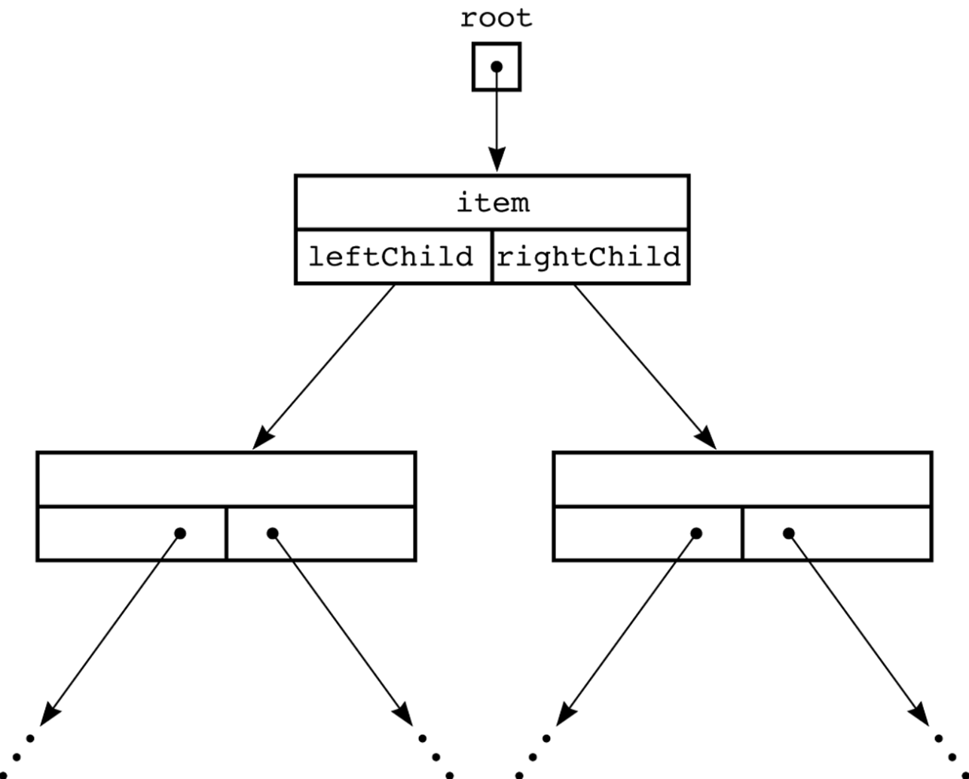
Reference-Based Representation

Slide 19
Reference-Based Implementation of Binary Tree
public class TreeNode {
private Object item;
private TreeNode leftChild;
private TreeNode rightChild;
public TreeNode(Object newItem) {
item = newItem;
leftChild = rightChild = null;
}
public TreeNode(Object newItem, TreeNode left, TreeNode right) {
item = newItem;
leftChild = left;
rightChild = right;
}
newItem
newItem
left
right

Slide 20
public Object getItem( ) {
return item;
}
public void setItem(Object newItem) {
item = newItem;
}
public TreeNode getLeft( ) {
return leftChild;
}
public TreeNode getRight( ) {
return rightChild;
}
public setLeft(TreeNode left) {
leftChild = left;
}
public setRight(TreeNode right) {
rightChild = right;
}
} // end TreeNode
•
left

Slide 21
Binary Search Tree
Each node has a search key
  There are no duplications among the search keys
  in a binary search tree
For each node n, it satisfies:
  n’s key is greater than all keys in its left subtree T_{L}
  n’s key is less than all keys in its right subtree T_{R}
  Both T_{L} and T_{R} are binary search trees

Slide 22
A Binary Search Tree of Names

Slide 23
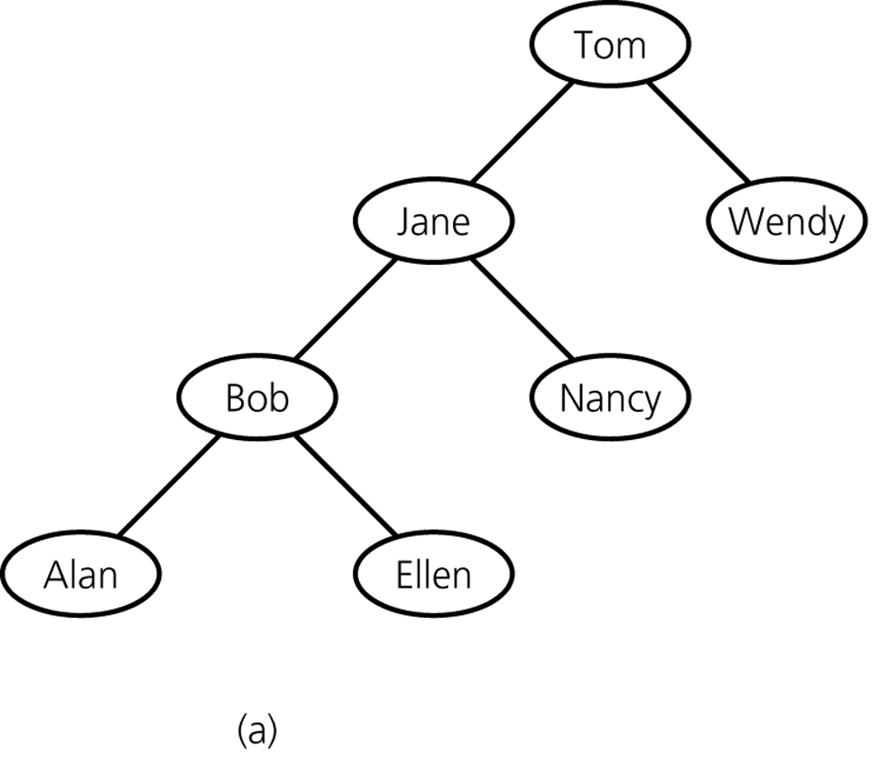
Another Binary Search Tree w/ the Same Data

Slide 24
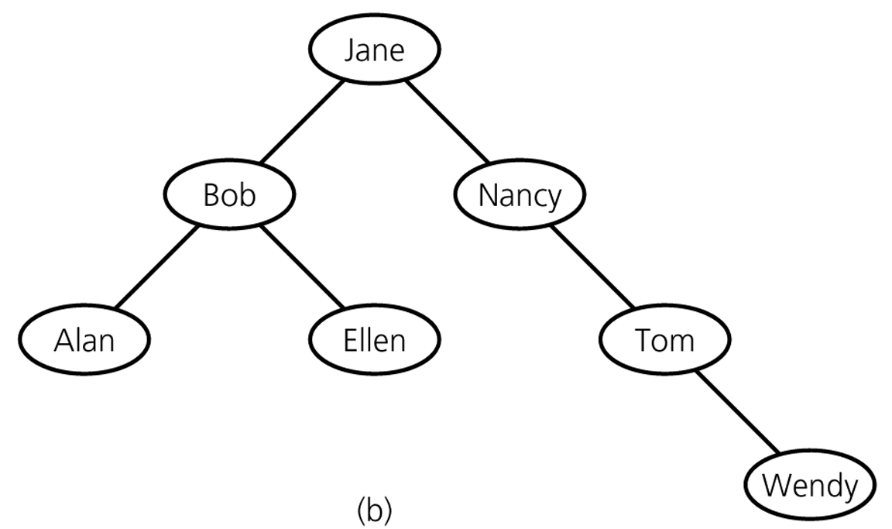
Yet Another

Slide 25
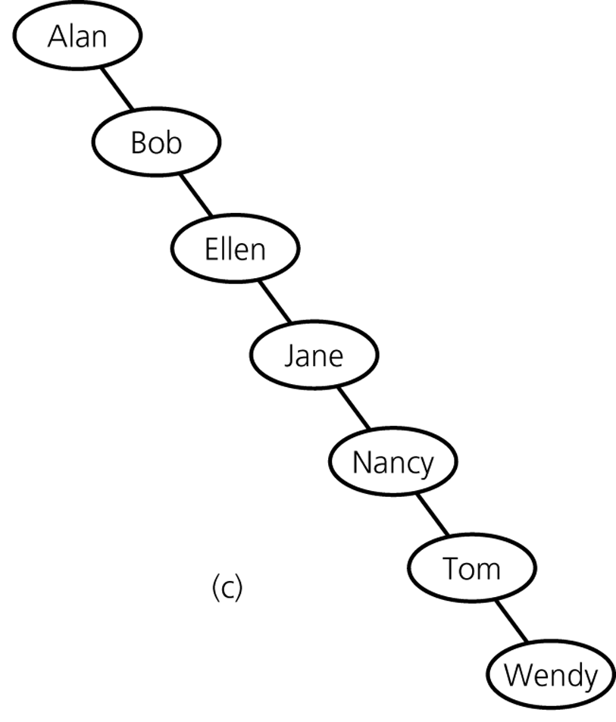
Yet Another

Slide 26
ADT Binary Search Tree Operations
Insert a new item into a binary search tree
Delete the item w/ a given search key from a binary search tree
Retrieve the item w/ a given search key from a binary search tree
Binary search tree는
index(색인, 찾아보기)용으로 유용하다

Slide 27
Search in a Binary Search Tree
search(root, searchKey) {
if (root is empty) return “Not found!”;
else if (searchKey == root’s key) return root;
else if (searchKey < root’s key)
return search(root’s left child, searchKey);
else
return search(root’s right child, searchKey);
}

Slide 28
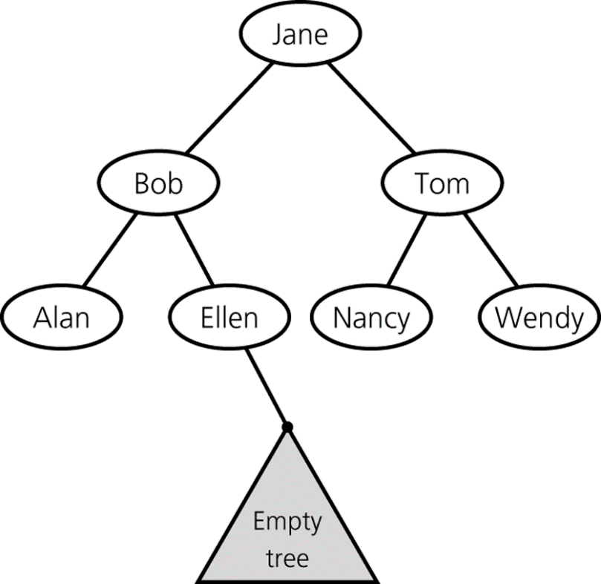
search(root, searchKey) {
if (root is empty) return “Not found!”;
else if (searchKey == root’s key) return root;
else if (searchKey < root’s key)
return search(root’s left child, searchKey);
else
return search(root’s right child, searchKey);
}

Slide 29
Insertion in a Binary Search Tree
insert (root, newItem) {
if (root is null) {
newItem을 key로 가진 새 node를 매단다;
}
else if (newItem < root’s key) insert(root’s left child, newItem);
else
insert(root’s right child, newItem);
}
Search()와 구조가 거의 같다

Slide 30
Deletion in a Binary Search Tree
deleteItem (root, searchKey) {
dNode = search(root, searchKey);
deleteNode(dNode);
}
Binary search tree의 operation들 중 상대적으로 복잡

Slide 31
deleteNode (dNode) {
if (dNode is a leaf) { dNode 삭제; } // case 1
else if (dNode has only one child c) { // case 2
c replaces dNode;
} else { // dNode has two children // case 3
minNode = dNode’ right subtree의 leftmost node;
// minNode has at most one right child
minNode replaces dNode;
deleteNode(minNode);
}
}

Slide 32
deleteNode (dNode) { // case 1
if (dNode is a leaf) { dNode 삭제; }
…
dNode

Slide 33
deleteNode (dNode) { // case 2
…
else if (dNode has only one child c) {
c replaces dNode;
}
…
dNode
Bob

Slide 34
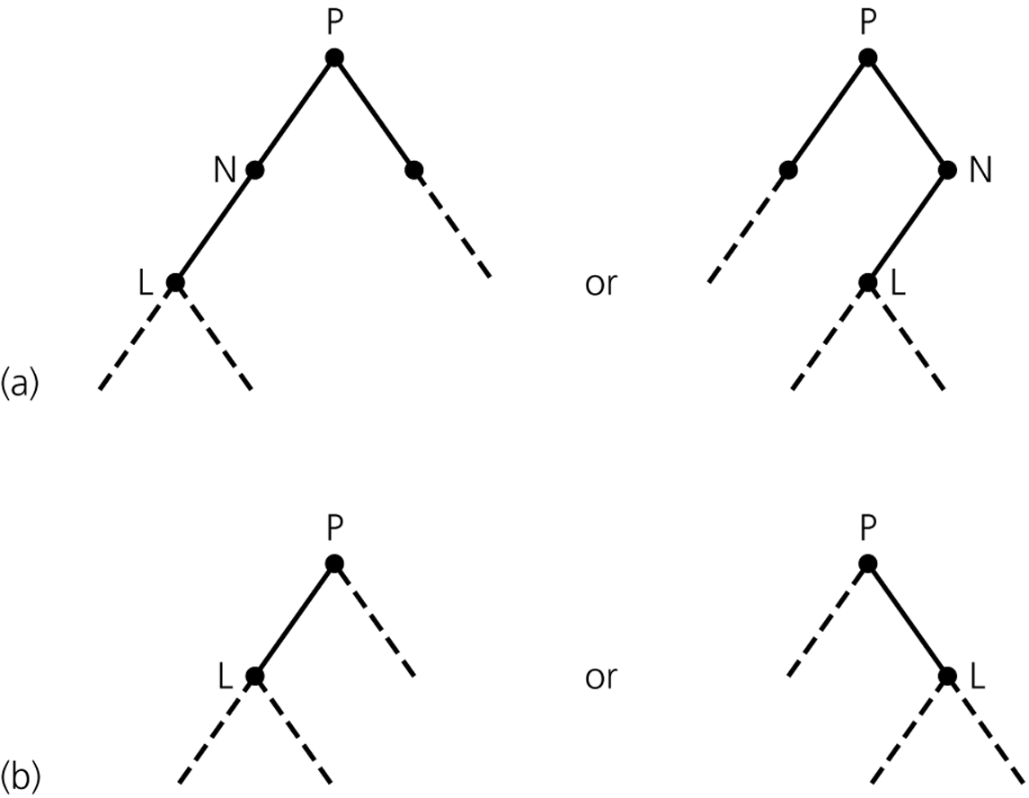
N with only a left child
N can be either the left or right child of P
After deleting node N

Slide 35
deleteNode (dNode) { // case 3
…
} else { // dNode has two children
minNode = dNode’ right subtree의 leftmost node;
// minNode has at most one right child
minNode replaces dNode;
deleteNode(minNode);
}
dNode
Bob
Jay
Jay
Notes:
~4/11/2018(제12강)

Slide 36
More Detailed Pseudo-Code
(Reference-Based)

Slide 37
insert(Comparable newItem) {
root = insertItem(root, newItem);
}
TreeNode insertItem(TreeNode tNode, Comparable newItem) {
if (tNode == null) { // insert after a leaf (or into an empty tree)
tNode = new TreeNode(newItem, null, null);
} else if (newItem < tNode’s item) { // branch left
tNode.setLeft( insertItem(tNode.getLeft( ), newItem) );
} else { // branch right
tNode.setRight( insertItem(tNode.getRight( ), newItem) );
}
return tNode;
} // end insertItem
tNode는 null일 때만 값이 바뀐다

Slide 38
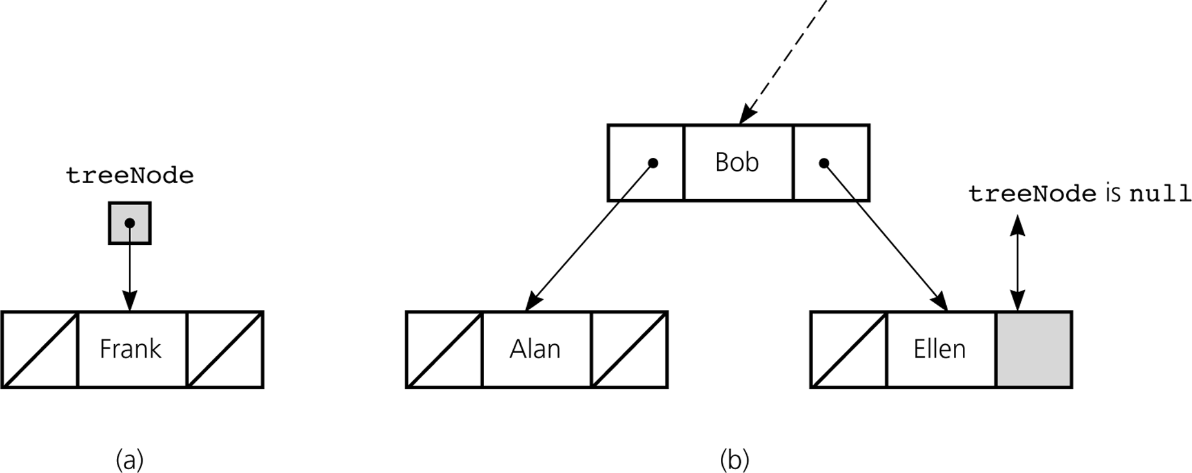

TreeNode insertItem(TreeNode tNode, Comparable newItem) {
if (tNode == null) { // insert after a leaf (or into an empty tree)
tNode = new TreeNode(newItem, null, null);
}
…
return tNode;
tNode
tNode
Empty tree
Leaf
상황 1
상황 2

Slide 39
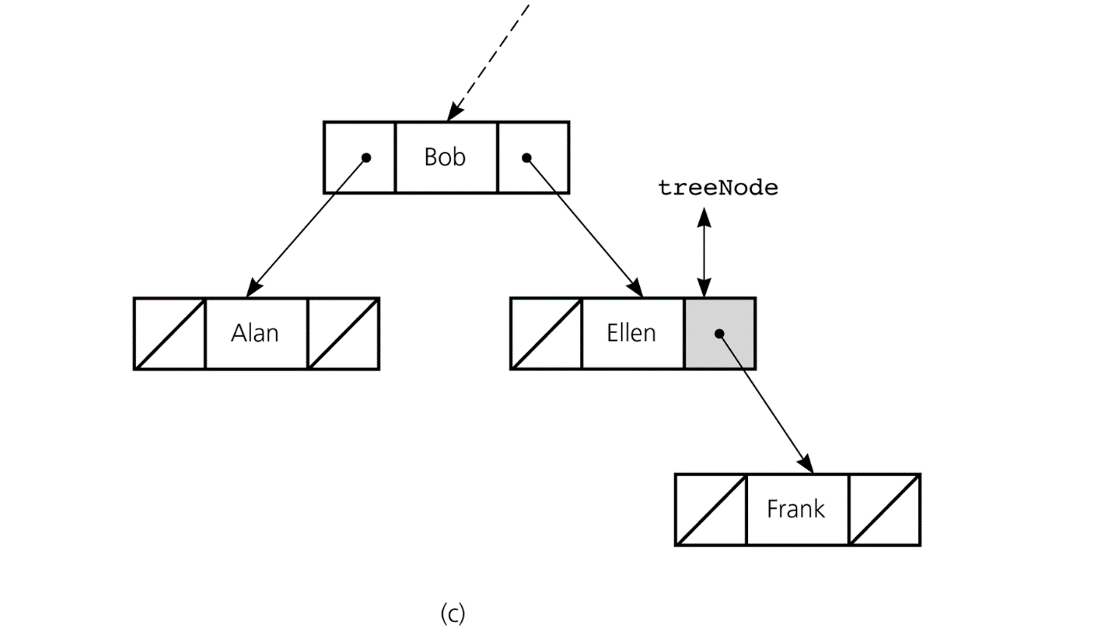

TreeNode insertItem(TreeNode tNode, Comparable newItem) {
if (tNode == null) { // insert after a leaf (or into an empty tree)
tNode = new TreeNode(newItem, null, null);
}
…
return tNode;
root
tNode
기다리고 있던 “root = …”에 의해 이렇게 연결된다
기다리고 있던 setRight( )에 의해 이렇게 연결된다
상황 1
상황 2

Slide 40
TreeNode insertItem(TreeNode tNode, Comparable newItem) {
…
if (newItem < tNode’s item) { // branch left
tNode.setLeft( insertItem(tNode.getLeft( ), newItem) );
}
…
return tNode;
tNode
이것은 안변한다
Jay
tNode
Jay
Caren
이것은 변한다
상황 1
상황 2

Slide 41
TreeNode retrieve (Comparable searchKey) {
return retrieveItem(root, searchKey);
}
TreeNode retrieveItem (TreeNode tNode, Comparable searchKey) {
if (tNode == null) return null; // not exist!
else {
if (searchKey == tNode’s key) return tNode;
else if (searchKey < tNode’s key)
return retrieveItem(tNode.getLeft( ), searchKey);
else
return retrieveItem(tNode.getRight( ), searchKey);
}
}

Slide 42
TreeNode deleteItem (TreeNode tNode, Comparable searchKey) {
if (tNode == null) {exception 처리}; // item not found!
else {
if (searchKey == tNode’s key) { // item found!
tNode = deleteNode(tNode);
} else if (searchKey < tNode’s key) {
tNode.setLeft(deleteItem(tNode.getLeft( ), searchKey));
} else {
tNode.setRight(deleteItem(tNode.getRight( ), searchKey) );
}
}
return tNode; // tNode: parent에 매달리는 노드
}

Slide 43
TreeNode deleteNode (TreeNode tNode) {
// Three cases
// 1. tNode is a leaf
// 2. tNode has only one child
// 3. tNode has two children
if ( (tNode.getLeft( ) == null) && (tNode.getRight( ) == null)) { // case 1
return null;
} else if (tNode.getLeft( ) == null ) { // case 2 (only right child)
return tNode.getRight( );
} else if (tNode.getRight( ) == null) { // case 2 (only left child)
return tNode.getLeft( );
} else { // case 3 – two children
tNode.setItem(minimum item of tNode’s right subtree);
tNode.setRight(deleteMin(tNode.getRight( ));
return tNode; // tNode survived
}
}

Slide 44
TreeNode deleteMin (TreeNode tNode) {
if (tNode.getLeft( ) == null) { // found min
return tNode.getRight( ); // right child moves to min’s place
} else { // branch left, then backtrack
tNode.setLeft(deleteMin(tNode.getLeft( ));
return tNode;
}
}
Jay

Slide 45
Traversal of Binary Tree
A traversal algorithm visits every node in the tree
There are three representative traversal algorithms for binary trees
  Preorder traversal
  Inorder traversal
  Postorder traversal

Slide 46
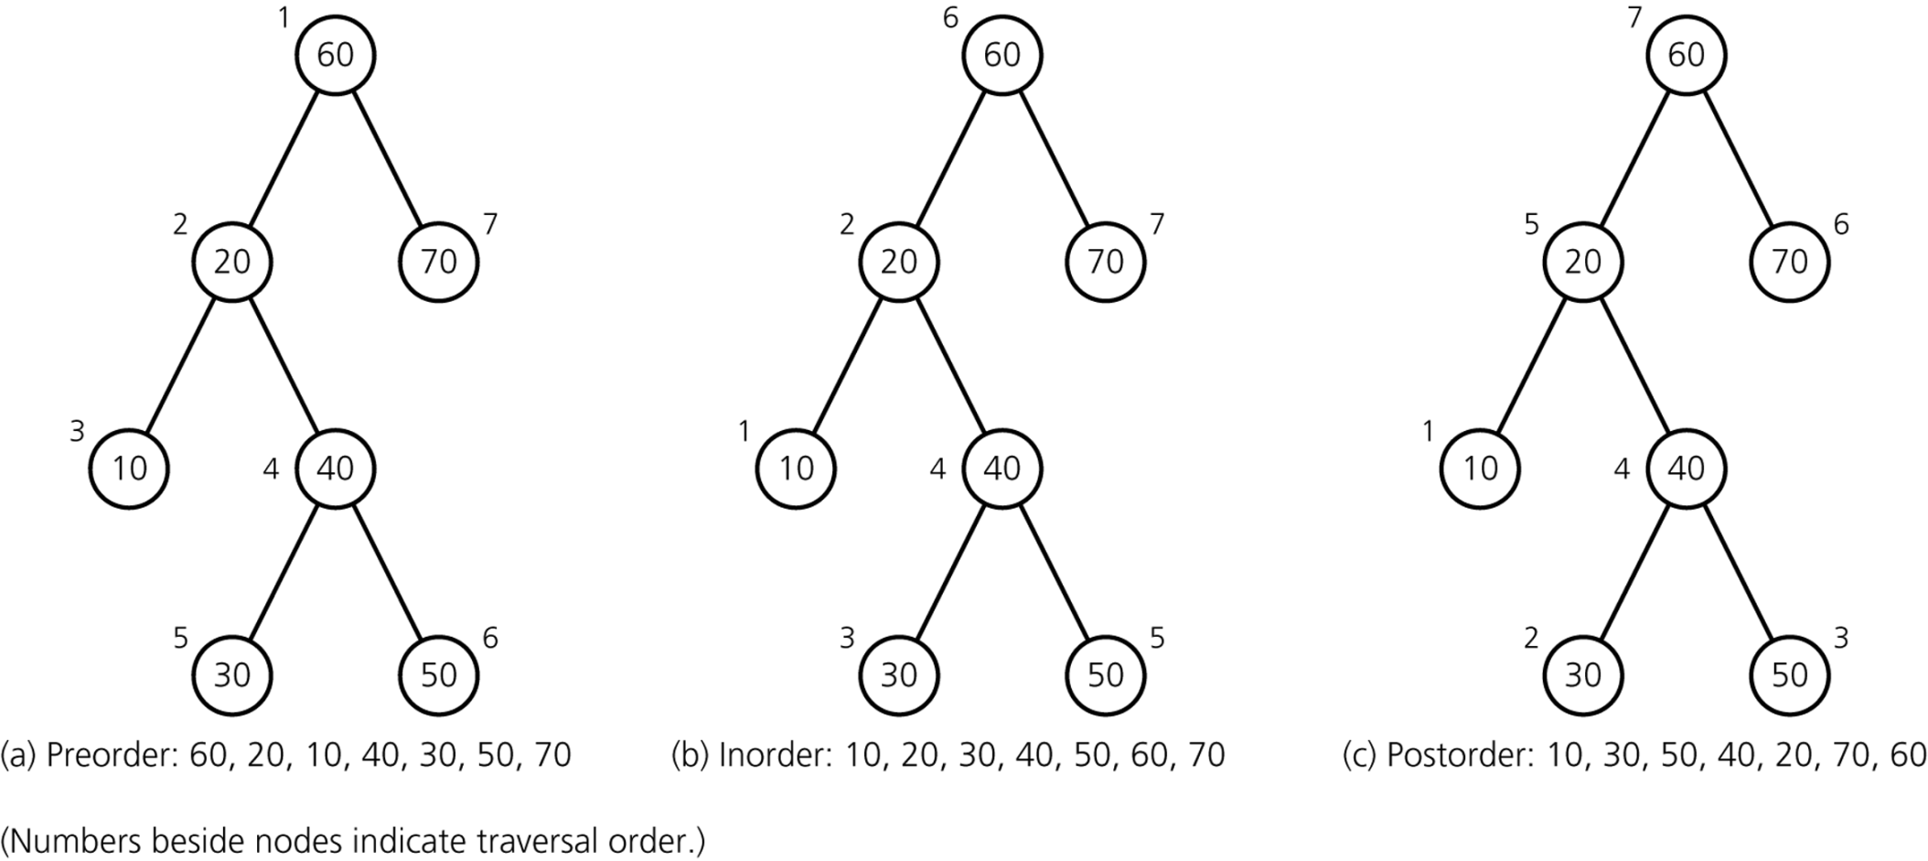
Preorder, Inorder, Postorder

Slide 47
Preorder Traversal
preorder(root)
{
if (root is not empty) {
Mark root;
preorder(Left subtree of root);
preorder(Right subtree of root);
}
}

Slide 48
Inorder Traversal
inorder(root)
{
if (root is not empty) {
inorder(Left subtree of root);
Mark root;
inorder(Right subtree of root);
}
}

Slide 49
Postorder Traversal
postorder(root)
{
if (root is not empty) {
postorder(Left subtree of root);
postorder(Right subtree of root);
Mark root;
}
}

Slide 50
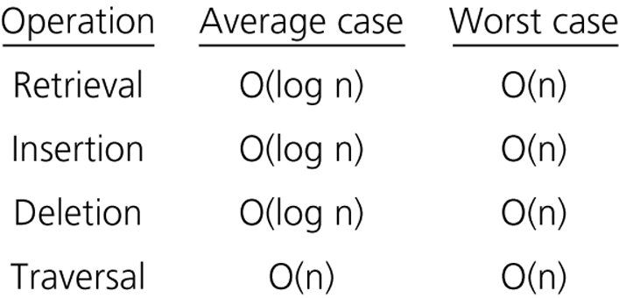
Operations’ Efficiency on B.S.T.

Slide 51
Properties of Binary Trees
Theorem 1
  The inorder traversal of a binary search tree T visits its nodes in sorted search-key order.
<Proof>
Basis: h = 1.
T consists of only one node, the root.
Visiting the only node is obviously in sorted order.
Inductive hypothesis: Assume that the theorem is true for
all k < h.

Slide 52
Inductive conclusion: Want to show that the theorem is
true for k = h. T is of the form
r
h
h–1
T_{L}
T_{R}
Inorder visits T_{L} and T_{R} in sorted order, respectively, by the inductive hypothesis. Because keys in T_{L} < r’s key and keys in T_{R} > r’s key, the inorder traversal of T_{L}→ r → T_{R} is in sorted order.

Slide 53
Height
Theorem 2
  A full binary tree of height h ≥ 0 has 2^{h} – 1 nodes.
Corollary 1
  The number of nodes in a binary tree of height h
  is at most 2^{h} – 1.
Proofs are simple!

Slide 54
Theorem 3
  The minimum height of a binary tree with n nodes is
  log₂(n+1) .
<Proof>
Straightforward by Corollary 1

Slide 55

Depth
Definition: Internal Path Length (IPL)
  Sum of depths of its nodes
1
2
2
3
3
IPL = 19
4
4

Slide 56
Theorem 4
  The expected IPL of a binary tree with n nodes is O(n log n)
  under the assumption that all permutations are equally likely.
<Proof> Chapter11-IPL증명.doc
Meaning: Average search time for an item is O(log n).

Slide 57
Tree Size 구하기
int size(TreeNode t)
{
if (t == null) return 0;
else return (1 + size(t.getLeft( )) + size(t.getRight( )));
}

Slide 58
An Example Use: Huffman Code
A Simple data compression
Examine the frequencies of each digit in the file
Then, determine the code for each digit w/ a binary tree
Optimal in symbol-by-symbol encoding with given probabilities
Cf: an interesting history in relation to Shannon-Fano algorithm (top-down)

Slide 59
E.g., Want to handle a file w/ only 10 digits
Digits 0 1 2 3 4 5 6 7 8 9
Freq. .20 .25 .15 .08 .07 .06 .05 .05 .05 .04
0
1
0
1
0
1
.13
.10
.09
0 00
1 10
2 110
3 1110
4 0100
5 0101
6 0110
7 0111
8 11110
9 11111
0
.17
1
0
1
.23
0
1
.32
2*0.45
+3*0.15
+4*0.31
+5*0.09
0
1
0
1
.43
.57
0
1
3.04 < 4
1.00

Slide 60
Treesort
Inorder traversal을 이용한 sorting 방법
  Element들을 모두 binary search tree로 넣는다
  Inorder traversal 순서대로 print 한다
Performance
  Average case: O(n log n)
  Worst case: O(n²)

Slide 61
Saving a B.S.T. in a File
Preserving the original shape
  Use preorder for saving
Restoring to a balanced shape
  Use inorder for saving
  Restoring
  recursiveRestore (L) { // L: an array
  Set the median item r to be the root;
    r.leftChild = recursiveRestore(the left part of median);
    r.rightChild = recursiveRestore(the right part of median);
    return r ;
  }

Slide 62
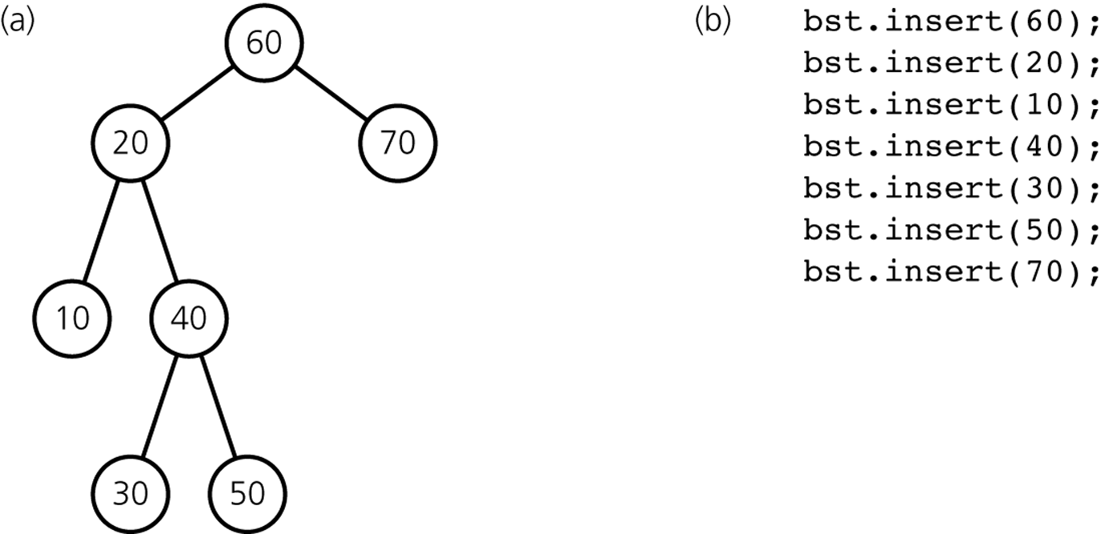
a) A binary search tree bst; b) the sequence of insertions that result in this tree

Slide 63
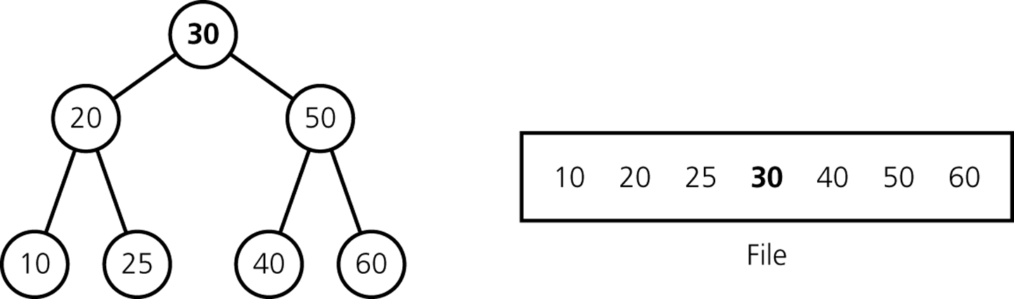
A full tree saved in a file by using inorder traversal

Slide 64
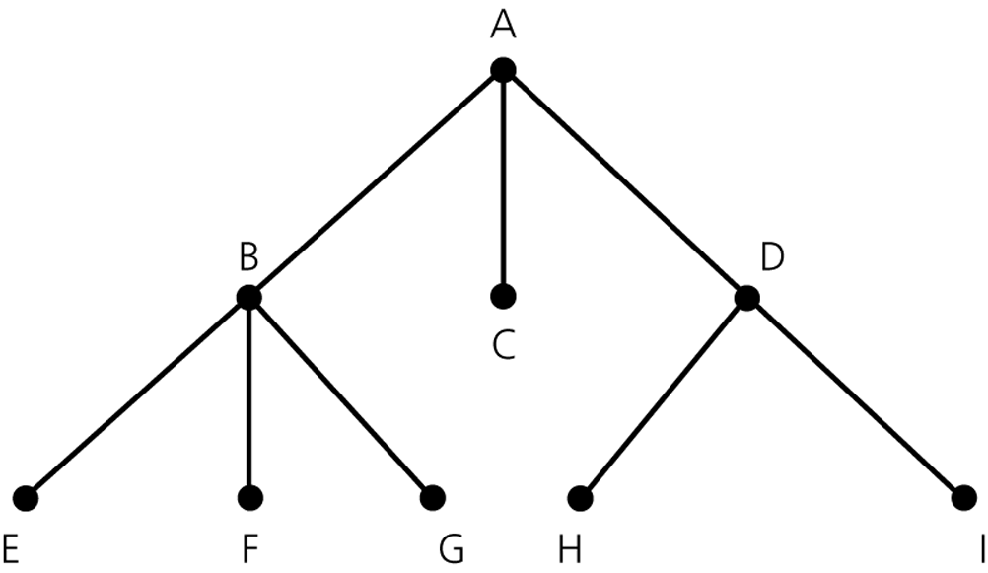
General Trees

Slide 65
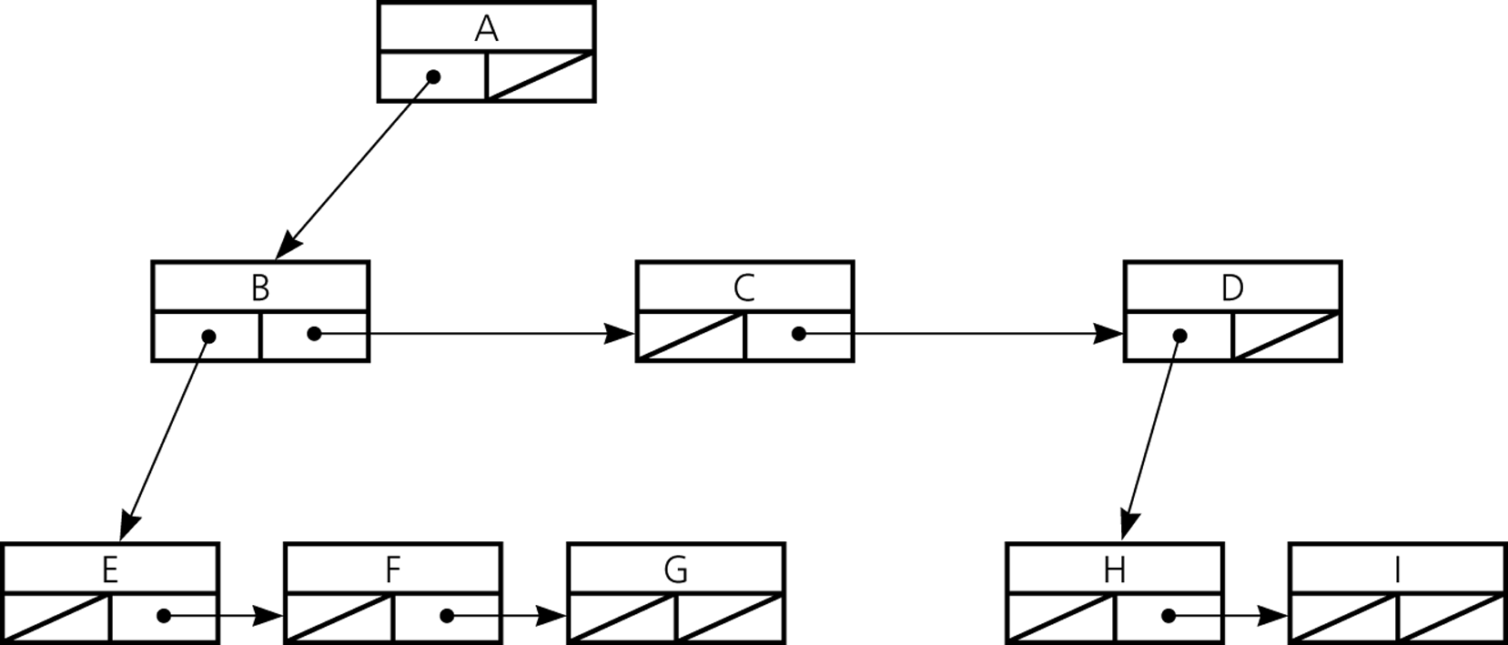
A Reference-Based Implementation of General Trees

Slide 66
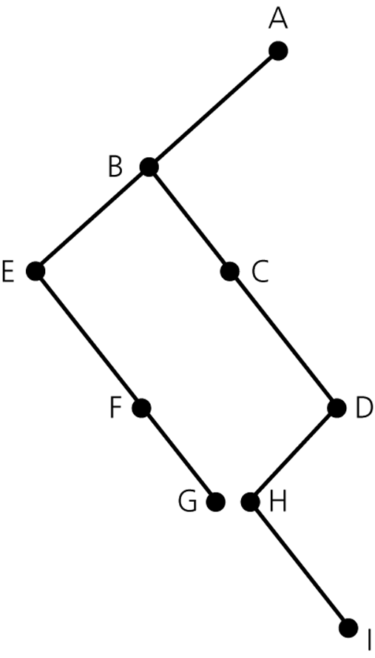
A General Tree and Corresponding Binary Tree

Slide 67
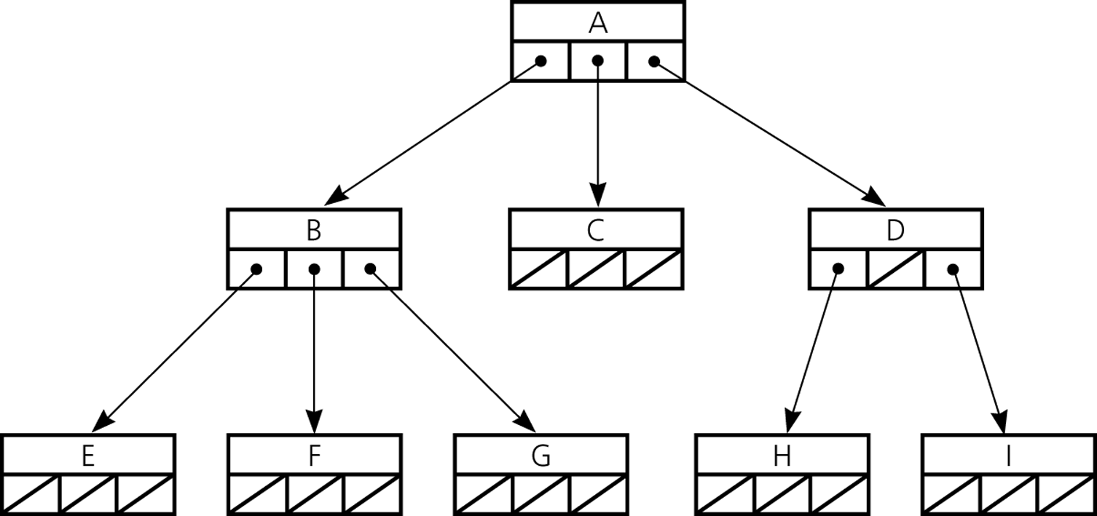
n-ary Tree

