Slide 1
OS Project 1
OS Team 7

Slide 2
Preprocess
Change __NR_syscalls in arch/arm/include/asm/unistd.h
__NR_syscalls must be divided by four
Define __NR_ptree in arch/arm/include/uapi/asm/unistd.h
Add CALL(sys_ptree) in arch/arm/kernel/calls.S
Declare struct prinfo in include/linux/prinfo.h
Add Object file(ptree.o) in kernel/Makefile

Slide 3
int ptree(struct print *buf, int *nr)
Input
struct prinfo * buf : Pointer where to copy process tree information
int * nr : size of buffer
Output
struct print * buf : process tree information
int * nr : number of entries written buf
Return value
success : total number of entries on success (can be different from *nr)
buf/nr is null or *nr <= 0 : -EINVAL
Can’t write to buf/nr : -EFAULT
Not enough memory : -ENOSPC

Slide 4
Process infomation
Are stored with “struct task_struct” type
struct prinfo | struct task_struct
long state | volatile long state;
pid_t pid | pid_t pid
pid_t pid | struct task_struct __rcu *real_parent
pid_t first_child_pid | struct list_head children
pid_t next_sibling_pid | struct list_head sibling
long uid | task_uid(struct task_struct)
char comm[64]; | char comm[TASK_COMM_LEN]

Slide 5
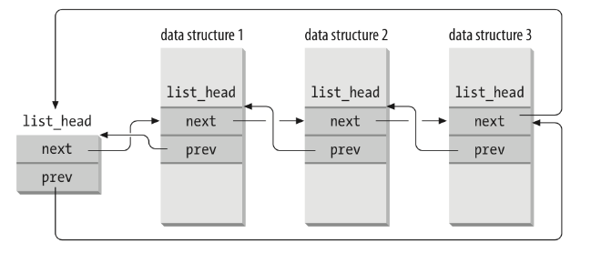

What is list_head?
#define list_for_each(pos, head)
for(pos = (head)->next; pos != (head); pos = pos->next)
#define list_entry(ptr, type, member)
container_of(ptr, type, member)
#define container_of(ptr, type, member) ({ \
const typeof( ((type *)0)->member ) *__mptr = (ptr); \
(type *)( (char *)__mptr - offsetof(type,member) );})

Slide 6
ptree_dfs
int ptree_dfs(struct task_struct *now) {
if(now != &init_task && memory enough) fill process information
list_for_each(p, &now->children) {
t = list_entry(p, struct task_struct, sibling);
all += ptree_dfs(t)
}
return all;
}

Slide 7
ptree.c (without checking error)
SYSCALL_DEFINE2(ptree, struct prinfo *, buf, int *, nr) {
num_of_proc = ptree_dfs(&init_task);
if(list_size > num_of_proc) list_size = num_of_proc;
rb = list_size;
kernel_buf += rb; user_buf += rb;
while((rb = copy_to_user(user_buf - rb, kernel_buf - rb, rb)) > 0);
return num_of_proc;
}

Slide 8
test_ptree.c
while(1) {
data = (struct prinfo*)malloc(size * sizeof(struct prinfo));
re = syscall(380, data, &size);
if(re == size) break;
size = re + 10;
free(data);
}
Print process tree information

Slide 9

Test our ptree (Demo)

Slide 10
What we learned?
How to use Git and Github properly
Branch usage
Push/Pull usage
Structure of process in Linux system
task_struct : What information does it contains?
list_head : Easy-to-use linked list
How to add system calls in Linux

