Slide 1
Ch. 10 Algorithm Efficiency & Sorting
O( ): Big-Oh
  An algorithm is said to take O(f (n))
  if
  its running time is upper-bounded by cf(n)
  e.g., O(n), O(n log n), O(n²), O(2^{n}), …
Formal definition
  O(f(n)) = { g(n) | ∃c > 0, n₀ ≥ 0 s.t.∀n ≥ n₀, cf(n) ≥ g(n) }
  g(n) ∈ O(f(n)이 맞지만 관행적으로 g(n) = O(f(n))이라고 쓴다.
직관적 의미
  g(n) = O(f(n)) ⇒ g grows no faster than f

Slide 2
Ω(f(n))
  적어도 f(n)의 비율로 증가하는 함수
  O(f(n))과 대칭적
Θ(f(n))
  f(n)의 비율로 증가하는 함수
  Θ(f(n)) = O(f(n)) ∩ Ω(f(n))

Slide 3
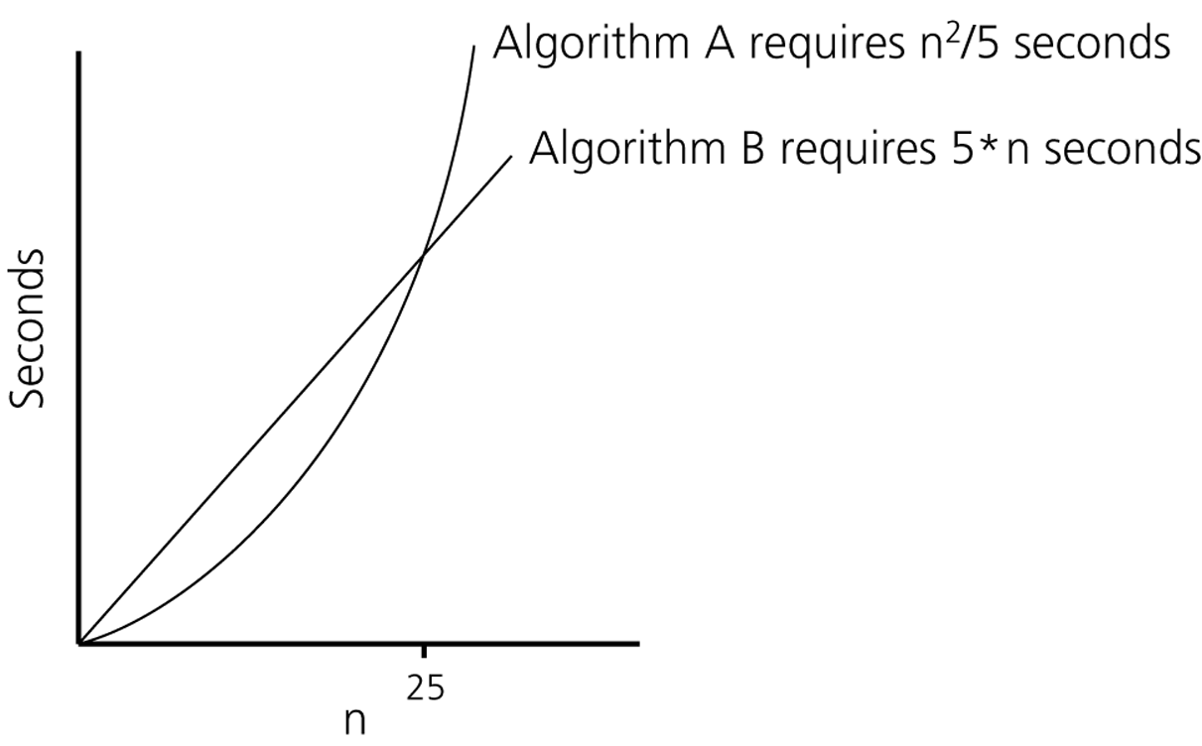
Time requirements as a function of the problem size n

Slide 4
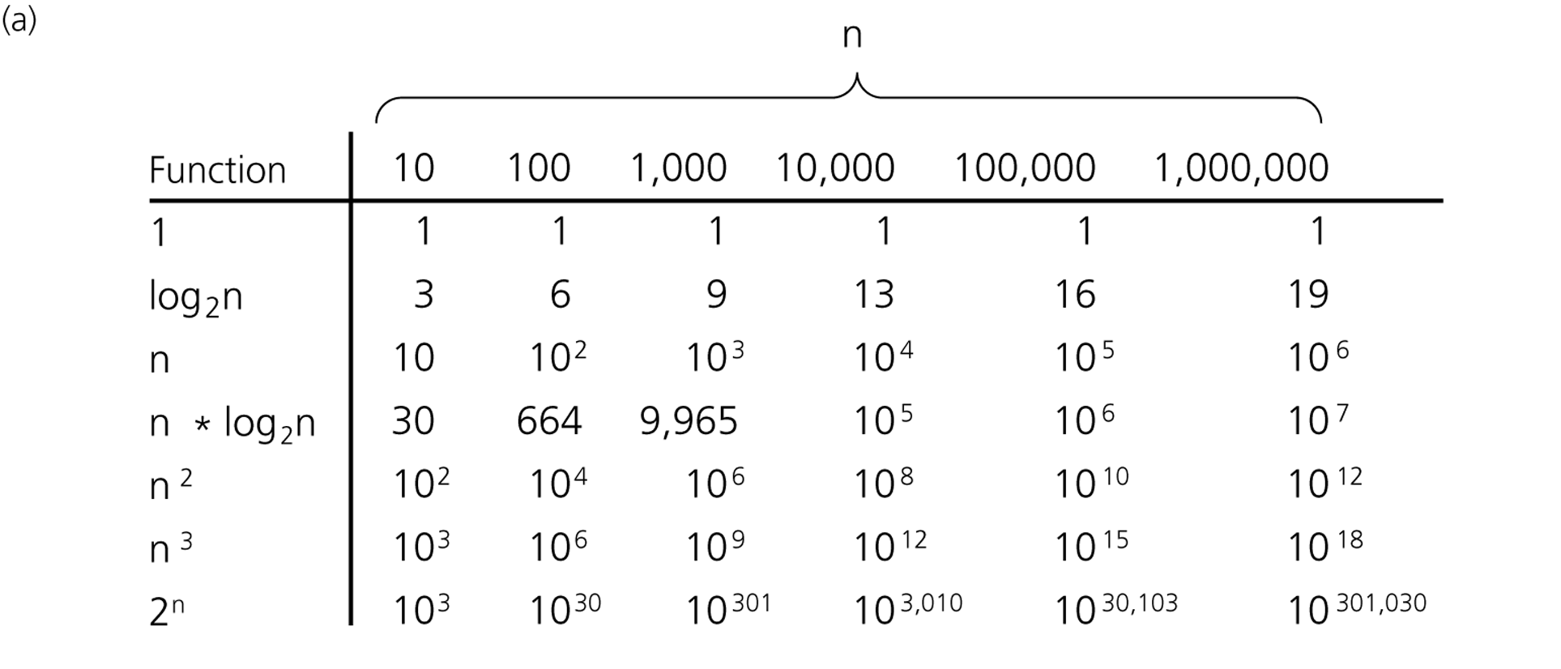
A comparison of growth-rate functions

Slide 5
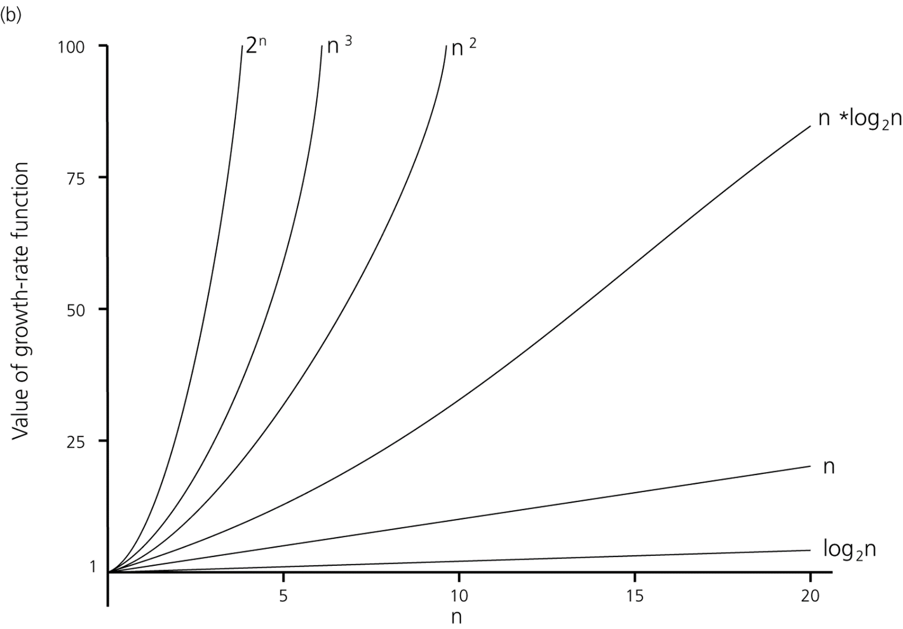
A comparison of growth-rate functions

Slide 6
Types of Running-Time Analysis
Worst-case analysis
  Analysis for the worst-case input(s)
Average-case analysis
  Analysis for all inputs
  More difficult to analyze
Best-case analysis
  Analysis for the best-case input(s)
  Mostly not meaningful

Slide 7
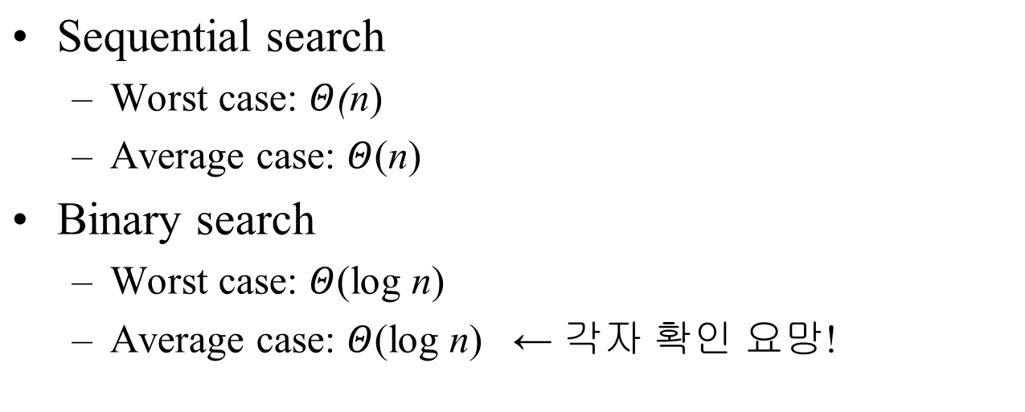
Running Time for Search in an Array

Slide 8
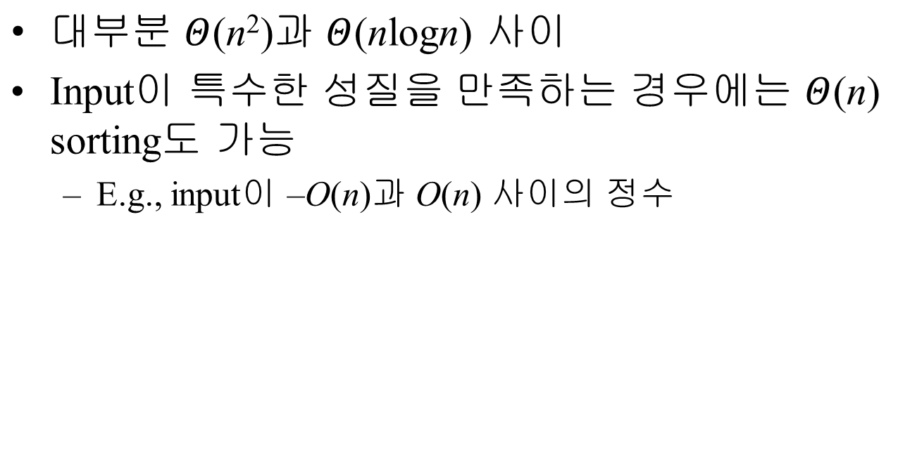
Sorting Algorithms

Slide 9
Selection Sort
An iteration
  Find the largest item
  Swap it to the rightmost place
  Exclude the rightmost item
Repeat the above iteration until only one item remained

Slide 10
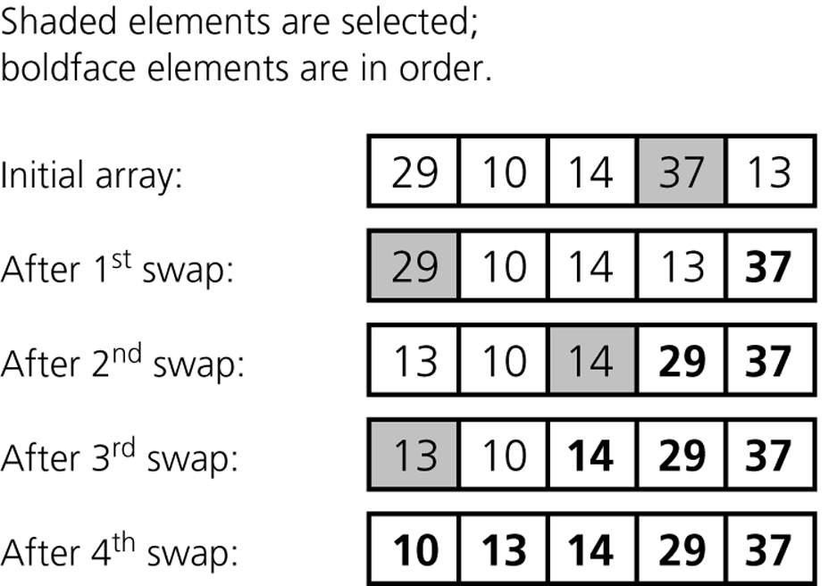
The largest item
Worst case
Average case

Slide 11

selectionSort(theArray[ ], n)
{
for (last = n-1; last >=1; last--) {
largest = indexOfLargest(theArray, last+1);
Swap theArray[largest] & theArray[last];
}
}
indexOfLargest(theArray, size)
{
largest = 0;
for (i = 1; i < size; ++i) {
if (theArray[i] > theArray[largest]) largest = i;
}
}
selectionSort(theArray[ ], n)
{
for (last = n-1; last >=1; last--) {
largest = indexOfLargest(theArray, last+1);
Swap theArray[largest] & theArray[last];
}
}
indexOfLargest(theArray, size)
{
largest = 0;
for (i = 1; i < size; ++i) {
if (theArray[i] > theArray[largest]) largest = i;
}
}
Running time: 두 함수의 for loop의 iteration 수의 합이 좌우
  indexOfLargest가 n-1 번 call 되고,
  call 될 때마다 indexOfLargest의 수행시간은
  한 단계씩 가벼워진다.
Running time: 두 함수의 for loop의 iteration 수의 합이 좌우
  indexOfLargest가 n-1 번 call 되고,
  call 될 때마다 indexOfLargest의 수행시간은
  한 단계씩 가벼워진다.

Slide 12
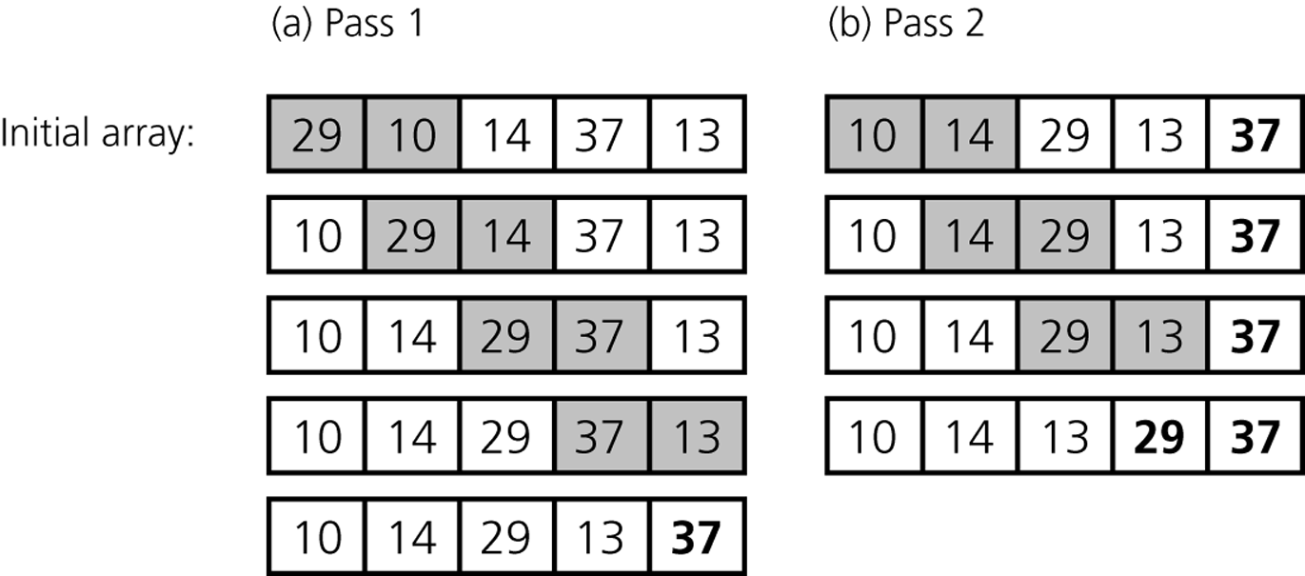
Bubble Sort
Worst case
Average case

Slide 13
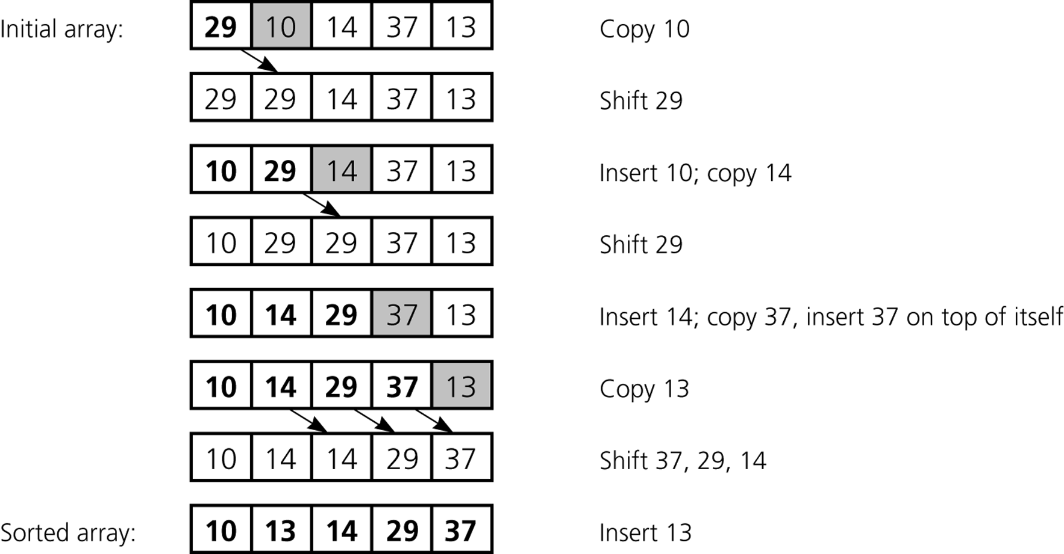

Insertion Sort
Worst case: 1+2+···+(n-2)+(n-1)
Average case: ½ (1+2+···+(n-2)+(n-1))

Slide 14
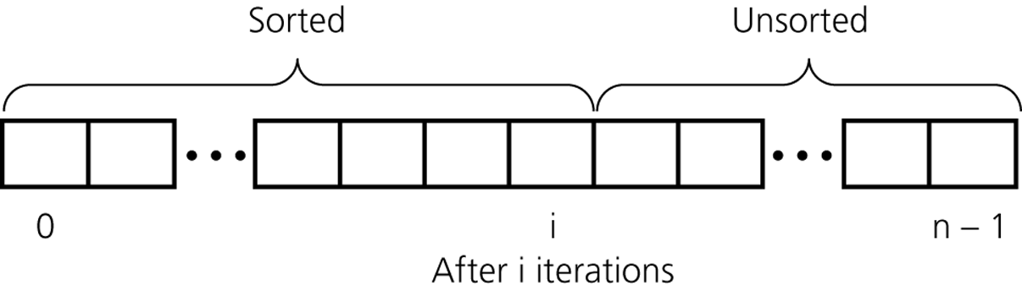
An insertion sort partitions the array into two regions

Slide 15
Mergesort
Algorithm mergeSort(S)
{ // Input: sequence S with n elements
// Output: sorted sequence S
  if (S.size( ) > 1) {
  Let S₁, S₂ be the 1st half and 2nd half of S, respectively;
  mergeSort(S₁);
  mergeSort(S₂);
  S ← merge(S₁, S₂);
  }
}
Algorithm merge(S₁, S₂)
{ sorting된 두 sequence S₁, S₂ 를 합쳐
sorting 된 하나의 sequence S를 만든다
}

Slide 16
Animation (Mergesort)
7 2 9 4 ⏐ 3 8 6 1
7 2 | 9 4
7 | 2
7

Slide 17

Animation (Mergesort)
7 2 9 4 ⏐ 3 8 6 1
1 2 3 4 6 7 8 9
2 4 7 9
1 3 6 8
7 2 | 9 4
2 4 7 9
2 7
4 9
7 | 2
2 7
9 | 4
7
2
4 9
9
4
7
2
9
4

Slide 18
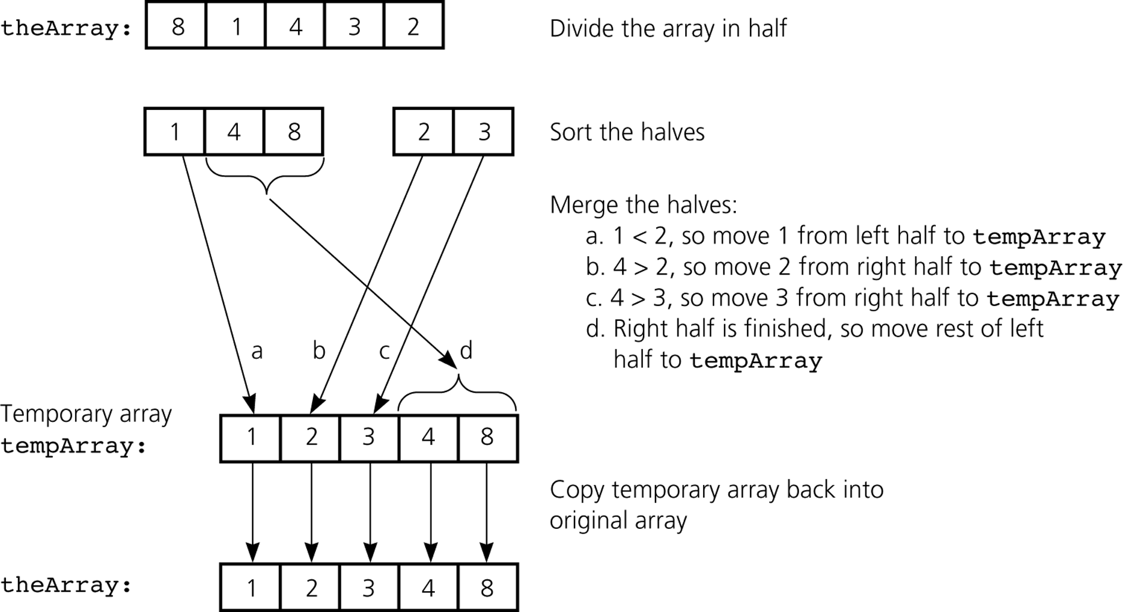
A mergesort with an auxiliary temporary array

Slide 19
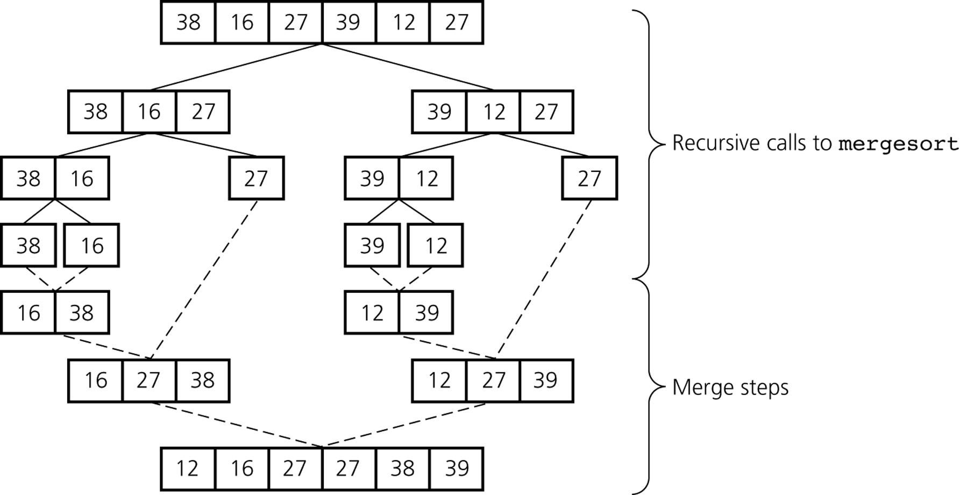
A mergesort of an array of six integers

Slide 20
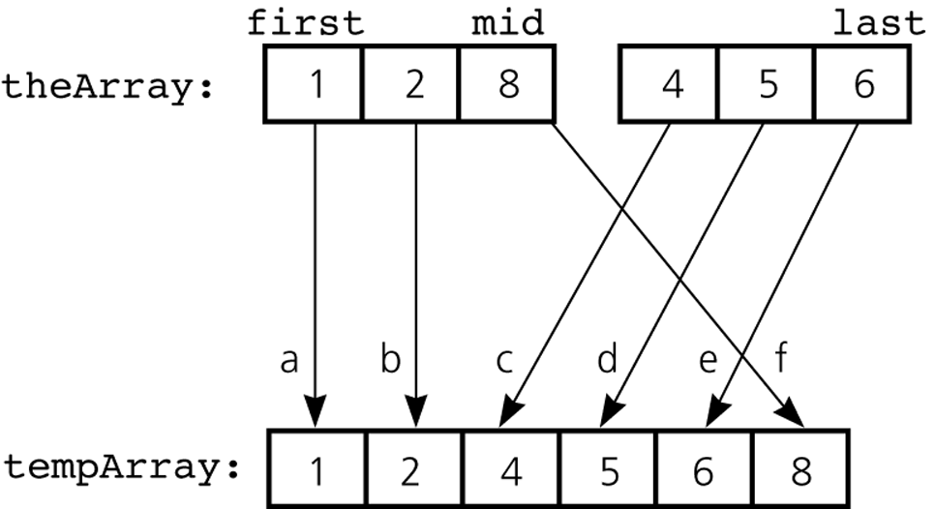
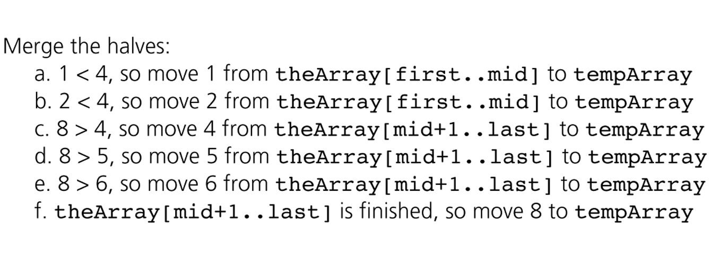
A worst-case instance of the merge step in mergesort

Slide 21
Quicksort
Algorithm quickSort(S)
{ // Input: sequence S with n elements
// Output: sorted sequence S
  if (S.size( ) > 1) {
  x ← pivot of S;
  (L, R) ← partition(S, x); // L: left partition, R: right partition
  quickSort(L);
  quickSort(R);
  return L • x • R; // concatenation
  }
}
Algorithm partition(S, x)
{ sequence S에서 x보다 작은 item은 partition L로,
x보다 크거나 같은 item은 partition R로 분류.
}

Slide 22
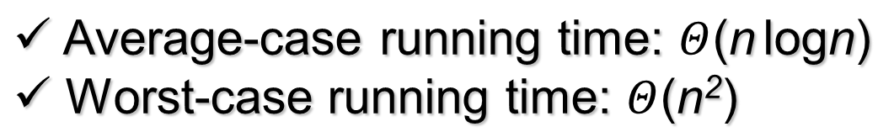
Animation (Quicksort)
5 1 9 4 2 6 8 3
3 1 4 2 5 9 6 8
1 2 3 4 5 9 6 8
1 2 3 4 5 6 8 9
6 8 9
9 6 8
6 8 9
3 1 4 2
8 6 9
2 1 3 4
1 2 3 4
1 2 3 4
8 6
6 8
6 8
4
6 8
2 1
4
1 2
1 2
1 2
6
1
6
1
1
1

Slide 23
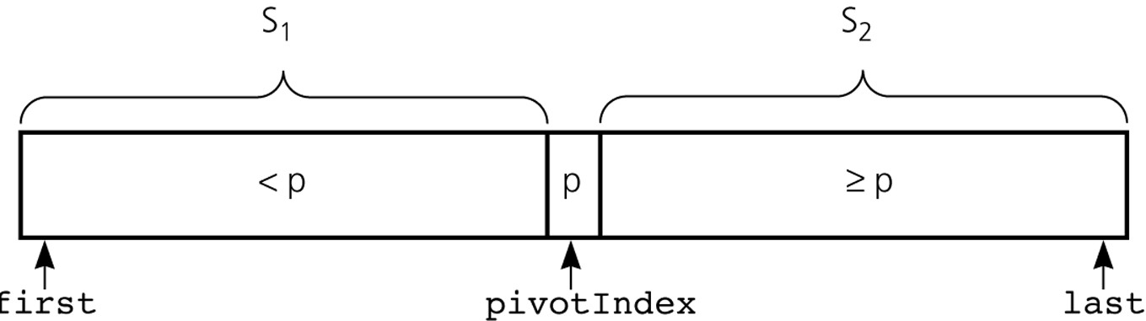
A partition with a pivot
Partitioning 방법은 다양하다
이것은 그 중 한 가지 방법

Slide 24
Radix Sort
radixSort(A[ ], d)
{ // Sort n d-digit integers in the array A[ ]
for (j = d downto 1) {
Do a stable sort on A[ ] by j^{th} digit;
}
}
Stable sort
  같은 값을 가진 item들은 sorting 후에도 원래의 순서가 유지되는 성질을 가진 sorting

Slide 25
0123
2154
0222
0004
0283
1560
1061
2150
1560
2150
1061
0222
0123
0283
2154
0004
0004
0222
0123
2150
2154
1560
1061
0283
0004
1061
0123
2150
2154
0222
0283
1560
0004
0123
0222
0283
1061
1560
2150
2154

Slide 26
Comparison of Sorting Efficiency
 | Worst Case | Average Case
Selection Sort | n² | n²
Bubble Sort | n² | n²
Insertion Sort | n² | n²
Mergesort | nlogn | nlogn
Quicksort | n² | nlogn
Radix Sort | n | n
Heapsort | nlogn | nlogn

