Slide 1
Ch. 14-1 External Methods
Notes:
~11/30/2005
~11/17/2010

Slide 2
External Storage
CPU
Main
memory
Disk, CD-ROM, tape, …
사이즈가 큰 data는 모두 internal memory에 load 될 수 없다.
  전체의 일부만 main memory에 있을 수 있다.
한 번의 disk access는 수십만 번의 instruction 수행과 맞먹는다.
External storage access가 포함된 작업에서는 대부분 external storage access가 시간을 지배한다.
SSD(Solid-State Drive) 시대가 열려 external storage의 부담은 많이 줄었다. But, 여전히 RAM과의 차이는 크다.
Disk

Slide 3
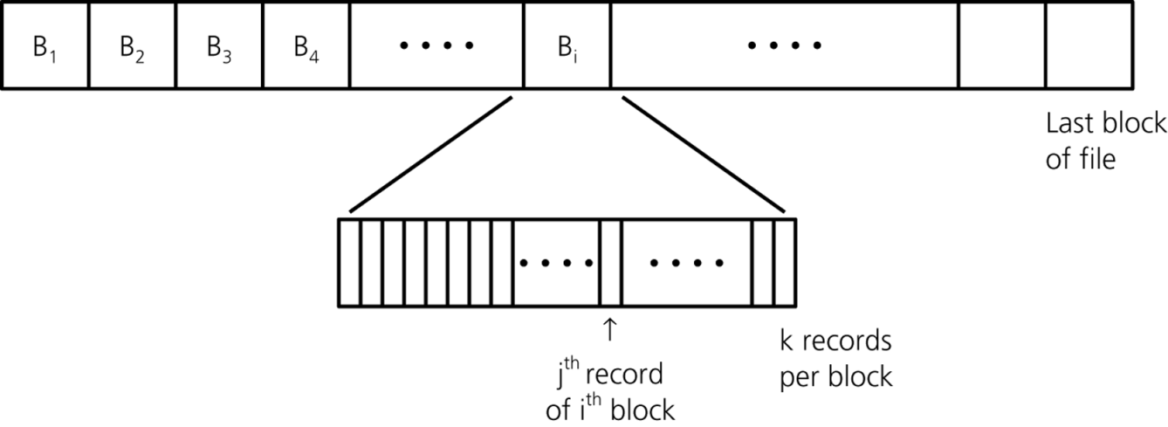
External storage access의 단위는 block
Typical block sizes
  4K, 8K, 16K, 32K bytes
  프로그래머가 결정하는 것이 아니고, 시스템에 따라 결정됨.
Each block consists of multiple data records
Typical access
  buf.readBlock(dataFile, i)
    buf: object for memory buffer
    dataFile: file containing the data
    i: index of block
Java
java.lang.Object
java.io.Reader
java.io.BufferedReader
java.io.Writer
java.io.BufferedWriter

Slide 4
External Mergesort
비현실적인 예제
  1,600 employee records
  100 records/block
  Maximum 300 records on memory
Files
  F : Original data
  F₁, F₂: work files

Slide 5
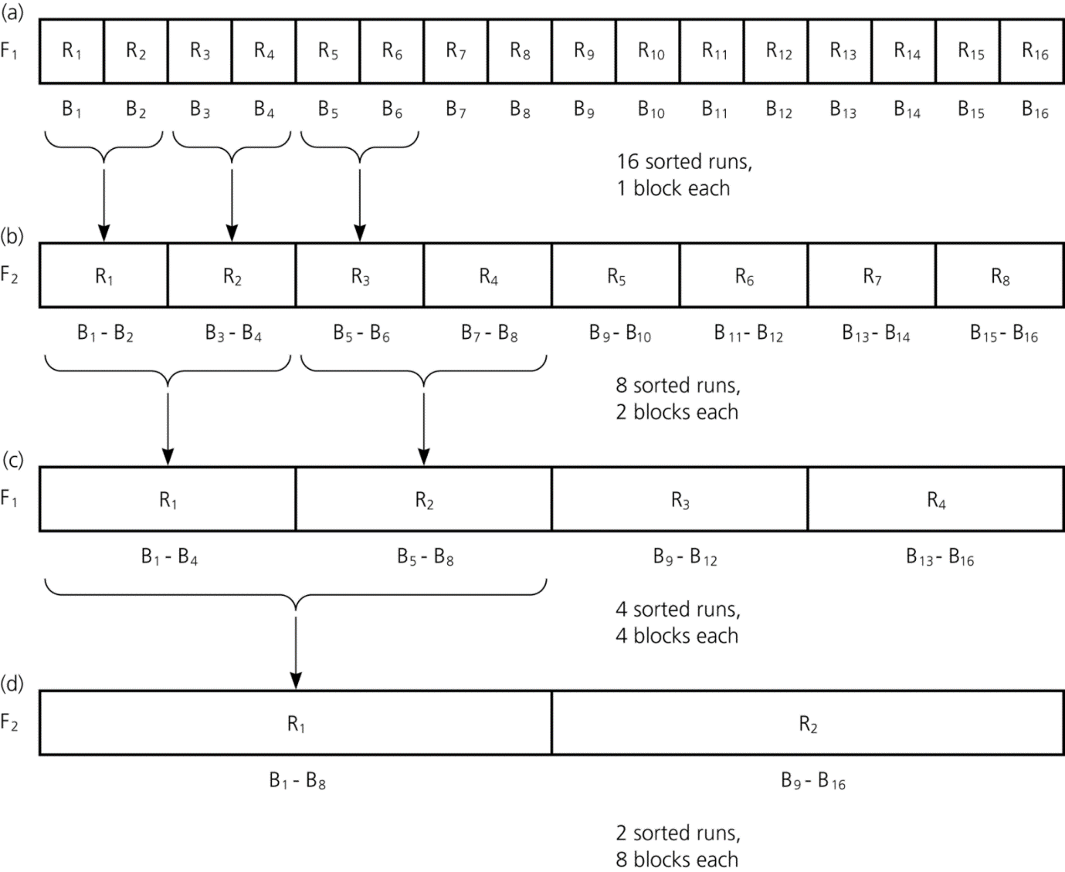
F
32 i/o-block accesses
32 i/o-block accesses
32 i/o-block accesses
32 i/o-block accesses
32 i/o-block accesses
(e)
F

Slide 6
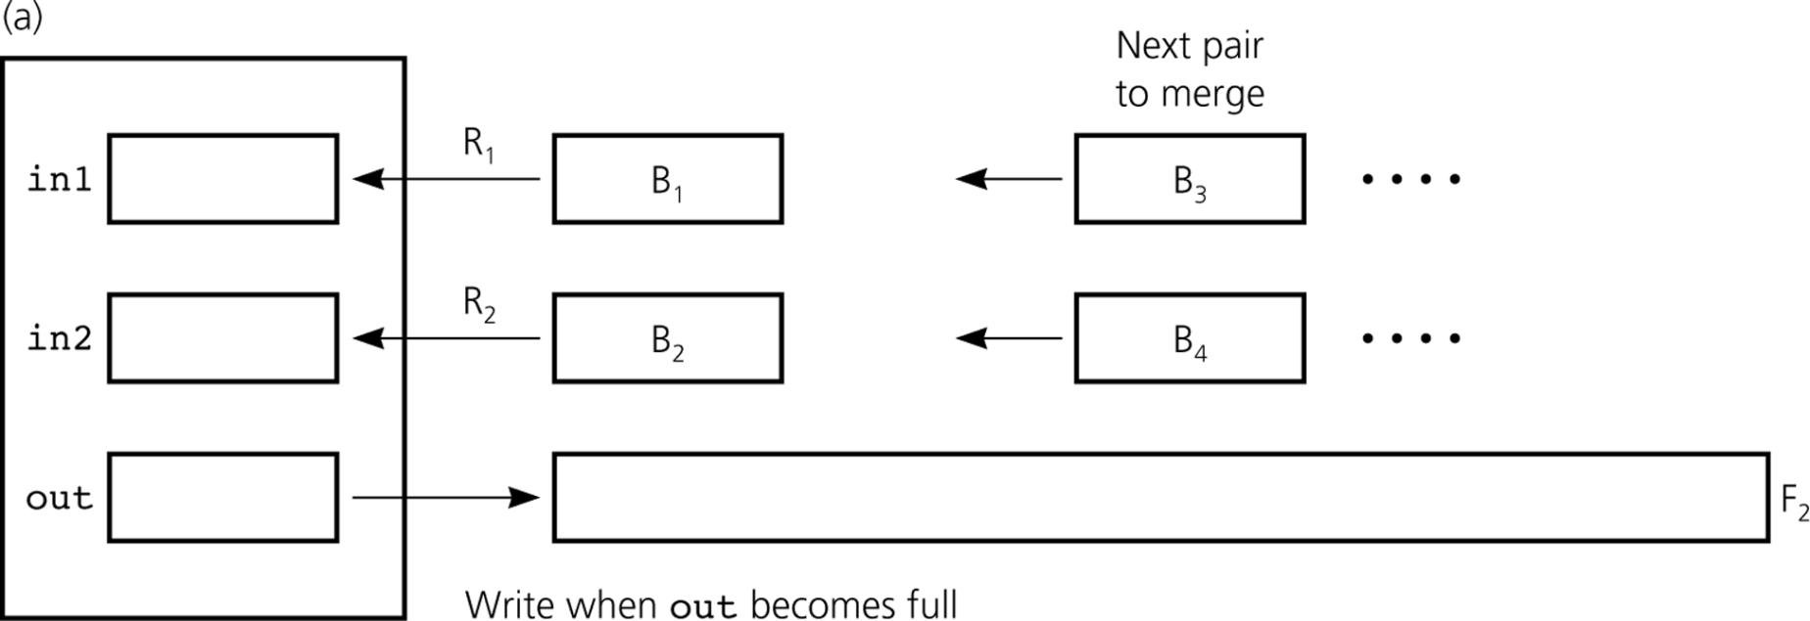
Merging Single Blocks

Slide 7
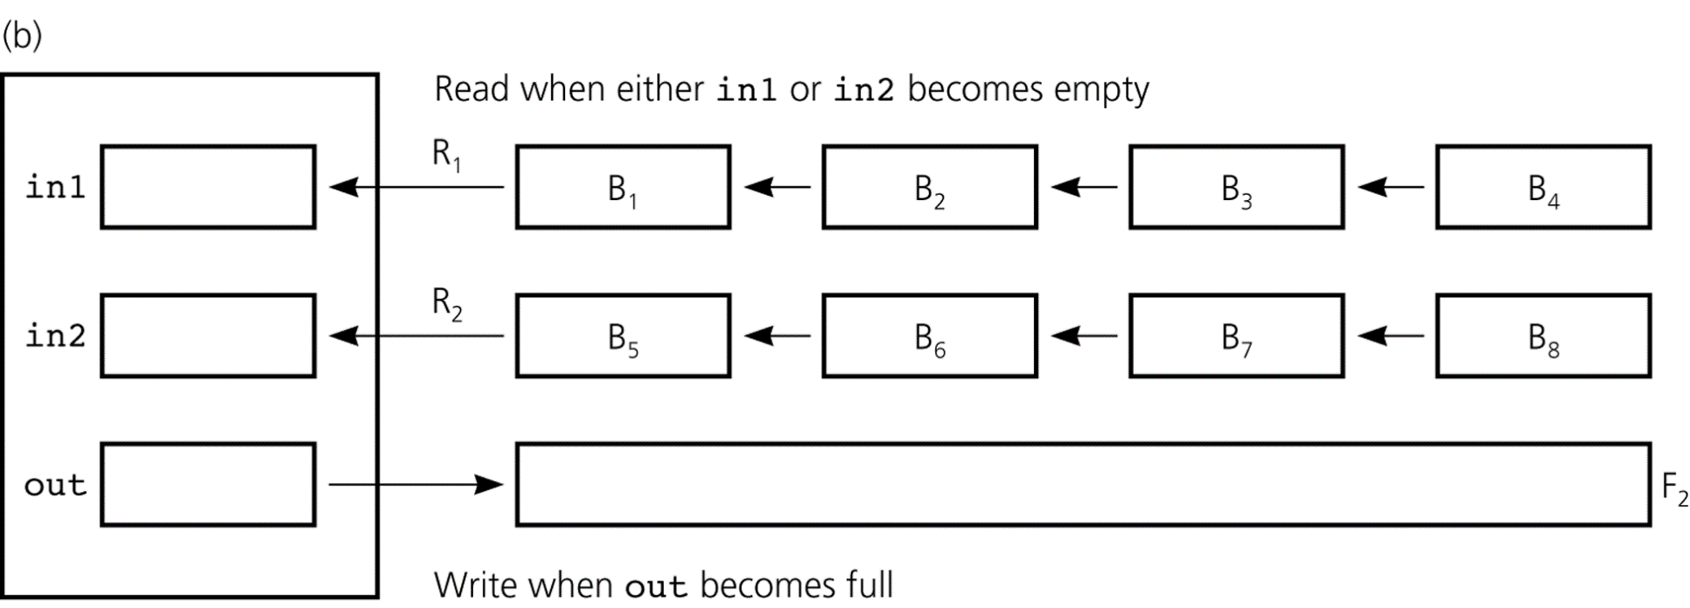
Merging Two 4-Block Runs

Slide 8
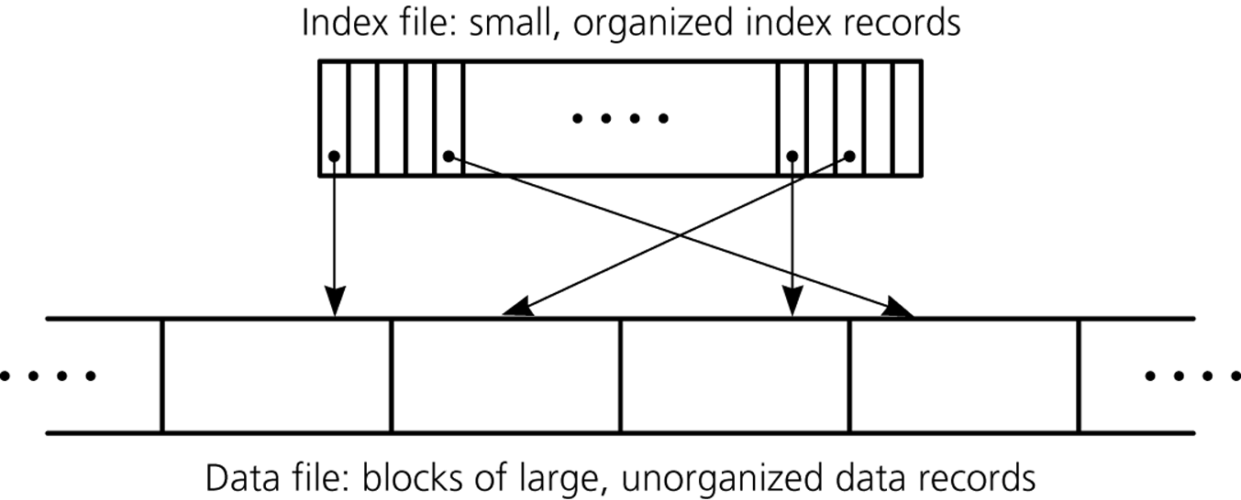
External Tables
Data are stored in an external storage
External hashing
B-trees

Slide 9
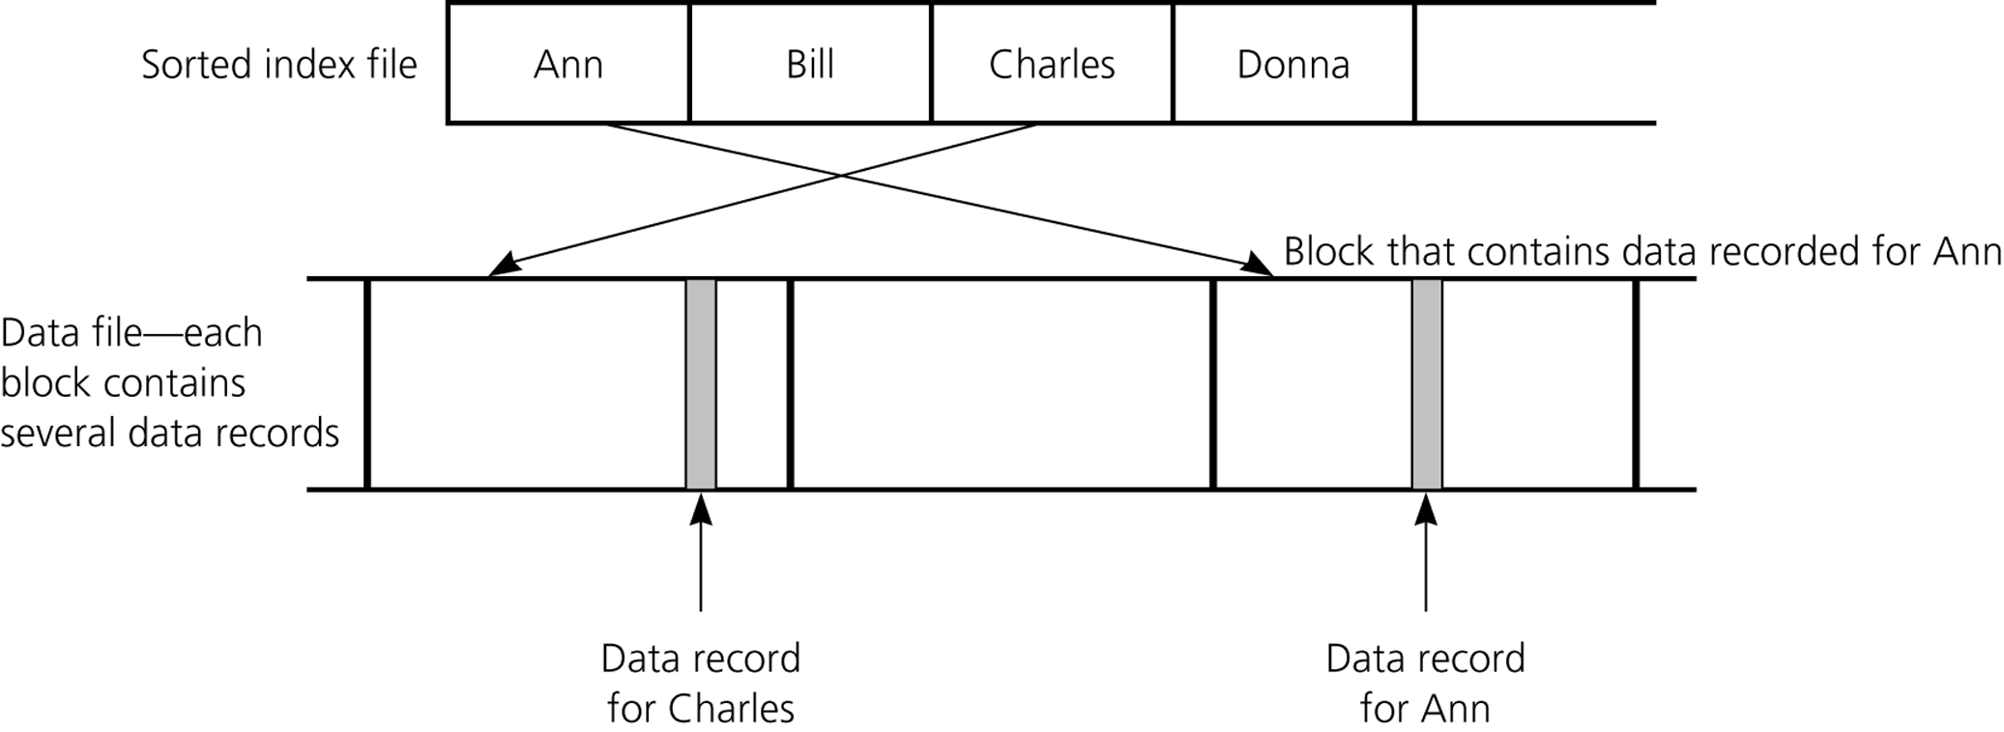
In external table, indices are managed not by references but by block numbers

Slide 10
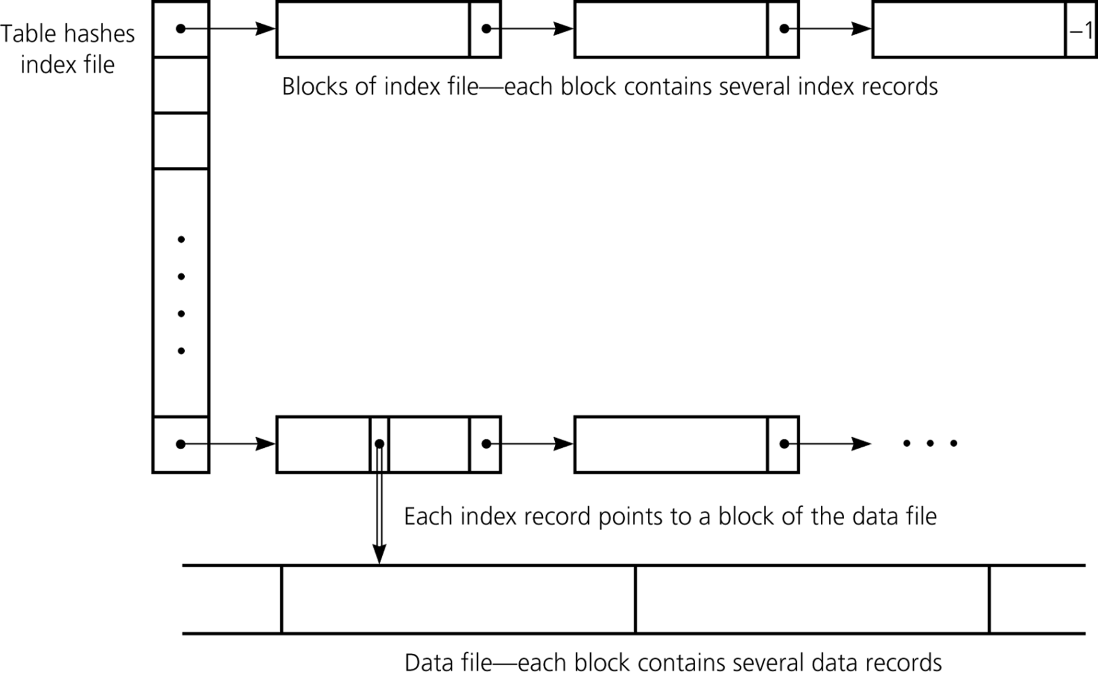
External Hashing
Main memory
Disk
Notes:
~11/19/2003
~11/22/2010

Slide 11
B-Trees
Block #
<k₂, b₂>
k-ary balanced search tree
There are up to m keys and m+1 branches in a node
Each internal node except the root has m ~ m/2 keys
Index record
• | k₁ | • | k₂ | • | • • • | • | k_{m} | •
• • •
S₀
S₁
S₂
S_{m}
S_{m+1}
Notes:
~5/20/2013

Slide 12
Retrieval in a B-tree
BRetrieve(fIndex, fData, rootNum, key)
// fIndex: B-tree file; fData: data file; key: search key
// rootNum: block # that contains the root of the tree(subtree)
{
if (rootNum == –1) return null;
buf.readBlock(fIndex, rootNum);
if (key is one of the k_{i}’s in the root) { // get data item
b_{i} = data-file block # that index record specifies;
buf.readBlock(fData, b_{i});
return the item corresponding to key from buf;
} else { // branch
b_{i} = block # to branch;
BRetrieve(fIndex, fData, b_{i}, key);
}
}
각 노드가 하나씩의 disk block

Slide 13
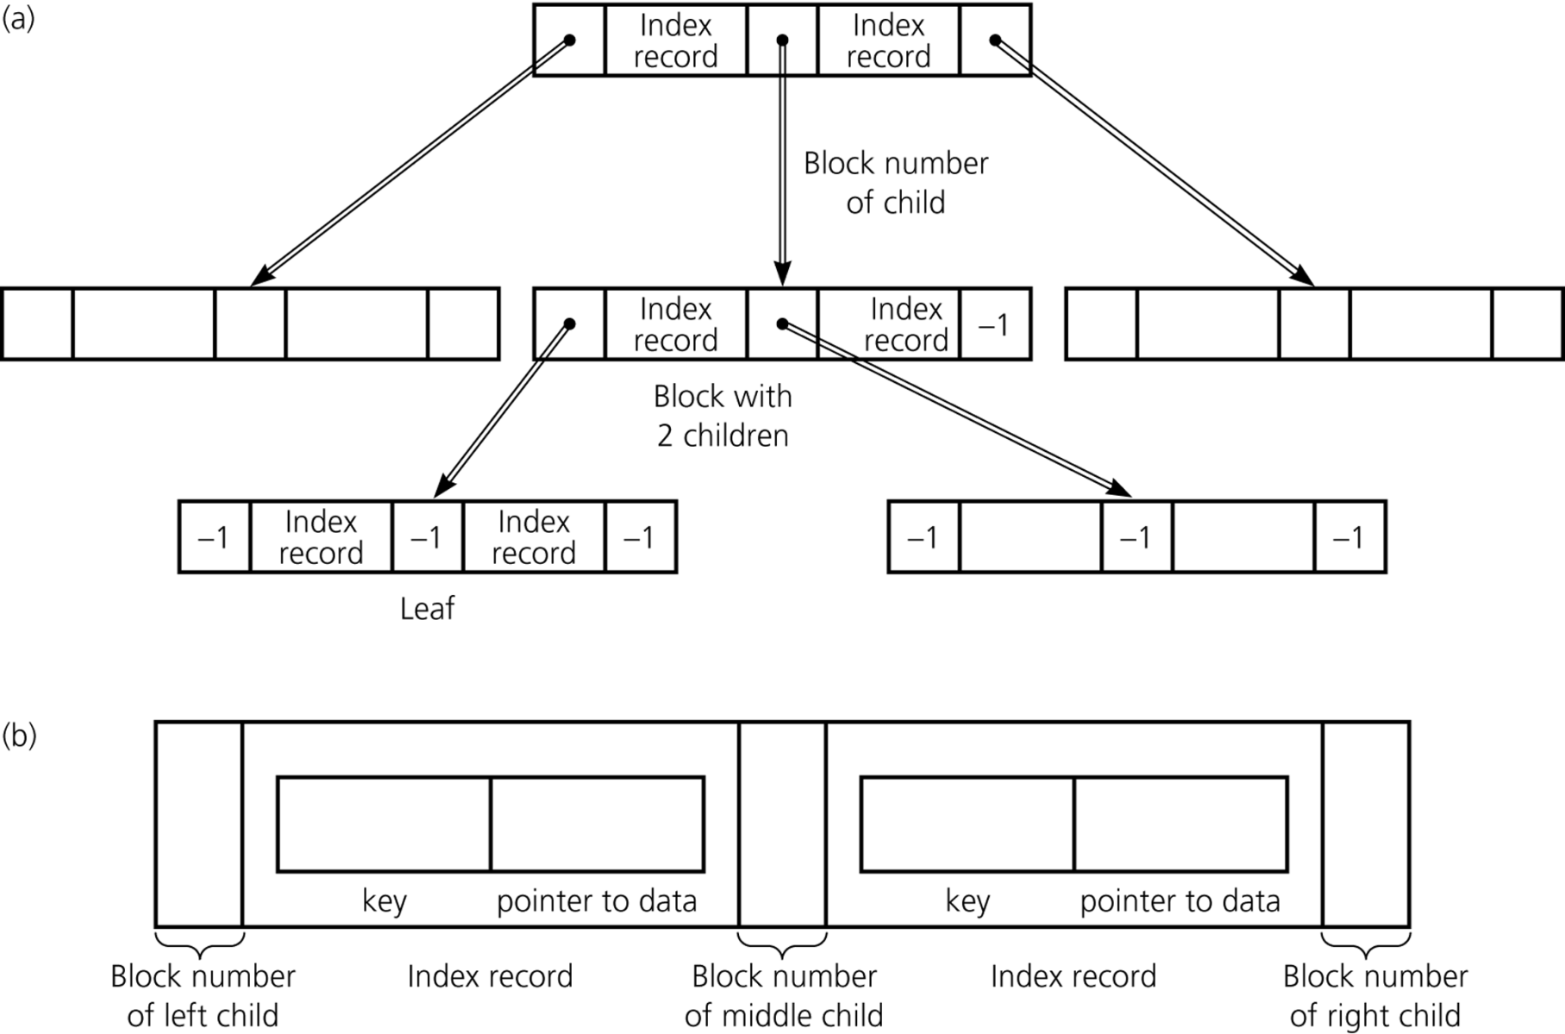
Node Structure of a B-tree

Slide 14
Insertion in a B-Tree
Insert the data into the data file
  Any block p with a vacant slot or a new block
Insert the index record into the index file
  Insert the index record <key, p> into the B-tree
  Analogous to the insertion of 2-3 tree

Slide 15
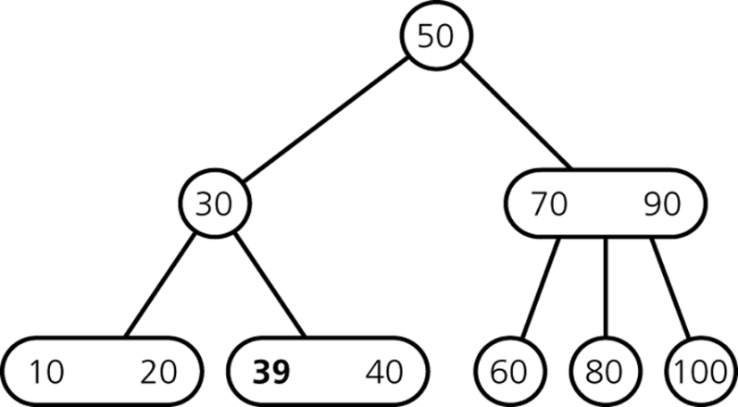
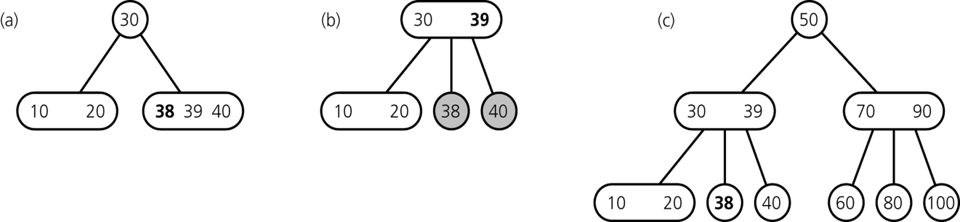
Remind: Insertion in 2-3 Trees
inserting 38

Slide 16
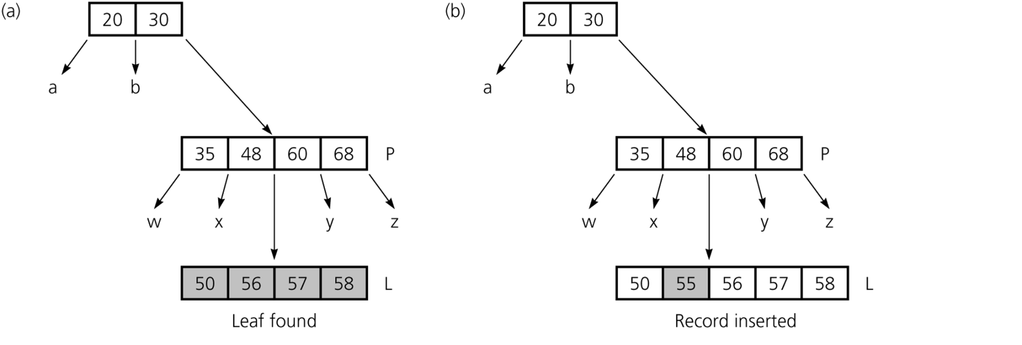
An Example Insertion in a B-Tree
가정: 노드당 최대 4개의 key 허용
(i.e., 2~4개)
Inserting 55
Overflow

Slide 17
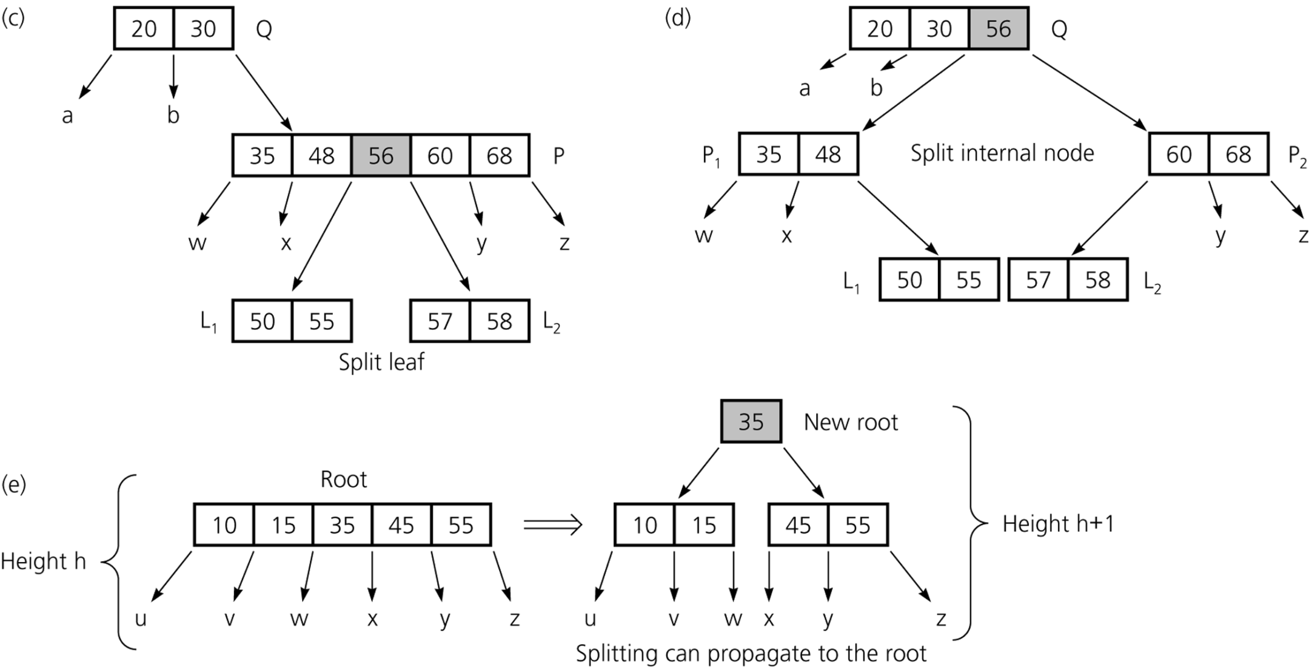
Overflow

Slide 18

Splitting the Root in a B-Tree

Slide 19
Deletion in a B-Tree
Find the index record (with the key) and delete in the B-tree
  Locate the index record
  If the record is not in a leaf, swap it with its inorder successor
  Delete the key
  If the leaf now has fewer than m/2 keys, merge appropriately
Delete the corresponding item in the data file

Slide 20
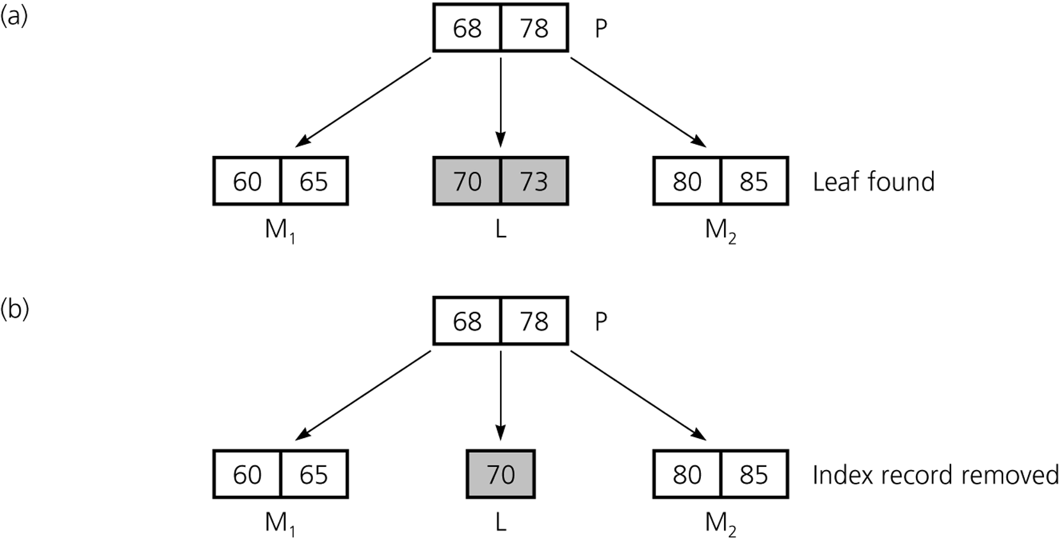
An Example Deletion in a B-Tree
Deleting 73
Violation!
Underflow

Slide 21
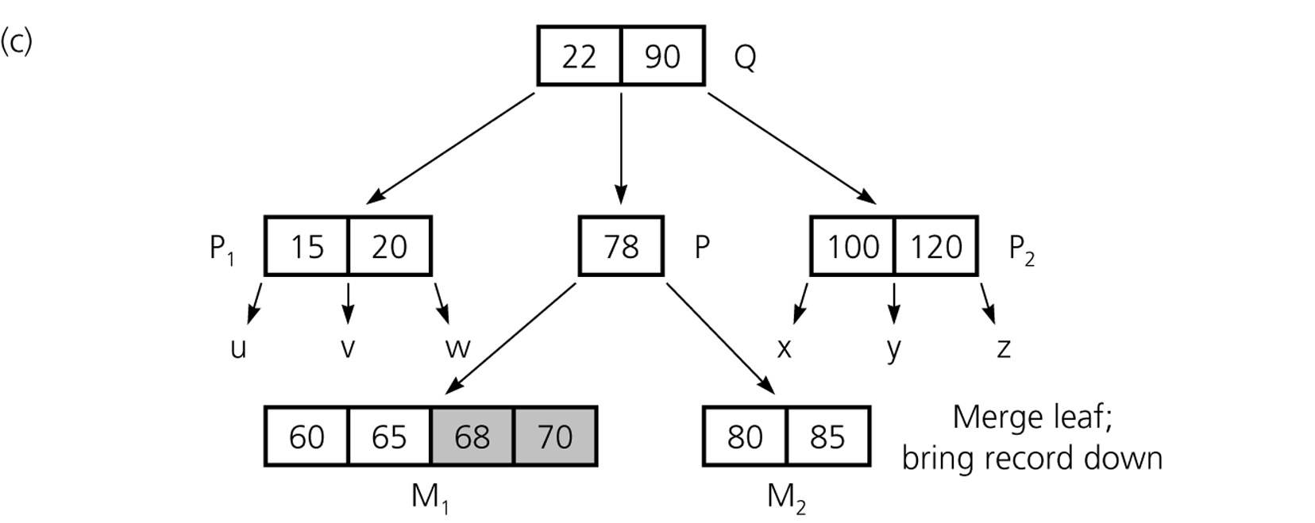
Violation!
Underflow

Slide 22
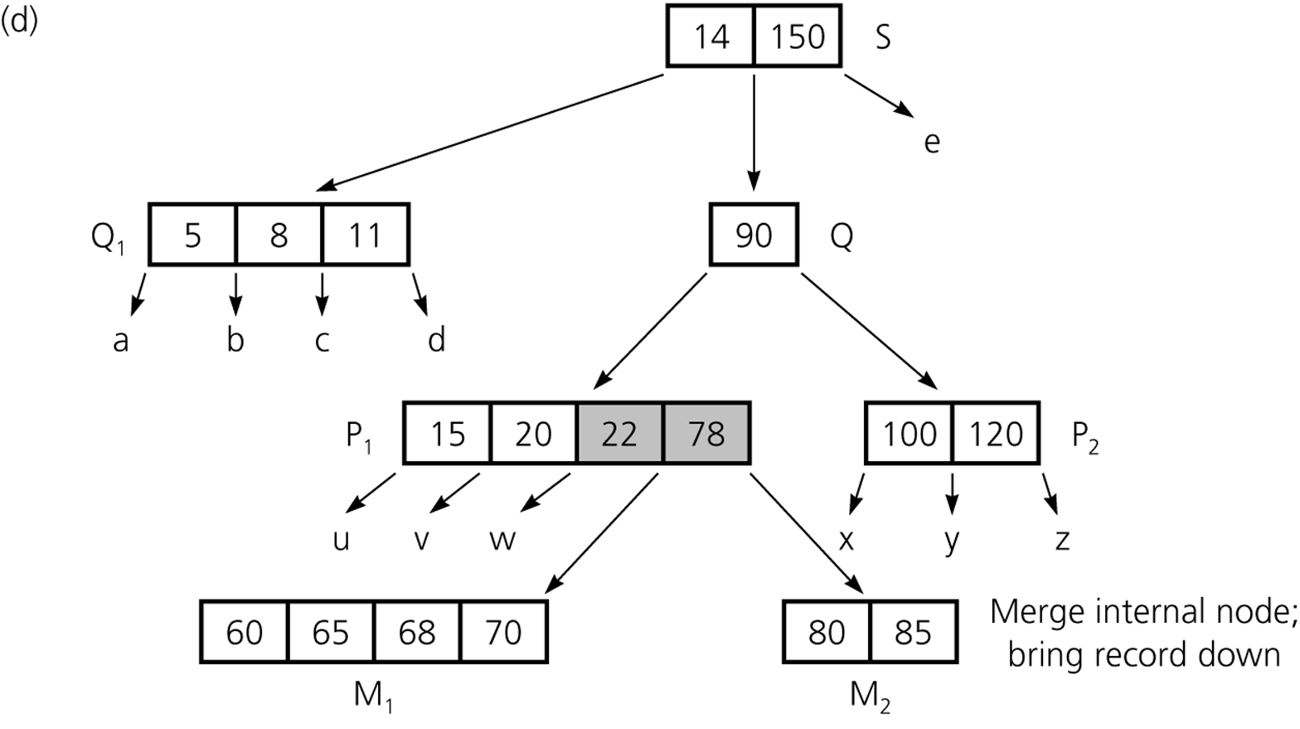
Violation!
Underflow

Slide 23
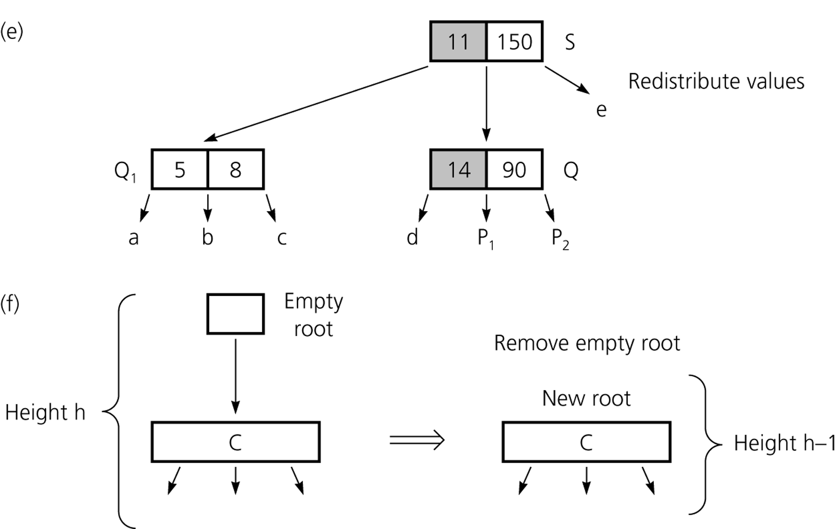

Slide 24
Removing the Root in a B-Tree
Situation: merging w.r.t. the root w/ only one key

Slide 25
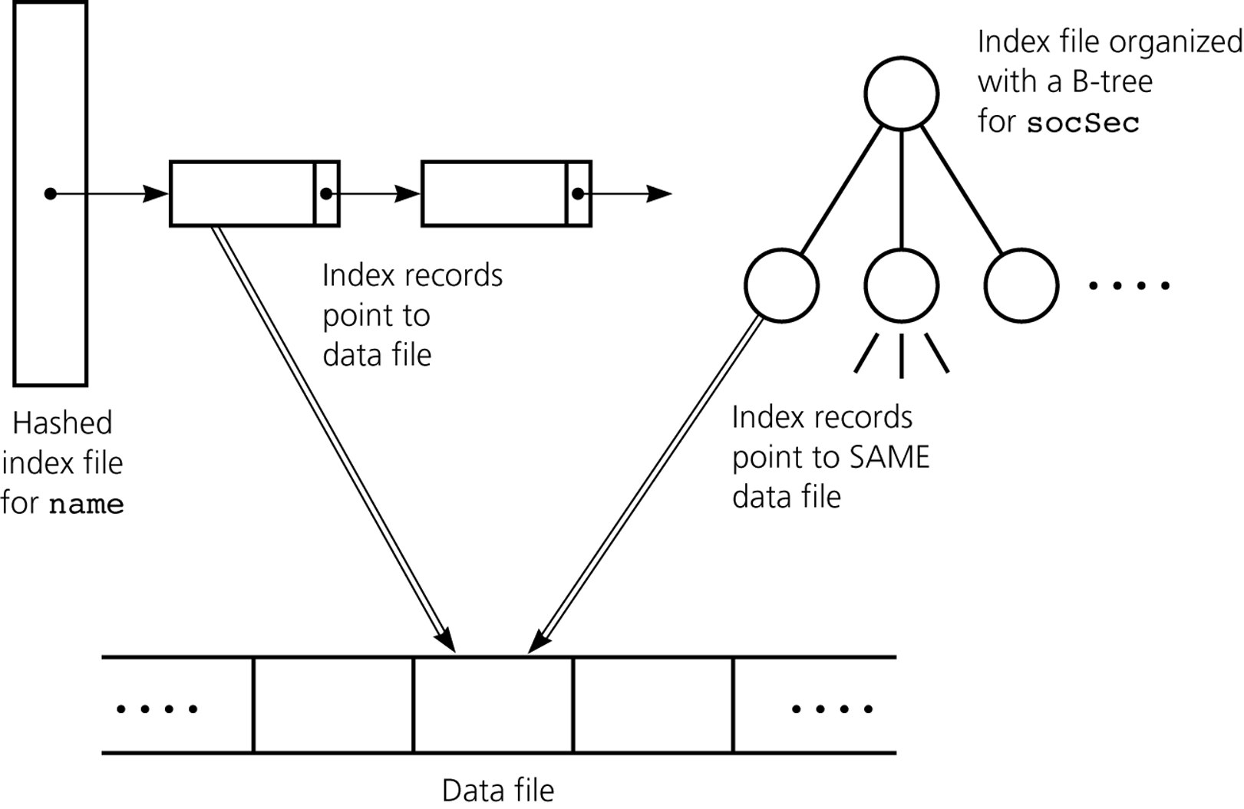
Multiple Indexing
Notes:
~5/16/2012
Deletion!
~11/26/2008

