Slide 1
OS Project 2
OS Team 7

Slide 2
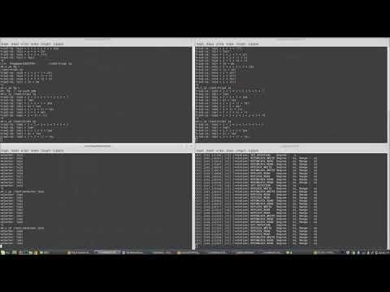
Demo

Slide 3
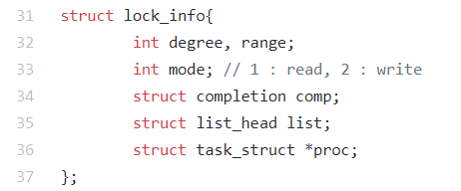
lock_info

Slide 4
completion
FIFO semaphore
wait_for_completion_interruptible
-ERESTARTSYS when signal is pending
Wait for completion call
When completion is called, return 0
Call wait_for_completion when the task wants to grab lock

Slide 5
Data structures
Acquire check arrays
write_acq_chk[i] : # of acquired write lock contains degree i
read_acq_chk[i] : # of acquired read lock contains degree I
wait_node_list_(read, write)
List of waiting locks
acq_node_list_(read,write)
List of acquired locks

Slide 6
rotlock_mutex
Mutex lock
Prevent simultaneous accessing of data structures(acquire check array, linked lists)
Manage all data structures with one mutex lock

Slide 7
find_available
mutex.Lock()
chk = 0
for(lock_info in waitList_write)
if(range(lock) contains degree)
chk = 1
if(task can acquire now)
complete()
mutex.unlock()
return
if(chk)return
for(lock_info in waitList_read)
if(task can acquire now)
complete()
mutex.unLock()

Slide 8
Lock and unlock
Lock
mutex.Lock()
new lock_info(new completion) T
waitList.push(T)
find_available()
return rotlock_wait()
unlock
mutex.Lock()
Find lock in acq_list match with given information
if no lock matched, return invalid
acq_chk_array[range(lock)]--
kfree()

Slide 9
exit_rotlock
Always called when the process was terminated
Added in do_exit
Find all lock_info matches with the process in wait lock & acquire lock lists and delete them
If there is at least one deleted element, call find_available

