Slide 1
Ch. 10 Algorithm Efficiency & Sorting
O( ): Big-Oh
  An algorithm is said to take O(f (n))
  if
  its running time is upper-bounded by cf(n)
  e.g., O(n), O(n log n), O(n²), O(2^{n}), …
Formal definition
  O(f(n)) = { g(n) | ∃c > 0, n₀ ≥ 0 s.t.∀n ≥ n₀, cf(n) ≥ g(n) }
  g(n) ∈ O(f(n)이 맞지만 관행적으로 g(n) = O(f(n))이라고 쓴다.
직관적 의미
  g(n) = O(f(n)) ⇒ g grows no faster than f

Slide 2
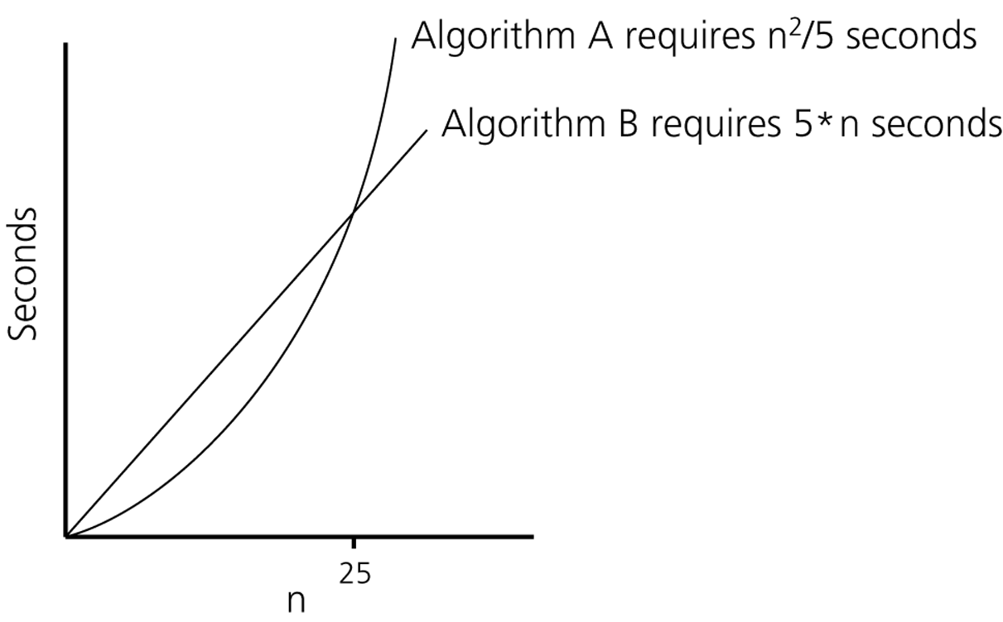
Figure 10.1
Time requirements as a function of the problem size n

Slide 3
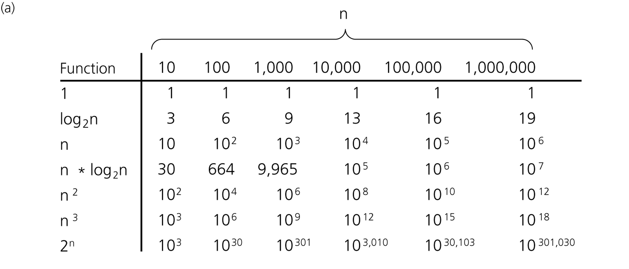
Figure 10.3a
A comparison of growth-rate functions: a) in tabular form

Slide 4
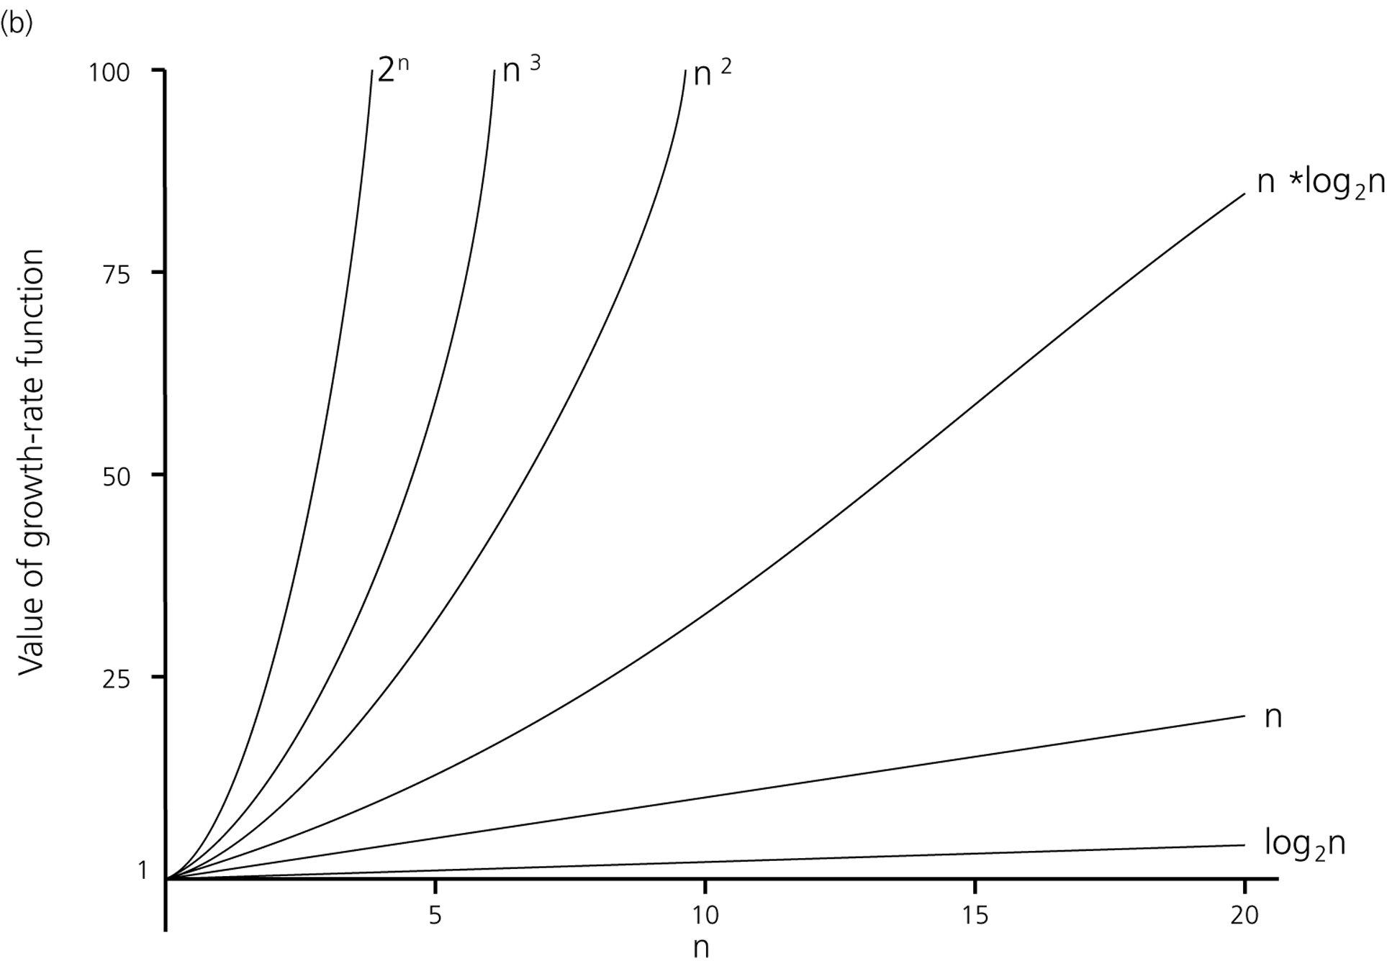
Figure 10.3b
A comparison of growth-rate functions: b) in graphical form

Slide 5
Types of Running-Time Analysis
Worst-case analysis
  Analysis for the worst-case input(s)
Average-case analysis
  Analysis for all inputs
  More difficult to analyze
Best-case analysis
  Analysis for the best-case input(s)
  Mostly not meaningful

Slide 6
Running Time for Search in an Array
Sequential search
  Worst case: O(n)
  Average case: O(n)
Binary search
  Worst case: O(log n)
  Average case: O(log n) ← 각자 확인 요망!

Slide 7
Sorting Algorithms
대부분 O(n²)과 O(nlogn) 사이
Input이 특수한 성질을 만족하는 경우에는 O(n) sorting도 가능
  E.g., input이 –O(n)과 O(n) 사이의 정수

Slide 8
Selection Sort
An iteration
  Find the largest item
  Swap it to the rightmost place
  Exclude the rightmost item
Repeat the above iteration until only one item remained

Slide 9
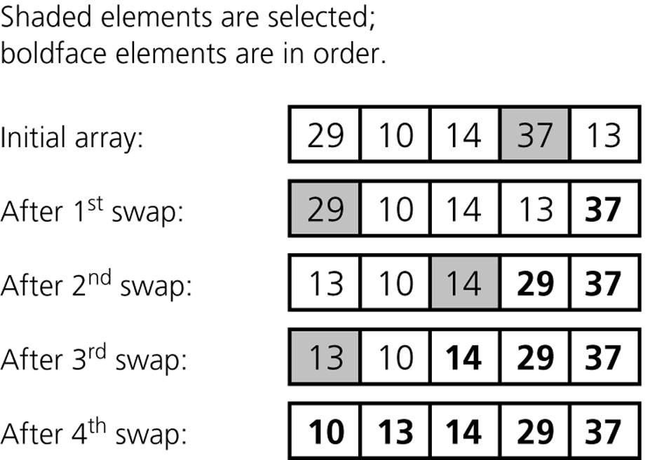
The largest item
Worst case
Average case
Running time: (n-1)+(n-2)+···+2+1 = O(n²)

Slide 10
selectionSort(theArray[ ], n)
{
for (last = n-1; last >=1; last--) {
largest = indexOfLargest(theArray, last+1);
Swap theArray[largest] & theArray[last];
}
}
indexOfLargest(theArray, size)
{
largest = 0;
for (i = 1; i < size; ++i) {
if (theArray[i] > theArray[largest]) largest = i;
}
}
selectionSort(theArray[ ], n)
{
for (last = n-1; last >=1; last--) {
largest = indexOfLargest(theArray, last+1);
Swap theArray[largest] & theArray[last];
}
}
indexOfLargest(theArray, size)
{
largest = 0;
for (i = 1; i < size; ++i) {
if (theArray[i] > theArray[largest]) largest = i;
}
}
Running time: 두 함수의 for loop의 iteration 수의 합이 좌우
  indexOfLargest가 n-1 번 call 되고,
  call 될 때마다 indexOfLargest의 수행시간은
  한 단계씩 가벼워진다.
Running time: 두 함수의 for loop의 iteration 수의 합이 좌우
  indexOfLargest가 n-1 번 call 되고,
  call 될 때마다 indexOfLargest의 수행시간은
  한 단계씩 가벼워진다.
(n-1)+(n-2)+···+2+1 = O(n²)

Slide 11
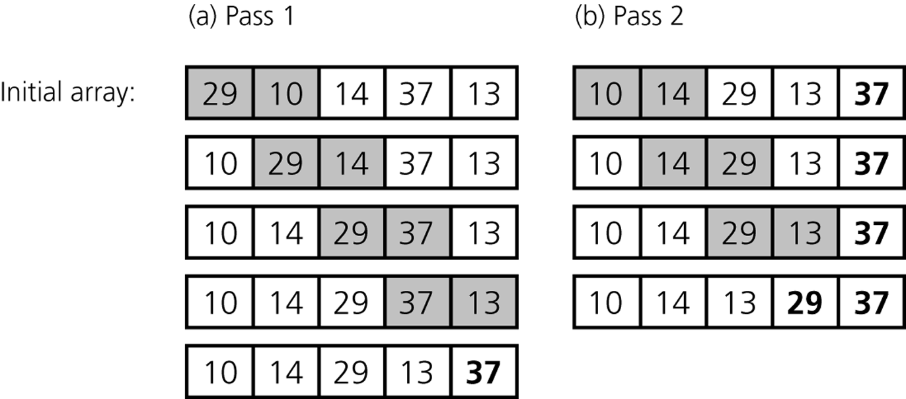
Bubble Sort
Worst case
Average case
Running time: (n-1)+(n-2)+···+2+1 = O(n²)

Slide 12
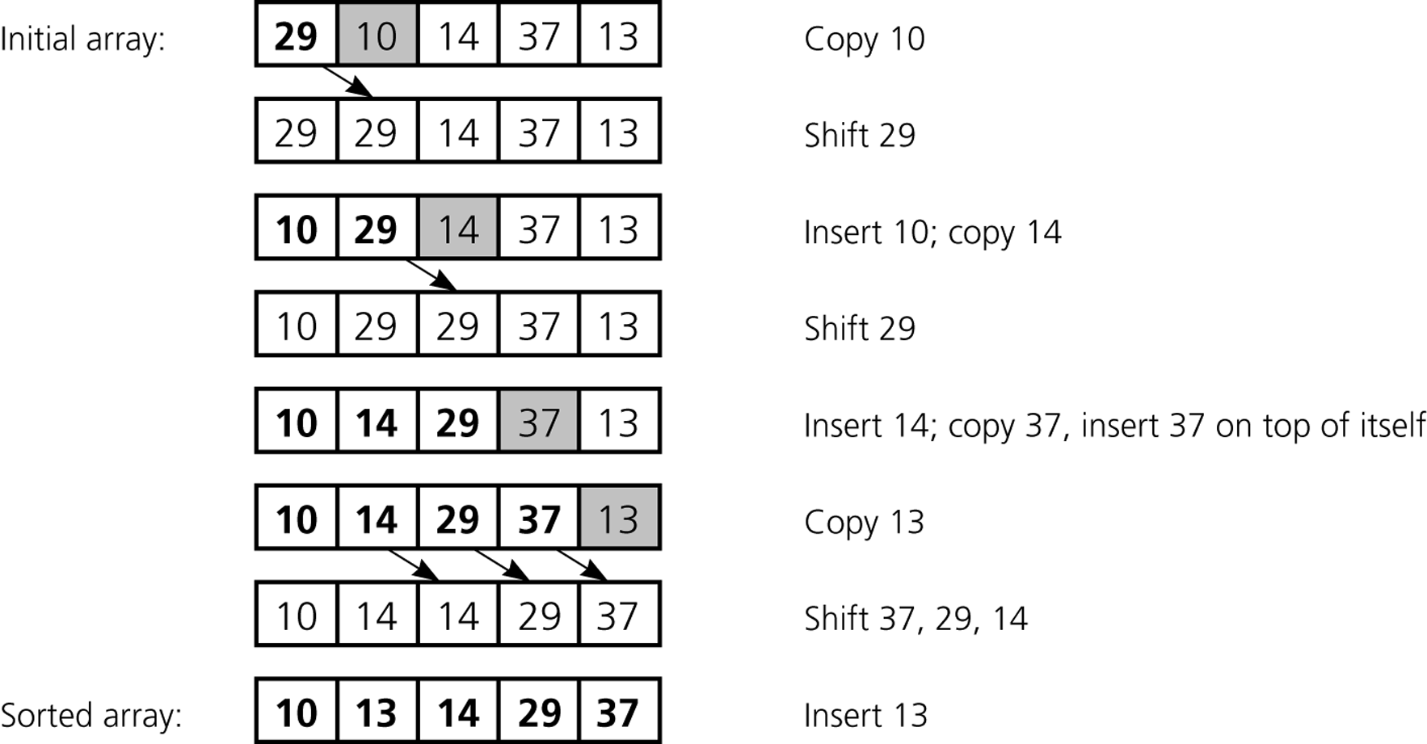
Insertion Sort
Worst case: 1+2+···+(n-2)+(n-1)
Average case: ½ (1+2+···+(n-2)+(n-1))
Running time: O(n²)

Slide 13
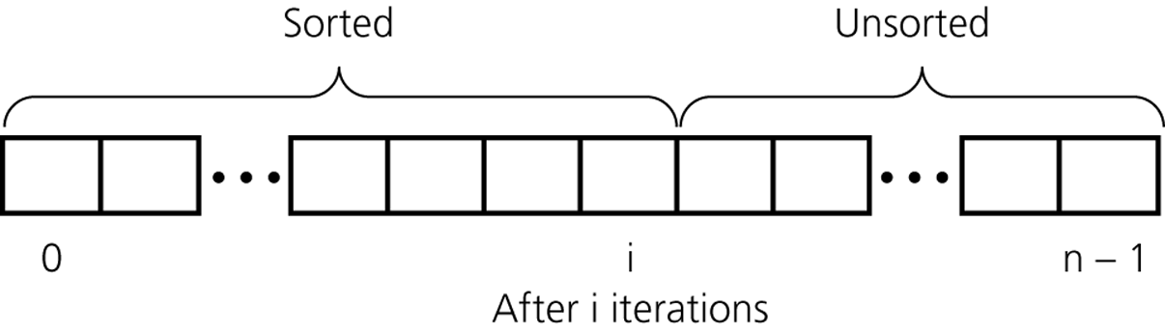
Figure 10.6
An insertion sort partitions the array into two regions

Slide 14
Mergesort
Algorithm mergeSort(S)
{ // Input: sequence S with n elements
// Output: sorted sequence S
  if (S.size( ) > 1) {
  Let S₁, S₂ be the 1st half and 2nd half of S, respectively;
  mergeSort(S₁);
  mergeSort(S₂);
  S ← merge(S₁, S₂);
  }
}
Algorithm merge(S₁, S₂)
{ sorting된 두 sequence S₁, S₂ 를 합쳐
sorting 된 하나의 sequence S를 만든다
}

Slide 15
Animation (Mergesort)
7 2 9 4 ⏐ 3 8 6 1
7 2 | 9 4
7 | 2
7

Slide 16
Animation (Mergesort)
7 2 9 4 ⏐ 3 8 6 1
1 2 3 4 6 7 8 9
2 4 7 9
1 3 6 8
7 2 | 9 4
2 4 7 9
2 7
4 9
7 | 2
2 7
9 | 4
7
2
4 9
9
4
7
2
9
4
Running time: O(nlogn)

Slide 17
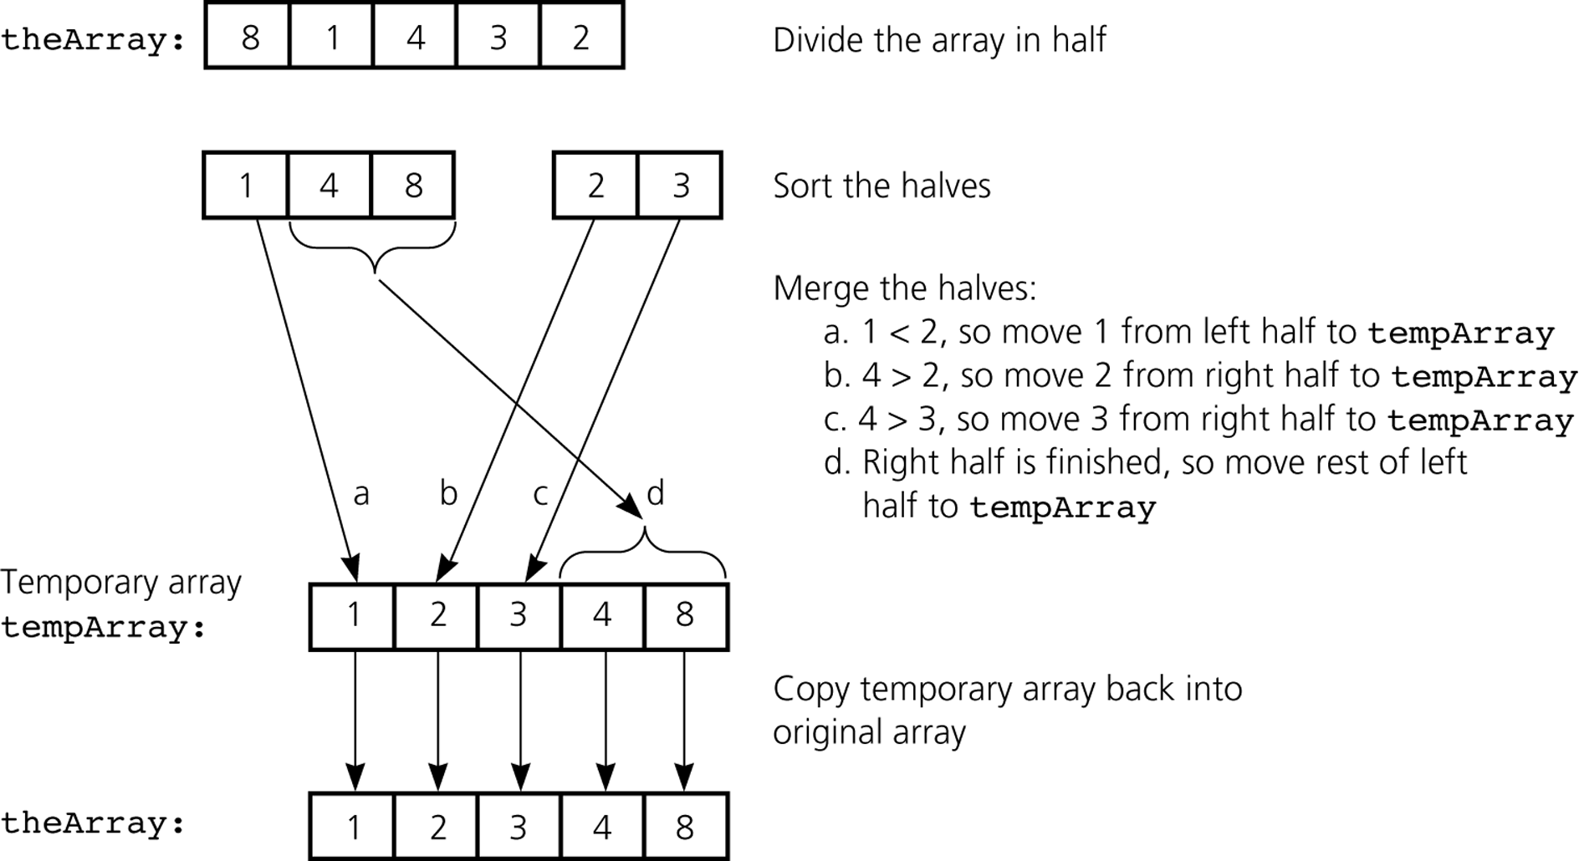
Figure 10.8
A mergesort with an auxiliary temporary array

Slide 18
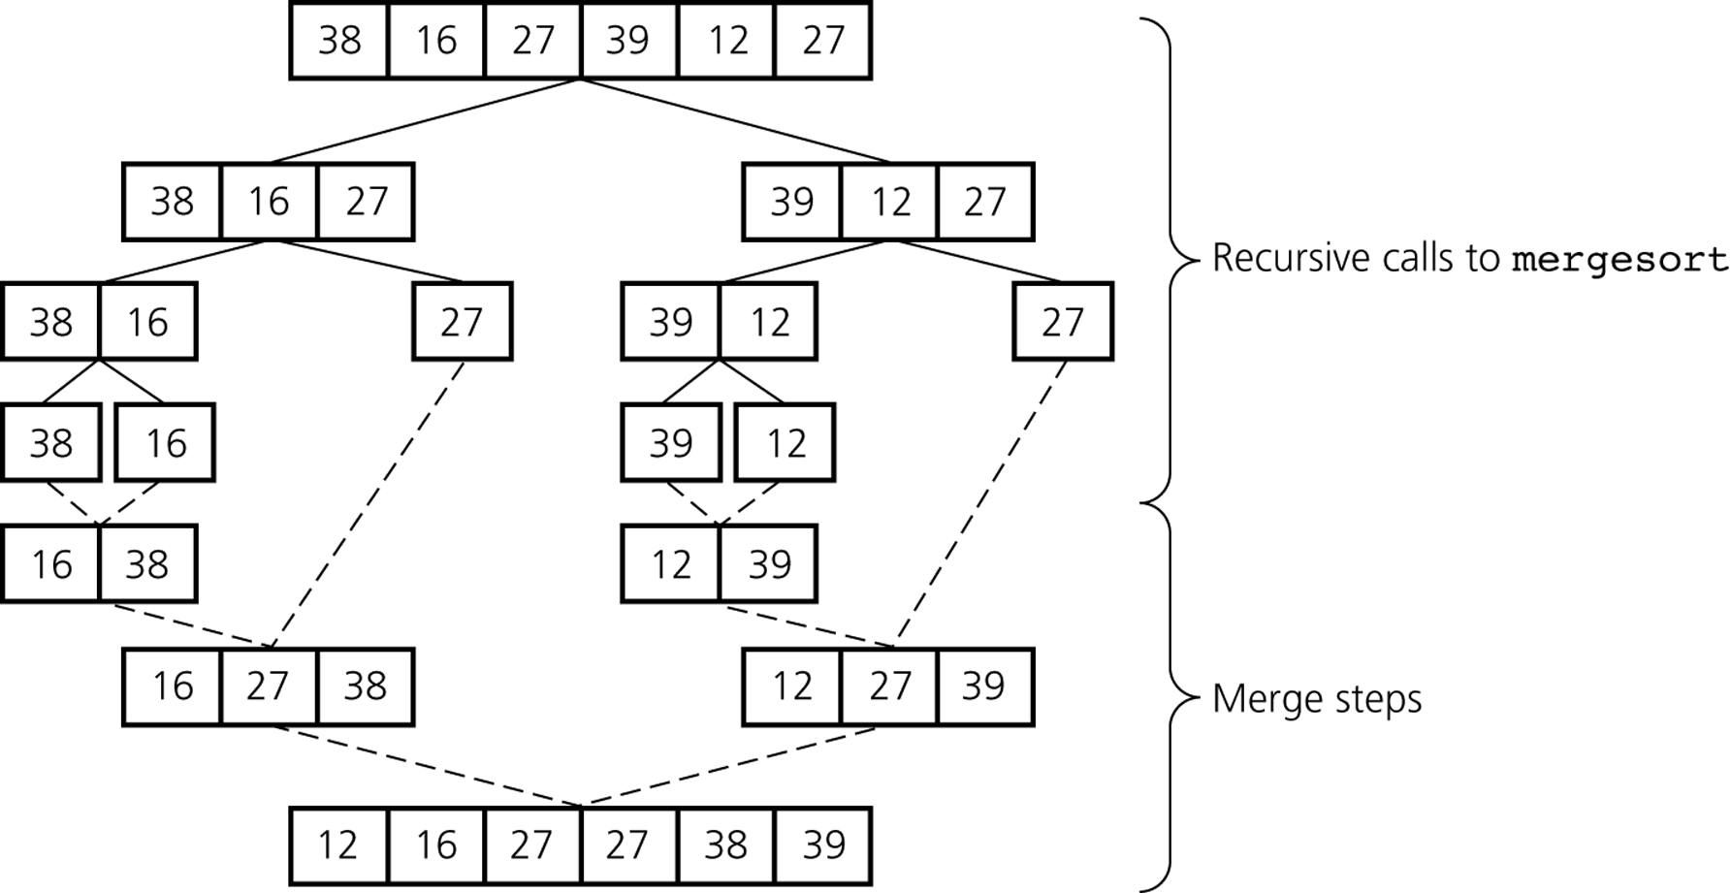
Figure 10.9
A mergesort of an array of six integers

Slide 19
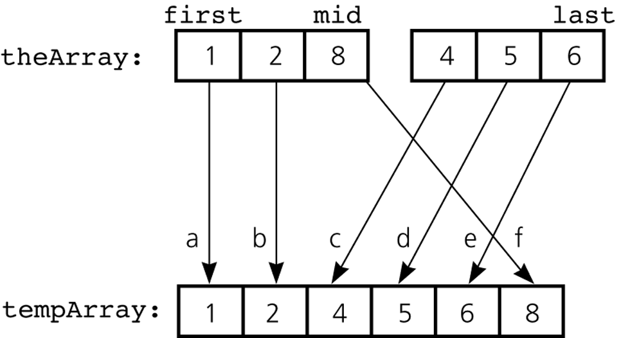
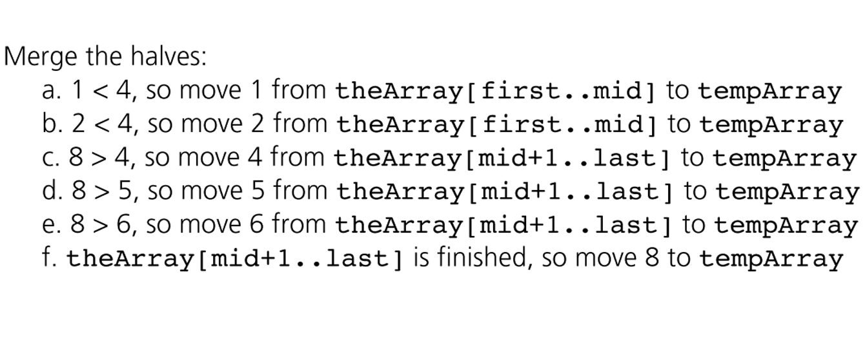
Figure 10.10
A worst-case instance of the merge step in mergesort

Slide 20
Quicksort
Algorithm quickSort(S)
{ // Input: sequence S with n elements
// Output: sorted sequence S
  if (S.size( ) > 1) {
  x ← pivot of S;
  (L, R) ← partition(S, x); // L: left partition, R: right partition
  quickSort(L);
  quickSort(R);
  return L • x • R; // concatenation
  }
}
Algorithm partition(S, x)
{ sequence S에서 x보다 작은 item은 partition L로,
x보다 크거나 같은 item은 partition R로 분류.
}

Slide 21
Animation (Quicksort)
5 1 9 4 2 6 8 3
3 1 4 2 5 9 6 8
1 2 3 4 5 9 6 8
1 2 3 4 5 6 8 9
6 8 9
9 6 8
6 8 9
3 1 4 2
8 6 9
2 1 3 4
1 2 3 4
1 2 3 4
8 6
6 8
6 8
4
6 8
2 1
4
1 2
1 2
1 2
6
6
1
Average-case running time: O(nlogn)
Worst-case running time: O(n²)
1
1
1

Slide 22
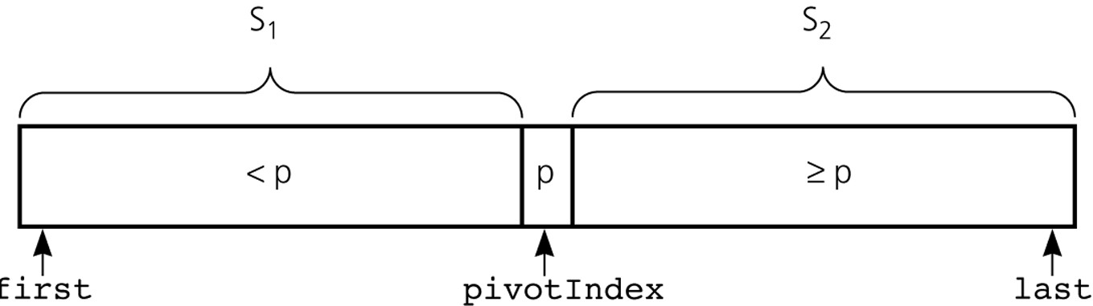
Figure 10.12
A partition with a pivot
Partitioning 방법은 다양하다.
교과서에 그 중 한 가지 방법을 소개하고 있다.

Slide 23
Radix Sort
radixSort(theArray, d)
{ // Sort n d-digit integers in the array theArray
for (j = d downto 1) {
Do a stable sort on theArray by j^{th} digit;
}
}
Stable sort
  같은 값을 가진 item들은 sorting 후에도 원래의 순서가 유지되는 성질을 가진 sort를 일컫는다.

Slide 24
0123
2154
0222
0004
0283
1560
1061
2150
1560
2150
1061
0222
0123
0283
2154
0004
0004
0222
0123
2150
2154
1560
1061
0283
0004
1061
0123
2150
2154
0222
0283
1560
0004
0123
0222
0283
1061
1560
2150
2154
Running time: O(n) ← d: a constant

Slide 25
Comparison of Sorting Efficiency
 | Worst Case | Average Case
Selection Sort | n² | n²
Bubble Sort | n² | n²
Insertion Sort | n² | n²
Mergesort | nlogn | nlogn
Quicksort | n² | nlogn
Radix Sort | n | n
Heapsort | nlogn | nlogn

