Slide 1
Chapter 2.
Problem Solving and Software Engineering
Problem solving
  algorithms + data structures
  For efficient algorithm design, we need carefully design good data structures
Software lifecycle
  Specification
  Design
  Coding (+ some degree of debugging)
  Testing
  Maintenance

Slide 2
Good solution
  Efficient
    Low resource requirement
    Fast running time
  Minimal cost
    Development time
      Coding, testing, etc
    Maintenance time
Good algorithm
Object oriented programming
e.g., C++, JAVA

Slide 3
Abstraction
  Separates the purpose of a module from its implementation details.
  Procedural abstraction
    Separates the purpose of a method (function) from its implementation details.
  Data abstraction
    Separates the operations of data from how you will implement them.
Algorithms
Data structures
Abstract data type (ADT)
  A collection of data and a set of operations on the data
Information hiding ~ abstraction
  Hides the implementation details of algorithms or data

Slide 4
Programming Issues
Modularity
Modifiability
Ease of use
Fail-safe programming
Style
  Use of methods; use of private data files; error handling; readability; documentation
Debugging

Slide 5
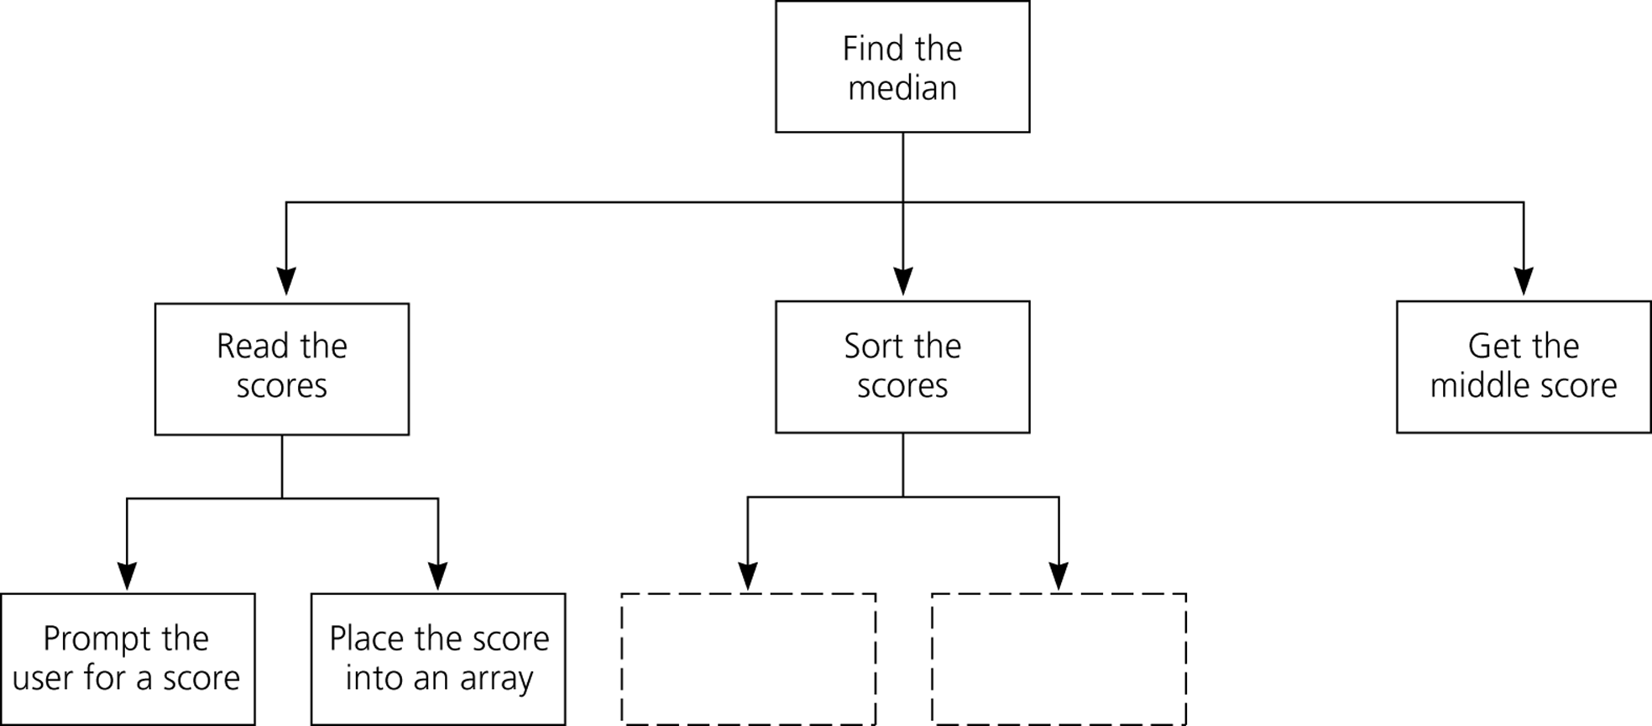
Figure 2.4
A structure chart showing the hierarchy of modules

