Slide 1
Chap. 3 Network Theorems
Node (voltage) analysis
Mesh (current) analysis
Superposition principle
Thevenin/Norton equivalent circuits

Slide 2
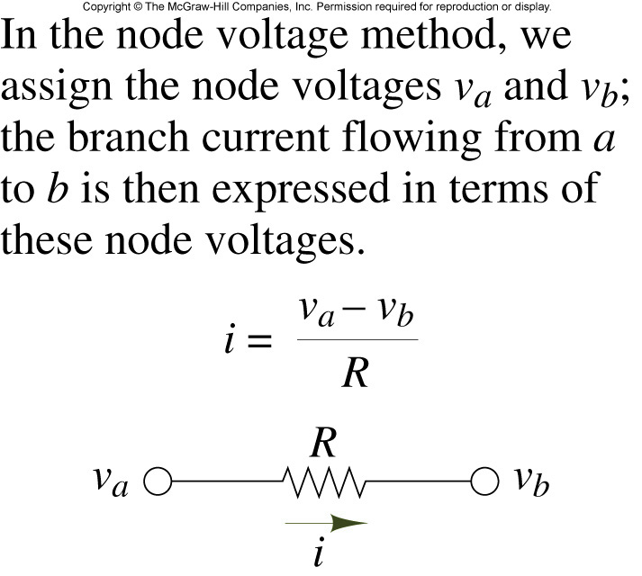
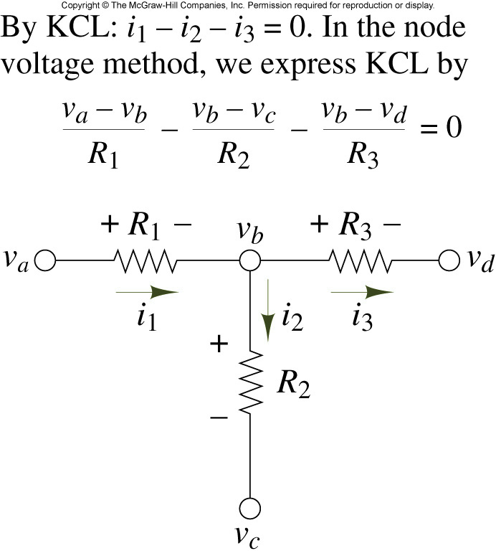
Branch current in Node Analysis

Slide 3
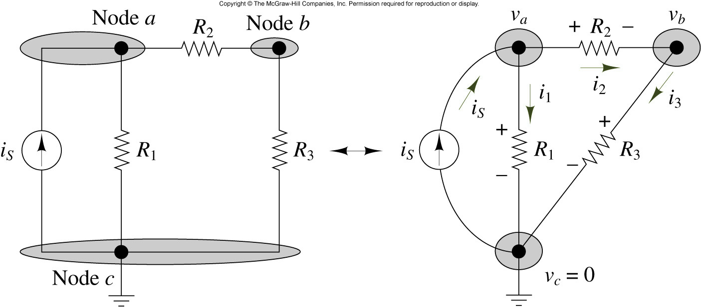
Illustration of Node Analysis

Slide 4
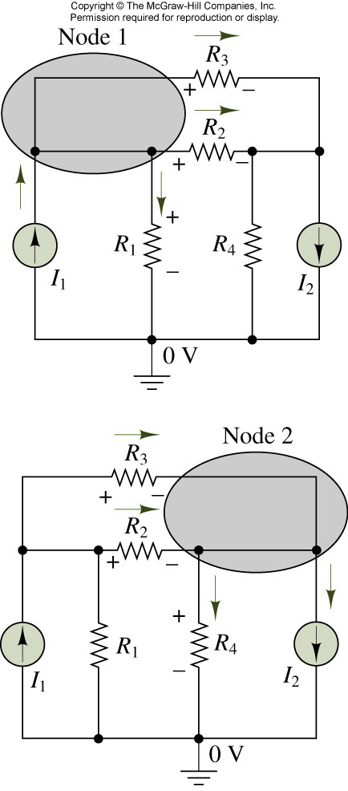
Example
I1=10mA, I2=50mA, R1 = 1kΩ, R2 = 2kΩ
_{R3 = 10k, R4 = 2kΩ}
Find all node voltages and branch currents

Slide 5
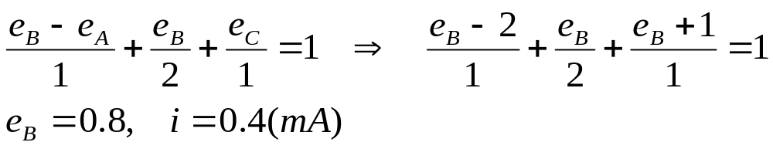
Node Analysis with Voltage Source
1kΩ
1V
1kΩ
A
B
C
A
B
-
-
+
1
i
2
4
3
2V
2k
1mA
+
D
(a)
(b)

Slide 6
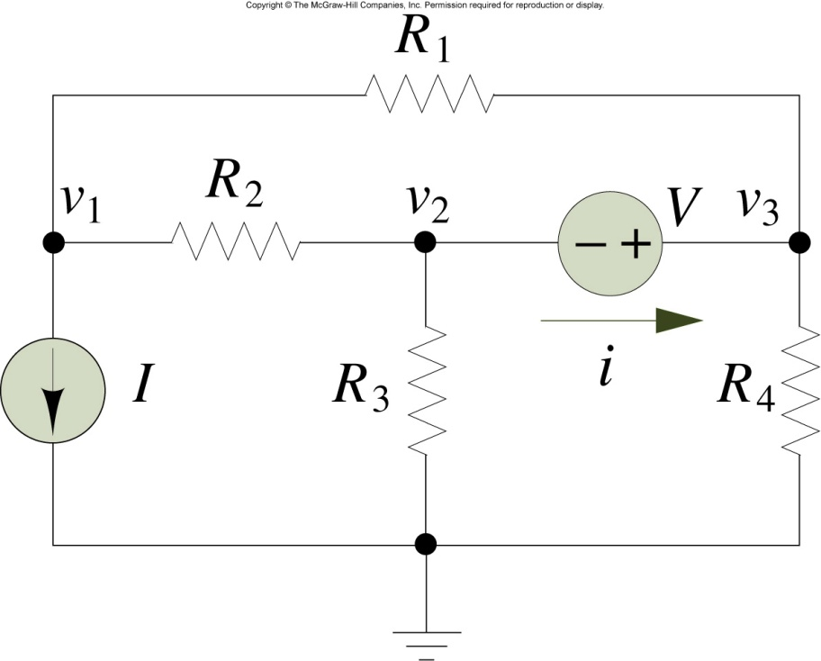
Circuit for Example
I = 1A, V = 3V, R1 = 2, R2 = 2
_{R3 = 4, R4 = 3}
_{Find i}

Slide 7
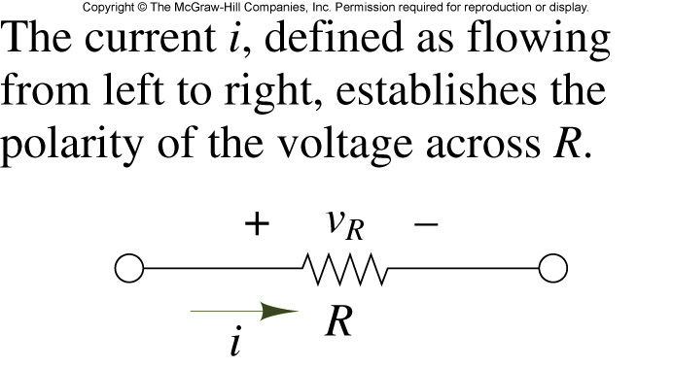
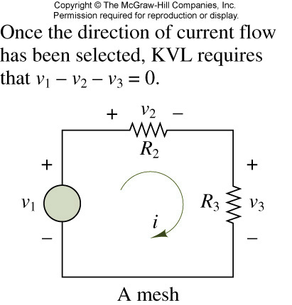
Basic principle of Mesh(Loop) Analysis

Slide 8
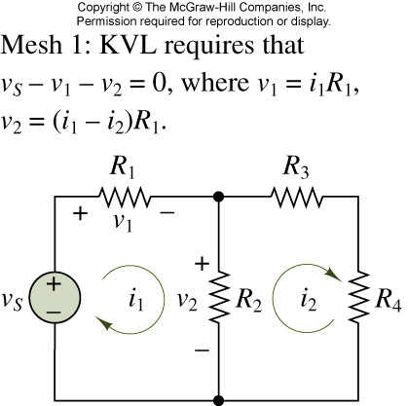
A two-mesh circuit

Slide 9
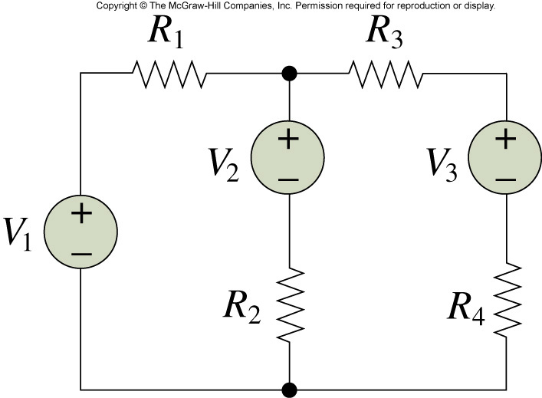
Example
_{V1 = 10V, V2 = 9V, V3 = 1V,}
R1 = 5kΩ, R2 = 10kΩ, R3 = 5kΩ, R4 = 5kΩ
_{Find i}

Slide 10
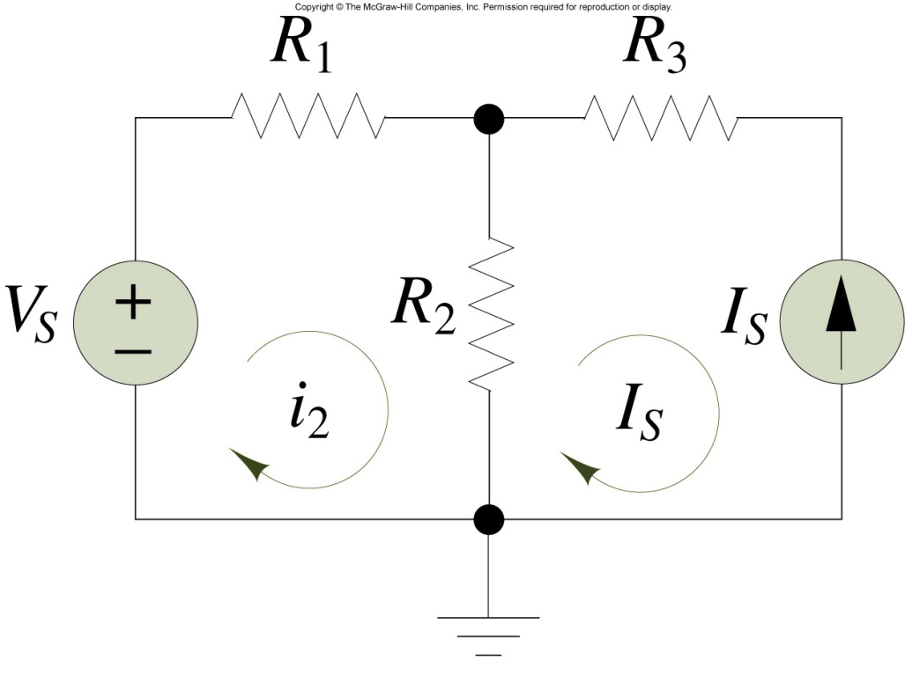
Mesh Analysis with Current Sources

Slide 11
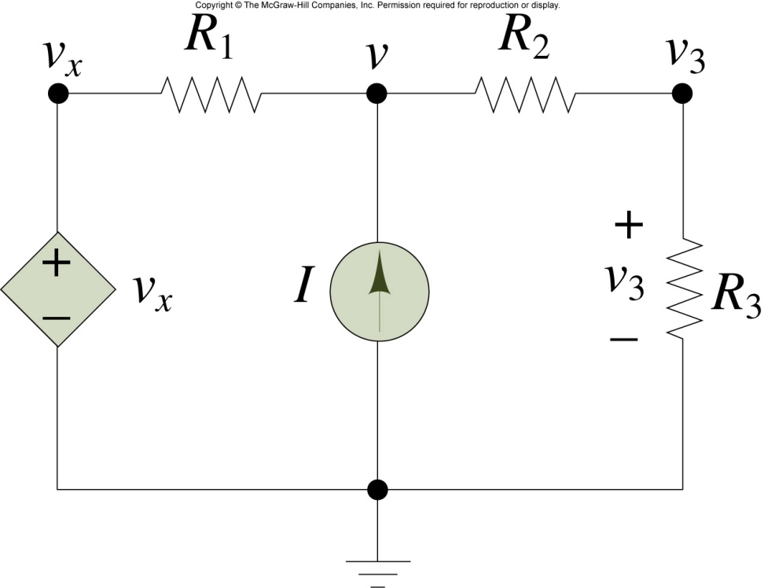
Node Analysis with Controlled Sources
_{I = 0.5mA, Vx = 2 x v3}
_{R1 = 5kΩ, R2 = 2kΩ, R3 = 4kΩ}
_{Find v}

Slide 12
Exercise
Find i using the node analysis technique
1kΩ
4i
A
B
C
+ -
2V
+
2kΩ
2kΩ
>
i

Slide 13
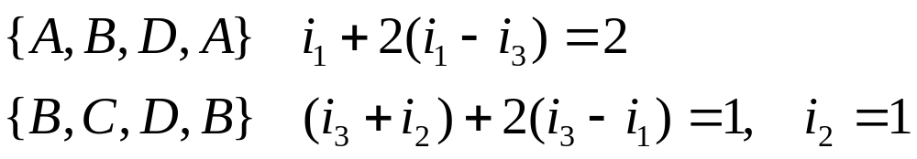
Loop Analysis
1kΩ
1V
1kΩ
A
B
C
-
+
i₂
2V
+
i₁
2kΩ
1mA
i₃
D

Slide 14
Exercise
Find v using the loop analysis technique.
1kΩ
2kΩ
A
B
C
8
+
2v
+
2
1kΩ
D
E
+ v -

Slide 15
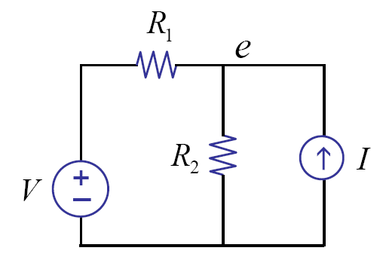

Linearity
Write node equations
Linear in V and I

Slide 16
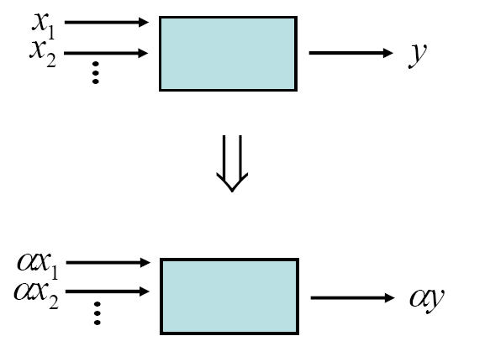
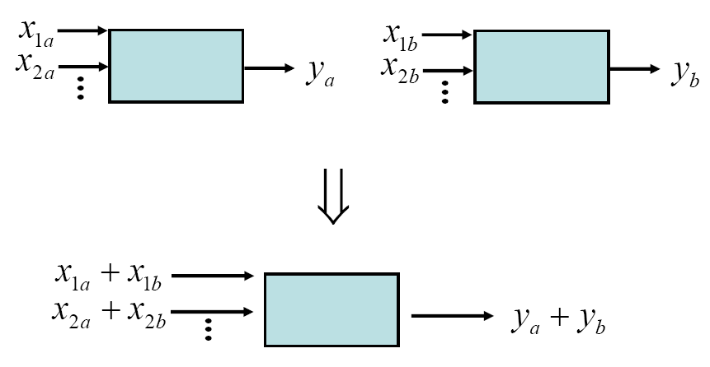
Linearity
Homogeneity
Superposition

Slide 17
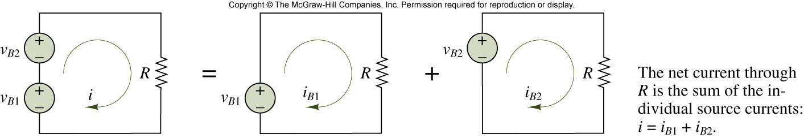
Superposition Principle

Slide 18
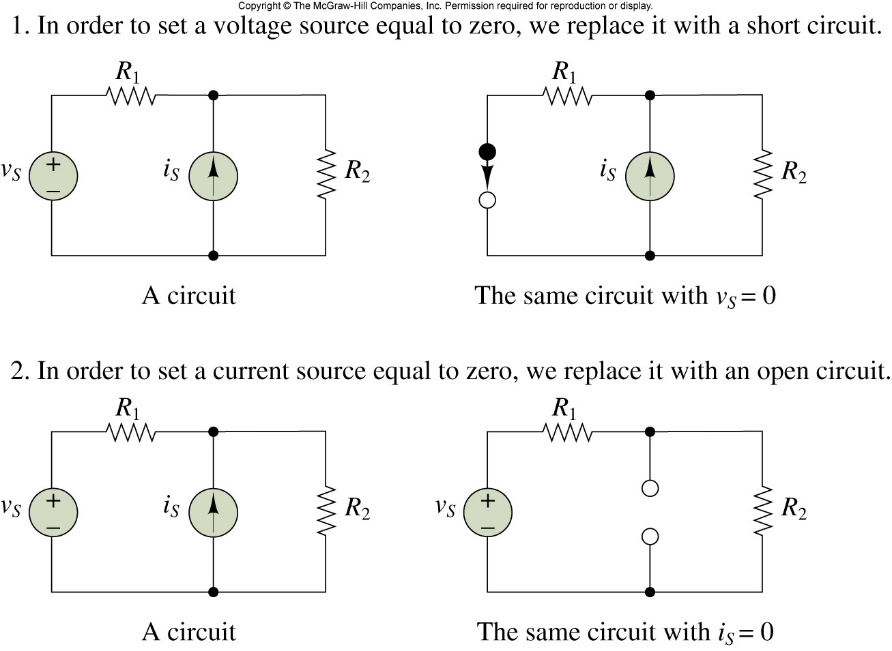
Zeroing Voltage and Current Sources

Slide 19
Exercise
1kΩ
A
1kΩ
v₁
+
2V
2mA
4kΩ
+
2V
4kΩ
1kΩ
2mA
4kΩ
i
i₁
i₂
(a)
(b)
(c)

Slide 20
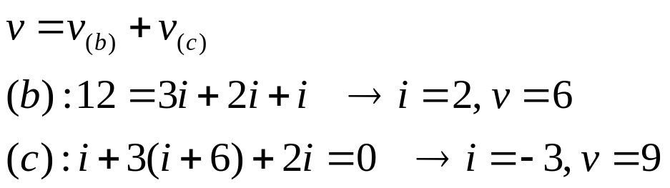
Superposition with Controlled Sources
i
12V
i
12V
i
A
-
-
+
+
+
v
-
+
v
-
+
v
-
3kΩ
3kΩ
1kΩ
3kΩ
1kΩ
6A
1kΩ
6A
+
+
+
2i
2i
2i
B
(a)
(b)
(c)

Slide 21
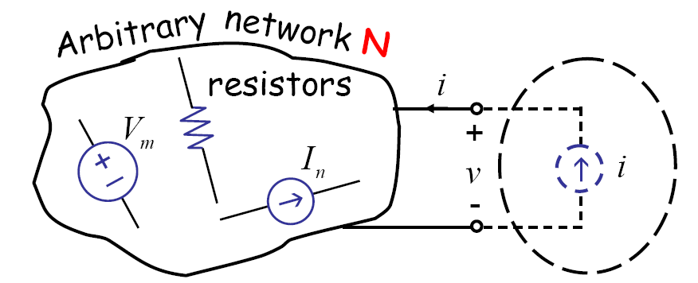
Derivation of the Thevenin’s Network
Consider

Slide 22
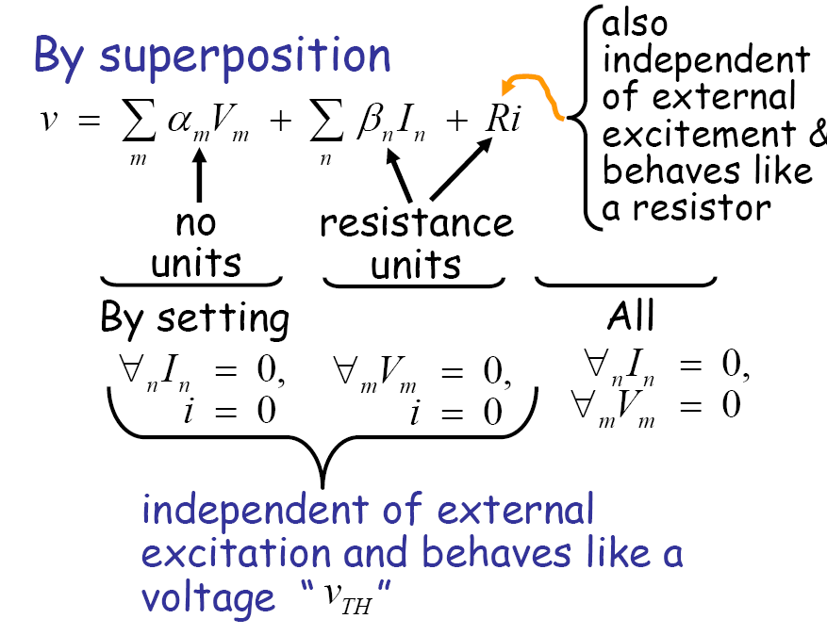

Slide 23
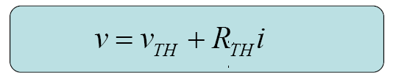
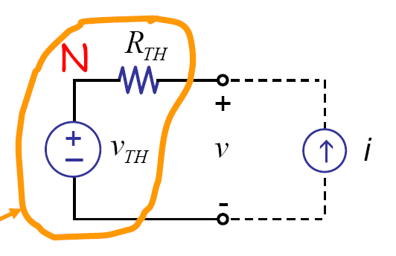
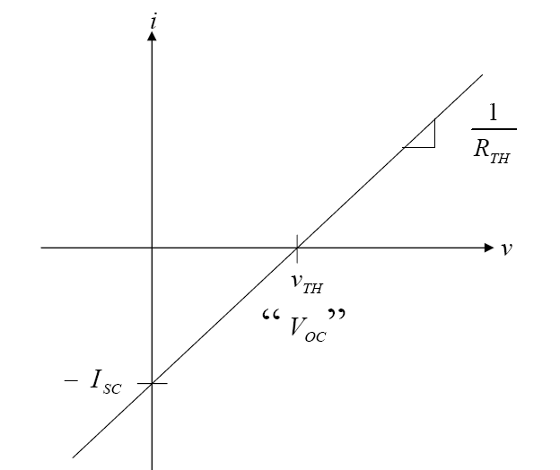
Thevenin equivalent network
Thevenin equivalent
network

Slide 24
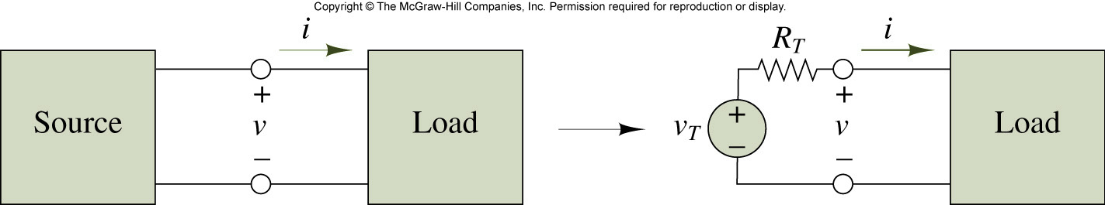
Illustration of Thévenin theorem

Slide 25
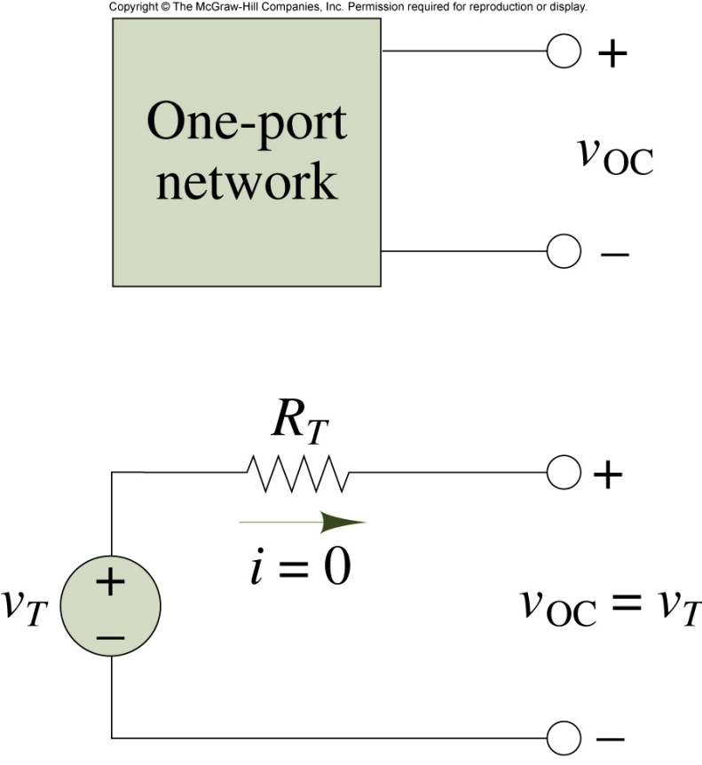
Open-circuit and Thévenin voltage

Slide 26
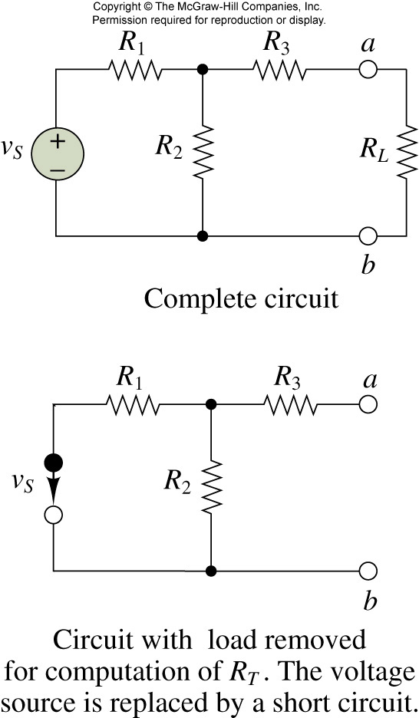
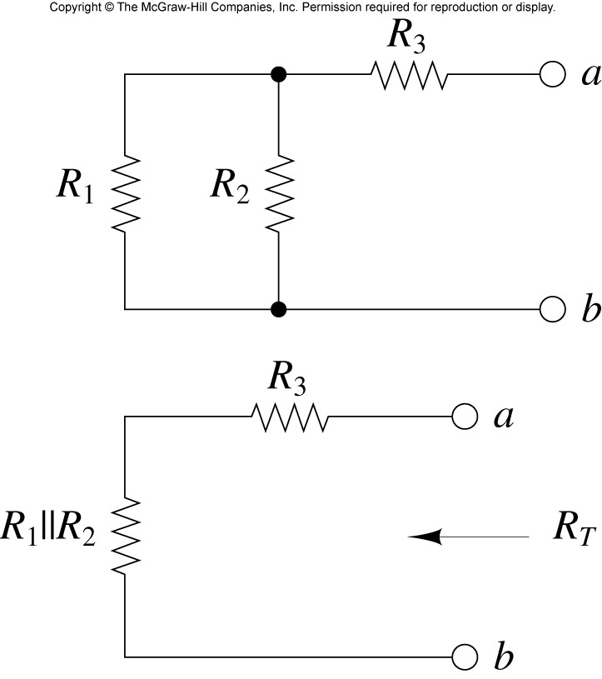
Computation of Thévenin resistance

Slide 27
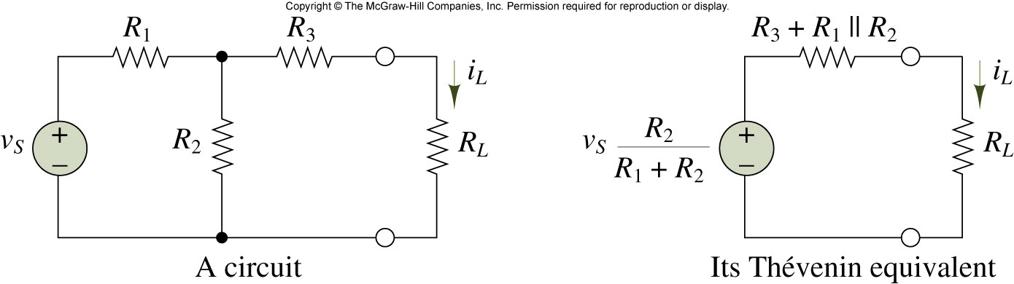
A circuit and its Thévenin equivalent

Slide 28
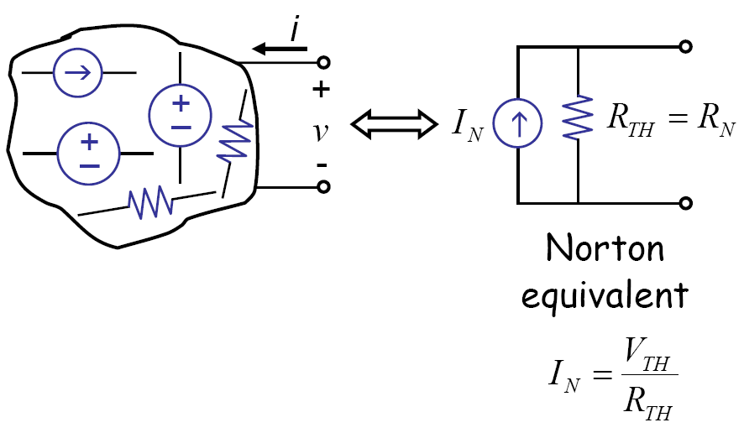
Norton equivalent circuit

Slide 29
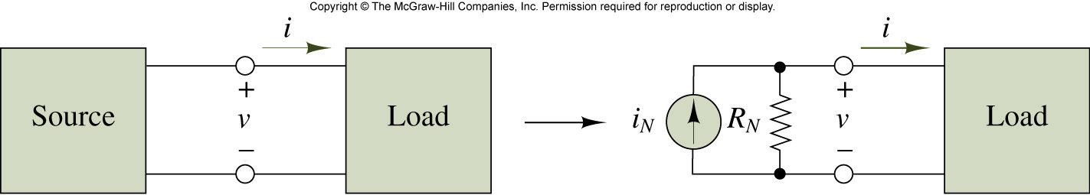
Illustration of Norton theorem

Slide 30
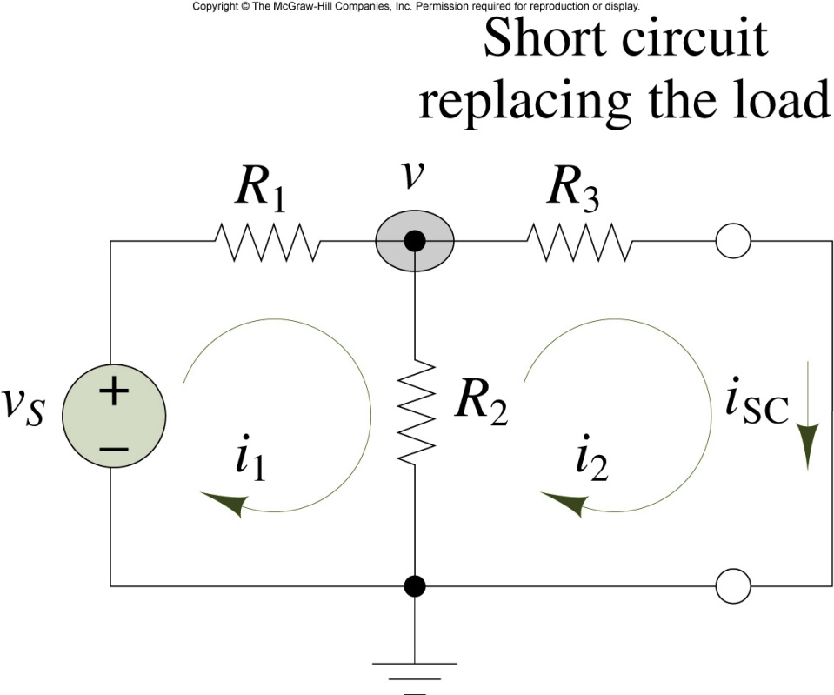
Computation of Norton current

Slide 31
Example
1kΩ
+
2V
2mA
4kΩ
(a)

Slide 32
Exercise
Obtain Thevenin and Norton equivalent circuits
2kΩ
3kΩ
2kΩ
3kΩ
A
B
C
A
i₁
B
i
C
>
i₁
+
-
+
v
-
i₁
+
-
i₁
4V
+
D
4V
+
D
1kΩ
1kΩ
E
E

Slide 33
Source Transformation
R_{th}
A
A
A
Linear
Circuit
Other
Circuit
Other
Circuit
+
v_{oc}
B
B
(a)
(b)
Thevenin
A
i_{sc}
Other
Circuit
R_{th}
B
(c)
Norton

Slide 34
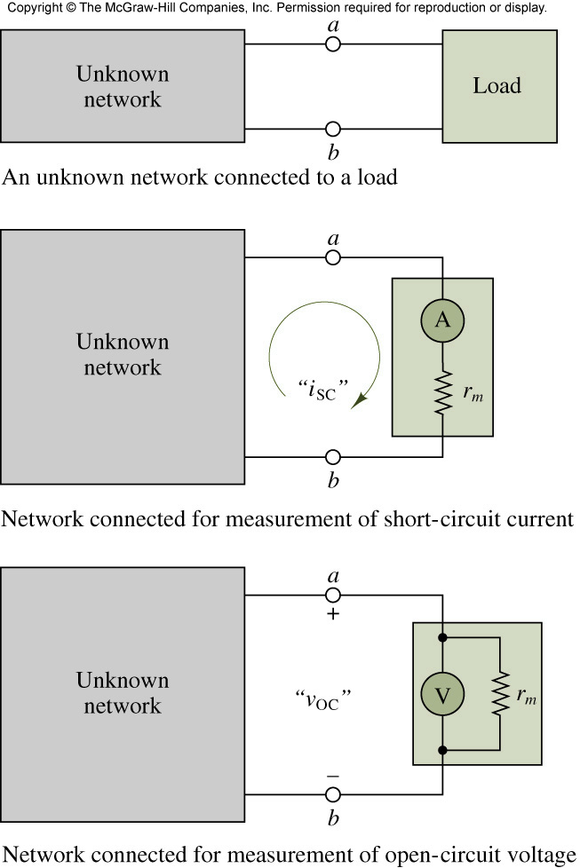
Measurement of open-circuit voltage and short-circuit current

Slide 35
Conclusion
Network analysis: node analysis and mesh analysis
Superposition principle: linear circuit
Thevenin and Norton equivalent circuits

