Slide 1
Chap. 4 Analysis of Nonlinear Circuits
Diode: Nonlinear Element
Analytical Solutions
Graphical Solutions
Piecewise Linear Analysis

Slide 2
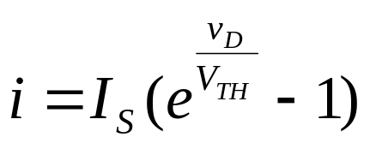
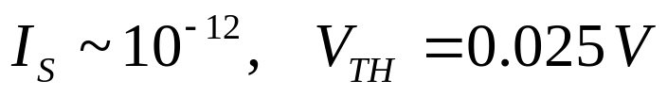
Diode: Nonlinear resistor
+ v -
i
(a) Diode circuit symbol
(b) characteristic equation
i
v
0.7
(c) i-v characteristic

Slide 3
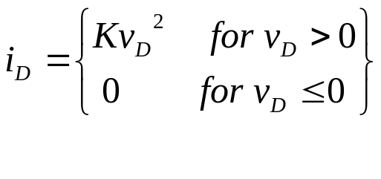


Circuit Example: Analytical Method
R
E
+
Node method
  Solve the equation by
    Trial and error, or
    Numerical method
Notes:
(Vd – E) / R + (Id = K (Vd)^2) = 0

Slide 4
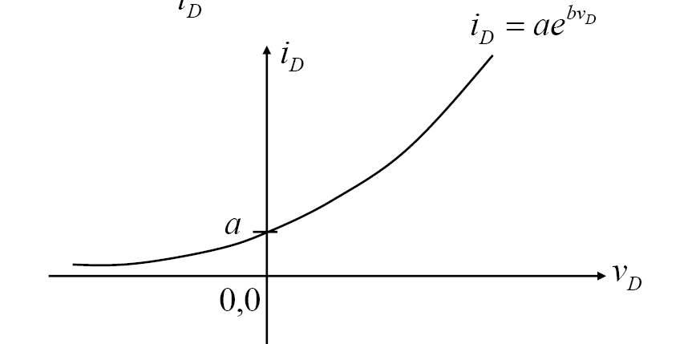
Another Example
R1
R2
Io
R3
V
+
Step 1: Simplify the circuit using Thevenin’s theorem
Step 2: Solve for the nonlinear element
Step 3: Solve for the other elements

Slide 6
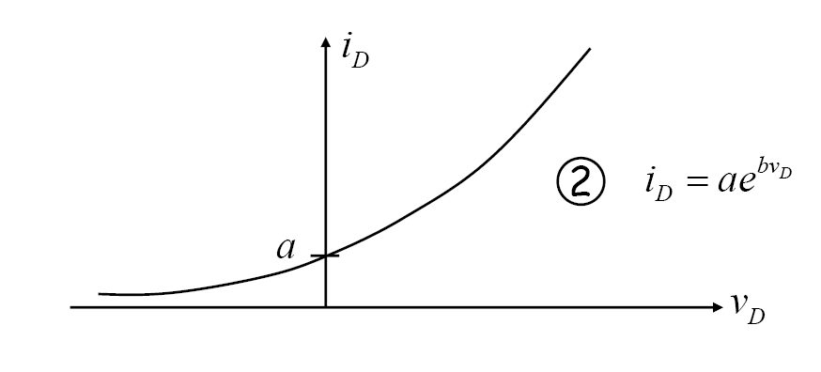
Graphical Method
Load line:

Slide 7
Exercise
This is a non-linear circuit with a zenor diode. The i-v characteristic of the zenor diode is shown below. Find the minimum R to make the output voltage equal to 5V.
B
Α
i*
1kΩ
+
V_{Z}=-5V
+
v*
10V
v
R_{L}
v*
i
i*
-
-
(a)
D
(b)
Notes:
전류 방향, 전압 방향 생각하면 (RL / (RL+1)) * 10 = 5 => RL = 1

Slide 8
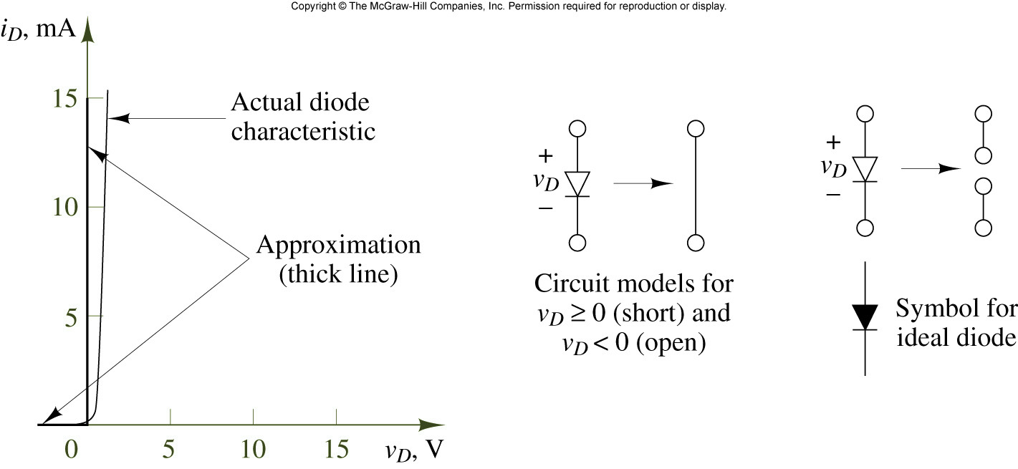
Piecewise Linear Analysis
(1) Idea Diode Model

Slide 9
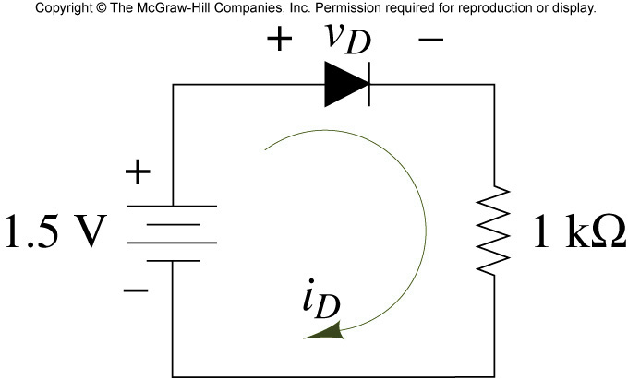
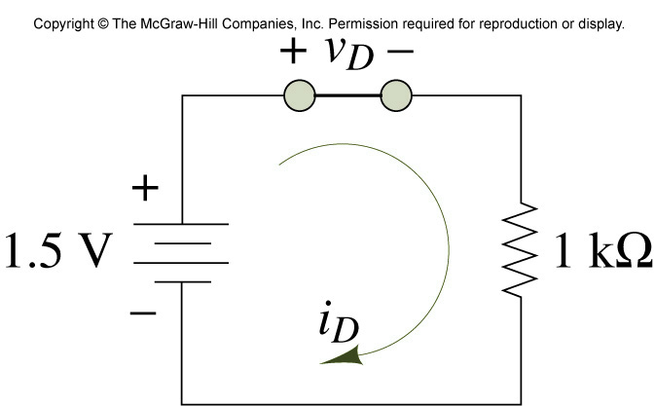
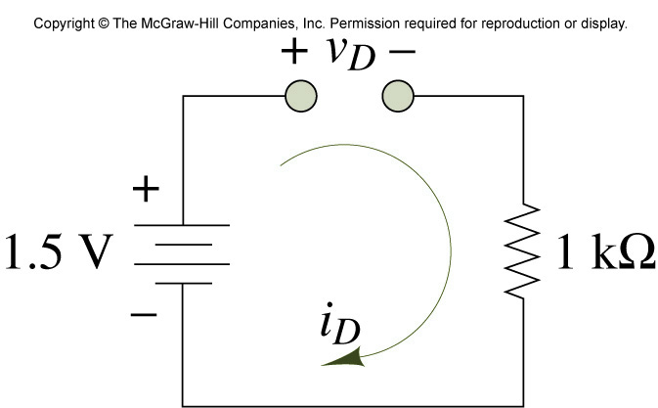
Circuit containing ideal diode
Determine the conduction state

Slide 10
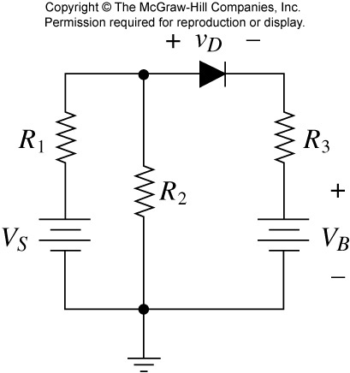
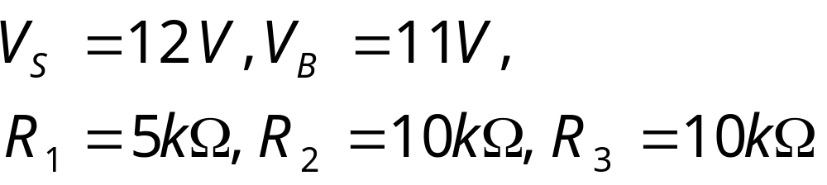
Example

Slide 11
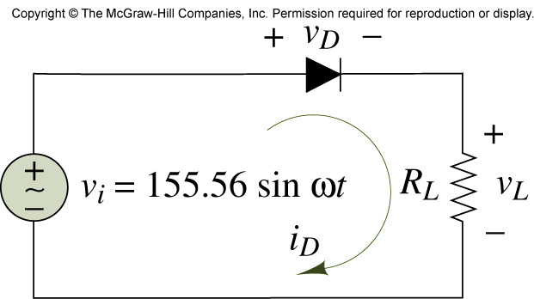
Halfwave Rectifier

Slide 12
Offset Diode Model
i
How will the Rectifier output change with this model?
V
Von = 0.6V

Slide 13
Exercise
10V
10kΩ
+
vo
-
D1
D2
5kΩ
-10V
What would happen if we switch two resistor values?

Slide 14
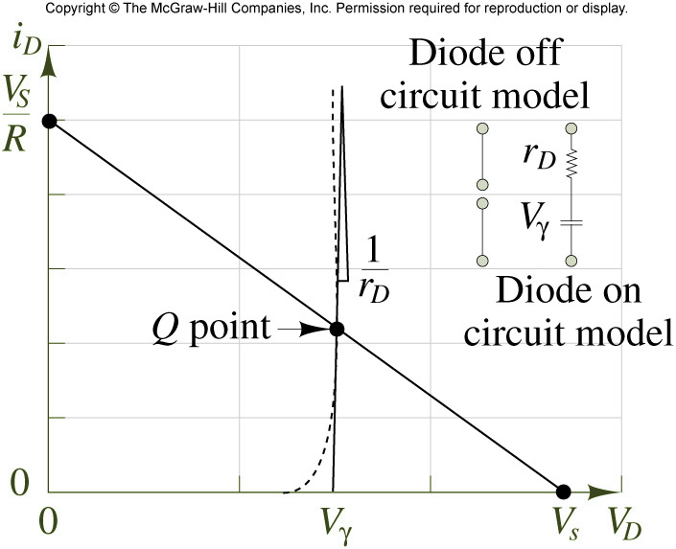
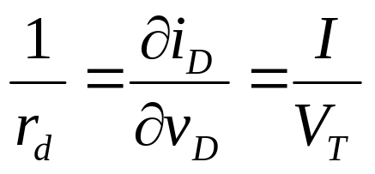
Piecewise linear diode model

Slide 15
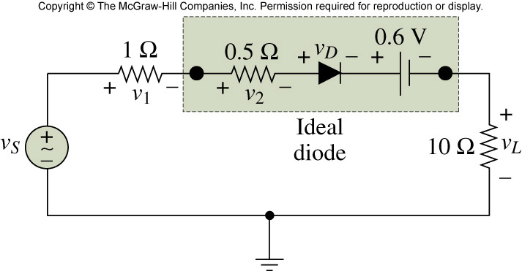
Example
1Ω
v_{s}
+
10Ω

Slide 16
Two Types of Non-linear Circuits
Digital circuit
  assume the operating mode of the device
  (ex) logic gates
Analog circuit
  Bias + Incremental analysis: small signal analysis
  (ex) amplifier

Slide 17
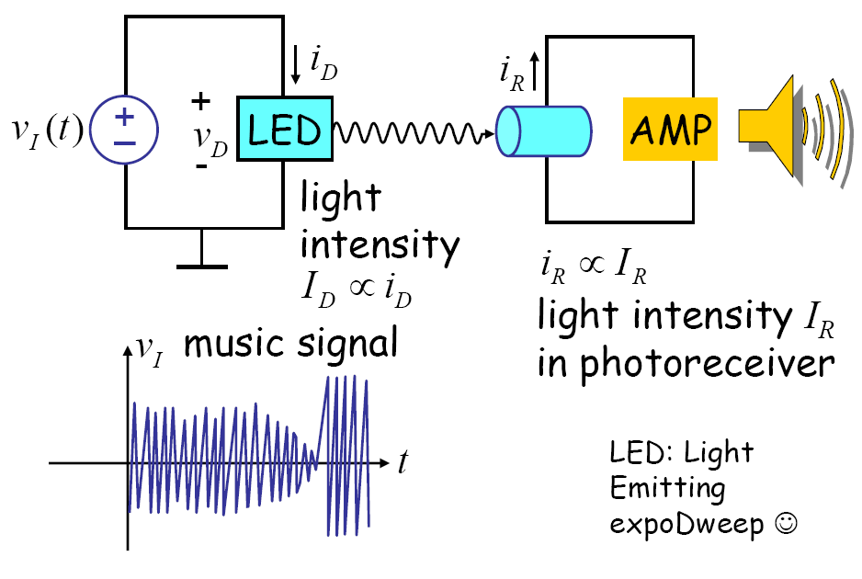
Incremental Analysis
Motivational Example

Slide 18
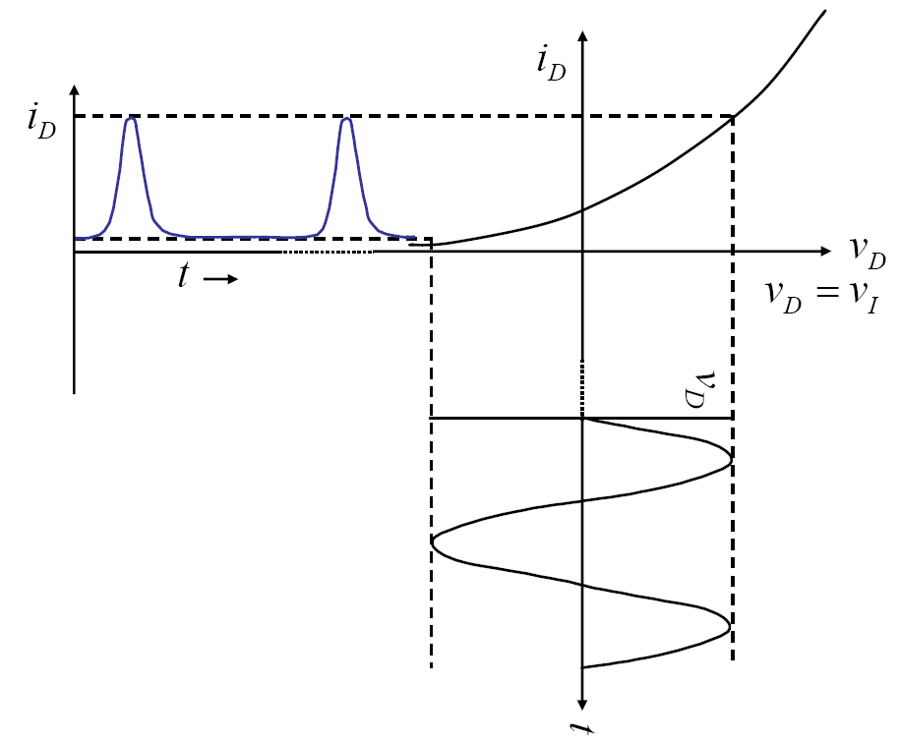
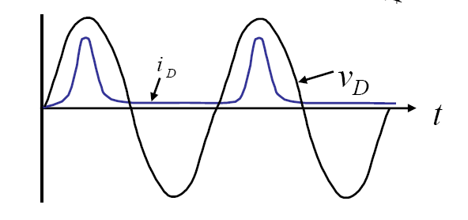

Slide 19
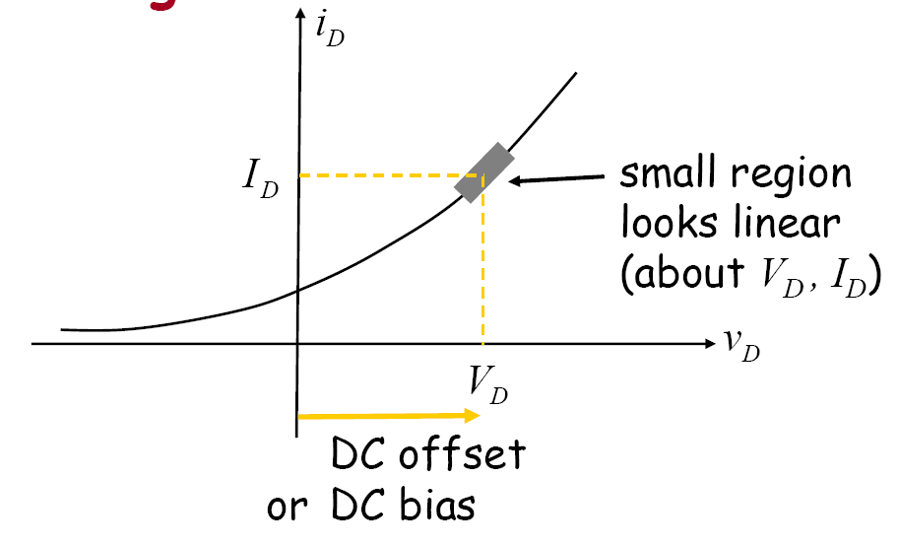
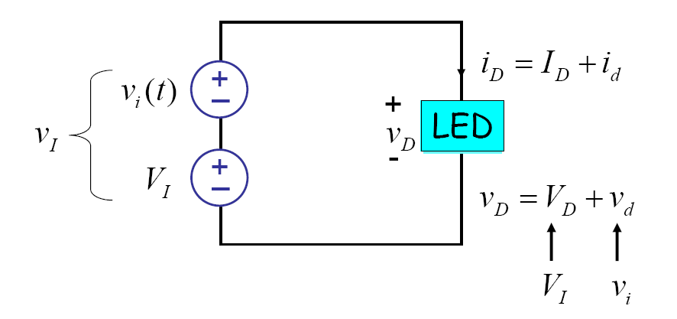
How to solve this problem?
Insight
Solution: biasing

Slide 20
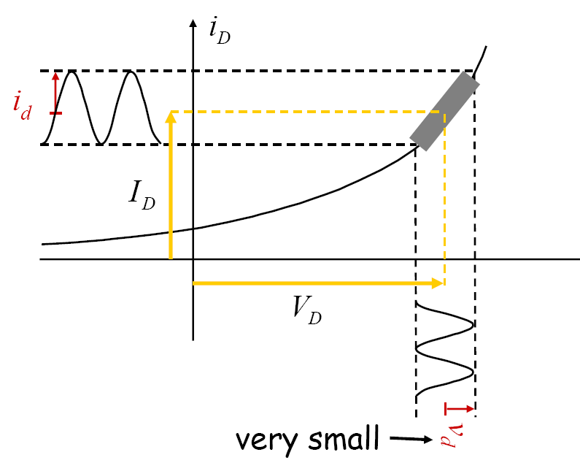
Solution

Slide 21
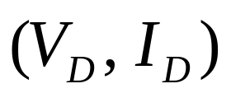
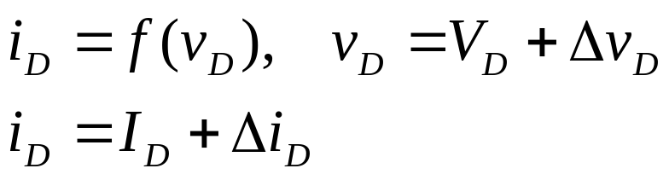
Incremental Method: small signal method
Operate at some DC offset: bias point
Superimpose small signal on top of DC offset
Solve the small signal circuit
response to small signal is (approximately) linear

Slide 22
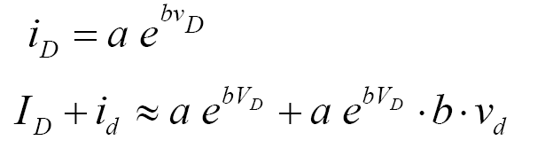
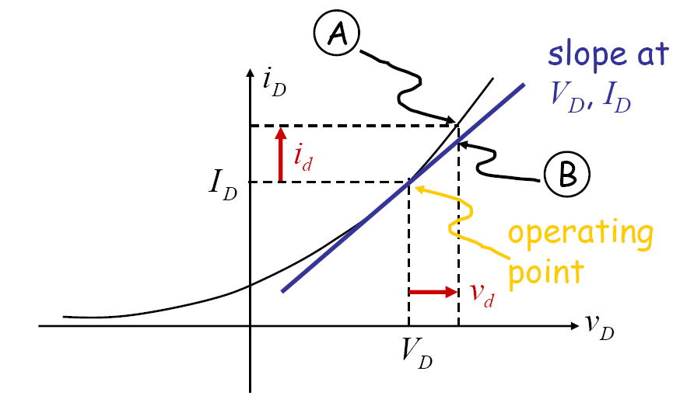


In our example
Operating point
Small signal

Slide 23
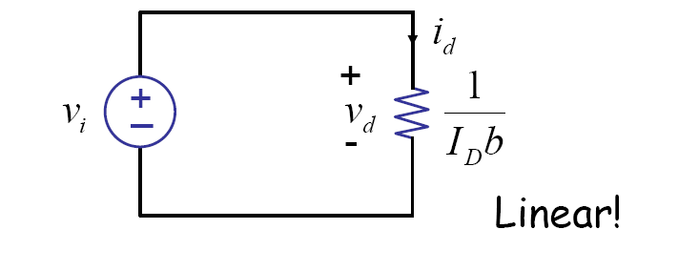
Small Signal Circuit

Slide 24
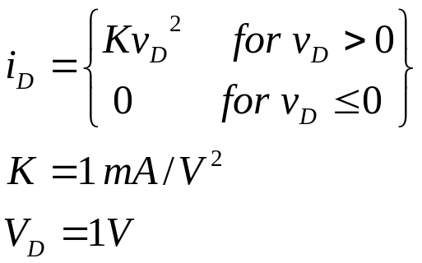
Example
Draw the small signal circuit
R
E
+

Slide 25
Conclusion
Nonlinear element: Diode is an example
Solution methods
  Analytical method
  Graphical method
  Piecewise linear method
Two types of non-linear circuits
  Digital circuit: assume the operating mode of the device (ex) logic gates
  Analog circuit: Bias + Incremental analysis: small signal analysis (ex) amplifier

