Slide 1
Ch. 4 Data Abstraction
Modular programming
Procedural abstraction
  Know what each method does but not how it does
Data abstraction
  Focus what you can do to a collection of data but not how you do it
ADT (Abstract data type)
  A collection of data together with a set of operations on the data

Slide 2
Examples of ADT
A sorted array
together w/ the binary search algorithm
A set of students
together w/ student-affairs operations
Grocery items
together w/ operations on them

Slide 3
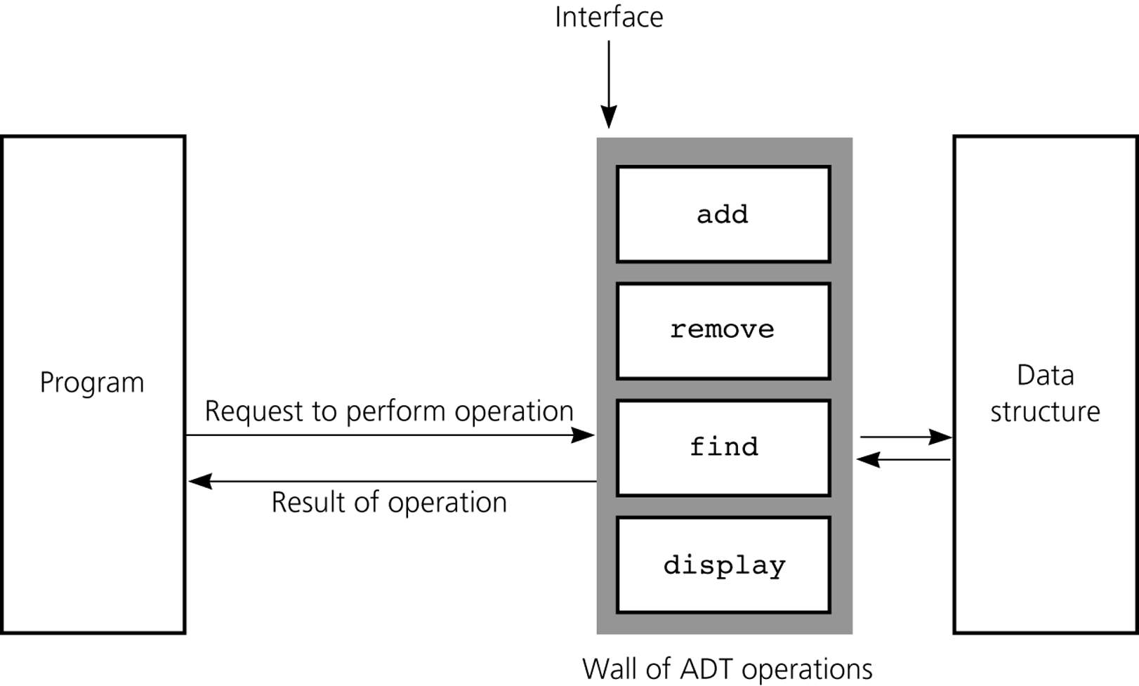
ADT Operations Isolates a Data Structure from the Program

Slide 4
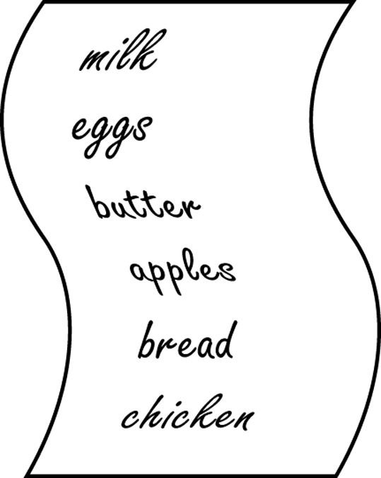
An Example Design of ADT
Grocery list
ADT consists of
  items
  operations that you can perform on the items

Slide 5
Operations on the Items
Create an empty list
Determine whether a list is empty
Determine the # of items on a list
Add an item in the list
Remove an item from the list
Retrieve an item from the list
Get the price of an item
Get the price sum of the items in the list
Print the items on the list
“How to implement” is another issue

Slide 6
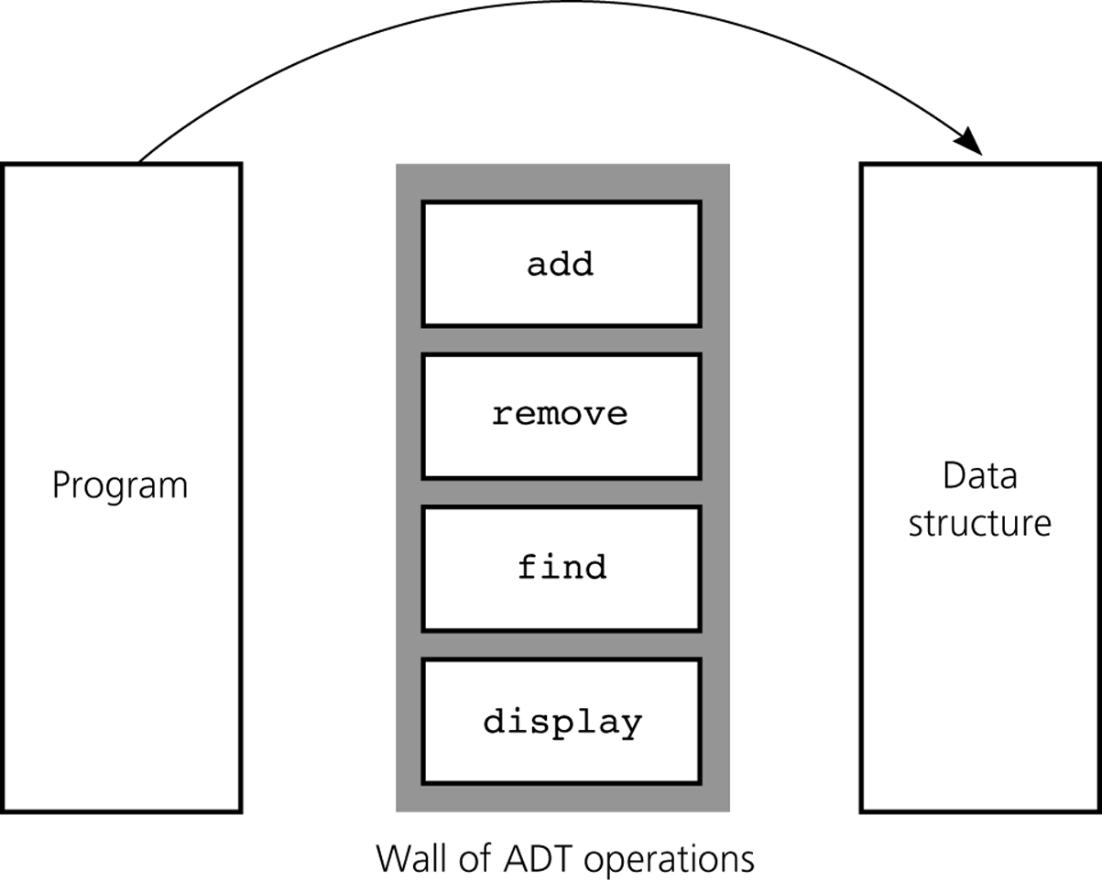
A Bad Design
Direct access to the data structure

Slide 7
Abstraction Example
firstItem = aList.item[0];
vs.
firstItem = aList.get(1);
Get the 1st item of the list
Get the item at slot 0 in the array item[ ] for list
What if the array changes to another data structure later?

Slide 8
JAVA Classes
Constructors
Inheritance
Class Object

Slide 9
public class Sphere {
private double theRadius;
public Sphere( ) {
setRadius(1.0);
} // default constructor
public Sphere(double initialRadius) {
setRadius(initialRadius);
}
public void setRadius(double newRadius) {
if (newRadius >= 0.0) {
theRadius = newRadius;
}
}
public double radius( ) {
return theRadius;
}
public double volume( ) {
return (4.0 * Math.PI * Math.pow(theRadius, 3.0)) / 3.0;
}
public void displayStatistics( ) {
System.out.println(“\nRadius = ” + radius( ) + “\nDiameter = ”
+ diameter( ) + “\nCircumference = ” + circumference( )
+ “\nArea” + area( ) + “\nVolume” + volume( ));
}
} // end Sphere
constructors

Slide 10
Inheritance
public class Ball extends Sphere {
private String theName;
public Ball( ) { // at first create a sphere w/ radius 1.0
setName(“unknown”);
} // default constructor
public Ball(double initialRadius, String initialName) {
super(initialRadius);
setName(initialName);
}
public String name( ) {
return theName;
}
public void setName(String newName) {
theName = newName;
}
public void displayStatistics( ) {
System.out.print(“\nStatistics for a ”+ name( ));
super.displayStatistics( );
}
} // end Ball
new methods
overwriting
(overriding)

Slide 11
Class Object
Every class is a subclass of the class Object
public class Sphere {
…
}
implicitly means
public class Sphere extends Object {
…
}

Slide 12
Object Equality
Class Object provides the method equals( )
Method equals( ) basically checks to see if two references are the same
Sphere sphere1 = new Sphere( );
Sphere sphere2 = sphere1;
If (sphere1.equals(sphere2)) {
System.out.println(“The same!”);
} else {
System.out.println(“Different!”);
}
The same!

Slide 13
Object Equality
Sphere sphere1 = new Sphere(2.0 );
Sphere sphere2 = new Sphere(2.0 );
If (sphere1.equals(sphere2)) {
System.out.println(“The same!”);
} else {
System.out.println(“Different!”);
}
Different!

Slide 14
Overriding
public class Sphere {
…
public boolean equals(Object sp) {
return ((sp instanceof Sphere)
&& theRadius == ((Sphere)sp).radius( ));
}
…
}

Slide 15
Cf: Overloading
public class Sphere {
…
public boolean equals(Sphere sp) {
return (theRadius == sp.radius( ));
}
…
}
헛점이 있으나 논외
Overriding: the same name, the same number & types of parameters
  Has only one method accessible w/ the name
Overloading: the same name, different number or types of parameters
  Has two different methods accessible w/ the name

Slide 16
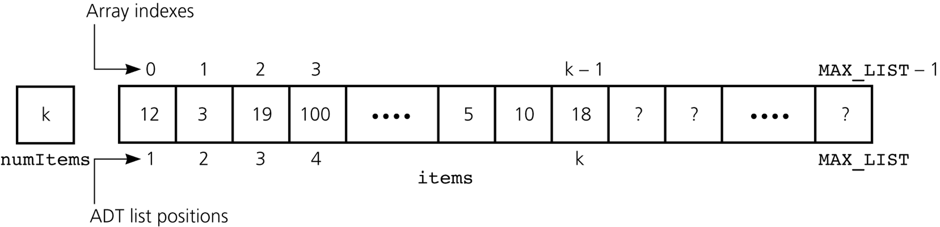
ADT List Implementation w/ Array
1 2 3 4
Operations
    createList( )
    isEmpty( )
    size( )
    add(newPosition, newItem)
    remove(index)
    removeAll( )
    get(index)

Slide 17
Interface Design
public interface ListInterface {
public boolean isEmpty( );
public int size( );
public void add(int index, Object item)
throws ListIndexOutOfBoundsException,
ListException;
public Object get(int index)
throws ListIndexOutOfBoundsException;
public void remove(int index)
throws ListIndexOutOfBoundsException;
public void removeAll( );
}

Slide 18
Implementation
public class ListArrayBased implements ListInterface {
private final int MAX_LIST = 50;
private Object items[ ]; // array of list items[1…MAX_LIST]
private int numItems; // # of items in the list
public ListArrayBased( ) {
items = new Object[MAX_LIST+1];
numItems = 0;
}
public boolean isEmpty( ) {
return (numItems == 0);
}
public int size( ) {
return numItems;
}

Slide 19
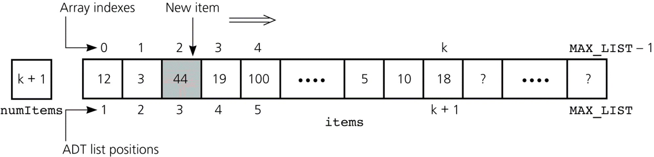
예: Shifting Items Before Insertion at Position 3
new item
shift

Slide 20
Continued…
public void removeAll( ) {
items = new Object[MAX_LIST+1];
numItems = 0;
}
public void add(int index, Object item)
throws ListIndexOutOfBoundsException {
if (numItems > MAX_LIST) {
Exception 처리;
}
if (index >= 1 && index <= numItems+1) { // shift right
for (int pos = numItems; pos >= index; pos--) {
items[pos+1] = items[pos];
}
items[index] = item;
numItems++;
} else {
Exception 처리;
}
}

Slide 21
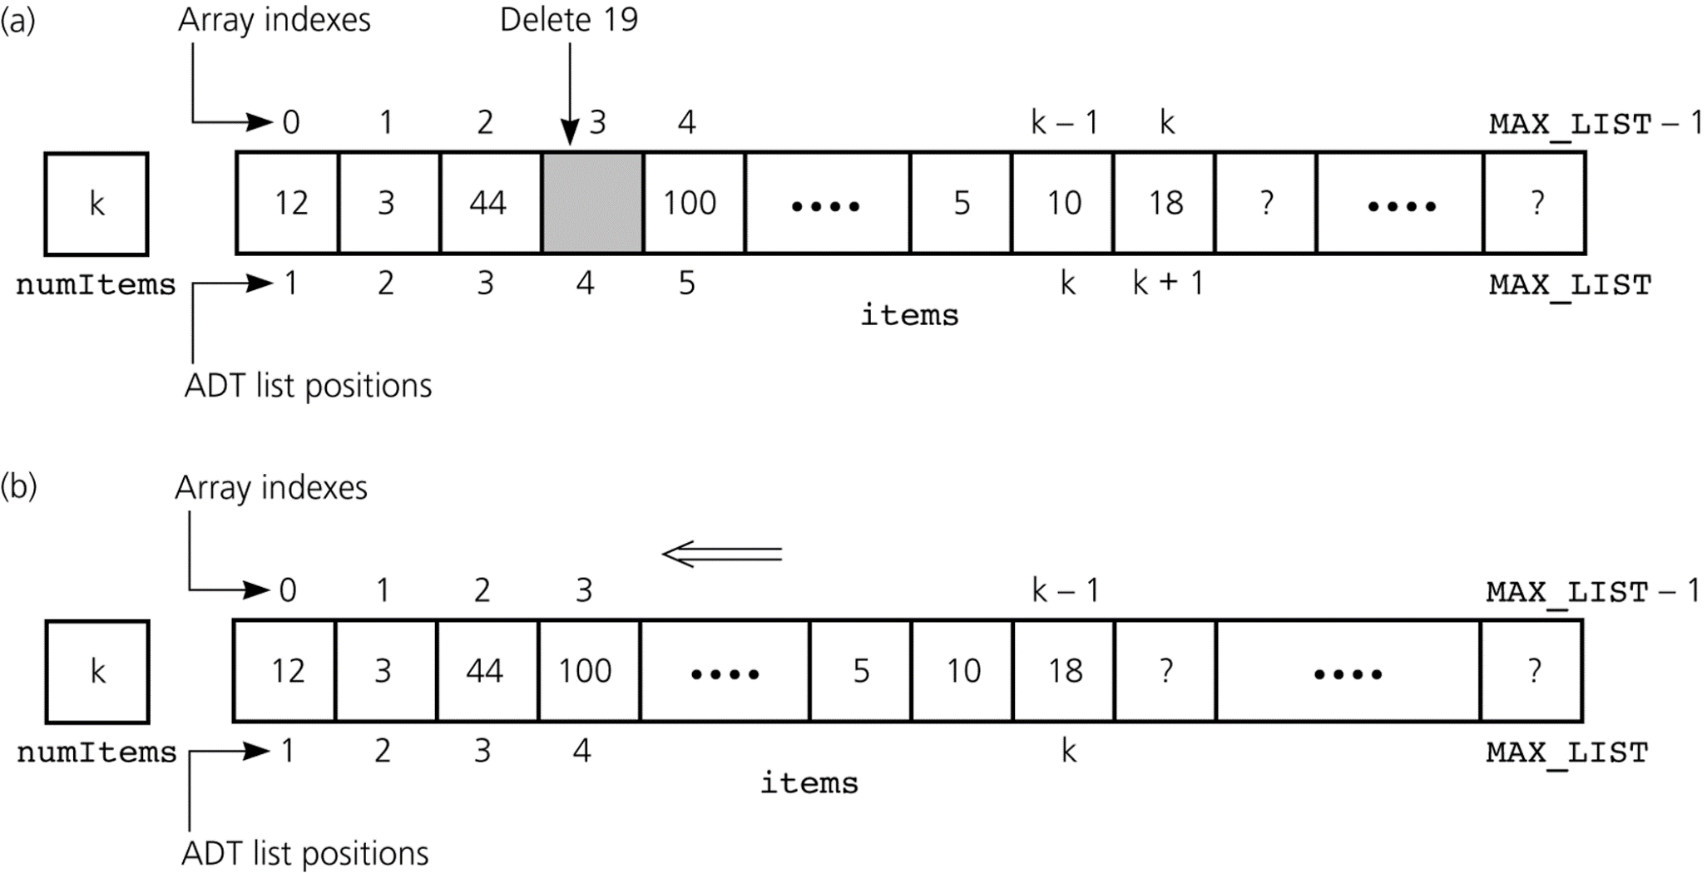
예: Shifting Items After Deletion at Position 4
deleted
shift

Slide 22
public Object get(int index)
throws ListIndexOutOfBoundsException {
if (index >= 1 && index <= numItems) {
return items[index];
} else { // index out of range
Exception handling;
}
}
public void remove(int index)
throws ListIndexOutOfBoundsException {
if (index >= 1 && index <= numItems) { // shift left
for (int pos = index+1; pos <= size( ); pos++) {
items[pos-1] = items[pos];
}
numItems--;
} else { // index out of range
Exception handling;
}
}
} // end class ListArrayBased

