Slide 1
Circuits for binary addition
Half adder (add 2 1-bit numbers)
Sum = Ai' Bi + Ai Bi' = Ai xor Bi
Cout = Ai Bi
Full adder (carry-in to cascade for multi-bit adders)
Sum = Ci xor A xor B
Cout = B Ci + A Ci + A B = Ci (A + B) + A B
Ai Bi Cin Sum Cout 0 0 0 0 0 0 0 1 1 0 0 1 0 1 0 0 1 1 0 1 1 0 0 1 0 1 0 1 0 1 1 1 0 0 1 1 1 1 1 1
Ai Bi Sum Cout 0 0 0 0 0 1 1 0 1 0 1 0 1 1 1 1

Slide 2
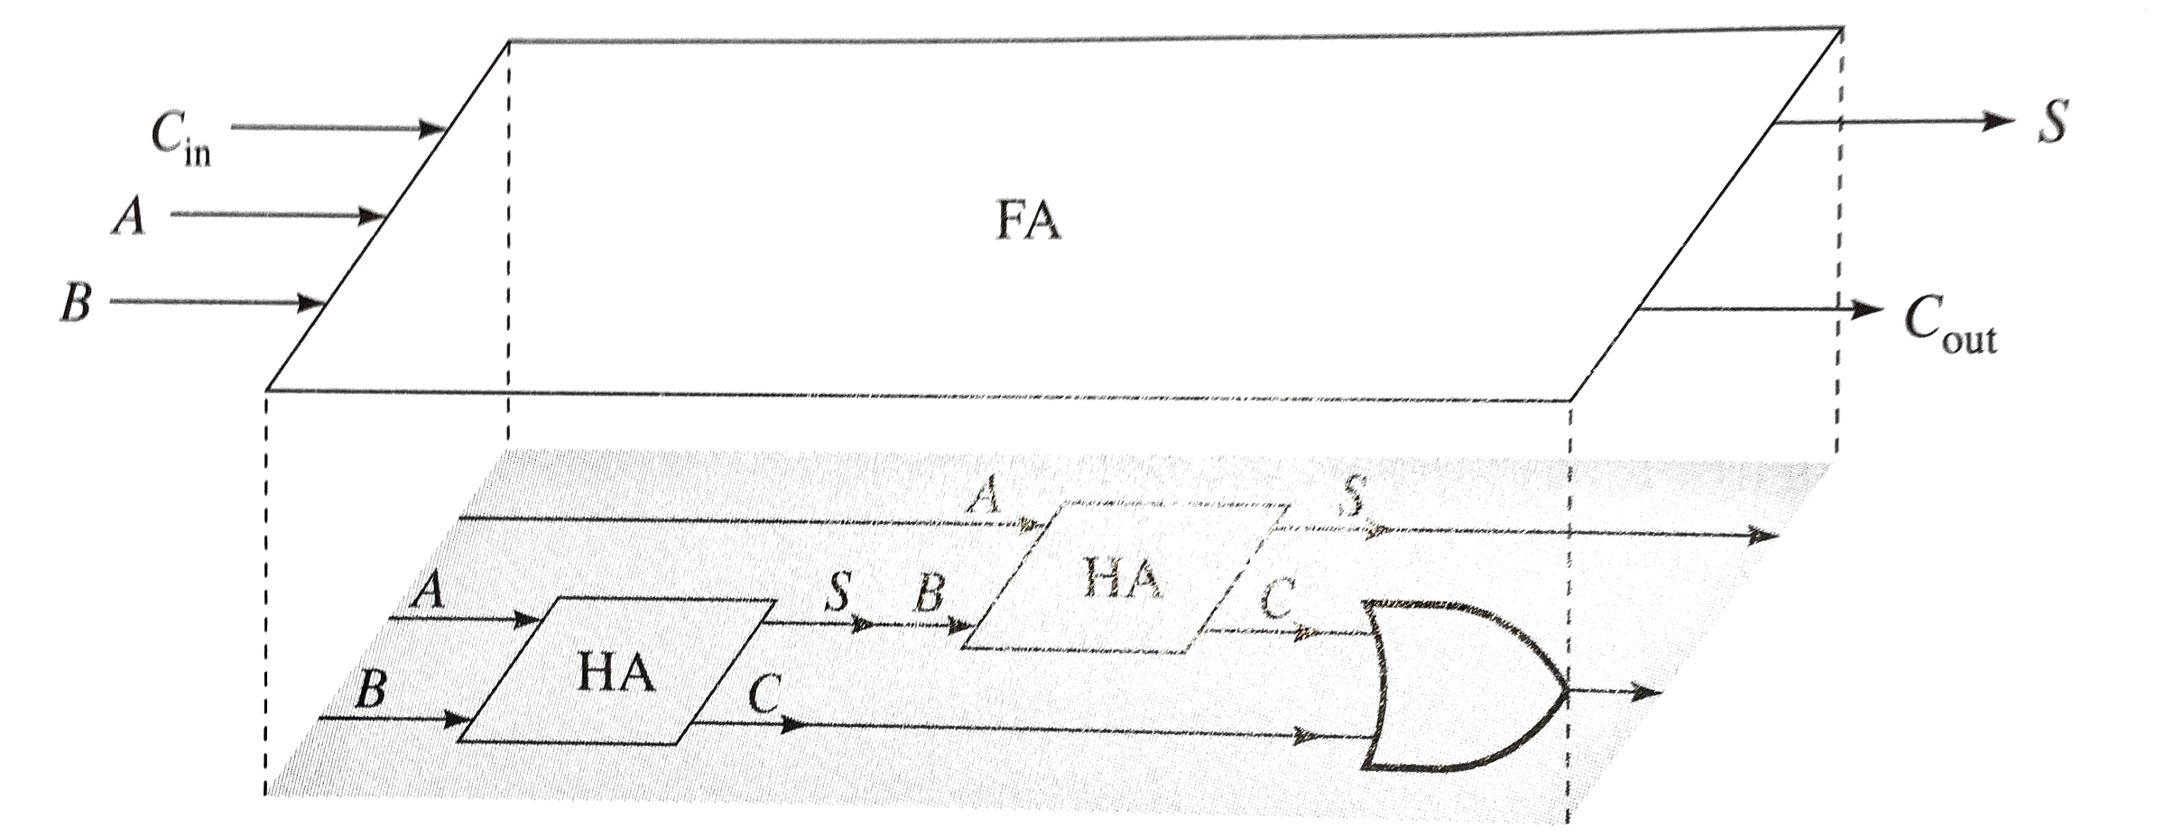
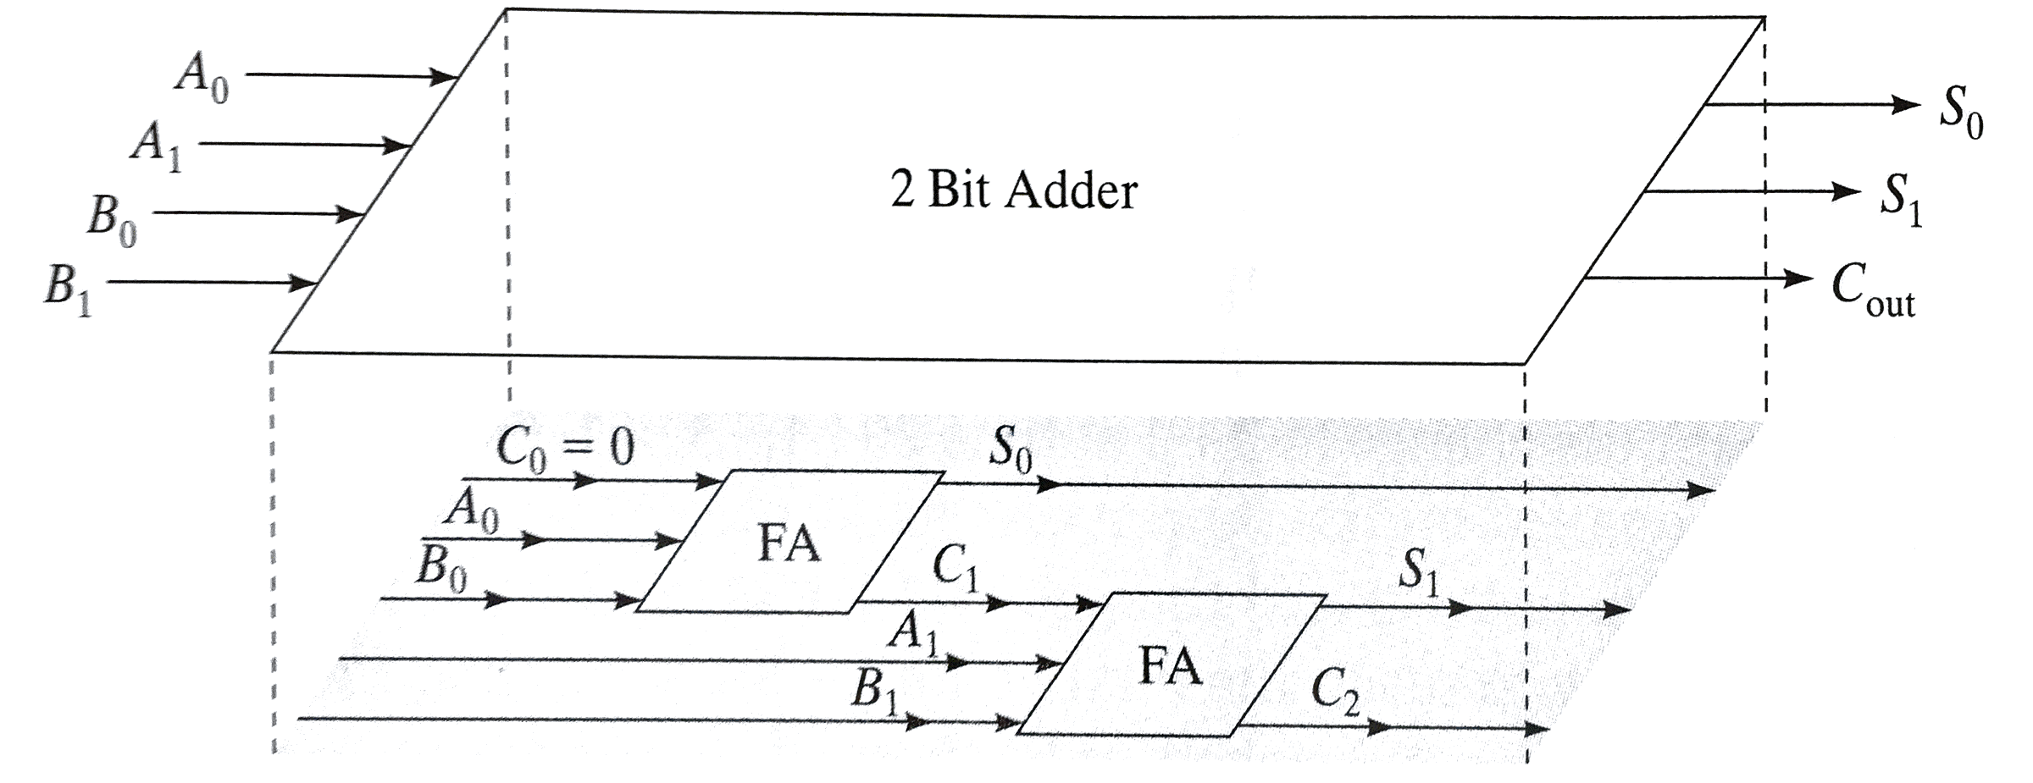
Full Adder & 2-Bit Adder

Slide 3
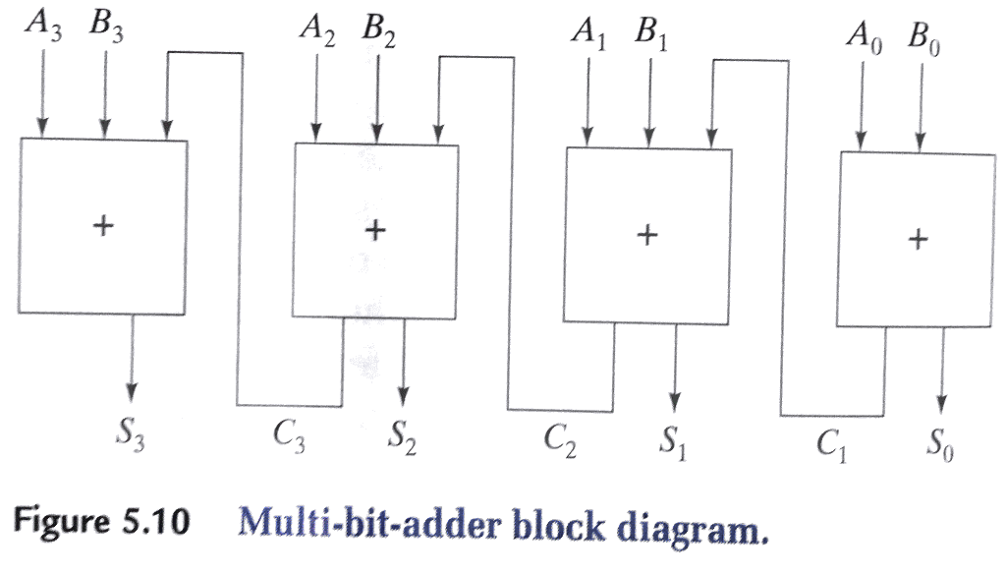
Multi-bit Adder

Slide 4
Carry-Select Adder
Redundant hardware to make carry calculation go faster
compute two high-order sums in parallel while waiting for carry-in
one assuming carry-in is 0 and another assuming carry-in is 1
select correct result once carry-in is finally computed
C8
4-bit adder [7:4]
1
adder high
C8
4-bit adder [7:4]
0
adder low
five 2:1 mux
1
0
1
0
1
0
1
0
1
0
C4
4-Bit Adder [3:0]
C0
C8
S7
S6
S5
S4
S3
S2
S1
S0

Slide 5
Multiplexers/selectors
Multiplexers/selectors: general concept
2^{n} data inputs, n control inputs (called "selects"), 1 output
used to connect 2^{n} points to a single point
control signal pattern forms binary index of input connected to output
I₁ I₀ A Z 0 0 0 0 0 0 1 0 0 1 0 1 0 1 1 0 1 0 0 0 1 0 1 1 1 1 0 1 1 1 1 1
A Z 0 I₀ 1 I₁
Z = A' I₀ + A I₁
functional form
logical form
two alternative forms
for a 2:1 Mux truth table

Slide 6
Multiplexers/selectors (cont'd)
2:1 mux: Z = A'I₀ + AI₁
I0 I1
2:1 mux
Z
A

Slide 7
Gate level implementation of muxes
2:1 mux

