Slide 1
Tri-State and Open-Collector
The Third State
Logic States: "0", "1"
Don't Care/Don't Know State: "X" (must be some value in real circuit!)
Third State: "Z" high impedance infinite resistance, no connection
Tri-state gates: output values are "0", "1", and "Z"
additional input: output enable (OE)
A
X
0
1
OE
0
1
1
F
Z
0
1
When OE is high, this gate is a non-inverting "buffer"
When OE is low, it is as though the gate was
disconnected from the output!
This allows more than one gate to be connected to the
same output wire, as long as only one has its
output enabled at the same time
Non-inverting buffer's
timing waveform
"Z"
"Z"
Notes:
Output enable 이 0이면 Z값을 가진다. Z는 끊어져 있는 상태를 의미한다.

Slide 2
Tri-state and Open Collector
Using tri-state gates to implement an economical multiplexer:
When SelectInput is asserted high
Input1 is connected to F
When SelectInput is driven low
Input0 is connected to F
This is essentially a 2:1 Mux

Slide 3
Tri-state and Open Collector
Alternative Tri-state Fragment
Active low tri-state enables
plus inverting tri-state buffers
Switch Level Implementation
of tri-state gate
Notes:
오른쪽 아래의 그림이 Tri-state Gate를 의미한다. [OE와 결과값이 둘다 inv되어서 들어가는 tri-state Gate]

Slide 4
Tri-State and Open Collector
4:1 Multiplexer, Revisited
Decoder + 4 tri-state Gates
Notes:
S1, S0 input을 주면, !Y3210중에서 하나가 선택되어서 1을 내보낸다.

Slide 5
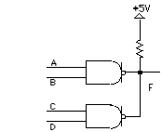
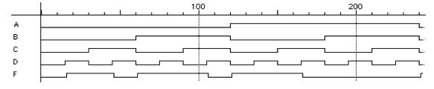
Tri-State and Open Collector
Open Collector
another way to connect multiple gates to the same output wire
gate only has the ability to pull its output low; it cannot actively
drive the wire high
this is done by pulling the wire up to a logic 1 voltage through a
resistor
OC NAND gates
Wired AND:
If A and B are "1", output is actively pulled low
if C and D are "1", output is actively pulled low
if one gate is low, the other high, then low wins
if both gates are "1", the output floats, pulled
high by resistor
Hence, the two NAND functions are AND'd
together!

Slide 6
Tri-State and Open Collector
4:1 Multiplexer
Decoder + 4 Open Collector Gates

