Slide 1
논리 설계 Logic Design Lecture 1: Course Overview Course #:M1522.000700 (001) Instructor: Jihong Kim 김지홍

Slide 2
Instructor
김 지 홍 Jihong Kim
Professor
Computer Science & Engineering
Office: 302-328
880-8792
jihong@davinci.snu.ac.kr
Office Hours:
Mondays 14:30 – 15:20
(or by appointment)@302-328

Slide 3
Today’s Lecture
Introduction to Digital Logic Design
Course Overview
Course Information

Slide 4
Big Questions
What is Design?
Given a specification of a problem, come up with a way of solving it by choosing appropriately from a collection of available components
While meeting some criteria for size, cost, performance, power consumption, color, taste, elegance, etc.
What is a Digital Value?
A physical quantity that can be interpreted as a “0” or “1”
Voltage: <0.5V (“0”) >3.0V (“1”)
Mirror: Tilting left (“0”) Tilting right (“1”)

Slide 5
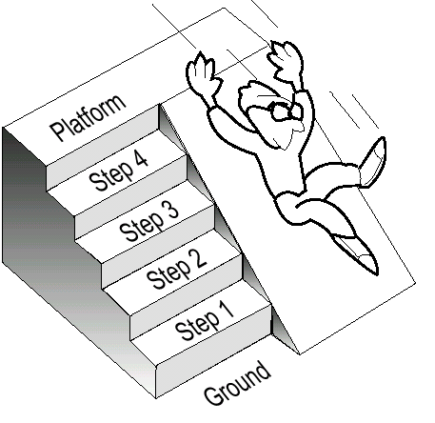
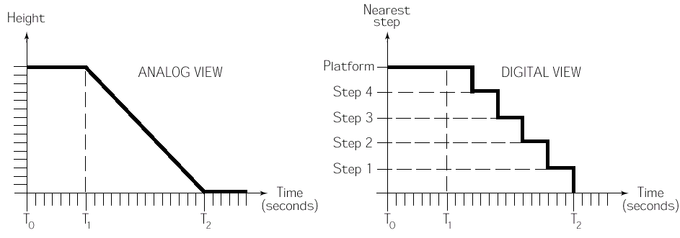
Analog vs. Digital

Slide 6
What is Digital Logic Design?
determining the collection of digital logic components to perform a specified function
alternative implementations/technologies
design constraints
N
W
Traffic Light Controller
E
S

Slide 7
Where is It Used?
To design and implement digital hardware systems
Examples that include Digital Hardware Systems:
PC processor,
Calculators
Digital alarms
Digital cameras
Cellular phones
MP3 players
...

Slide 8
Digital Logic Design Example: 16-bit Adder
Problem:
Design & Implement a 16-bit adder that takes two 16-bit numbers, A and B, and produces A+B as an output.
Design Constraints:
How fast?
How expensive?
How big?
What power consumption?
My Adder
What is a building block?
Alternative Solutions:
2 8-bit adders
4 4-bit adders
different addition algorithms
...

Slide 9
Building Blocks of Digital Systems
System
. . .
. . .
Subsystems
. . .
. . .
Functional blocks
. . .
. . .
Logic gates
Our building blocks
Switches

Slide 10
Why do we study Logic Design?
Implementation basis for all modern computing devices
First exposure to parallel computation
Useful in furthering the understanding of computation (cf. software design)

Slide 11
Course Goals & 구성
Understand the basic building blocks of digital systems.
Understand the design methods used in building these blocks.
Understand the optimization techniques to build these blocks efficiently.
Learn how to build a digital logic system using building blocks.
[이론]과 [실습]으로 구성

Slide 12
Related Courses
System-level
Computer Organization
Logic-level
Logic Design
Circuit-level

Slide 13
Course Information
Textbook:
Randy H. Katz & Gaetano Borriello
Contemporary Logic Design, 2nd Edition
Pearson Prentice Hall, 2005
(교재의 1장에서 10장을 [이론]수업에서 다룸)
Prerequisite:
Programming experience
TAs: 박지성, 한승욱, 천명준, 유정석, 조유현, 진용석 [315-2@302, 880-1861]
TA전체 이메일리스트: tas0217@davinci.snu.ac.kr
(TA별 이메일은 강의계획서 참고)
Office hours: 결정되면 따로 공지 예정

Slide 14
Q: 프로그래밍 경험이 없습니다. 수강 가능한지요?
module binary_counter (clk, c8, c4, c2, c1);
input clk; output c8, c4, c2, c1;
reg [3:0] count;
initial begin count = 0; end always @(posedge clk) begin count = count + 4’b0001; end
assign c8 = count[3]; assign c4 = count[2]; assign c2 = count[1]; assign c1 = count[0]; endmodule
module binary_counter (clk, c8, c4, c2, c1, rco);
input clk; output c8, c4, c2, c1, rco;
reg [3:0] count; reg rco;
initial begin . . . end always @(posedge clk) begin . . . end
assign c8 = count[3]; assign c4 = count[2]; assign c2 = count[1]; assign c1 = count[0]; assign rco = (count == 4b’1111); endmodule

Slide 15
Course Information
Course Home Page: 논리설계(001) at http://etl.snu.ac.kr
- Lecture Slides
- Q&A
- Announcements
Evaluation: (Course Repeat Policy: A0 Maximum )
Midterm: 20% (10월 30일 예정)
Final: 30% (12월 11일 예정)
Assignments: 35%
[실습] 평가: 10%
[이론] 출석: 5%

Slide 16
Assignments
5번의 이론 및 설계 과제
대부분의 과제가 [실습]과 연관되어 제공됨
설계프로젝트 (약 3주간의 기간 동안 진행)

Slide 17
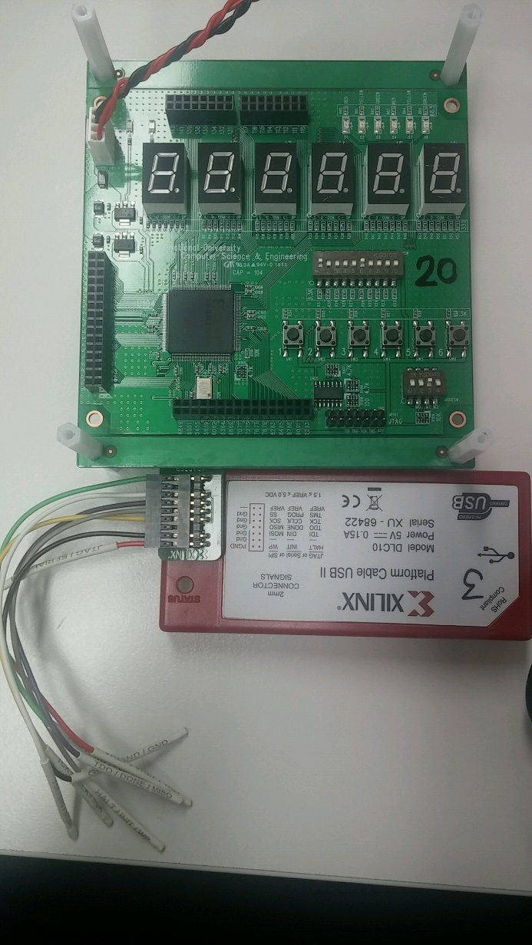
[실습] 소개
추후 실험시간에 별도 소개 예정

Slide 18
[실습] 출석 관련
출석이 매우 중요함
무단 결석 1회당:
100점으로 환산된 최종성적에서 10점 감점
9/6 [실습]은 없음
9/13 [실습] Orientation

Slide 19
Assignment Submission Policy
3 Bonus Days
Used for any assignment except for the last one (마지막 실습 프로젝트)
Once 3 Bonus Days are exhausted, late submission penalties:
the first 12 hours: 30% of the total points
the next 12 hours: 60% of the total points
Ex: Due 2:00 pm, 9/8
Assignment: 150 points
Submitted at 03:40 pm, 9/8: (-45)
Submitted at 11:00 am, 9/9: (-90)

Slide 20
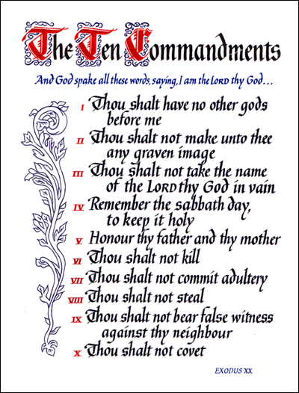
Thou shalt not cheat!!

Slide 21
Do Not Steal… 탐하지 말라 …
…
네 친구의 답을 탐하지 말라… Your Friend’s Answers
네 친구의 숙제를 탐하지 말라… Your Friend’s Assignments
네 친구의 프로그램을 탐하지 말라… Your Friend’s Programs
네 친구의 리포트를 탐하지 말라…Your Friend’s Reports

Slide 22
그럼에도 불구하고…In Spite of All the Warnings…

Slide 23
Cheating Policy
I’M F
For Any Type of Cheating, a grade of F will be given.
The College & University will be notified of cheating activities for further disciplinary actions.

Slide 24
김영란법과 논리설계
부정청탁 및 금품 등 수수의 금지에 관한 법률
5조10항: 각급 학교의 입학·성적·수행평가 등의 업무에 관하여 법령을 위반하여 처리·조작하도록 하는 행위
부정청탁의 예:
D-를 받은 학생이 교수를 찾아와서
학점을 D+로 올려달라고 하는 행위
부정청탁의 신고 및 처리:
1회: 부정청탁임을 알리고 거절을 명확히 표시
2회: 소속기관장에게 서면으로 신고

Slide 25
Any Questions??

