Slide 1
Electrical and Electronics Circuits (2017)
Lecturer: Prof. Soonhoi Ha (301-408, x8382)
sha@snu.ac.kr, http://peace.snu.ac.kr/sha
Textbook: Foundations of Analog and Digital Electronic Circuits
Course homepage: ETL
Grades: 3 exams 30, 30, 30% homework + attendance: 10%

Slide 2
Tips for the course
Do not leave the class until you understand the contents.
Exercise is the best way to learn the key concepts.
Better if you can prepare and review the class
Prerequisites: Engineering Math.
  Differential equation, complex numbers
Why do you need this course
  Pre-requisite for advanced system courses
  Broad knowledge on IT-related issues
Computer
Hardware
Embedded
System
Eng. Math
전기전자회로
(This course)

Slide 3
Chap. 1 Circuit Abstraction
Lumped Circuit Abstraction
Practical Two-Terminal Elements
Electric power
i-v characteristics
Resistors: Ohm’s law

Slide 4
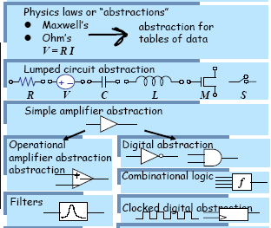
Abstraction

Slide 5
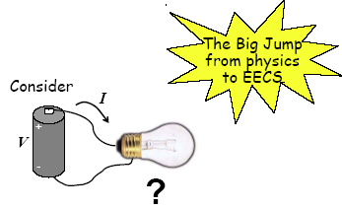
Lumped Circuit Abstraction
Model
Circuit Element
Physical element
Interconnection
Interconnection
Model
Real circuit
Electric circuit
Notes:
<-> distributed circuit abstraction

Slide 6

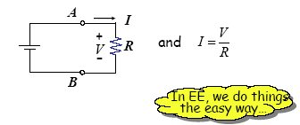
The Easy Way …
R is the “lumped circuit abstraction” of the bulb.

Slide 7
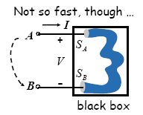
Lumped Circuit Abstraction Assumption
V and I must be defined for the element
Element behavior is completely captured by its
I-V relationship.

Slide 8
When you measure the current of a circuit, the measured value turns out to be 10 times higher than the analyzed one. What happens?
Notes:
Model is wrong!

Slide 9
Charge and Current
Charge Q
Current I = dq/dt (C/sec = A)

Slide 10
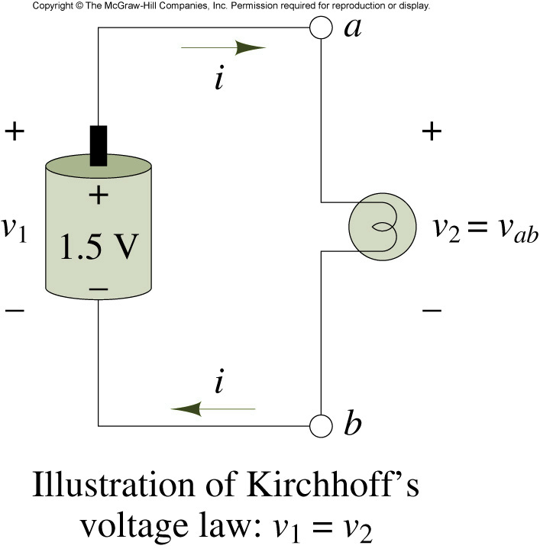
Voltages around a circuit
Voltage = Joule/Coulomb

Slide 11


Direction of Current and Voltage
A
i =3A
i = -3A
B
5A Current flows from A to B. What is the value of current i?
A
i
B

Slide 12
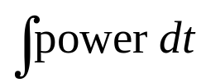
Power and Energy
Power = work/time = work/charge * charge/time
= voltage * current
P = VI
1k Ω
1.5V
i =1.5mA
Power consumed by the resistor: 2.25 mW
Power consumed by the battery? -2.25 mW
Energy =

Slide 13
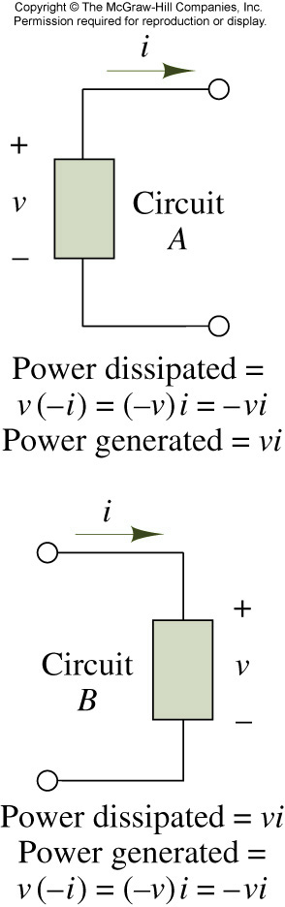
The passive sign convention

Slide 14
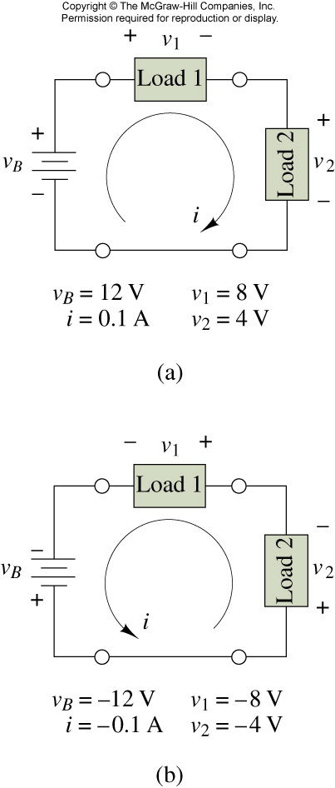
Find power dissipated by each element

Slide 15
i – v characteristics
Generalized circuit element
i-v characteristics
  Voltage source
  Current source
+ v -
i
_{Resistor: i = f(v), v = g(i)}
_{In general, F(v,i,t) = 0}

Slide 16
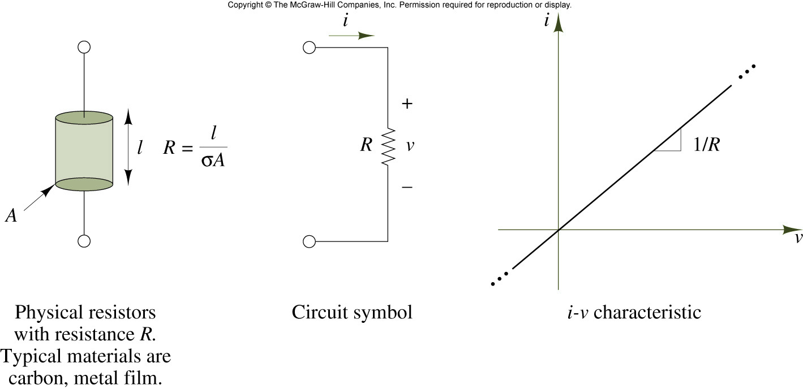
The resistance element: Ohm’s law
_{Conductance = 1 / resistance}
_{P = VI}

Slide 17
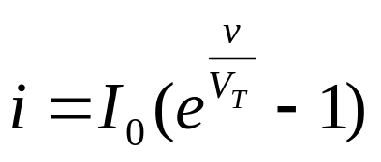
Diode: non-linear resistor
+ v -
i
(a) Diode circuit symbol
(b) Characteristic equation
i
ι
ι
v
v
v
0.7
0.7
(c) i-v characteristic
(d) simplified i-v characteristic

Slide 18
Open and short circuits
Open circuit
Short circuit

Slide 19
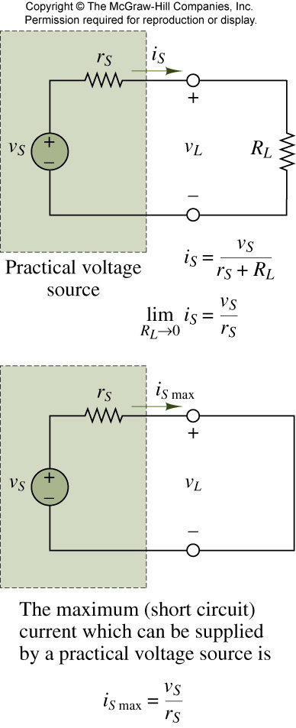
Practical voltage source

Slide 20
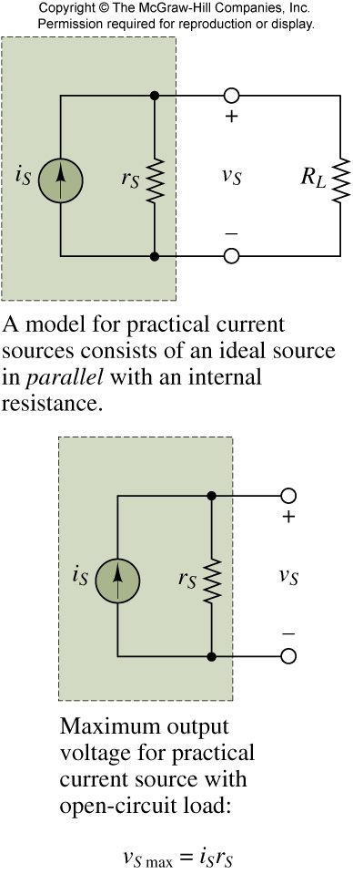
Practical current source

Slide 21
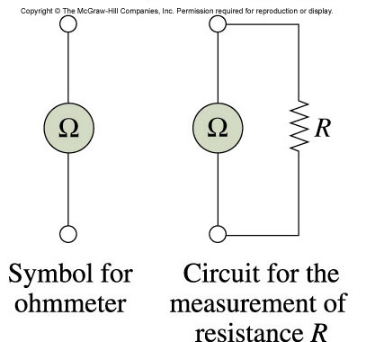
Ohmmeter and measurement of resistance
Figure 2.48

Slide 22
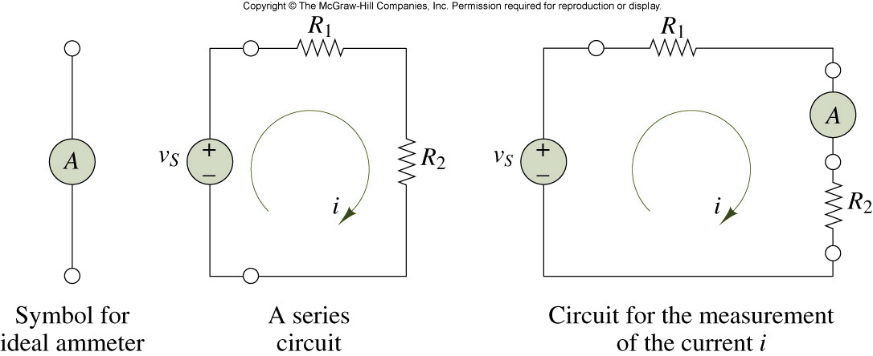
Measurement of current

Slide 23
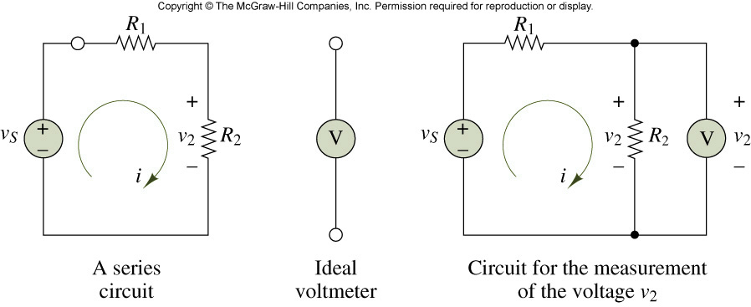
Measurement of voltage

Slide 24
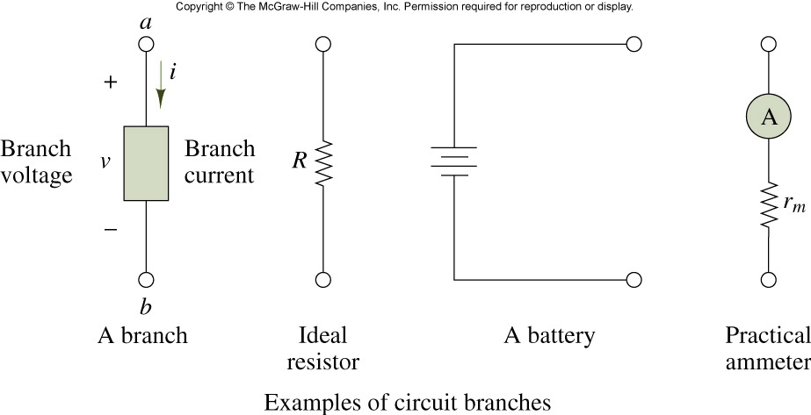
Definition of a branch

Slide 25
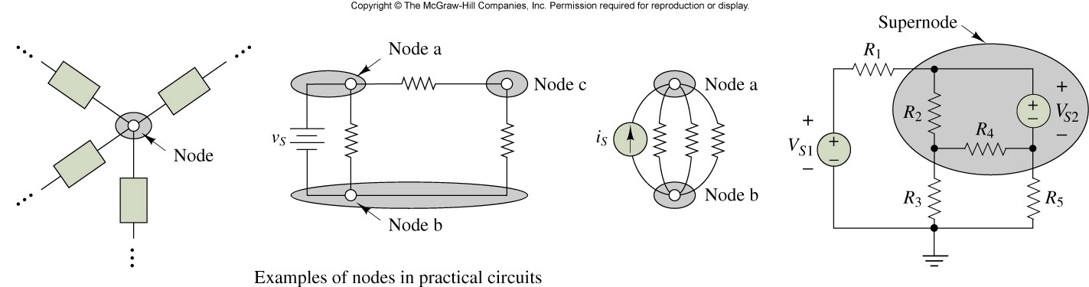
Definitions of node and supernode
1
2
3
Circuit element
(a)
(b)

Slide 26
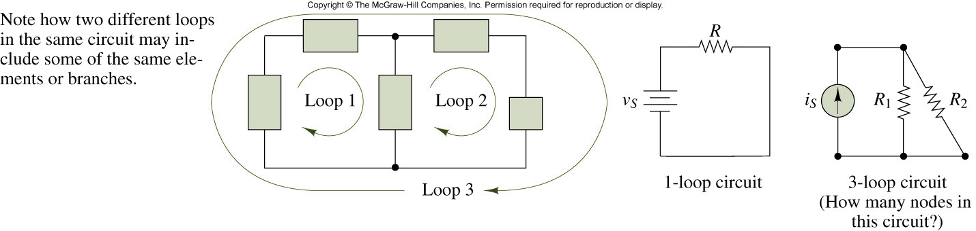
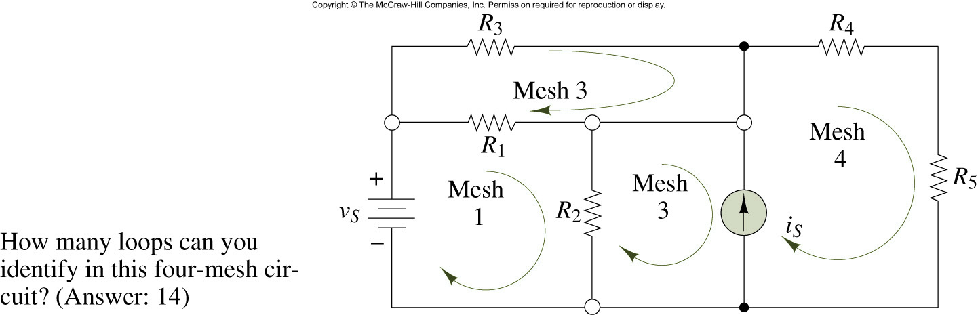
Definition of a loop and a mesh

Slide 27
Draw the directed graph. How many nodes and edges exist?
1
2
4
3

Slide 28
Summary
Lumped Circuit Abstraction
Circuit Elements
Power and Energy
Circuit Graph: Branch and Node

