Slide 1
Chap. 11 Energy and Power in Digital Circuits
Average Power in an RC Circuit
Power Dissipation in Logic Gates
CMOS Logic

Slide 2
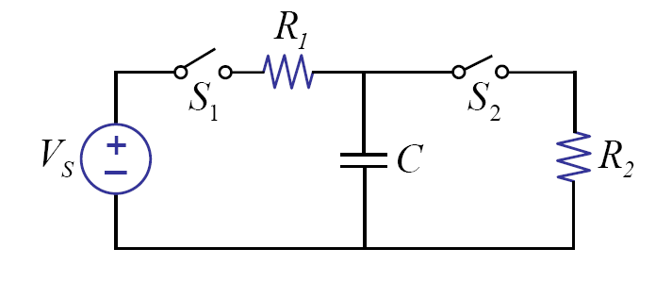
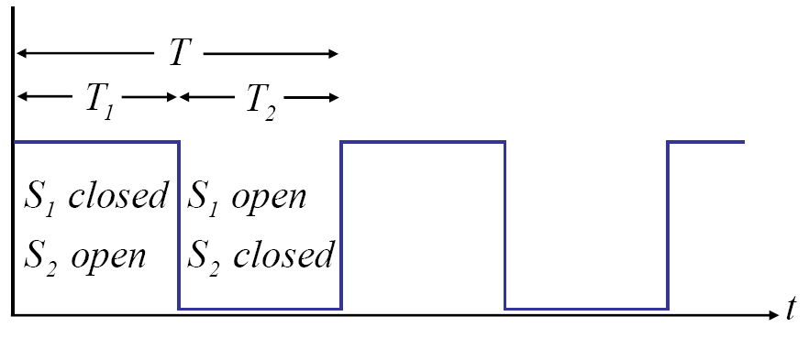
RC Circuit with a Switch
Find energy dissipated in each cycle
Find the average power.

Slide 3
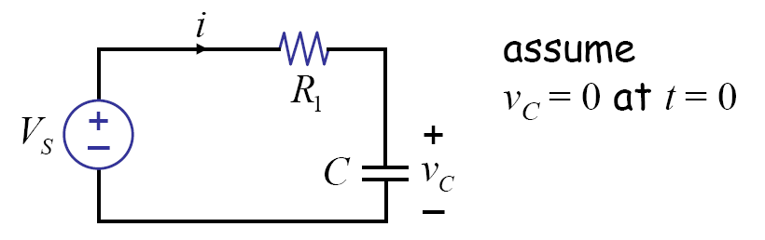
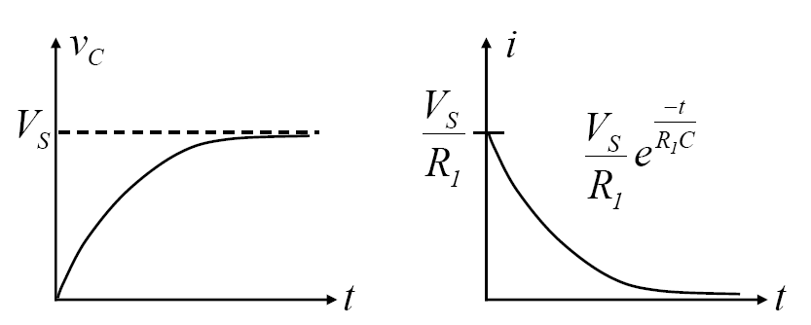
During T1

Slide 4
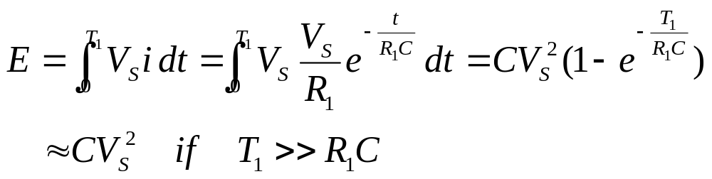
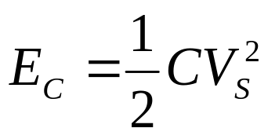
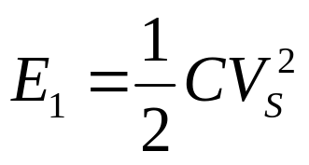
Energy Computation
Total energy provided by the source during T1
Energy stored in the capacitor:
Energy dissipated in the resistor:
  Independent of R

Slide 5
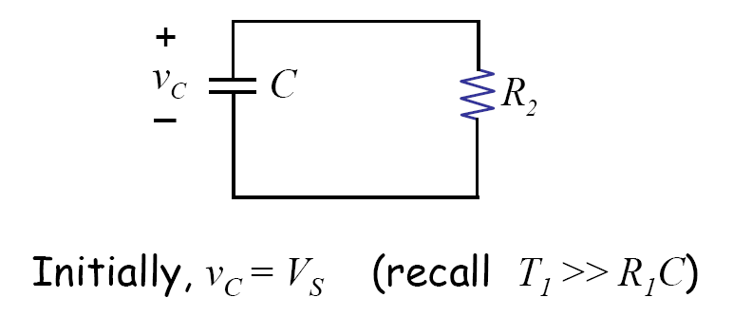

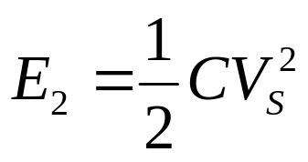
During T2
If we assume
Capacitor energy is fully discharged =
Energy dissipated by the resister:
- independent of R

Slide 6
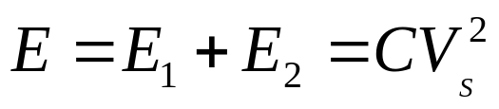
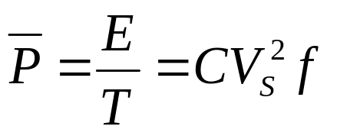
Putting Together
Energy dissipated in each cycle
  assuming that Capacitor is fully charged and discharged during the period.
Average power

Slide 7
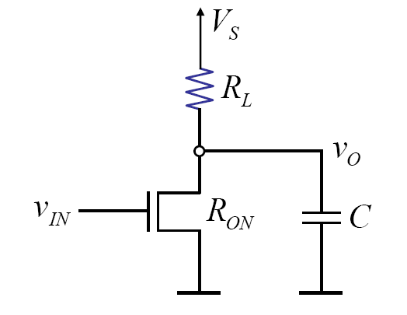
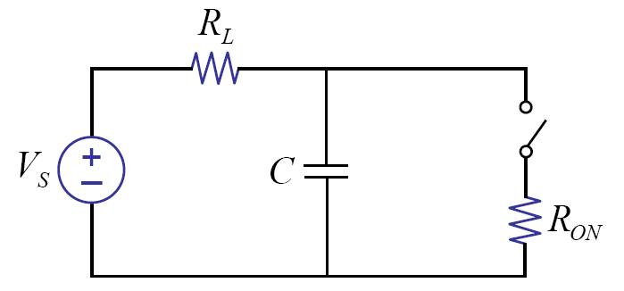
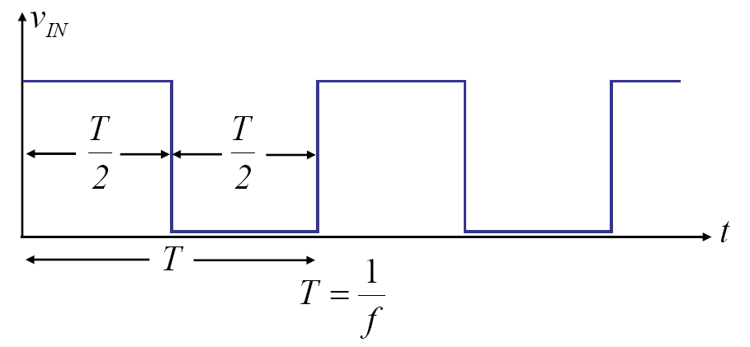
Power Dissipation of Inverter

Slide 8
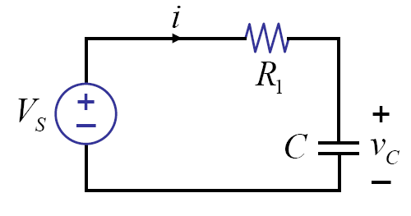
During input is low

Slide 9
During input is high

Slide 10
Easy way to solve
Average power = static power + dynamic power
  Static power: independent of the frequency
  Dynamic power: charging-and-discharging of the capacitor

Slide 11
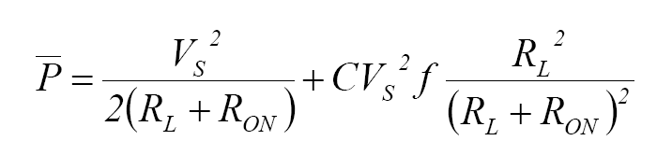
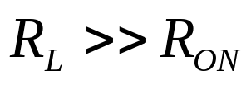
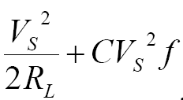
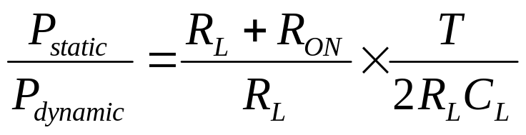
Average Power
Static power + dynamic power
Static power: Independent of the switching frequency.
Dynamic power: related to switching capacitor

Slide 12
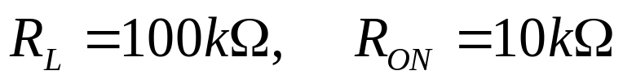


Example II.1
Worst static power dissipation

Slide 13
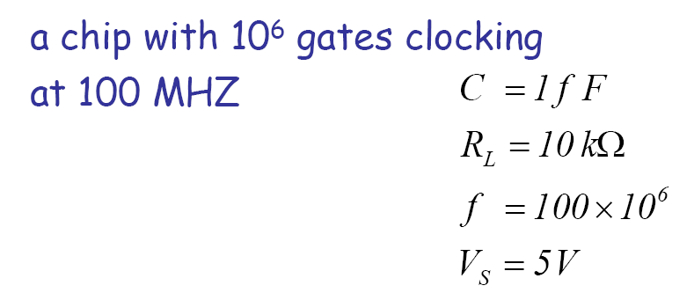
Some numbers

Slide 14
Power Minimization
Dynamic power
  Reduce the supply voltage (5V -> 1.5V)
    Change the voltage on need
  Reduce the capacitance
  Reduce the frequency
    Turn off clock when not in use
Static power
  CMOS logic

Slide 15
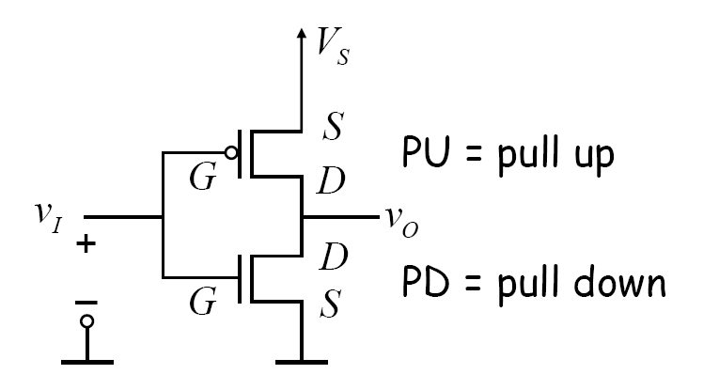
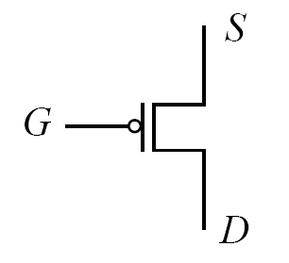
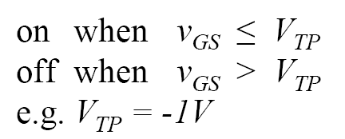
PMOS
CMOS Logic

Slide 16
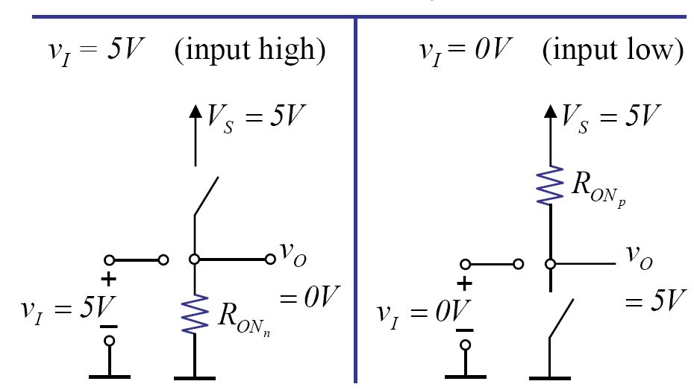
CMOS Inverter
No static power!
- No direct path from the supply to ground

Slide 17
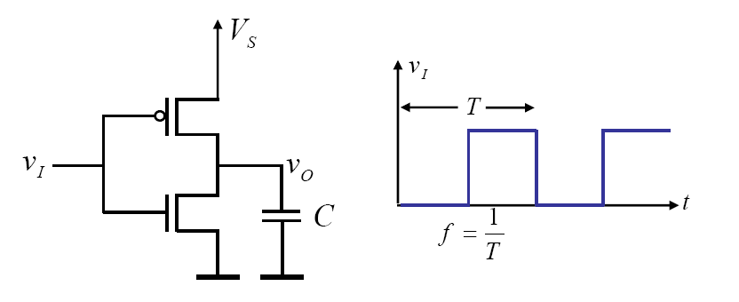
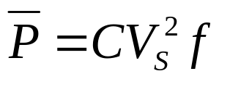
Dynamic Power of CMOS

Slide 18


Static Power of CMOS
Leakage power
Transient current

Slide 19
Some Examples
Example II.6: Processor SA27E
  # of gates = 3M, 25% activity

Slide 20

Exercise
Estimate the power of the following processor (~ P-IV)
  # of gates = 25M, 25% activity

Slide 21
Summary
Total power = static power + dynamic power
CMOS does not exhibit static loss
Dynamic power
  Reduce the supply voltage
  Reduce the switching activities
  Turn off the logic not in use (clock gating)

Slide 22
Chap. 12 Transients in Second-order Circuits
LC Circuit
RLC Circuits

Slide 23
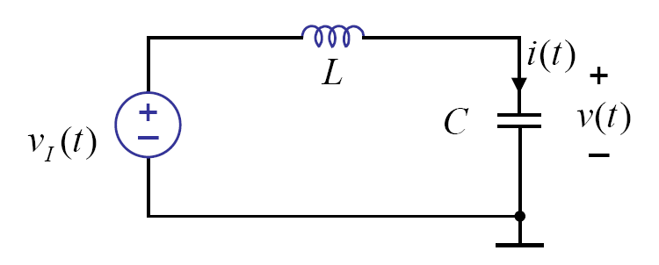
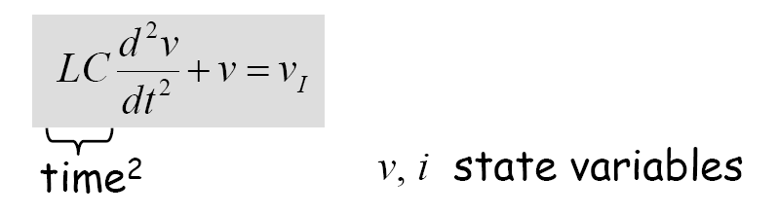
LC Circuit

Slide 24




Solutions
Find the particular solution
Find the form of homogeneous solution
Use initial condition to obtain the total solution
< example >
Zero initial condition:

Slide 25

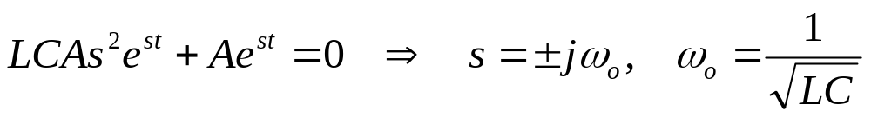
Homogeneous Solution
General Form:

Slide 26
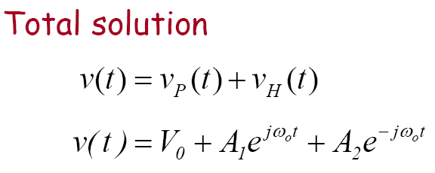
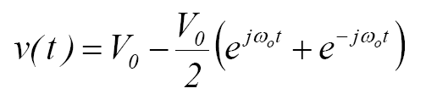

Total Solution
Find A1 and A2 from initial conditions

Slide 27
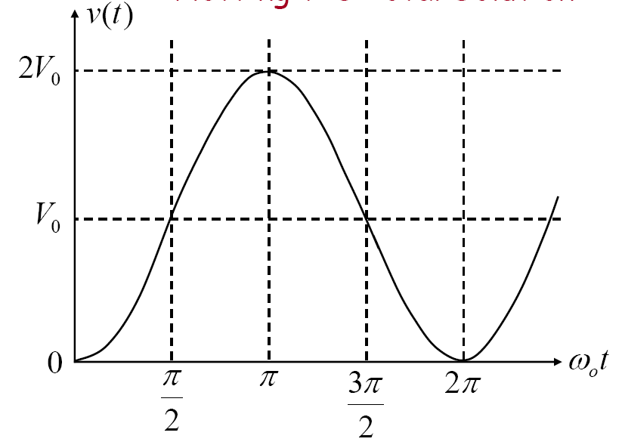

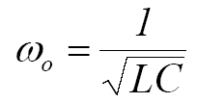
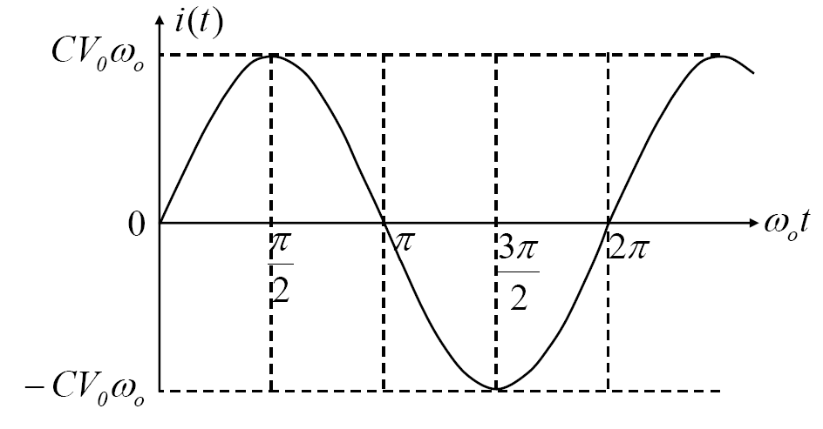

Total Solution: Plot

Slide 28
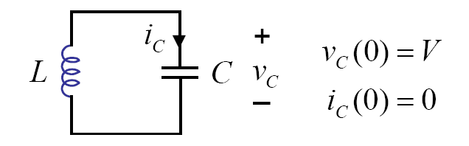

Undriven LC Circuit

Slide 29
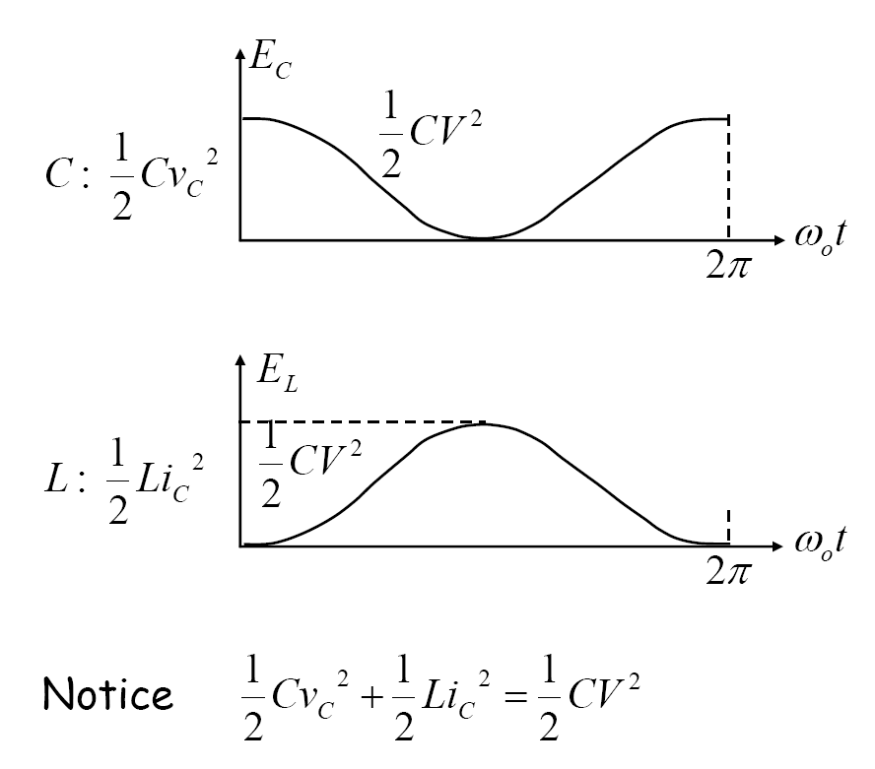
Energy

Slide 30

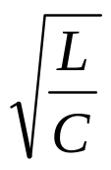
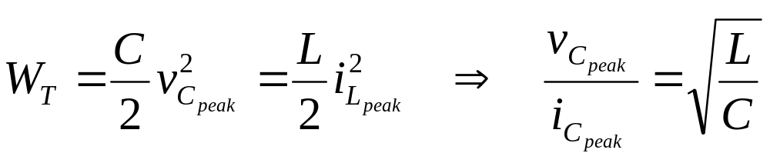
Observations from undriven LC Circuit
1. LC circuits are capable of oscillation
2. Important time constant:
3. Characteristic impedance

Slide 31
Example 12.1

Slide 32
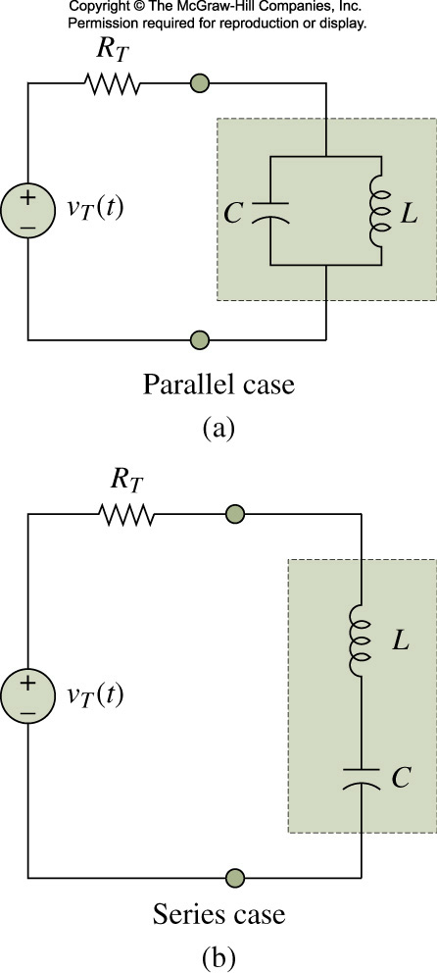
RLC Circuits

Slide 33
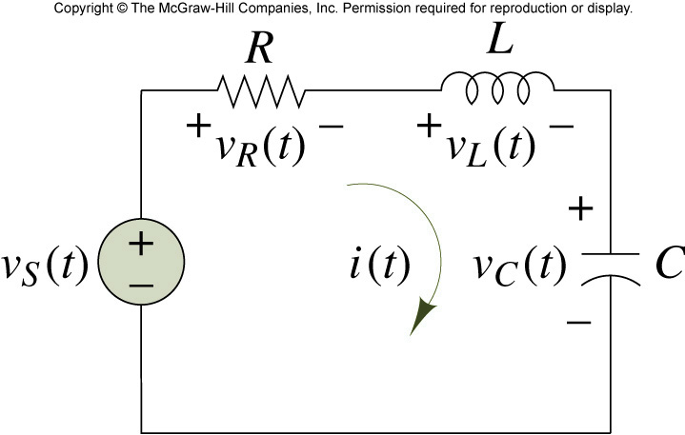
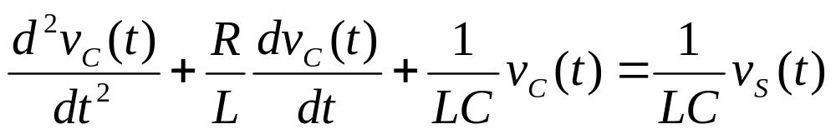
Series RLC Circuit: second order circuit

Slide 34
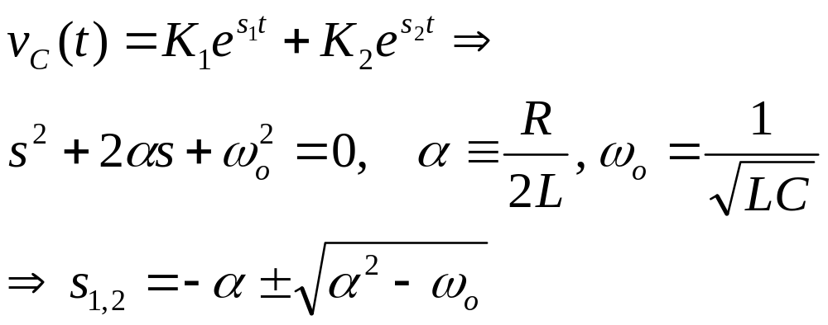
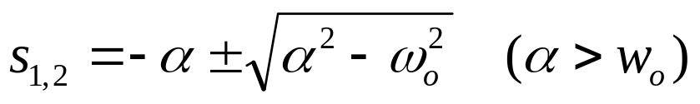
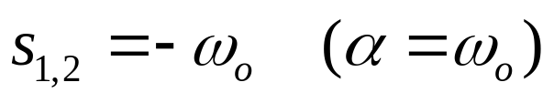
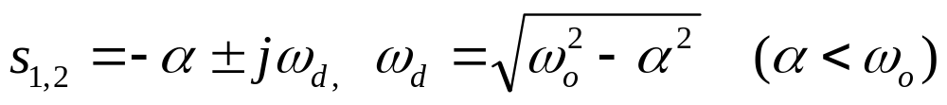
Homogeneous Solution
Overdamped case: real and distinct roots
Critically damped case: real and repeated roots
Underdamped case: complex conjugate roots

Slide 35

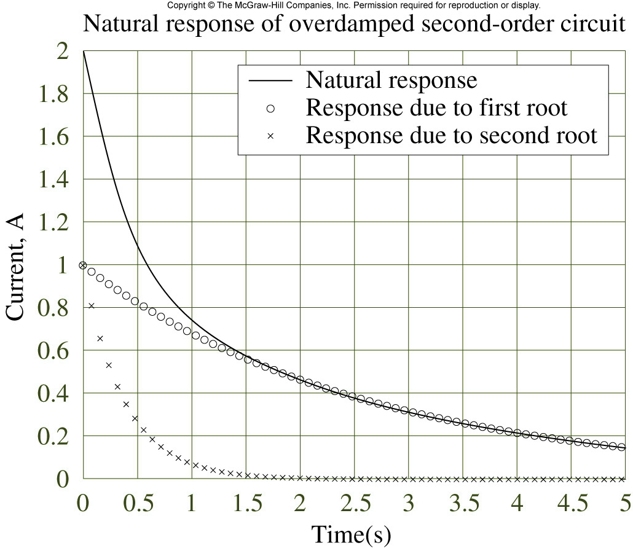
Natural Response: overdamped case

Slide 36

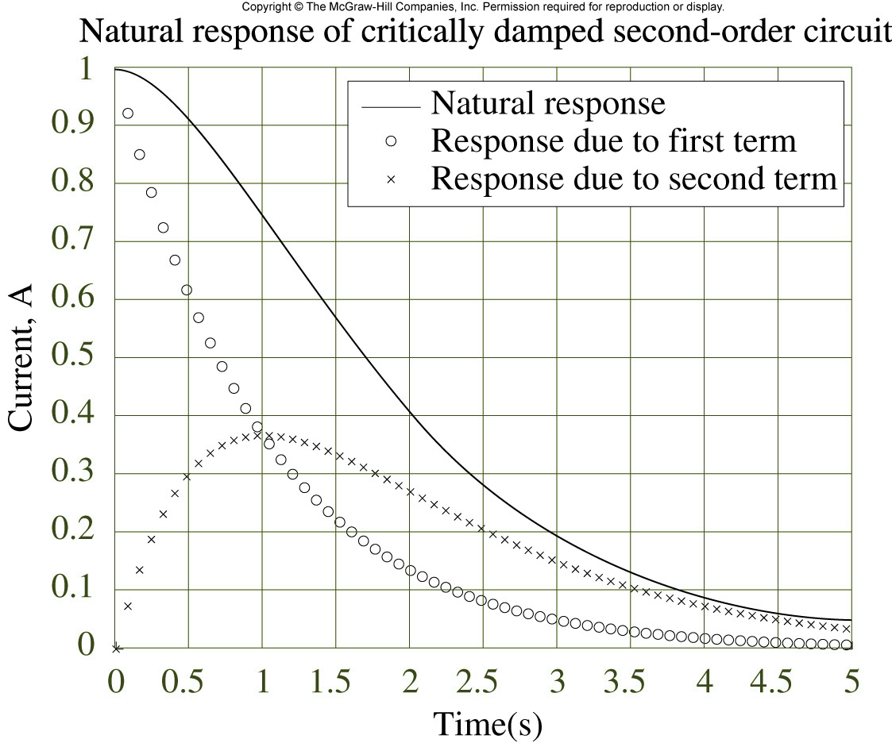
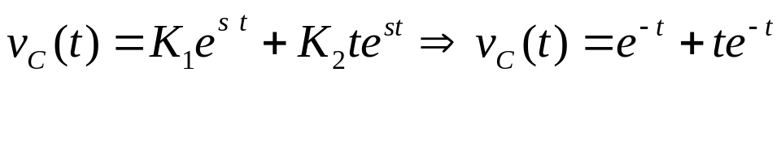
Natural Response: Critically damped case

Slide 37

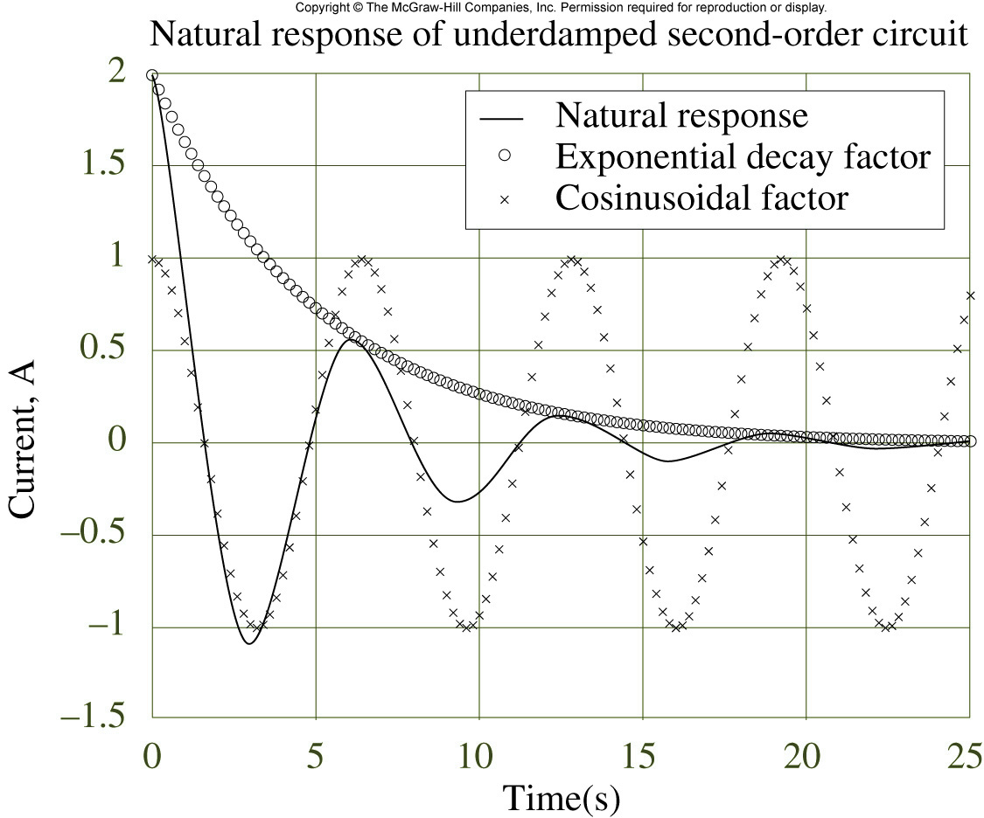
Natural Response: Underdamped case

Slide 38


Response to step input voltage

Slide 39

Exercise: Parallel RLC Circuit
Find i_{L}(t)
assume zero initial state

Slide 40

Exercise
Find the range of L to make v_{C}(t) to be overdamped
L
v_{s}(t) = u(t)
+
-
v(t)
= u(t)
+
1k
1
v_{c}(t)
0
t

Slide 41
Exercise
Find the differential equation for capacitor voltage. Find the total response with the following initial condition.
i_{L} (0) = 4 mA, v_{C} (0) = 0 (V)
4mA
2kΩ
1H
+
-
1
4
μF
v_{c}(t)
+-
2kΩ
12V

Slide 42















Example 12.4 Ideal Switched Power Supply
+
-
(1) S1 on, S2 off
(2) S1 off, S2 on until inductor
current becomes zero
(3) S1 off, S2 off

Slide 43
Summary
LC Circuit
RLC Circuit
  Three kinds of transient responses
    Over-damped
    Critically damped
    Under-damped

Slide 44
Chap. 13 Sinusoidal Steady State: Impedance and Frequency Response
Sinusoidal Steady-state Response
Impedance
Frequency Response
Filter

Slide 45



Sinusoidal Response of RC Circuit
Find the particular solution to

Slide 47


Total solution

Slide 48




Sinusoidal Steady State (SSS)
Particular solution for sinusoidal input after transients have died
All information of SSS is contained in the complex amplitude

Slide 49

Magnitude Plot

Slide 50

Phase Plot

Slide 51



Impedance Model

Slide 52



Impedance Model
Circuit corresponding to a complex exponential input

Slide 53

Series RLC Circuit

Slide 54

Exercise 1
2kΩ
1H
+
10cos2t
1μF

Slide 55
Exercise 2
Find v(t) at steady state (time unit: msec)
1kΩ
2kΩ
+
-
sint
v(t)
1μF
+
cos2t

Slide 56

What we are doing? The Big Picture

Slide 57



Slide 58

Frequency Response

Slide 59

Frequency Response of Basic Elements

Slide 60


RC and RL Circuits

Slide 61

RLC Circuits

Slide 62

Resonance
Equivalent impedance = Resistor
Circuit response is maximum

Slide 63


Slide 64

Another Example

Slide 65

AM Radio Receiver

Slide 66


Slide 67

Selectivity

Slide 68


Quality Factor: Q

Slide 69


Quality Factor
Lower R, higher Q
Another interpretation

Slide 70
Exercise
Find the resonance frequency and the equivalent impedance at resonance.
2kΩ
200mH
Z
0.2μF
600Ω

Slide 71
Summary
Sinusoidal Steady-state Response
Impedance
Frequency Response
Filter

