Slide 1
Chap. 2 Fundamentals of Electric
Circuits
Kirchhoff’s laws
Circuit Analysis: Basic Methods
Dependent Sources

Slide 2
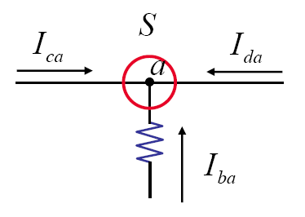
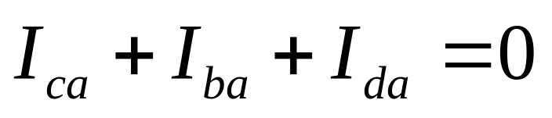
KCL (Kirchhoff’s Current Law)
The sum of all branch currents flowing into a node is zero – charge conservation.

Slide 3
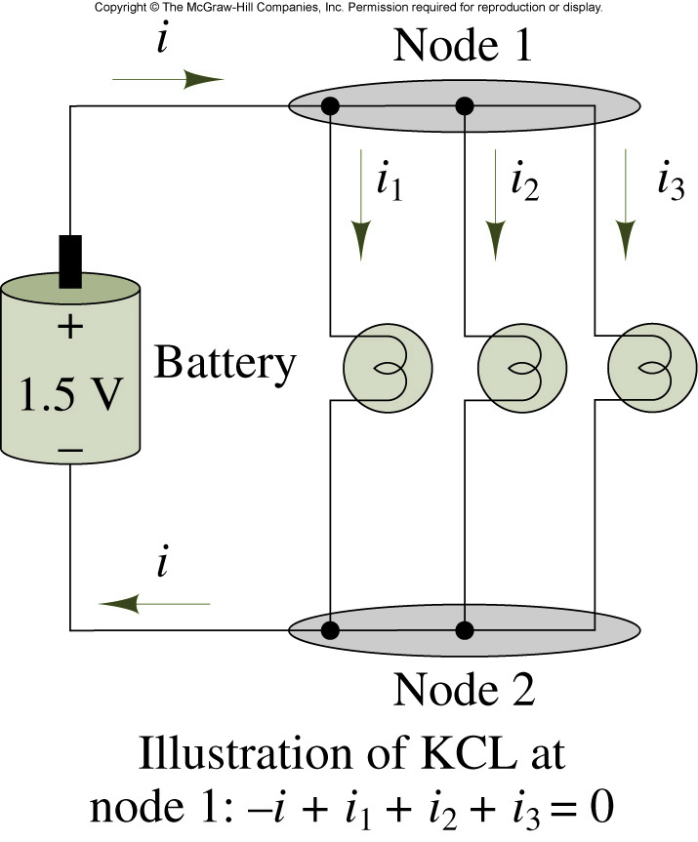
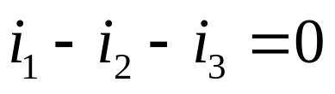
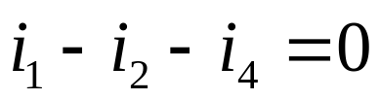
Illustration of Kirchhoff’s current law
G
B 1 A 3 C
2
5
4
D
Node:
G:

Slide 4
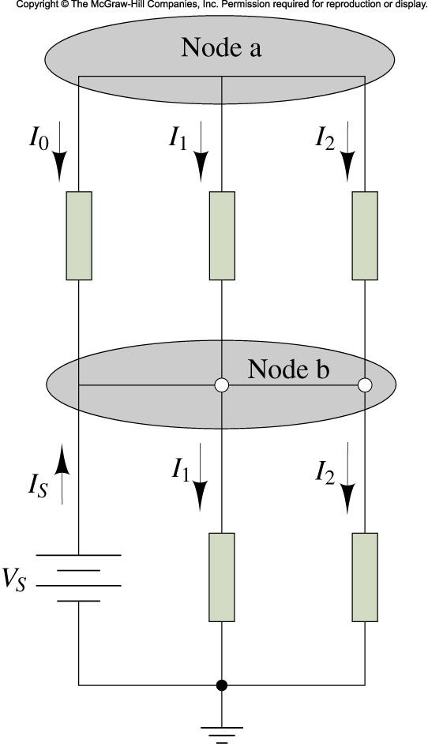
Demonstration of KCL
Is = 5A, I1 = 2A, I2 = -3A, I3 = 1.5 A
_{Find I0 and I4}
₃
₄

Slide 5
Example
i2
Write down the KCL equation for G.
i1
G
i3
i4
i5

Slide 6
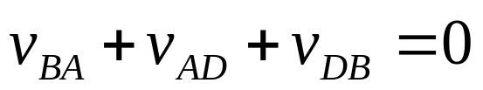
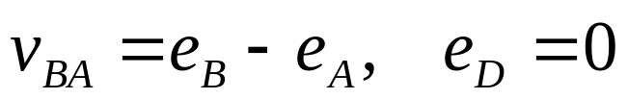
KVL (Kirchhoff’s Voltage Law)
The algebraic sum of the branch voltages around any closed path in a network must be zero
G
B 1 A 3 C
2
5
4
D
(a)
(b)
Node sequence B,A,D,B:
Using node voltages:
(reference node = D, reference voltage = 0)

Slide 7
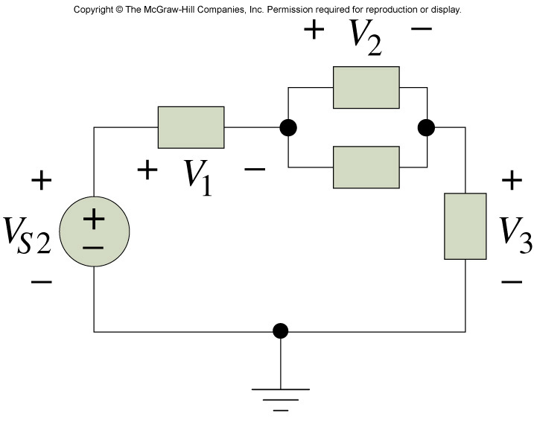
Example
_{Vs2 = 12 V, V1 = 6V, V3 = 1V}
_{Find V2.}

Slide 8
Some Useful Facts
The branch currents passing through series-connected elements must be the same.
The voltages across parallel-connected elements must be the same.

Slide 9
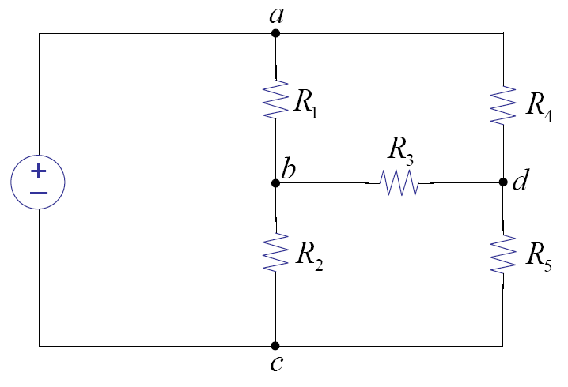
Independent Equations
How many independent KCL equations can be made?
How many independent KVL equations can be made?

Slide 10
Circuit Analysis: Basic Method
Goal: find all V and I s for all elements
  Write element’s V-I relationships
  Write KCL for all nodes
  Write KVL for all loops

Slide 11
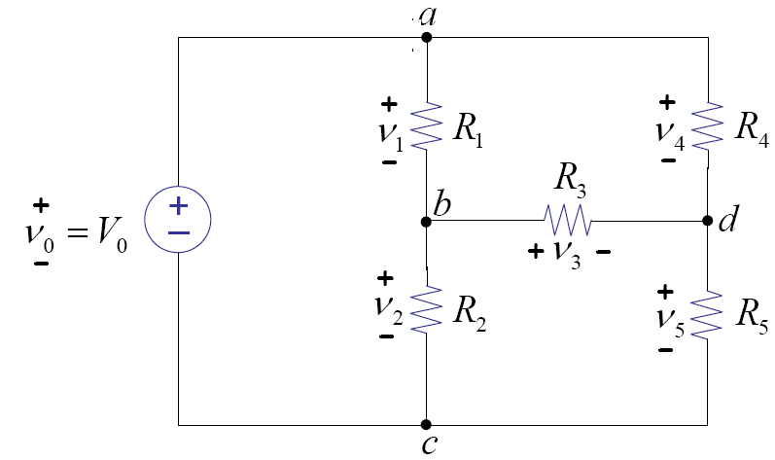
Example
Element’s equations
KCL
KVL

Slide 13
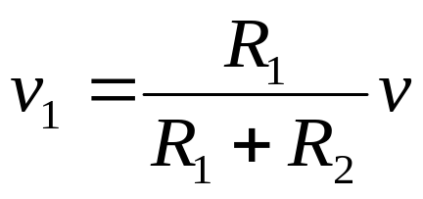
Voltage Divider and Series Resistors
A
i
A
i
+
+
v₁
R1
+
v
-
v
Req
R2
B
B
(a) Voltage divider
(b) Equivalent resistance
What does “equivalent” mean?

Slide 14
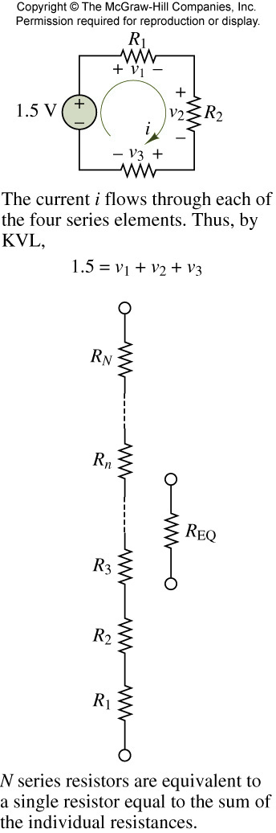
R1 = 10 kΩ, R2 = 6 kΩ, R3 = 8 kΩ
_{Find V3.}

Slide 15
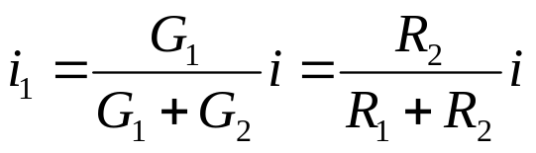
Current Divider and Parallel Resistors
A
A
+
i
i
+
v₁
R₁
R₂
v₁
Req
-
i₁
i₂
-
B
B
(a) Current divider
(b) Equivalent resistance

Slide 16
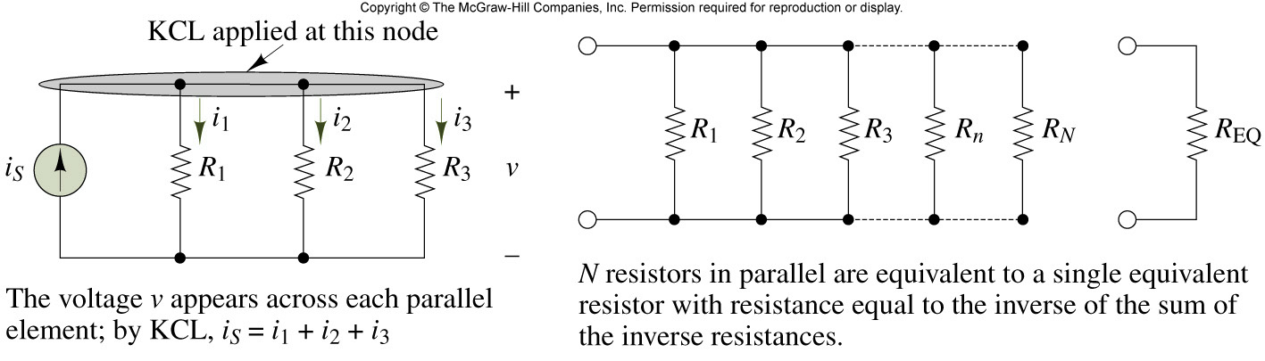
Parallel circuits

Slide 17
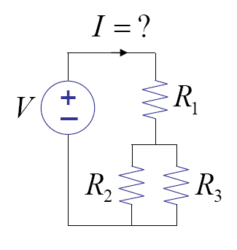
Example 1

Slide 18
Example 2
Find the voltage (v) between nodes A and B.
+
v
-
C
Α
Β
3kΩ
3kΩ
10V
4kΩ
2kΩ
2kΩ
D

Slide 19
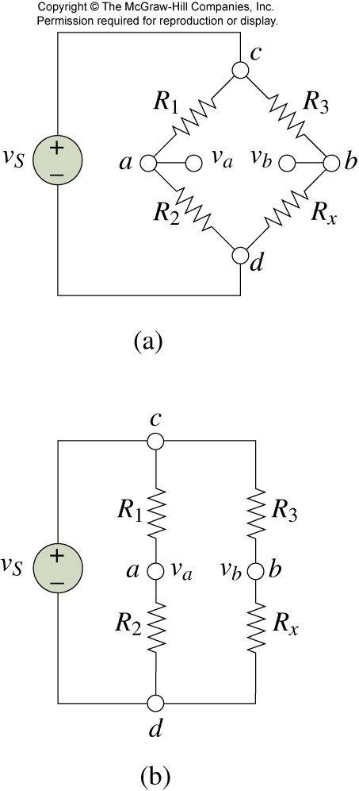
Wheatstone bridge circuits
_{R1 , R2, R3 are known}
_{Find Rx by measuring Vab}

Slide 20
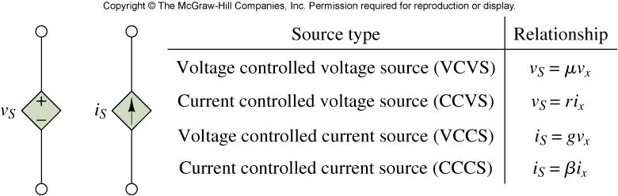
Symbols for dependent sources
Figure 2.4
o
o
o
o
o
o
o
o
+
+
v₁
+
v= μ v₁
i
+
v= ri
v₁
i= gv₁
i
-
-
o
o
o
o
o
o
o
o
(a)VCVS
(b) CCVS
(c) VCCS
(d) CCCS

Slide 21
Example 3
1kΩ
i₁
A
+
v₁
-
What is the current on 2kΩ resistor?
i₂
2
₊
--
v₁
2kΩ

Slide 22
Example 4
Find v. How much power does 4 k Ω resistor consume?
10V
+
A
B
i
v
2i
4kΩ
2kΩ
−
2v
+−
D
C
Now, the voltage source is changed from 10V to 5V. How much power dies 4kΩ resistor consume?

Slide 23
Conclusion
Kirchhoff’s current and voltage laws
Basic Circuit Analysis Method
Series-parallel circuits
Dependent Sources

