Slide 1
Ch. 3 Recursion: The Mirrors
Recursive algorithm
  An algorithm that calls itself for subproblems
  The subproblems are of exactly the same type as the original problem – mirror images
  It provides a simple look for a complicated problem
  E.g., search, sorting, traversals, etc.
    Medicine when properly used, “poisonous” when badly used.

Slide 2
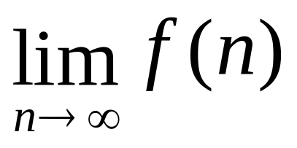
Asymptotic Analysis
입력의 크기가 충분히 큰 경우에 대한 분석
이미 알고 있는 점근적 개념의 예
Ο, Ω, Θ 표기법

Slide 3
Asymptotic Notation
O(f(n)): Big-Oh
  기껏해야 f (n)의 비율로 증가하는 함수들의 집합
  e.g., O(n), O(n log n), O(n²), O(2^{n}), …
  g(n) ∈ O(f(n)을 관행적으로 g(n) = O(f(n))이라고 쓴다
  상수 비율의 차이는 무시
  Upper bound in running time

Slide 4
예, O( n² )
  3n² + 2n
  7n² – 100n
  nlogn + 5n
  3n
알 수 있는 한 최대한 tight 하게
  nlogn + 5n = O(nlogn) 인데 굳이 O(n²)으로 쓸 필요없다
  엄밀하지 않은 만큼 정보의 손실이 일어난다

Slide 5
Ω(f(n))
  적어도 f(n)의 비율로 증가하는 함수
  O(f(n))과 대칭적
  Lower bound in running time
Θ(f(n))
  f(n)의 비율로 증가하는 함수
  Θ(f(n)) = O(f(n)) ∩ Ω(f(n))

Slide 6
Search in an Array
Want to find an element with value x in an array of size n
  Unsorted array
    Have to check all of the n elements
    O(n)
  Sorted array
    Don’t have to check all of the elements
    Binary search: O(log n)

Slide 7
Binary Search, Non-Recursive
BinarySearch (A[ ], n, x)
// A: array
// n: # of elements
// x: search key
{
low = 0;
high = n-1;
while (low ≤ high) {
mid = (low + high)/2;
if (A[mid] < x) low = mid + 1;
else if (A[mid] > x) high = mid – 1;
else return mid;
}
return “Not found”;
}
Time: O(log n)

Slide 8
Binary Search, Recursive
BinarySearch (A[ ], x, low, high)
// A: array
// x: search key
// low, high: array bounds
{
if (low > high) return “Not found”;
mid = (low + high)/2;
if (A[mid] < x) return BinarySearch(A, x, mid+1, high);
else if (A[mid] > x) return BinarySearch(A, x, low, mid-1);
else return mid;
}
Time: O(log n)
The same problems with different sizes
search
search

Slide 9
Factorial
n! = 1·2·3···n
n! = n·(n-1)·(n-2)···1
= n·(n-1)!
Recursive structure of factorial
1 if n = 0
factorial(n) =
n * factorial(n-1) if n > 0

Slide 10
fact (n)
{
tmp = 1;
for (i=1; i ≤ n; i++) {
tmp = i * tmp;
}
return tmp;
}
Non-recursive
fact (n)
{
if (n=0) return 1;
else return n*fact(n-1);
}
Recursive

Slide 11
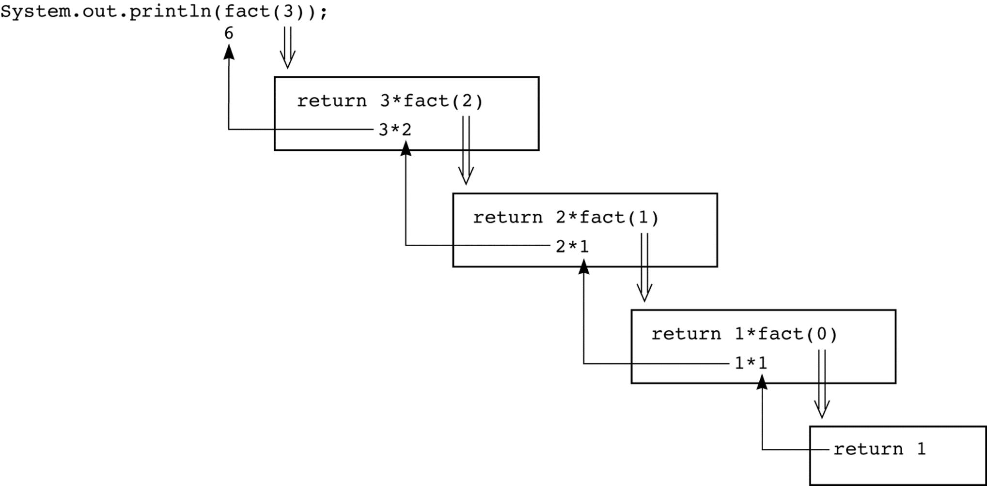
fact(n)
{
if (n==0) return 1;
else return n*fact(n-1);
}
fact(3)

Slide 12
Fibonacci Sequence
1 if n = 1 or 2
fib(n) =
fib(n-1)+fib(n-2) if n > 2
fib (n)
{
if (n ≤ 2) return 1;
else return (fib(n-1)+fib(n-2));
}

Slide 13
fib (n)
{
if (n ≤ 2) return 1;
else return fib(n-1)+fib(n-2);
}
Recursive
Simple, but terrible!
fib (n)
{
t[1] = t[2] = 1;
for (i=3; i ≤ n; i++) {
t[i] = t[i-1]+t[i-2];
}
return t[n];
}
Non-recursive

Slide 14
Writing a String Backward
Print a string in reverse order
E.g., ACTGCC → CCGTCA
writeBackward (s)
// s: input string
{
if (s is empty) { do nothing }
else {
write the last character of s;
writeBackward (s minus its last character);
}
}
ACTGCC
C
C
G
T
C
A

Slide 15
Another Method for the Same Result
writeBackward (s)
// s: input string
{
if (s is empty) { do nothing }
else {
write the last character of s;
writeBackward (s minus its last character);
}
}
writeBackward2 (s)
// s: input string
{
if (s is empty) { do nothing }
else {
writeBackward2 (s minus its first character);
write the first character of s;
}
}
first
first

Slide 16
C(n, k)
1 if k = 0
1 if k = n
C(n, k) =
0 if k > n
C(n-1, k-1)+C(n-1, k) if 0 < k < n
C (n, k)
{
if (k = 0 or k = n) return 1;
else if (k > n) return 0;
else return (C(n-1, k-1)+C(n-1, k));
}
Bad example of using recursion

Slide 17
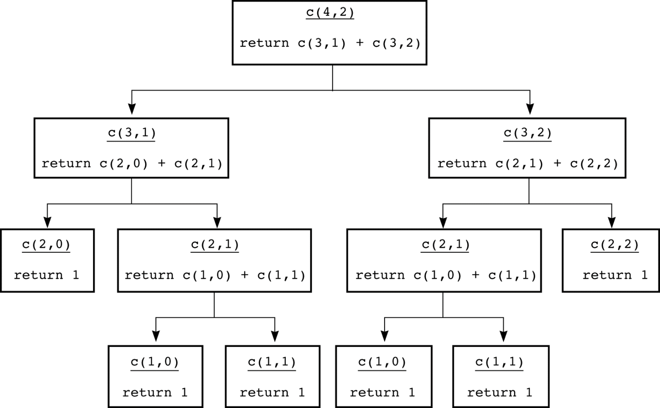
Figure 3.12
The recursive calls that c(4, 2) generates
c (2, 1)
return c (1, 0) + c (1, 1)
c (2, 1)
return c (1, 0) + c (1, 1)

Slide 18
k^{th} Smallest Element in an Array
Want to find the k^{th} smallest element in an unsorted array
E.g., 7th element in {10, 24, 3, 49, 55, 22, 4, 19, 24, 98, 42} ?

Slide 19

Elementary-School Version
KthSmallest (A[ ], k, n)
// find the k^{th} smallest in A[1…n]
{
Find the smallest item min in A[1…n];
Remove min from the array and compact the remaining items in A[1…n-1];
if (k = 1) return min;
else return KthSmallest(A, k-1, n-1);
}

Slide 20
Better Version
KthSmallest (A[ ], k, first, last)
// find the k^{th} smallest in A[first…last]
{
Select a pivot item p;
pivotIndex = partition (A, p, first, last);
if (k < pivotIndex – first + 1) // # of items not greater than p
return KthSmallest(A, k, first, pivotIndex –1);
else if ( k = pivotIndex – first + 1) return p;
else return KthSmallest(A, k-(pivotIndex–first+1), pivotIndex + 1, last);
}

Slide 21
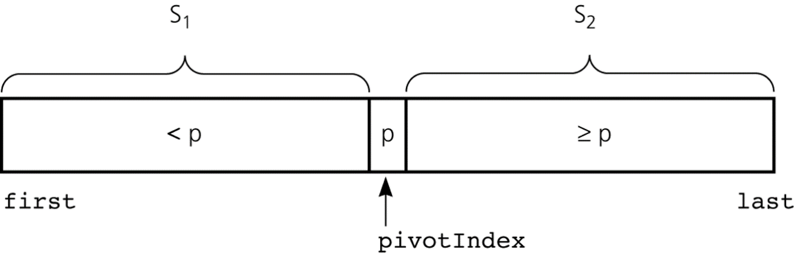
partition (A[ ], p, first, last)
{
In the array A[first…last],
put the items less than p in the left side of p,
put the items greater than p in the right side of p,
and return the index of p.
}
A[first…last] :

Slide 22
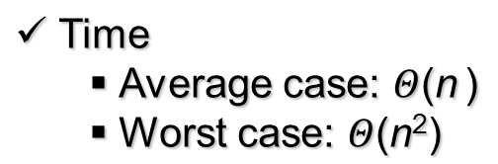
KthSmallest (A[ ], k, first, last)
// find the k^{th} smallest in A[first…last]
{
Select a pivot item p;
pivotIndex = partition (A, p, first, last);
if (k < pivotIndex – first + 1) // # items not greater than p
return KthSmallest(A, k, first, pivotIndex –1);
else if ( k = pivotIndex – first + 1) return p;
else return KthSmallest(A, k-(pivotIndex–first+1), pivotIndex + 1, last);
}
return
return
return

Slide 23
Hanoi Tower
n disks, 3 poles (A, B, C)
Move only one disk at a time.
A bigger disk cannot lie over a smaller one.
Objective
  Move n disks in pole A to pole B
A
B
C

Slide 24
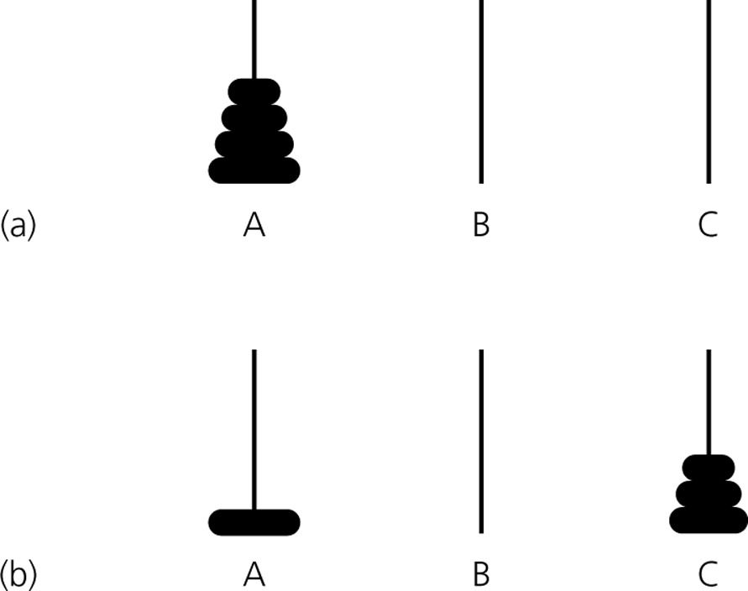
Function definition
move(count, source, destination, spare)
// move count disks from pole source to pole destination
Objective: move(4, A, B, C)
move(3, A, C, B)
move(1, A, B, C)
move(3, C, B, A)

Slide 25
move(n, A, B, C)
{
move(n-1, A, C, B);
move(1, A, B, C);
move(n-1, C, B, A);
}

Slide 26
Keys of Recursive Solution
Define the problem in terms of smaller problems of the same type
Base case
Termination (by base case)
fib (n)
{
if (n <= 2) return 1;
else return fib(n-1)+fib(n-2);
}
base case

Slide 27
move(n, A, B, C)
{
if (n=1) then move the disk from A to B;
else {
move(n-1, A, C, B);
move(1, A, B, C);
move(n-1, C, B, A);
}
}

