Slide 1
Ch. 5 Linked List
When a list is implemented by an array
  Intuitively simple
  Weak points
    Overflow
    Needs shift operation for insertion/deletion
Linked list
  Free from shift overhead
  Overhead for linking

Slide 2
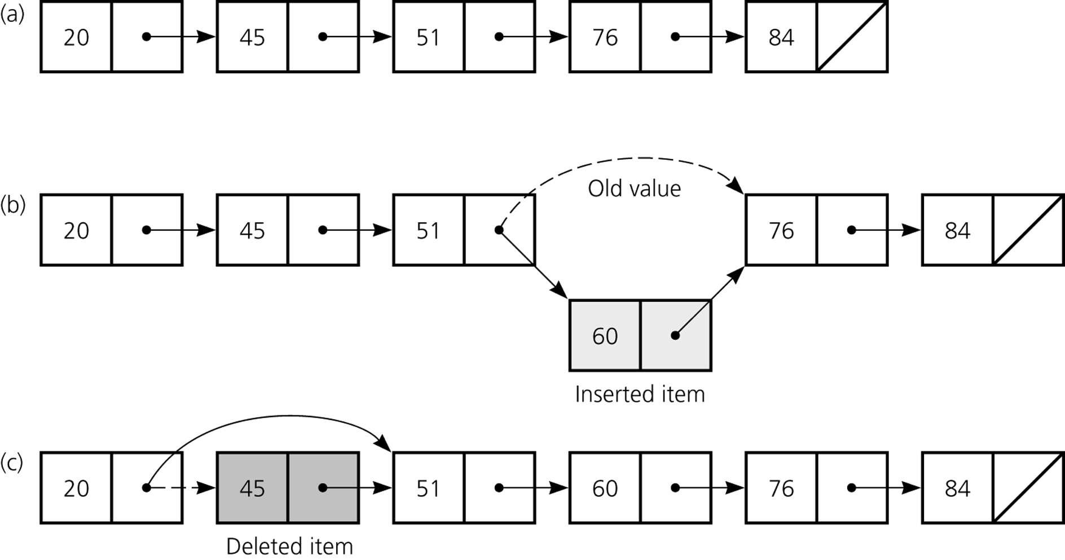
Figure 5.1
a) A linked list of integers; b) insertion; c) deletion

Slide 3
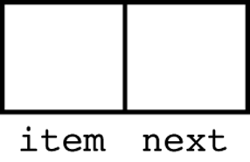
Linked List
Each node contains
  Data (item)
  Link
number, string, object, …

Slide 4
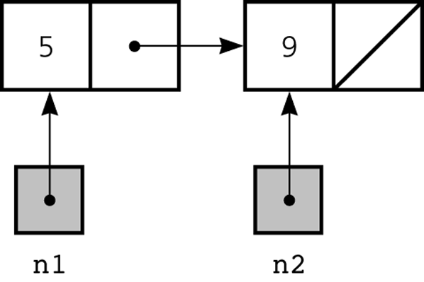
A naïve structure
public class IntegerNode {
public int item;
public IntegerNode next;
}
Not good information hiding
Not good data abstraction
Example:
IntegerNode n1 = new IntegerNode( );
IntegerNode n2 = new IntegerNode( );
n1.item = 5;
n2.item = 9;
n2.next = null;
n1.next = n2;

Slide 5
An Intermediate Version
public class IntegerNode {
private int item;
private IntegerNode next;
public void setItem(int newItem) {
item = newItem;
}
public int getItem( ) {
return item;
}
public void setNext(IntegerNode nextNode) {
next = nextNode;
}
public IntegerNode getNext( ) {
return next;
}
}
Example:
IntegerNode n1 = new IntegerNode( );
IntegerNode n2 = new IntegerNode( );
n1.setItem(5);
n2.setItem(9);
n2.setNext(null);
n1.setNext(n2);

Slide 6
An Improved Version
public class IntegerNode {
private int item;
private IntegerNode next;
// constructors
public IntegerNode(int newItem) {
item = newItem;
next = null;
}
public IntegerNode(int newItem, IntegerNode nextNode) {
item = newItem;
next = nextNode;
}
// setItem, getItem, setNext, getNext as before
…
}
Example:
IntegerNode n2 = new IntegerNode(9);
IntegerNode n1 = new IntegerNode(5, n2);
Example:
IntegerNode n1 = new IntegerNode(5, new IntegerNode(9));

Slide 7
Problems Still Remained
restricted to a single integer field
low reusability
public class IntegerNode {
private int item;
private IntegerNode next;
public IntegerNode(int newItem) {
item = newItem;
next = null;
}
public IntegerNode(int newItem, IntegerNode nextNode) {
item = newItem;
next = nextNode;
}
…
}

Slide 8
A Reusable Version
The Object class is
a superclass of every class
public class Node {
private Object item;
private Node next;
public Node(Object newItem) {
item = newItem;
next = null;
}
public Node(Object newItem, Node nextNode) {
item = newItem;
next = nextNode;
}
public Object getItem( ) {
return item;
}
// setItem, setNext, getNext similar
…
}

Slide 9
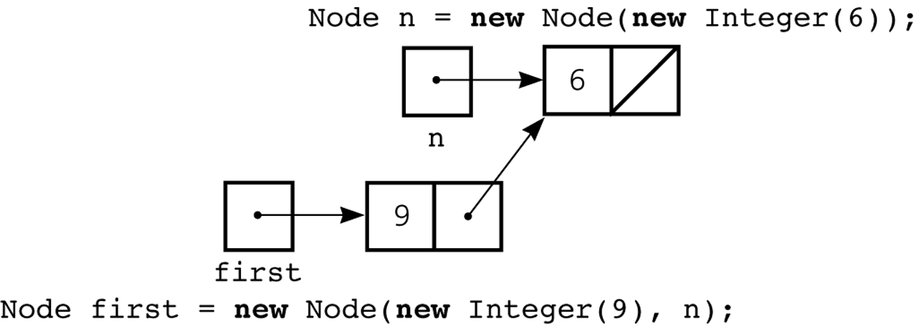
Example:
Node n = new Node(new Integer(6));
Node first = new Node(new Integer(9), n);
Since int is a primitive type, it cannot be an inherited class of Object.
  Integer is a class in package java.lang.

Slide 10
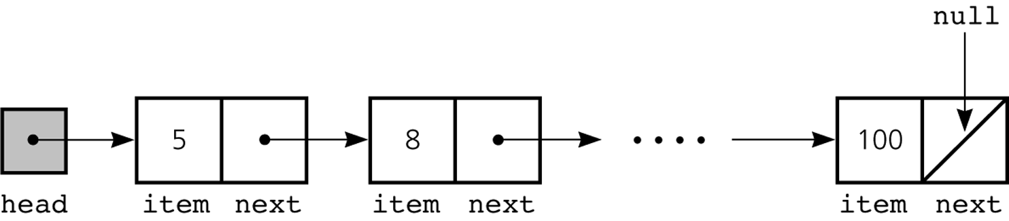
Head Node
Linked lists usually have a head reference
Node head = null;
Node head = new Node(new Integer(5));
. . .
Here, head is a simple reference variable

Slide 11
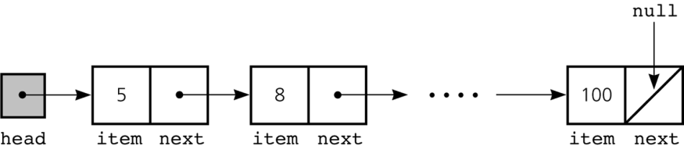
Displaying the Contents
Sequential display of the contents of the linked list referenced by head
for (Node curr = head; curr != null; curr = curr.getNext( )) {
System.out.println(curr.getItem( ));
}
5
8
.
.
.
100

Slide 12
Implementation of Linked List
Public class Node {
See the slide ahead;
}
public interface ListInterface {
// list operators
public boolean isEmpty( );
public int size( );
public void add(int index, Object item);
public void remove(int index);
public Object get(int index);
public void removeAll( );
}

Slide 13
public class ListReferenceBased implements ListInterface {
private Node head;
private int numItems;
// constructor
public ListReferenceBased( ) {
numItems = 0;
head = null;
}
// operations
public boolean isEmpty( ) {
return numItems == 0;
}
public int size( ) {
return numItems;
}
…

Slide 14
private Node find(int index) {
// return reference to i^{th} node
Node curr = head; // 1st node
for (int i = 1; i < index; i++) {
curr = curr.getNext( );
}
return curr;
}
public Object get(int index) {
if (index >= 1 && index <= numItems) {
Node curr = find(index);
return curr.getItem( );
} else {
Exception handling;
}
}
…

Slide 15
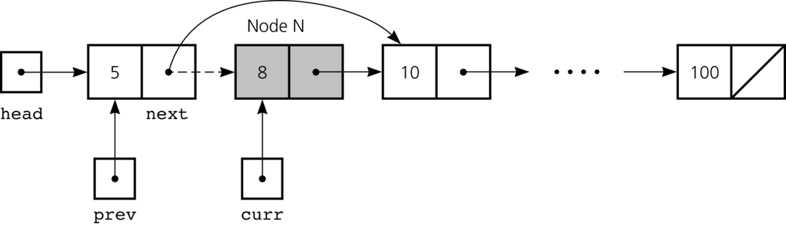
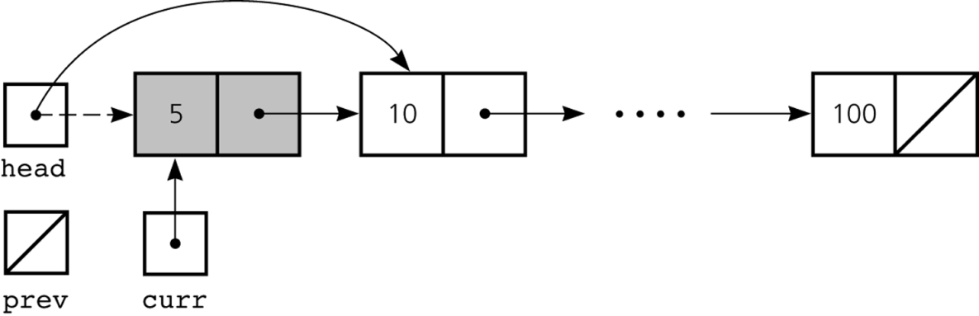
Deleting a Specified Node
Removing the node referenced by variable curr
  The previous node of curr is referenced by prev
prev.setNext(curr.getNext( ));
In C, prev->next = curr->next;
Removing the 1st node
head = curr.getNext( );

Slide 16
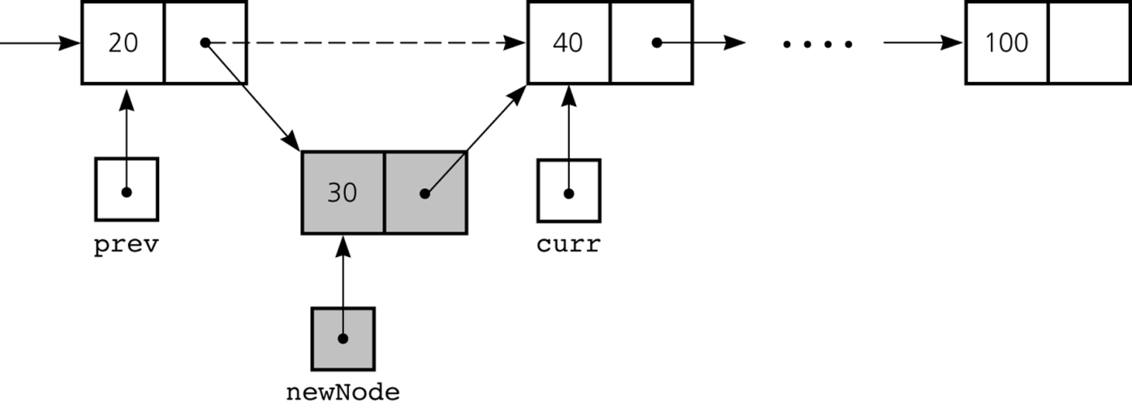
Inserting a Node
Inserting a node between prev and curr
In C,
newNode = malloc(sizeof Node);
newNode->item = 30;
newNode->next = curr;
prev.next = newNode;
newNode = new Node(new Integer(30));
newNode.setNext(curr);
prev.setNext(newNode);

Slide 17
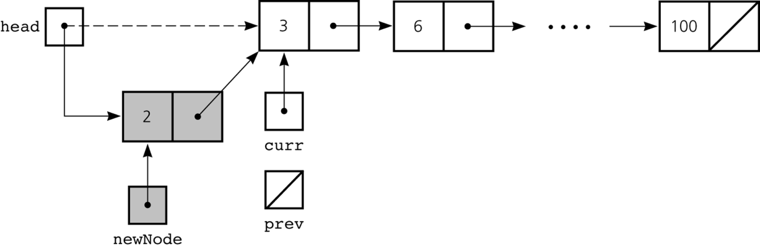
Inserting a node in front of the 1st node
newNode = new Node(new Integer(2));
newNode.setNext(head);
head = newNode;
In C,
newNode = malloc(sizeof Node);
newNode->item = 2;
newNode->next = head;
head = newNode;

Slide 18
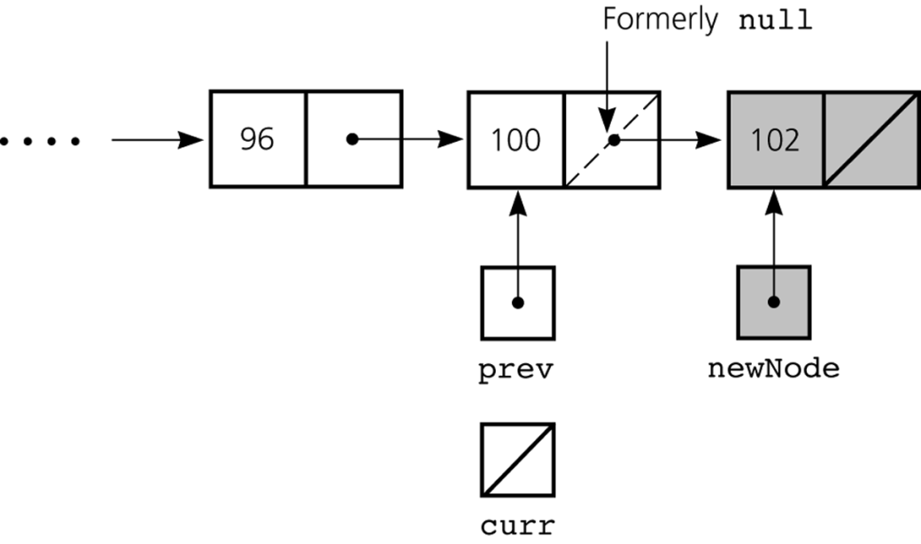
Inserting a node after the last node (no special case)
newNode = new Node(new Integer(102));
newNode.setNext(curr);
prev.setNext(newNode);
No need for special handling even if curr = null

Slide 19
Implementation of Deletion
public class ListReferenceBased implements ListInterface {
private Node head;
private int numItems;
…
public void remove(int index) {
if (index >= 1 && index <= numItems) {
if (index == 1) head = head.getNext( );
else {
Node prev = find(index – 1);
Node curr = prev.getNext( );
prev.setNext(curr.getNext( ));
}
numItems--;
} else {Exception handling;}
}
…
}
head
prev
curr

Slide 20
Implementation of Insertion
head
…
public class ListReferenceBased implements ListInterface {
private Node head;
private int numItems;
…
public void add(int index, Object item) {
if (index >= 1 && index <= numItems+1) {
if (index == 1) {
Node newNode = new Node(item, head);
head = newNode;
} else {
Node prev = find(index – 1);
Node newNode = new Node(item, prev.getNext( ));
prev.setNext(newNode);
}
numItems++;
} else {Exception handling;}
}
…
}
item
prev
…
item

Slide 21
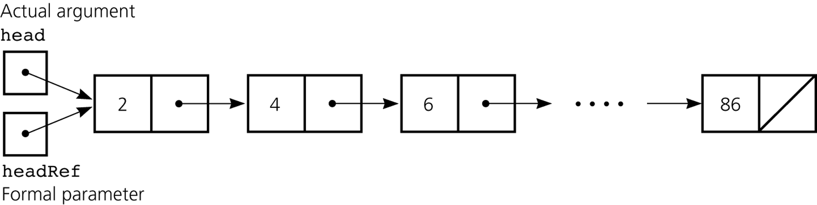
Passing a Linked List to a Method
printList(head);

Slide 22
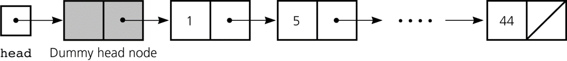
Dummy Head Node
Put a dummy head node in front of the list
  No need of special handling related to the 1st node
Initialization/Constructor
public class ListReferenceBased implements ListInterface {
private Node head;
private int numItems;
public ListReferenceBased( ) {
numItems = 0;
head = new Node( );
head.setNext(null);
}
…
}
head
Dummy head node

Slide 23
Cf. W/o Dummy Node
Initialization/Constructor
public class ListReferenceBased implements ListInterface {
private Node head;
private int numItems;
public ListReferenceBased( ) {
numItems = 0;
head = null;
}
…
}
head

Slide 24
Deletion When the Dummy Node Exists
public class ListReferenceBased implements ListInterface {
private Node head;
private int numItems;
…
public void remove(int index) {
if (index >= 1 && index <= numItems) {
Node prev = find(index – 1);
Node curr = prev.getNext( );
prev.setNext(curr.getNext( ));
numItems--;
} else {Exception handling;}
}
…
}

Slide 25
Cf. W/o Dummy Node
public class ListReferenceBased implements ListInterface {
private Node head;
private int numItems;
…
public void remove(int index) {
if (index >= 1 && index <= numItems) {
if (index == 1) head = head.getNext( );
else {
Node prev = find(index – 1);
Node curr = prev.getNext( );
prev.setNext(curr.getNext( ));
}
numItems--;
} else {Exception handling;}
}
…
}
if (index == 1) head = head.getNext( );
else {
Node prev = find(index – 1);
Node curr = prev.getNext( );
prev.setNext(curr.getNext( ));
}
numItems--;
numItems--;

Slide 26
Utilization of the Dummy Node
We can use the empty item field
head
Dummy head node
3
5
89
5
24
89
length
largest
smallest
public class ListInfo {
private int length;
private Object smallestItem, largestItem;
// methods for accessing the private data—length, smallestItem, largestItem—appear here
…
} // end class

Slide 27
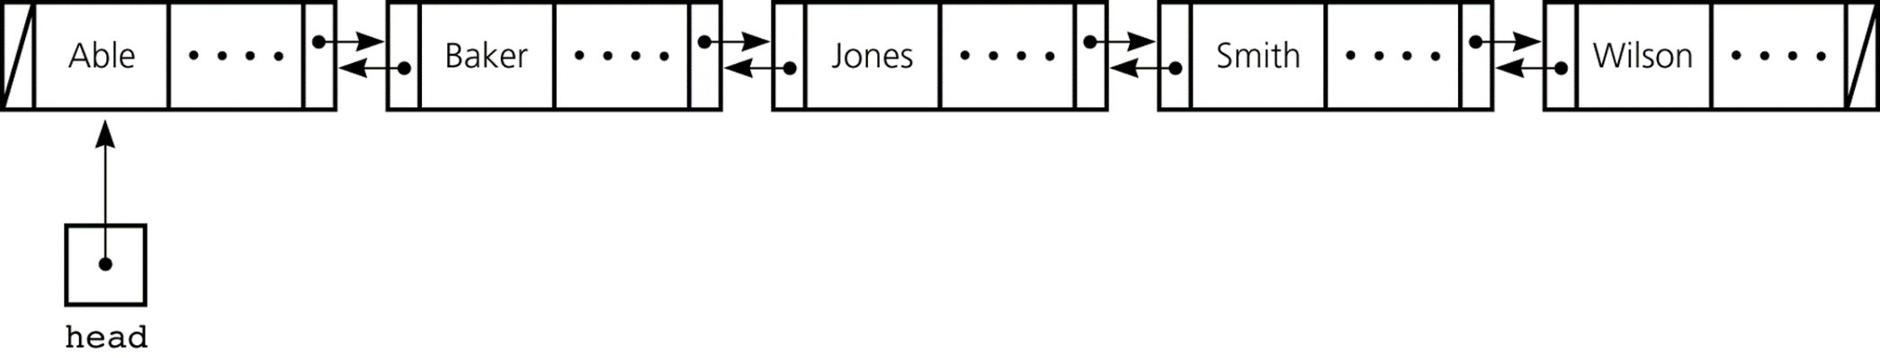
Doubly Linked List

Slide 28
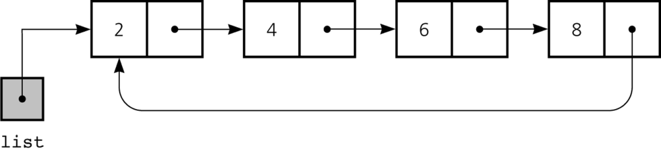
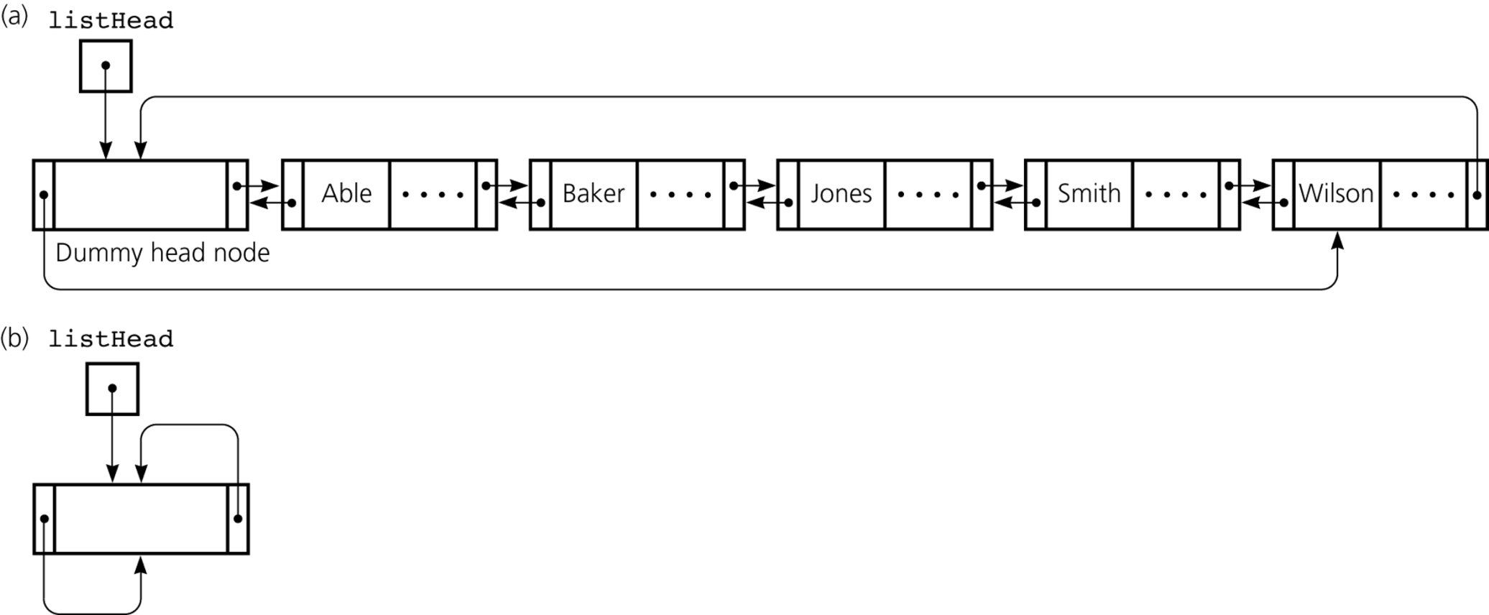
Circular Linked List
Singly linked list
Doubly linked list
Initial state

Slide 29
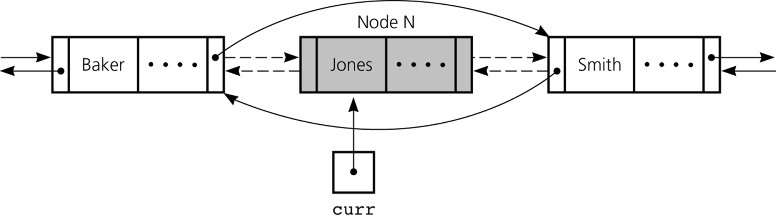
Deletion in Doubly Linked List
No need to save the prev node
When there exist nodes in both sides
curr.getPrecede( ).setNext(curr.getNext( ));
curr.getNext( ).setPrecede(curr.getPrecede( ));
We still need a special treatment
    for the case that there is no node in at least one side

Slide 30
Deletion in Circular Doubly Linked List w/ Dummy Head Node
Dummy head node
 |  | …
 | Jones | …
curr
No need of special treatment for the case of absence in any side
curr.getPrecede( ).setNext(curr.getNext( ));
curr.getNext( ).setPrecede(curr.getPrecede( ));

Slide 31
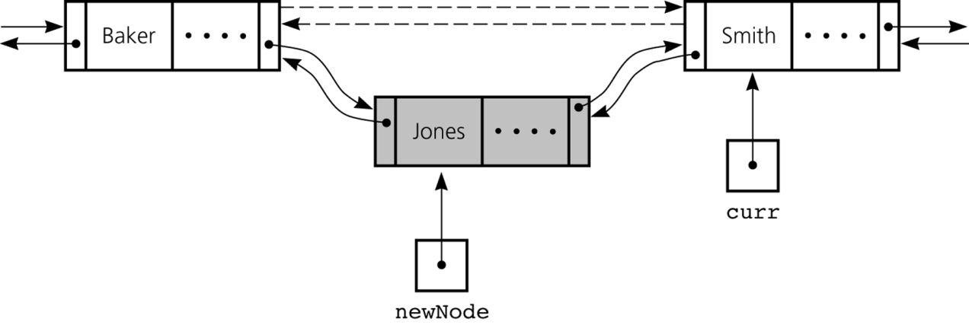
Insertion in Doubly Linked List
When there exist nodes in both sides
newNode = new dListNode(…);
newNode.setNext(curr);
newNode.setPrecede(curr.getPrecede( ));
curr.getPrecede( ).setNext(newNode);
curr.setPrecede(newNode);
or
newNode = new dListNode(… curr.getPrecede( ), curr, …);
Curr.getPrecede( ).setNext(newNode);
Curr.setPrecede(newNode);
Otherwise?

Slide 32
An Example: Sparse Polynomial
-3x⁷ + 4x⁵ + 7x³ –x² + 9
Dummy head
5
#terms

Slide 33
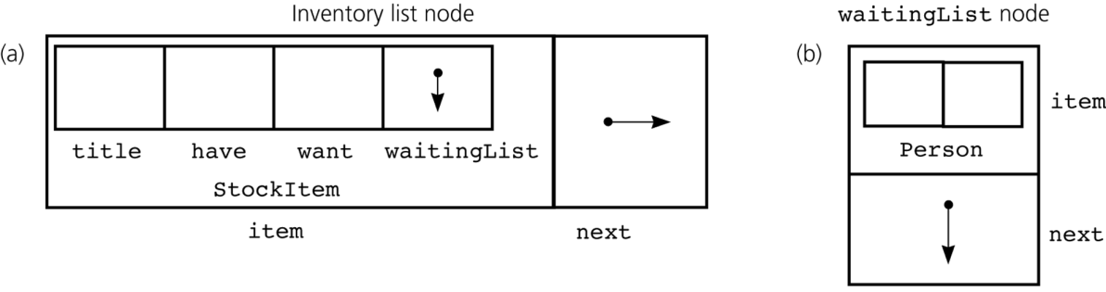
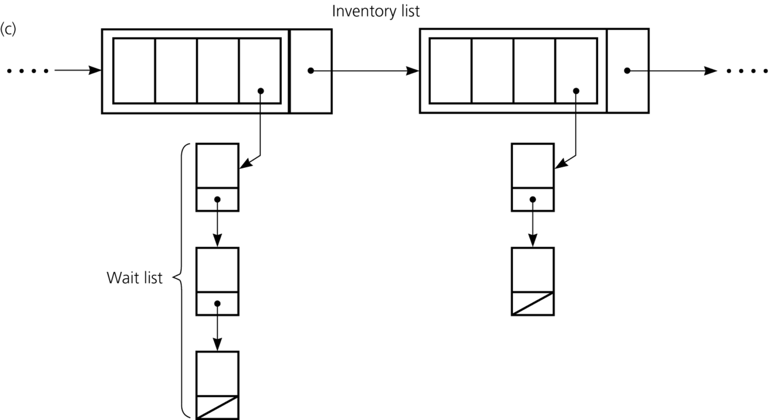
A Mixed Structure

Slide 34
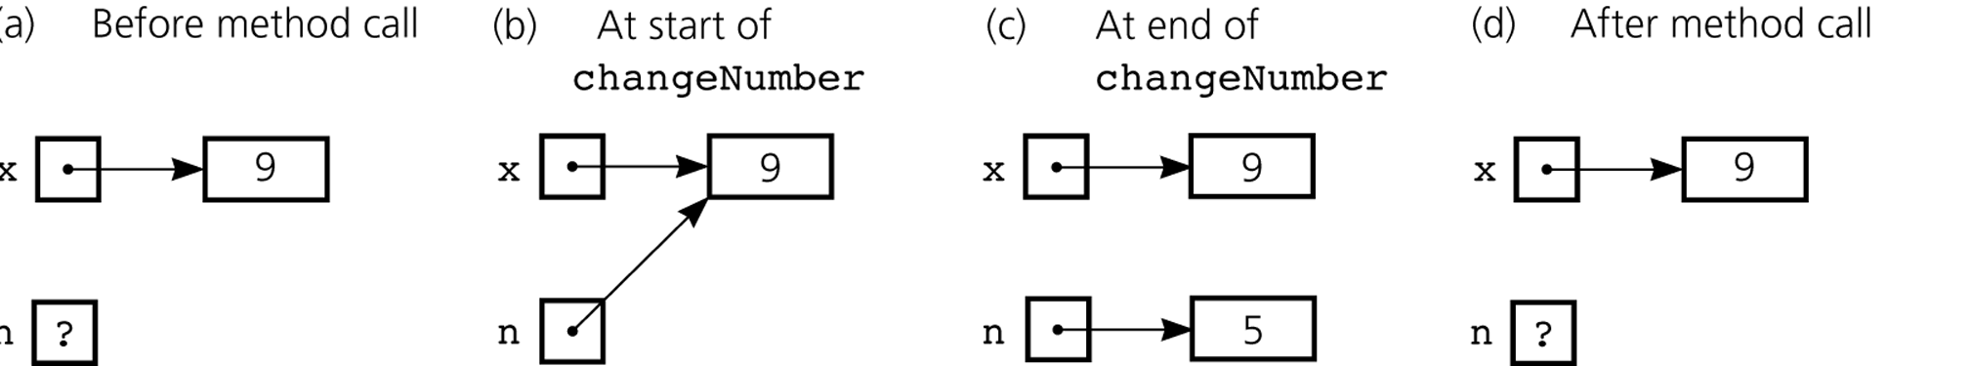
Call by Value
Integer x = new Integer(9);
changeNumber(x, new Integer(5)); // attempts to assign Integer(5) to x
public void changeNumber(Integer n, Integer k) {
n = k;
}

