Slide 1
Chapter 4:
Combinational Logic Technologies

Slide 2
Combinational Logic Technologies
Standard gates
  gate packages
  cell libraries
Regular logic
  multiplexers
  decoders
Two-level programmable logic
  PALs
  PLAs
  ROMs
vs. Random Logic with No Clear High-level Structure

Slide 3
Random logic
Transistors quickly integrated into logic gates (1960s)
Catalog of common gates (1970s)
  Texas Instruments Logic Data Book – the yellow bible
  all common packages listed and characterized (delays, power)
  typical packages:
    in 14-pin IC: 6-inverters, 4 NAND gates, 4 XOR gates
Today, very few parts are still in use
However, parts libraries exist for chip design
  designers reuse already characterized logic gates on chips
  same reasons as before
  difference is that the parts don’t exist in physical inventory – created as needed

Slide 4
Random logic
Too hard to figure out exactly what gates to use
  map from logic to NAND/NOR networks
  determine minimum number of packages
    slight changes to logic function could decrease cost
Changes too difficult to realize
  need to rewire parts
  may need new parts
  design with spares (few extra inverters and gates on every board)

Slide 5
Regular logic
Need to make design faster
Need to make engineering changes easier to make
Simpler for designers to understand and map to functionality
  harder to think in terms of specific gates
  better to think in terms of a large multi-purpose block

Slide 6
Making connections
Direct point-to-point connections between gates
  wires we've seen so far
Route one of many inputs to a single output --- multiplexer
Route a single input to one of many outputs --- demultiplexer
control
control
multiplexer
demultiplexer
4x4 switch

Slide 7
Mux and demux
Switch implementation of multiplexers and demultiplexers
  can be composed to make arbitrary size switching networks
  used to implement multiple-source/multiple-destination interconnections
A
Y
B
Z
A
Y
B
Z

Slide 8
Mux and demux (cont'd)
Uses of multiplexers/demultiplexers in multi-point connections
A0
A1
B0
B1
Sa
MUX
MUX
Sb
multiple input sources
A
B
Sum
Ss
DEMUX
multiple output destinations
S0
S1

Slide 9
Multiplexers/selectors
Multiplexers/selectors: general concept
  2^{n} data inputs, n control inputs (called "selects"), 1 output
  used to connect 2^{n} points to a single point
  control signal pattern forms binary index of input connected to output
A Z
0 I₀
1 I₁
I₁ I₀ A Z
0 0 0 0
0 0 1 0
0 1 0 1
0 1 1 0
1 0 0 0
1 0 1 1
1 1 0 1
1 1 1 1
Z = A' I₀ + A I₁
functional form
logical form
two alternative forms
for a 2:1 Mux truth table

Slide 10
Multiplexers/selectors (cont'd)
2:1 mux: Z = A'I₀ + AI₁
4:1 mux: Z = A'B'I₀ + A'BI₁ + AB'I₂ + ABI₃
8:1 mux: Z = A'B'C'I₀ + A'B'CI₁ + A'BC'I₂ + A'BCI₃ +
AB'C'I₄ + AB'CI₅ + ABC'I₆ + ABCI₇
In general: Z = Σ (m_{k}I_{k})
  in minterm shorthand form for a 2^{n}:1 Mux
n
I0
I1
I2
I3
I4
I5
I6
I7
2 -1
k=0
8:1
mux
Z
I0
I1
I2
I3
4:1
mux
Z
I0
I1
2:1
mux
Z
A B C
A
A B

Slide 11
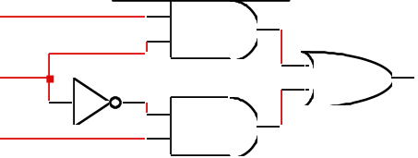
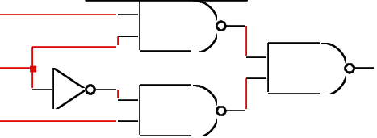
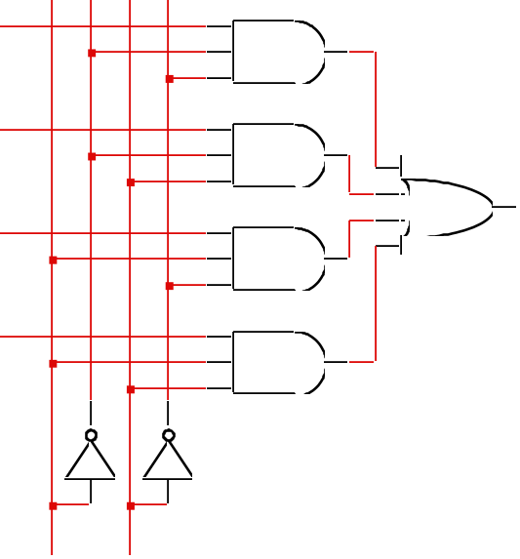
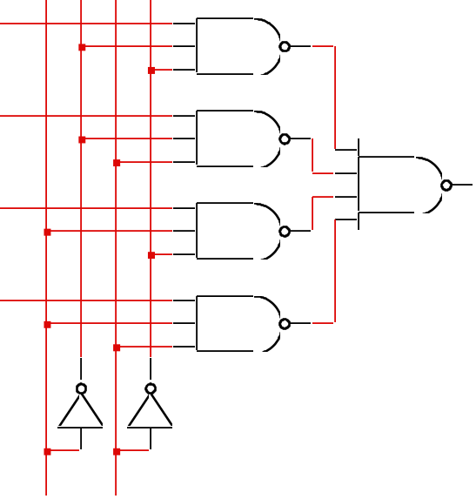
Gate level implementation of muxes
2:1 mux
4:1 mux

Slide 12
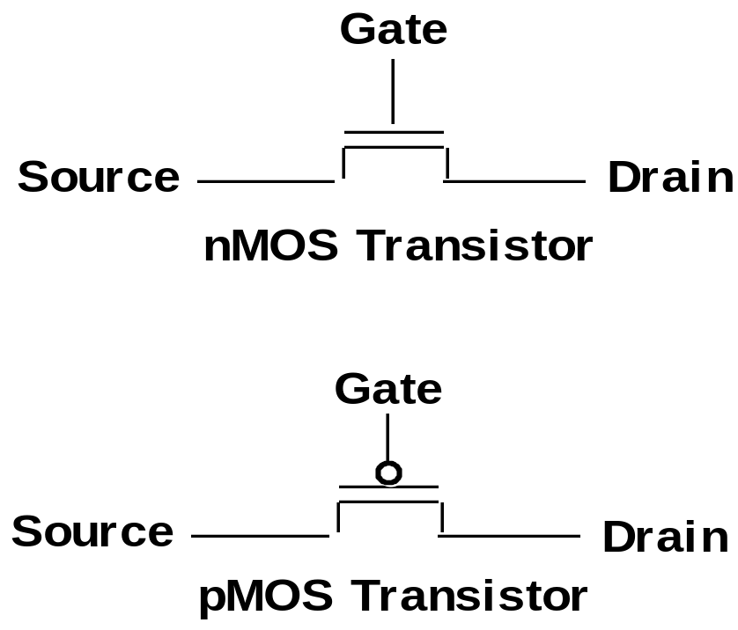
Steering Logic
Voltage Controlled Switches
Logic 1 on gate,
Source and Drain connected
Logic 0 on gate,
Source and Drain connected

Slide 13
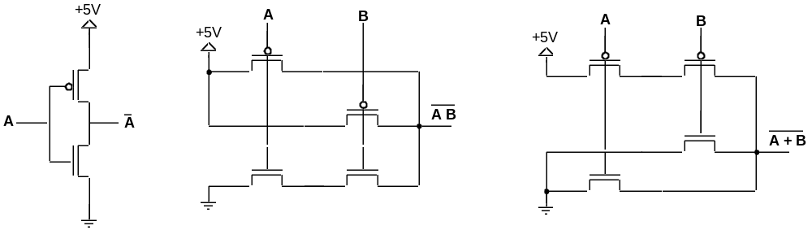
Steering Logic
Logic Gates from Switches
Inverter
NAND Gate
NOR Gate
Pull-up network constructed from pMOS transistors
Pull-down network constructed from nMOS transistors

Slide 14
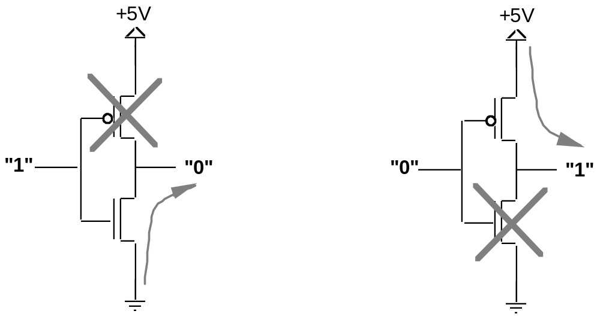
Steering Logic
Inverter Operation
Input is 1
Pull-up does not conduct
Pull-down conducts
Output connected to GND
Input is 0
Pull-up conducts
Pull-down does not conduct
Output connected to VDD

Slide 15
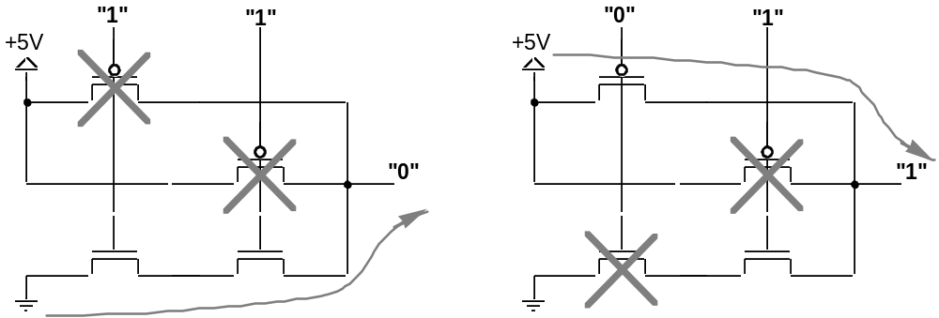
Steering Logic
NAND Gate Operation
A = 1, B = 1
Pull-up network does not conduct
Pull-down network conducts
Output node connected to GND
A = 0, B = 1
Pull-up network has path to VDD
Pull-down network path broken
Output node connected to VDD

Slide 16
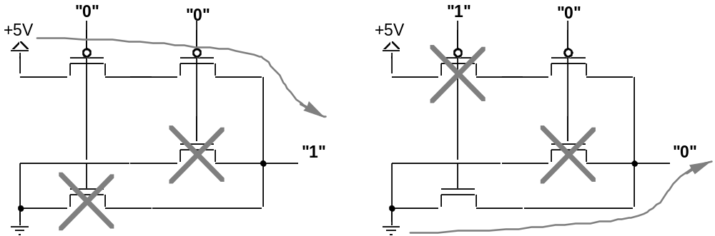
Steering Logic
NOR Gate Operation
A = 0, B = 0
Pull-up network conducts
Pull-down network broken
Output node at VDD
A = 1, B = 0
Pull-up network broken
Pull-down network conducts
Output node at GND

Slide 17
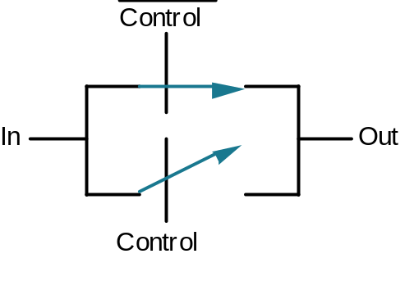
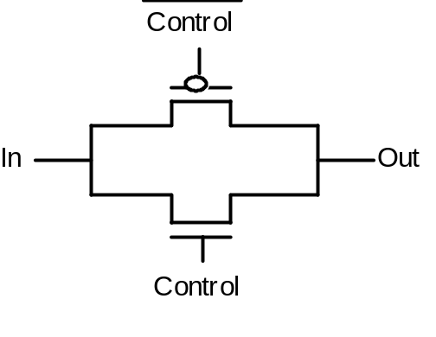
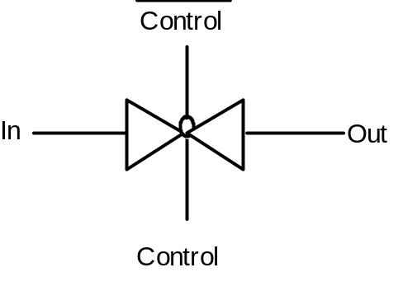
CMOS Transmission Gate
nMOS transistors good at passing 0's but bad at passing 1's
pMOS transistors good at passing 1's but bad at passing 0's
perfect "transmission" gate places these in parallel:
Switches
Transistors
Transmission or
"Butterfly" Gate

Slide 18
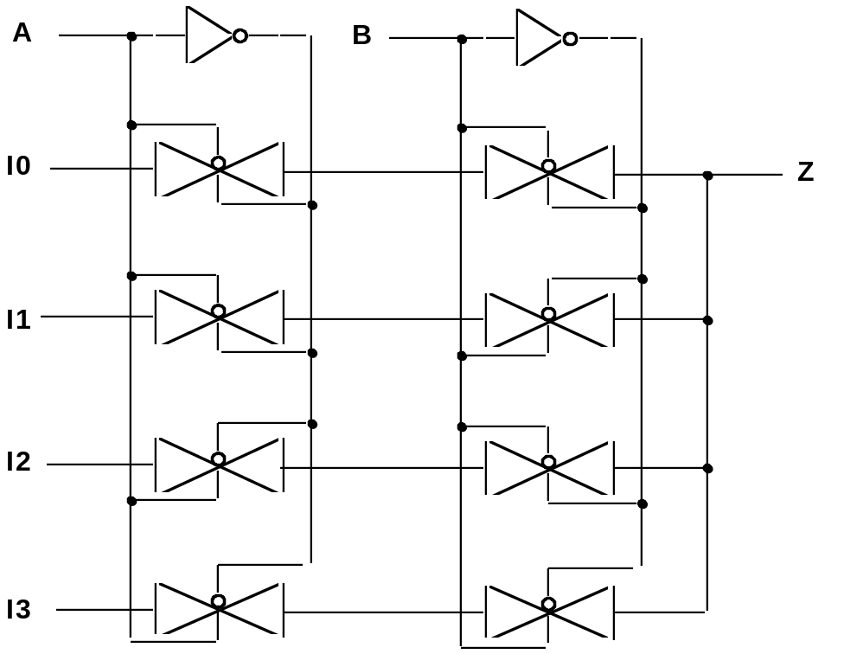
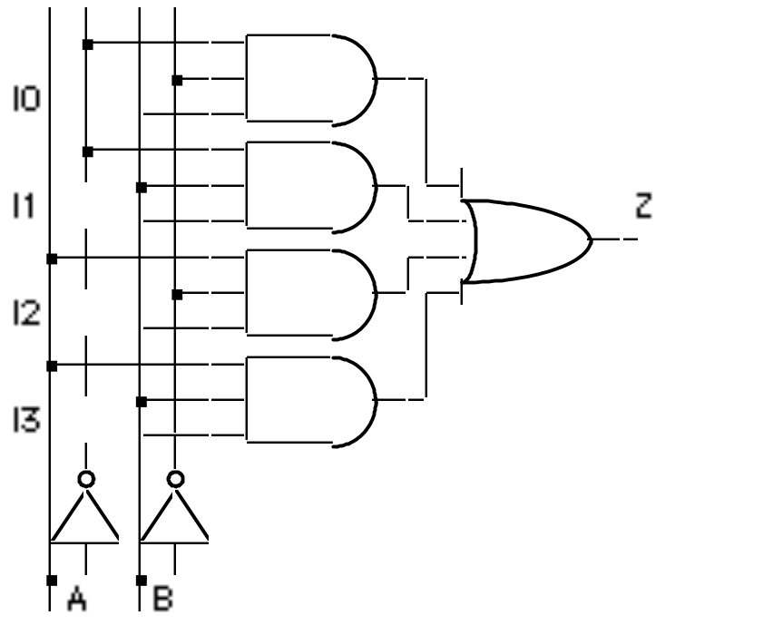
Multiplexers/Selectors: Alternative Implementation
I0
I1
I2
I3
Z
A B
Gate Level
Implementation
of 4:1 Mux
Transmission Gate
Implementation of
4:1 Mux
thirty six transistors
twenty transistors

Slide 19
Cascading multiplexers
Large multiplexers can be made by cascading smaller ones
I0
I1
I2
I3
8:1
mux
4:1
mux
alternative
implementation
2:1
mux
Z
I4
I5
I6
I7
I0
I1
2:1
mux
8:1
mux
4:1
mux
I2
I3
2:1
mux
4:1
mux
Z
B C
A
I4
I5
2:1
mux
control signals B and C simultaneously choose
one of I0, I1, I2, I3 and one of I4, I5, I6, I7
control signal A chooses which of the
upper or lower mux's output to gate to Z
I6
I7
2:1
mux
C
A B

Slide 20
Multiplexers as general-purpose logic
A 2^{n}:1 multiplexer can implement any function of n variables
  with the variables used as control inputs and
  the data inputs tied to 0 or 1
  in essence, a lookup table
Example:
  F(A,B,C) = m0 + m2 + m6 + m7
  = A'B'C' + A'BC' + ABC' + ABC
1
0
1
0
0
0
1
1
0
1
2
3
4
5
6
7
Z
  = A'B'C'(1) + A'B'C(0)
  + A'BC'(1) + A'BC(0)
  + AB'C'(0) + AB'C(0)
  + ABC'(1) + ABC(1)
8:1 MUX
F
S2
S1
S0
A
B
C
Z = A'B'C'I₀ + A'B'CI₁ + A'BC'I₂ + A'BCI₃ +
AB'C'I₄ + AB'CI₅ + ABC'I₆ + ABCI₇

Slide 21
Multiplexers as general-purpose logic (cont’d)
A 2^{n-1}:1 multiplexer can implement any function of n variables
  with n-1 variables used as control inputs and
  the data inputs tied to the last variable or its complement
Example:
  F(A,B,C) = m0 + m2 + m6 + m7
  = A'B'C' + A'BC' + ABC' + ABC
  = A'B'(C') + A'B(C') + AB'(0) + AB(1)
1
0
1
0
0
0
1
1
0
1
2
3
4
5
6
7
A B C F
0 0 0 1
0 0 1 0
0 1 0 1
0 1 1 0
1 0 0 0
1 0 1 0
1 1 0 1
1 1 1 1
C'
C'
0
1
C'
C'
0
1
0
1
2
3
4:1 MUX
F
8:1 MUX
F
S1
S0
S2
S1
S0
A
B
A
B
C

Slide 22
Multiplexers as general-purpose logic (cont’d)
Generalization
Example:
G(A,B,C,D)
can be realized
by an 8:1 MUX
I₀ I₁ . . . I_{n-2} I_{n-1} F
. . . . 0 0 0 1 1
. . . . 1 0 1 0 1
0 I_{n-1} I_{n-1}' 1
four possible
configurations
of truth table
rows can be
expressed as
a function of I_{n-1}
n-1 mux control
variables
  single mux data
  variable
A B C D G
0 0 0 0 1
0 0 0 1 1
0 0 1 0 0
0 0 1 1 1
0 1 0 0 0
0 1 0 1 0
0 1 1 0 1
0 1 1 1 1
1 0 0 0 1
1 0 0 1 0
1 0 1 0 0
1 0 1 1 1
1 1 0 0 1
1 1 0 1 0
1 1 1 0 1
1 1 1 1 0
1
D
0
1
D'
D
D’
D’
1
D
0
1
D’
D
D’
D’
0
1
2
3
4
5
6
7
8:1 MUX
choose A,B,C as
control variables
S2
S1
S0
A
B
C

Slide 23
Activity
Realize F = B’CD’ + ABC’ with a 4:1 multiplexer and a minimum of other gates:
A B C D Z
0 0 0 0 0
0 0 0 1 0
0 0 1 0 1
0 0 1 1 0
0 1 0 0 0
0 1 0 1 0
0 1 1 0 0
0 1 1 1 0
1 0 0 0 0
1 0 0 1 0
1 0 1 0 1
1 0 1 1 0
1 1 0 0 1
1 1 0 1 1
1 1 1 0 0
1 1 1 1 0
0 when B’C’
D’ when B’C
0
D’
A
0
0
1
2
3
4:1 MUX
F
A when BC’
S1
S0
0 when BC
B
C
Z = B’C’(0) + B’C(D’) + BC’(A) + BC(0)

Slide 24
Demultiplexers/decoders
Decoders/demultiplexers: general concept
  single data input, n control inputs, 2^{n} outputs
  control inputs (called “selects” (S)) represent binary index of output to which the input is connected
  data input usually called “enable” (G)
1:2 Decoder:
O0 = G • S’
O1 = G • S
3:8 Decoder:
O0 = G • S2’ • S1’ • S0’
O1 = G • S2’ • S1’ • S0
O2 = G • S2’ • S1 • S0’
O3 = G • S2’ • S1 • S0
O4 = G • S2 • S1’ • S0’
O5 = G • S2 • S1’ • S0
O6 = G • S2 • S1 • S0’
O7 = G • S2 • S1 • S0
2:4 Decoder:
O0 = G • S1’ • S0’
O1 = G • S1’ • S0
O2 = G • S1 • S0’
O3 = G • S1 • S0

Slide 25
Gate level implementation of demultiplexers
1:2 decoders
2:4 decoders
active-high
enable
active-low
enable
G
O0
\G
O0
S
S
O1
O1
G
\G
O0
O0
active-high
enable
active-low
enable
O1
O1
O2
O2
O3
O3
S1
S0
S1
S0

Slide 26
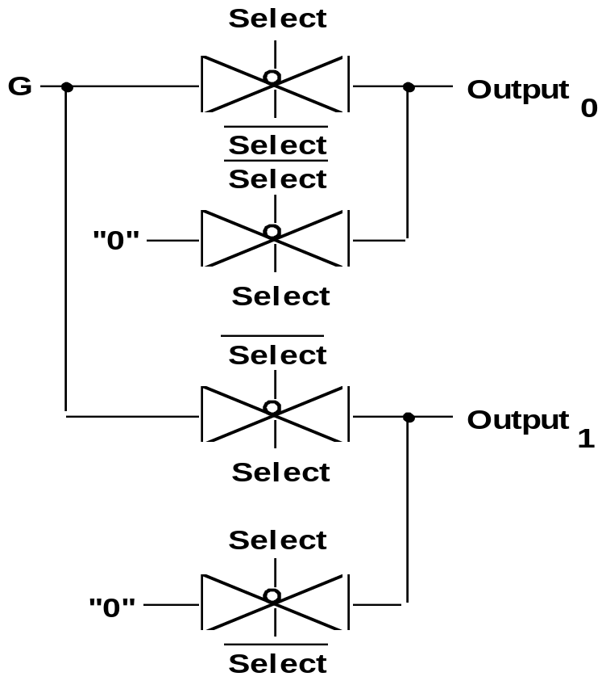
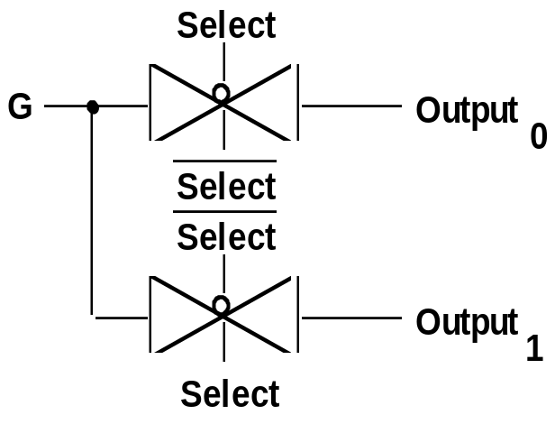
Decoder: Switch Logic Implementation
Naive, Incorrect Implementation
All outputs not driven at all times
Well-formed switching network:
the output node should be always
driven from some input
Correct 1:2 Decoder Implementation

Slide 27
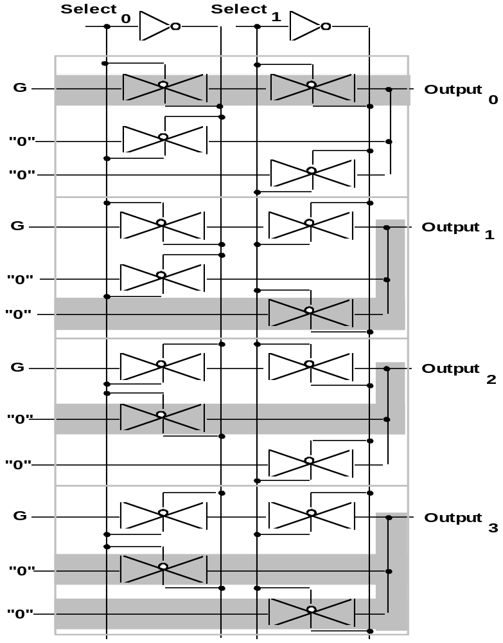
Switch Implementation of 2:4 Decoder
Operation of 2:4 Decoder
S0 = 0, S1 = 0
one straight thru path
three diagonal paths

Slide 28
Demultiplexers as general-purpose logic
A n:2^{n} decoder can implement any function of n variables
  with the variables used as control inputs
  the enable inputs tied to 1 and
  the appropriate minterms summed to form the function
0
1
2
3
4
5
6
7
A'B'C'
A'B'C
A'BC'
A'BC
AB'C'
AB'C
ABC'
ABC
demultiplexer generates appropriate
minterm based on control signals
(it "decodes" control signals)
“1”
3:8 DEC
S2
S1
S0
A
B
C

Slide 29
Demultiplexers as general-purpose logic (cont’d)
F1 = A'BC'D + A'B'CD + ABCD
F2 = ABC'D' + ABC
F3 = (A' + B' + C' + D')
0 A'B'C'D'
1 A'B'C'D
2 A'B'CD'
3 A'B'CD
4 A'BC'D'
5 A'BC'D
6 A'BCD'
7 A'BCD
8 AB'C'D'
9 AB'C'D
10 AB'CD'
11 AB'CD
12 ABC'D'
13 ABC'D
14 ABCD'
15 ABCD
F1
4:16
DEC
Enable
F2
F3
A
B
C
D

Slide 30
Cascading decoders
5:32 decoder
  1x2:4 decoder
  4x3:8 decoders
0 A'B'C'D'E'
1
2
3
4
5
6
7
0
1
2 A'BC'DE'
3
4
5
6
7
3:8 DEC
3:8 DEC
S2
S1
S0
S2
S1
S0
0
1
2
3
F
2:4 DEC
S1
S0
0
1
2
3
4
5
6
7 ABCDE
0 AB'C'D'E'
1
2
3
4
5
6
7 AB'CDE
A
B
3:8 DEC
3:8 DEC
S2
S1
S0
S2
S1
S0
C
D
E
C
D
E

Slide 31
Programmable logic arrays
Pre-fabricated building block of many AND/OR gates
  actually NOR or NAND
  "personalized" by making/breaking connections among the gates
  programmable array block diagram for sum of products form
• • •
inputs
AND
array
OR
array
product
terms
outputs
• • •

Slide 32
Enabling concept
Shared product terms among outputs
F0 = A + B' C'
F1 = A C' + A B
F2 = B' C' + A B
F3 = B' C + A
example:
input side:
personality matrix
1 = uncomplemented in term
0 = complemented in term
– = does not participate
product inputs outputs
term A B C F0 F1 F2 F3
AB 1 1 – 0 1 1 0
B'C – 0 1 0 0 0 1
AC' 1 – 0 0 1 0 0
B'C' – 0 0 1 0 1 0
A 1 – – 1 0 0 1
output side:
1 = term connected to output
0 = no connection to output
reuse of terms

Slide 33
Before programming
All possible connections are available before "programming"
  in reality, all AND and OR gates are NANDs

Slide 34
After programming
Unwanted connections are "blown"
  fuse (normally connected, break unwanted ones)
  anti-fuse (normally disconnected, make wanted connections)
A
B
C
AB
B'C
AC'
B'C'
A
F0
F1
F2
F3

Slide 35
Alternate representation for high fan-in structures
Short-hand notation so we don't have to draw all the wires
  signifies a connection is present and perpendicular signal is an input to gate
notation for implementing
F0 = A B + A' B'
F1 = C D' + C' D
A
B
C
D
AB
A'B'
CD'
C'D
AB+A'B'
CD'+C'D

Slide 36
Programmable logic array example
Multiple functions of A, B, C
  F1 = A B C
  F2 = A + B + C
  F3 = A' B' C'
  F4 = A' + B' + C'
  F5 = A xor B xor C
  F6 = A xnor B xnor C
full decoder as for memory address
bits stored in memory
A
B
C
A'B'C'
A'B'C
A'BC'
A'BC
AB'C'
AB'C
ABC'
ABC
A B C F1 F2 F3 F4 F5 F6
0 0 0 0 0 1 1 0 0
0 0 1 0 1 0 1 1 1
0 1 0 0 1 0 1 1 1
0 1 1 0 1 0 1 0 0
1 0 0 0 1 0 1 1 1
1 0 1 0 1 0 1 0 0
1 1 0 0 1 0 1 0 0
1 1 1 1 1 0 0 1 1
F1
F2
F3
F4
F5
F6

Slide 37
PALs and PLAs
Programmable logic array (PLA)
  what we've seen so far
  unconstrained fully-general AND and OR arrays
Programmable array logic (PAL)
  constrained topology of the OR array
  innovation by Monolithic Memories
  faster and smaller OR plane
a given column of the OR array
has access to only a subset of
the possible product terms

Slide 38
PALs and PLAs: design example
BCD to Gray code converter
A B C D W X Y Z
0 0 0 0 0 0 0 0
0 0 0 1 0 0 0 1
0 0 1 0 0 0 1 1
0 0 1 1 0 0 1 0
0 1 0 0 0 1 1 0
0 1 0 1 1 1 1 0
0 1 1 0 1 0 1 0
0 1 1 1 1 0 1 1
1 0 0 0 1 0 0 1
1 0 0 1 1 0 0 0
1 0 1 – – – – –
1 1 – – – – – –
minimized functions:
W = A + BD + BC
X = BC'
Y = B + C
Z = A'B'C'D + BCD + AD' + B'CD'

Slide 39
PALs and PLAs: design example (cont’d)
Code converter: programmed PLA
minimized functions:
W = A + BD + BC
X = B C'
Y = B + C
Z = A'B'C'D + BCD + AD' + B'CD'
A B C D
A
BD
BC
BC'
B
C
A'B'C'D
BCD
AD'
BCD'
not a particularly good
candidate for PLA
implementation since no terms
are shared among outputs
however, much more compact
and regular implementation
when compared with discrete
AND and OR gates
W X Y Z

Slide 40
PALs and PLAs: design example (cont’d)
A B C D
Code converter: programmed PAL
A
BD
BC
0
BC'
0
0
0
B
C
0
0
A'B'C'D
BCD
AD'
B'CD'
4 product terms
per each OR gate
W X Y Z

Slide 41
PALs and PLAs: design example (cont’d)
Code converter: NAND gate implementation
  loss or regularity, harder to understand
  harder to make changes
A
A
B
C
B
W
D
D
B
B
C
C
D
Z
A
B
\D
X
\B
C
C
\D
Y
B

Slide 42
PALs and PLAs: another design example
A B C D
Magnitude comparator
A'B'C'D'
A'BC'D
ABCD
AB'CD'
AC'
A'C
B'D
BD'
A'B'D
B'CD
ABC
BC'D'
A B C D EQ NE LT GT
0 0 0 0 1 0 0 0
0 0 0 1 0 1 1 0
0 0 1 0 0 1 1 0
0 0 1 1 0 1 1 0
0 1 0 0 0 1 0 1
0 1 0 1 1 0 0 0
0 1 1 0 0 1 1 0
0 1 1 1 0 1 1 0
1 0 0 0 0 1 0 1
1 0 0 1 0 1 0 1
1 0 1 0 1 0 0 0
1 0 1 1 0 1 1 0
1 1 0 0 0 1 0 1
1 1 0 1 0 1 0 1
1 1 1 0 0 1 0 1
1 1 1 1 1 0 0 0
minimized functions:
EQ = A’B’C’D’ + A’BC’D + ABCD + AB’CD’ NE = AC’ + A’C + B’D + BD’
LT = A’C + A’B’D + B’CD GT = AC’ + ABC + BC’D’
EQ NE LT GT

Slide 43
Activity
Map the following functions to the PLA below:
  W = AB + A’C’ + BC’
  X = ABC + AB’ + A’B
  Y = ABC’ + BC + B’C’
A
B
C
W
X
Y

Slide 44
Activity (cont’d)
9 terms won’t fit in a 7 term PLA
  can apply concensus theorem
  to W to simplify to:
  W = AB + A’C’
8 terms wont’ fit in a 7 term PLA
  observe that AB = ABC + ABC’
  can rewrite W to reuse terms:
  W = ABC + ABC’ + A’C’
Now it fits
  W = ABC + ABC’ + A’C’
  X = ABC + AB’ + A’B
  Y = ABC’ + BC + B’C’
This is called technology mapping
  manipulating logic functions
  so that they can use available
  resources
A
B
C
ABC
ABC’
A’C’
AB’
A’B
BC
B’C’
W
X
Y

Slide 45
Read-only memories
Two dimensional array of 1s and 0s
  entry (row) is called a "word"
  width of row = word-size
  index is called an "address"
  address is input
  selected word is output
word lines (only one
is active – decoder is
just right for this)
1
1
1
1
n
2 -1
i
word[i] = 0011
word[j] = 1010
decoder
j
internal organization
0
0 n-1
  Address
bit lines (normally pulled to 1 through
resistor – selectively connected to 0
by word line controlled switches)

Slide 46
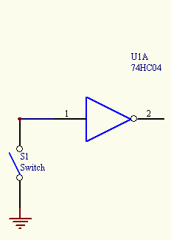
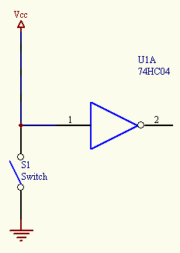
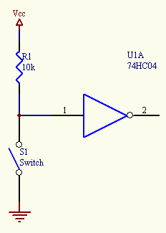
Pull Up Resistor

Slide 47
ROMs and combinational logic
Combinational logic implementation (two-level canonical form) using a ROM
F0 = A' B' C + A B' C' + A B' C
F1 = A' B' C + A' B C' + A B C
F2 = A' B' C' + A' B' C + A B' C'
F3 = A' B C + A B' C' + A B C'
A B C F0 F1 F2 F3
0 0 0 0 0 1 0
0 0 1 1 1 1 0
0 1 0 0 1 0 0
0 1 1 0 0 0 1
1 0 0 1 0 1 1
1 0 1 1 0 0 0
1 1 0 0 0 0 1
1 1 1 0 1 0 0
ROM
8 words x 4 bits/word
A B C F0 F1 F2 F3
address
outputs
truth table
block diagram

Slide 48
ROM structure
Similar to a PLA structure but with a fully decoded AND array
  completely flexible OR array (unlike PAL)
n address lines
• • •
inputs
memory
array
(2^{n} words
by m bits)
decoder
2^{n} word
lines
outputs
• • •
m data lines

Slide 49
ROM vs. PLA
ROM approach advantageous when
  design time is short (no need to minimize output functions)
  most input combinations are needed (e.g., code converters)
  little sharing of product terms among output functions
ROM problems
  size doubles for each additional input
  can't exploit don't cares
PLA approach advantageous when
  design tools are available for multi-output minimization
  there are relatively few unique minterm combinations
  many minterms are shared among the output functions
PAL problems
  constrained fan-ins on OR plane

Slide 50
Regular logic structures for two-level logic
ROM – full AND plane, general OR plane
  cheap (high-volume component)
  can implement any function of n inputs
  medium speed
PAL – programmable AND plane, fixed OR plane
  intermediate cost
  can implement functions limited by number of terms
  high speed (only one programmable plane that is much smaller than ROM's decoder)
PLA – programmable AND and OR planes
  most expensive (most complex in design, need more sophisticated tools)
  can implement any function up to a product term limit
  slow (two programmable planes)

Slide 51
Regular logic structures for multi-level logic
Difficult to devise a regular structure for arbitrary connections between a large set of different types of gates
  efficiency/speed concerns for such a structure
  In Chap 9, you'll learn about field programmable gate arrays (FPGAs) that are just such programmable multi-level structures
    programmable multiplexers for wiring
    lookup tables for logic functions (programming fills in the table)
    multi-purpose cells (utilization is the big issue)
Use multiple levels of PALs/PLAs/ROMs
  output intermediate result
  make it an input to be used in further logic

Slide 52
Combinational logic technology summary
Random logic
  Single gates or in groups
  conversion to NAND-NAND and NOR-NOR networks
  transition from simple gates to more complex gate building blocks
  reduced gate count, fan-ins, potentially faster
  more levels, harder to design
Time response in combinational networks
  gate delays and timing waveforms
  hazards/glitches (what they are and why they happen)
Regular logic
  multiplexers/decoders
  ROMs
  PLAs/PALs
  advantages/disadvantages of each

