Slide 1
Chapter 9: Sequential Logic Technologies
Part 2

Slide 2
BCD to Excess 3 Converter
PLA-based Design
State Assignment with NOVA
0 S0 S1 1
1 S0 S2 0
0 S1 S3 1
1 S1 S4 0
0 S2 S4 0
1 S2 S4 1
0 S3 S5 0
1 S3 S5 1
0 S4 S5 1
1 S4 S6 0
0 S5 S0 0
1 S5 S0 1
0 S6 S0 1
S0 = 000
S1 = 001
S2 = 011
S3 = 110
S4 = 100
S5 = 111
S6 = 101
NOVA derived
state assignment
9 product term
implementation
NOVA input file

Slide 3
BCD to Excess 3 Converter
.i 4
.o 4
.ilb x q2 q1 q0
.ob d2 d1 d0 z
.p 16
0 000 001 1
1 000 011 0
0 001 110 1
1 001 100 0
0 011 100 0
1 011 100 1
0 110 111 0
1 110 111 1
0 100 111 1
1 100 101 0
0 111 000 0
1 111 000 1
0 101 000 1
1 101 --- -
0 010 --- -
1 010 --- -
.e
Espresso Inputs
.i 4
.o 4
.ilb x q2 q1 q0
.ob d2 d1 d0 z
.p 9
0001 0100
10-0 0100
01-0 0100
1-1- 0001
-0-1 1000
0-0- 0001
-1-0 1000
--10 0100
---0 0010
.e
Espresso Outputs

Slide 4
BCD to Excess 3 Converter
D2 = Q2 • Q0 + Q2 • Q0
D1 = X • Q2 • Q1 • Q0 + X • Q2 • Q0 + X • Q2 • Q0 + Q1 • Q0
D0 = Q0
Z = X • Q1 + X • Q1

Slide 5
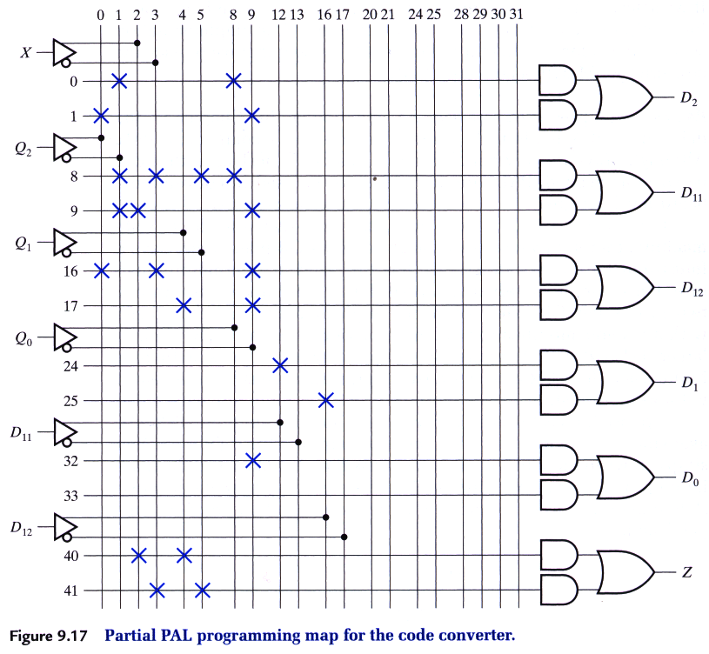
BCD to Excess 3 Serial Converter
10H8 PAL: 10 inputs, 8 outputs, 2 product terms per OR gate
D1 = D11 + D12
D11 = X • Q2 • Q1 • Q0 + X • Q2 • Q0
D12 = X • Q2 • Q0 + Q1 •Q0
0. Q2 • Q0
1. Q2 • Q0
8. X • Q2 • Q1 • Q0
9. X • Q2 • Q0
16. X • Q2 • Q0
17. Q1 • Q0
24. D11
25. D12
32. Q0
33. not used
40. X • Q1
41. X • Q1

Slide 6
BCD to Excess 3 Serial Converter

Slide 7
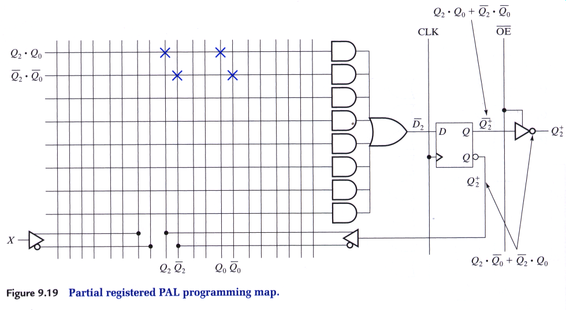
More Advanced PAL Architectures
Registered PAL Architecture
Buffered Input
or product term
Negative Logic
Feedback
D2 = Q2 • Q0 + Q2 • Q0
D1 = X • Q2 • Q1 • Q0 + X • Q2 + X • Q0 + Q2 • Q0 + Q1 • Q0
D0 = Q0
Z = X • Q1 + X • Q1

Slide 8
Implementation Strategies
Advanced PAL Architectures
Programmable Output Polarity/XOR PALs
Buried Registers: decouple
FF from the output pin
Advantage of XOR PALs: Parity and Arithmetic Operations

Slide 9
Implementation Strategies
Example of XOR PAL
Example of Registered PAL

Slide 10
FSM Design with More Sophisticated PLDs
Programmable Logic Devices = PLDs
PALs, PLAs = 10 - 100 Gate Equivalents
Field Programmable Gate Arrays = FPGAs
Altera Erasable Programmable Logic Devices
Actel Field Programmable Gate Arrays
Xilinx Field Programmable Gate Arrays

Slide 11
Design with More Sophisticated PLDs
Altera EPLD (Erasable Programmable Logic Devices)
Historical Perspective:
PALs: same technology as programmed once bipolar PROM
EPLDs: CMOS erasable programmable ROM (EPROM)
erased by UV light
Altera building block = MACROCELL
8 Product Term
AND-OR Array
+
Programmable
MUX's
I/O Pin
Seq. Logic
Block
Programmable polarity
Programmable feedback

Slide 12
Design with More Sophisticated PLDs
Altera EPLDs contain 32 to 512 independently programmed macrocells
Personalized by EPROM bits:
Flipflop controlled
by global clock signal
local signal computes
output enable
Flipflop controlled
by locally generated
clock signal
+ Seq Logic: could be D, T positive or negative edge triggered
+ product term to implement clear function

Slide 13
Design with More Sophisticated PLDs
AND-OR structures are relatively limited
Cannot share signals/product terms among macrocells
Altera solution: Multiple Array Matrix (MAX)
Logic
Array
Blocks
(similar to
macrocells)
Global Routing:
Programmable
Interconnect
Array
EPM5128:
8 Fixed Inputs
52 I/O Pins
8 LABs
16 Macrocells/LAB
32 Expanders/LAB

Slide 14
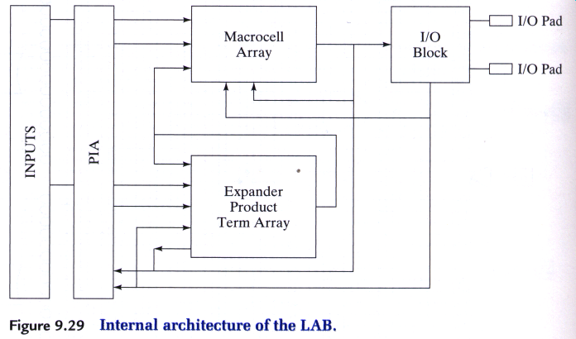
Design with More Sophisticated PLDs
LAB Architecture
Expander Terms shared among all
macrocells within the LAB

Slide 15
20 of these PALs!!
P22V10 PAL
Supports large number of product terms per output
Latches and muxes associated with output pins

Slide 16
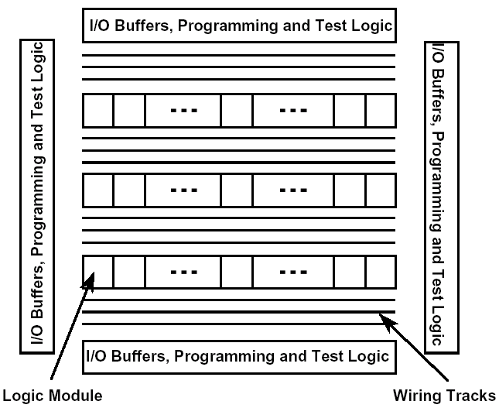
Design with More Sophisticated PLDs
Actel Field Programmable Gate Arrays
Rows of programmable
logic building blocks
+
rows of interconnect
Anti-fuse Technology:
Program Once
Use Anti-fuses to build
up long wiring runs from
short segments

Slide 17
Actel Logic Module
2 combinational-logic cells per logic module
1 sequential-logic cell per logic module
Basic Module is a
Modified 4:1 Multiplexer
Example:
Implementation of S-R Latch

Slide 18
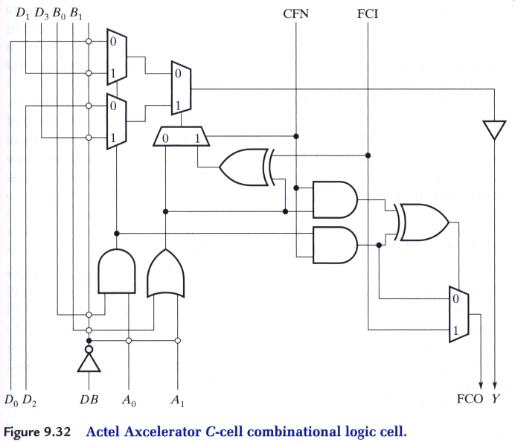
Actel Axcelerator C-Cell Combinational Logic Cell

Slide 19
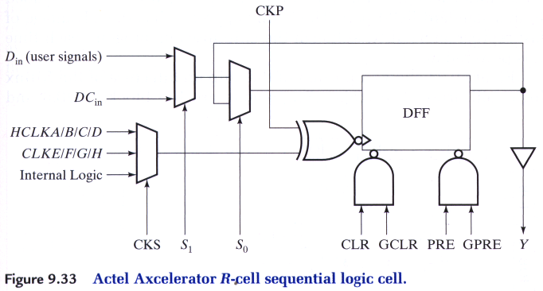
Actel Axcelerator R-Cell Sequential Logic Cell

Slide 20
Actel Interconnect
Interconnection Fabric

Slide 21
Actel Routing Example
Jogs cross an anti-fuse
minimize the # of jogs for speed critical circuits
2 - 3 hops for most interconnections

Slide 22
Design with More Sophisticated PLDs
Xilinx Field Programmable Gate Arrays
CMOS Static RAM Technology
All personality elements connected into serial shift register
Shift in string of 1's and 0's on power up
General Chip Architecture:
Logic Blocks (CLBs)
IO Blocks (IOBs)
Wiring Channels

Slide 23
Design with More Sophisticated PLDs
Xilinx LCA Architecture
Inputs:
Tri-state enable
bit to output
input, output clocks
Outputs:
input bit
Internal FFs for
input & output paths
Fast/Slow outputs
5 ns vs. 30 ns rise
Pull-up used with
unused IOBs

Slide 24
Design with More Sophisticated PLDs
Xilinx LCA Architecture
Configurable Logic Block: CLB
2 FFs
Any function of
5 Variables
Global Reset
Clock, Clock Enb
Independent DIN

Slide 25
Design with More Sophisticated PLDs
Xilinx LCA Architecture
CLB Function Generator
Any function of 5 variables
Two Independent Functions
of 4 variables each

Slide 26
Design with More Sophisticated PLDs
Xilinx LCA Architecture
CLB Function Generator
Certain Limited
Functions of more than
5 Variables

Slide 27
Designing with More Sophisticated PLDs
Xilinx Application Examples
5-Input Parity Generator
Implemented with 1 CLB:
F = A xor B xor C xor D xor E
2-bit Comparator: A B = C D or A B > C D
Implemented with 1 CLB:
(GT) F = A C + A B D + B C D
(EQ) G = A B C D + A B C D + A B C D + A B C D

Slide 28
Designing with More Sophisticated PLDs
Xilinx Application Examples
n-Input Majority Circuit
Assert 1 whenever n/2 or greater inputs are 1
n-input Parity Functions
5 input = 1 CLB, 2 Levels of CLBs yield up to 25 inputs!

Slide 29
Designing with More Sophisticated PLDs
Xilinx Application Examples
4-bit Binary Adder
Full Adder, 4 CLB delays to
final carry out
2 x Two-bit Adders (3 CLBs
each) yields 2 CLBs to final
carry out

Slide 30
Design with More Sophisticated PLDs
Xilinx LCA Architecture
Interconnect
Direct Connections
Global Long Line
Horizontal/Vertical
Long Lines
Switching Matrix
Connections

Slide 31
Design with More Sophisticated PLDs
Xilinx LCA Architecture
Implementing the BCD to Excess 3 FSM
Q2+ = Q2 • Q0 + Q2 • Q0
Q1+ = X • Q2 • Q1 • Q0 + X • Q2 • Q0 + X • Q2 • Q0 + Q1 •Q0
Q0+ = Q0
Z = X • Q1 + X • Q1
No function more complex than 4 variables
4 FFs implies 2 CLBs
Synchronous Mealy Machine
Global Reset to be used
Place Q2+, Q0+ in the first CLB
Q1, Z in second CLB
maximize use of direct &
minimize general purpose interconnections

Slide 32
Design with More Sophisticated PLDs
Xilinx LCA Architecture
Implementing the BCD to Excess 3 FSM

Slide 33
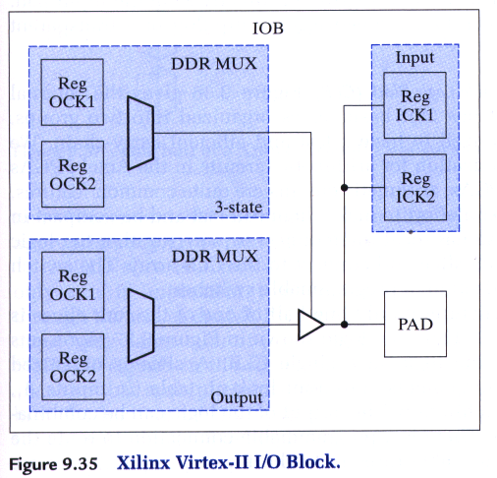
Virtex-II IOB

Slide 34
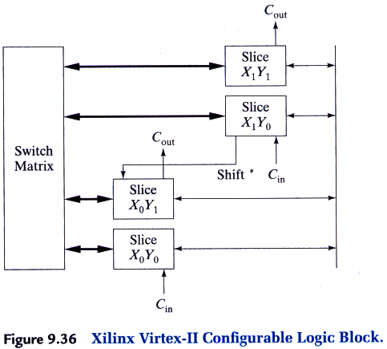
Virtex-II CLB

Slide 35
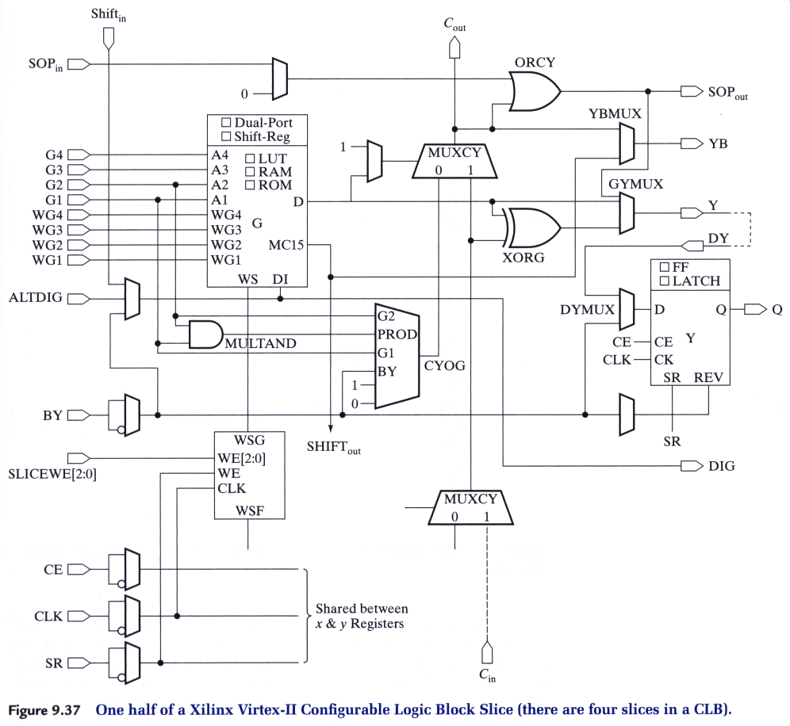
½ of CLB Slice

Slide 36
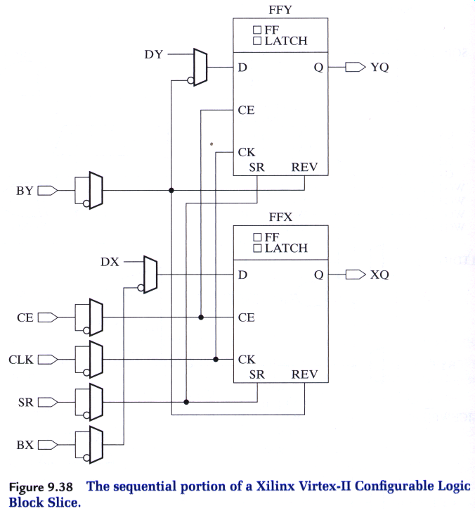
CLB: Sequential Portion

Slide 37
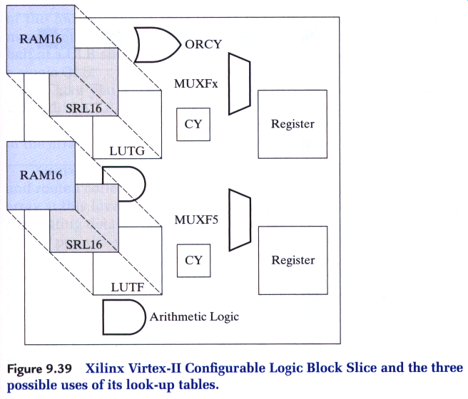
Virtex-II CLB Slice

Slide 38
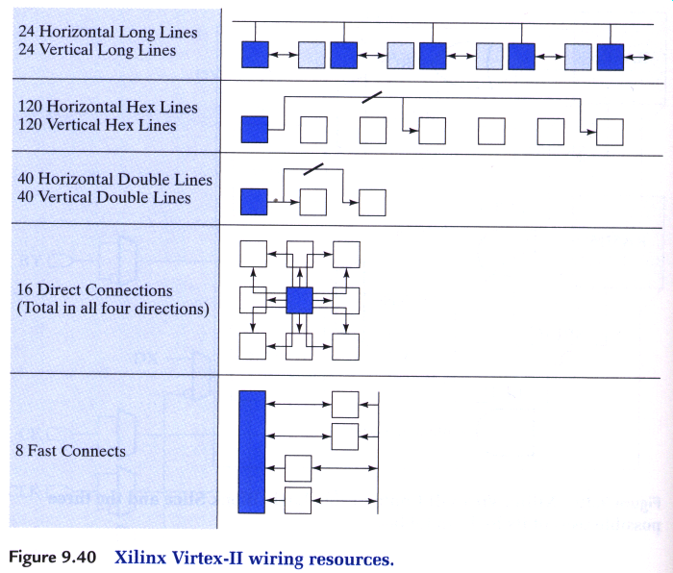
Virtex-II Wiring:

Slide 39
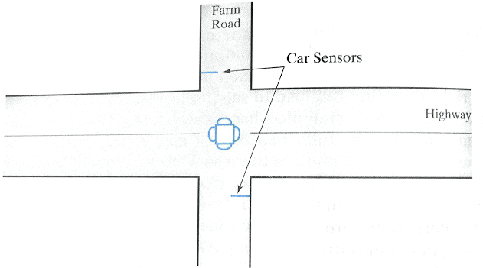
Case Study: Traffic-Light Controller

