Slide 1
Chap. 15 The Operational Amplifier Abstraction
Device Properties of OP AMP
OP AMP Circuits
OP AMP RC Circuits

Slide 2
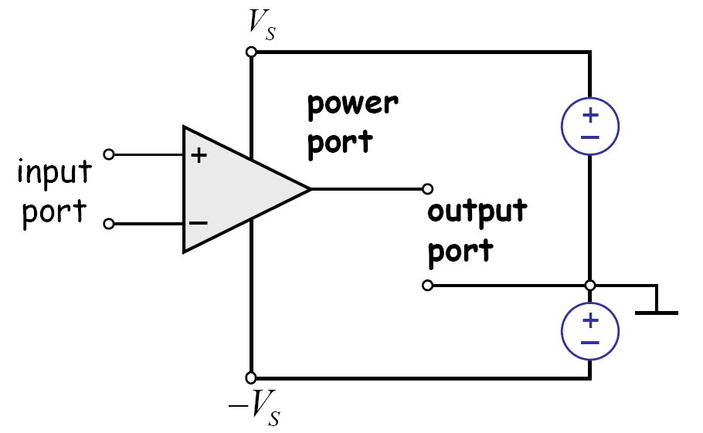
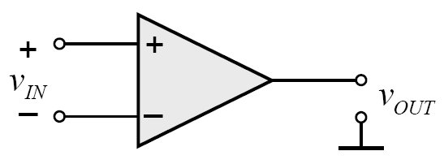
Operational Amplifier (OP AMP) Abstraction

Slide 3
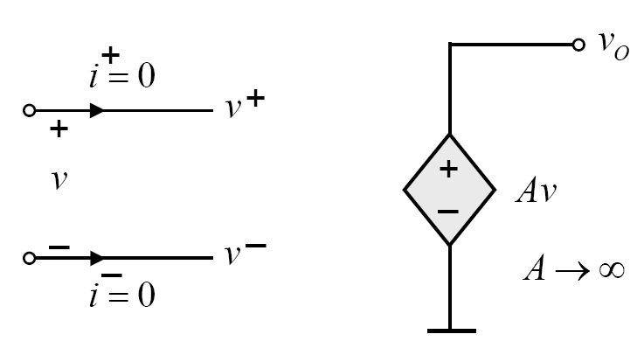
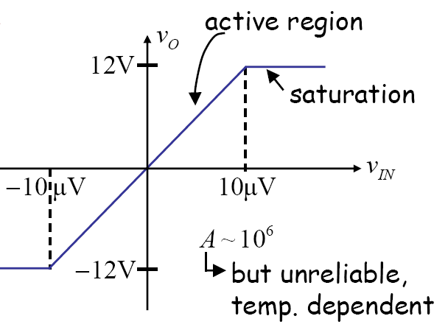
Ideal Circuit Model of OP AMP
v₀
Esat
v
-Esat
Input resistance is infinite
Output resistance is 0
Infinite gain

Slide 4
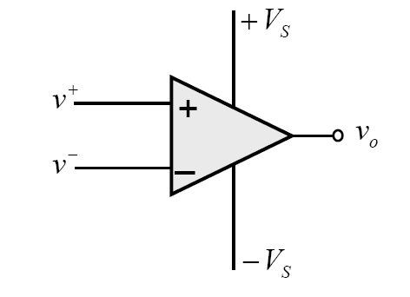
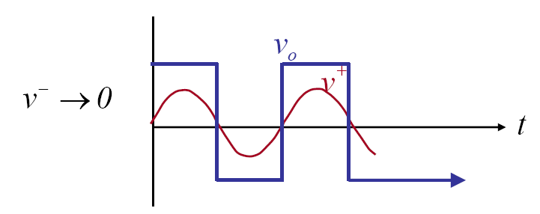
Comparator (OP AMP in Saturation)

Slide 5
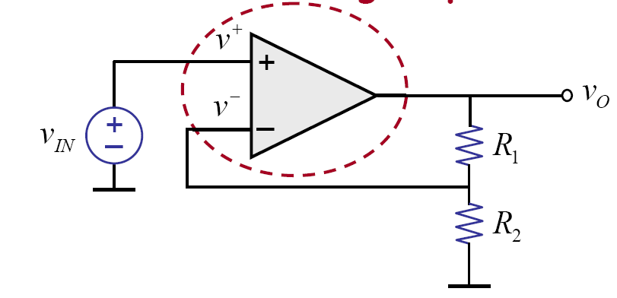
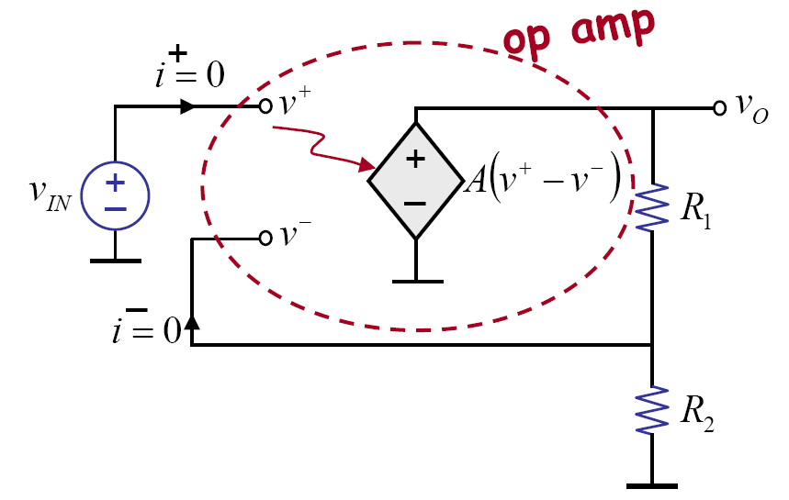
Non-inverting Amplifier

Slide 6
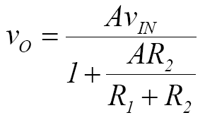
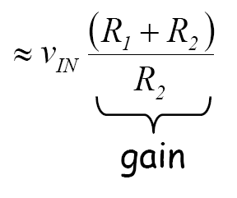
Non-inverting Amplifier (2)
Show

Slide 7
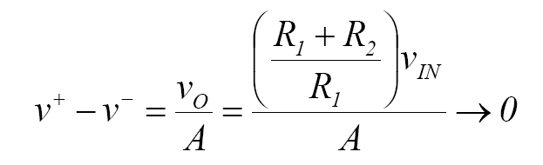

Negative Feedback
Portion of output is fed back into the negative input
  Stable state is reached without saturation
Output is independent of OP AMP gain and temperature.

Slide 8
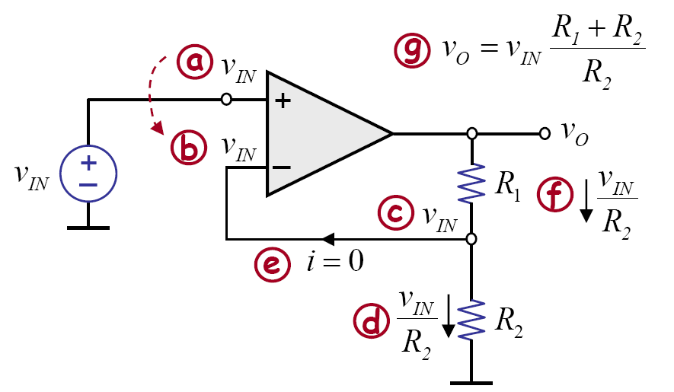
Easy Solution
Node equation at the input ports !

Slide 9
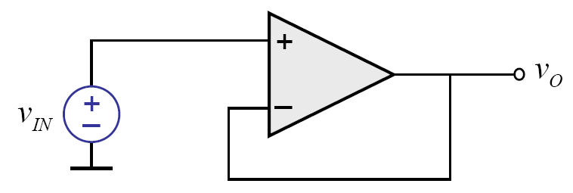
Voltage Follower
Voltage gain = 1, current gain = infinite
Buffer: isolate the input and the output circuits

Slide 10
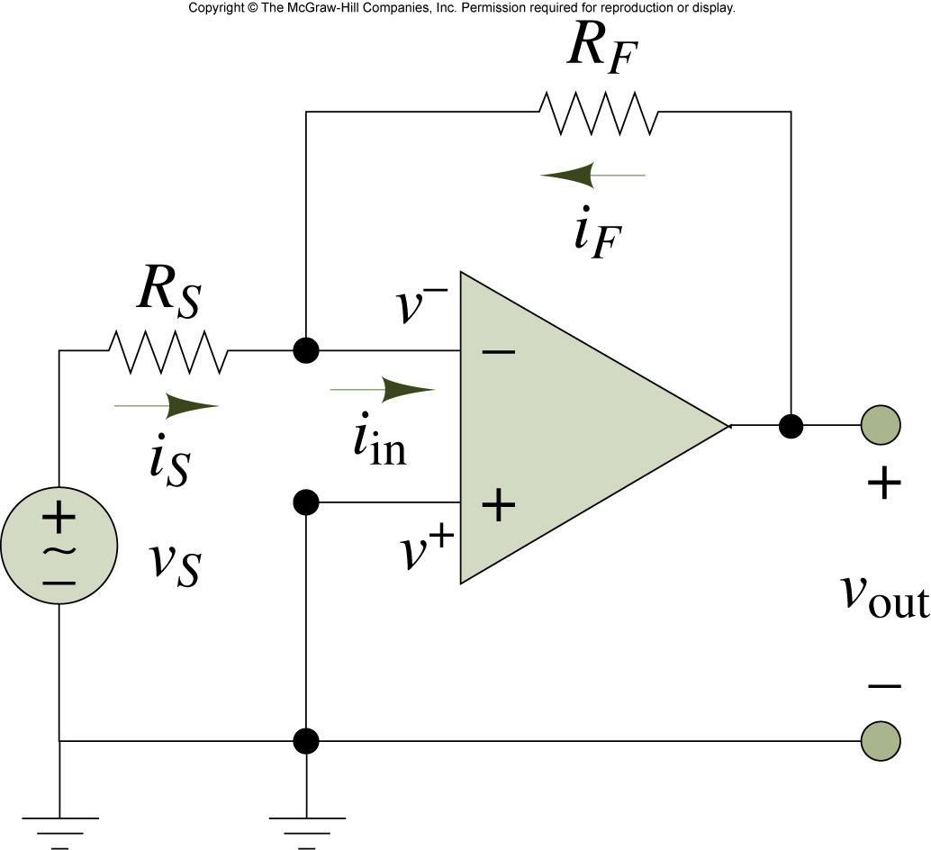
Inverting OP AMP

Slide 11
Adder
R₁
R₃
v₁
+
R₂
-
+
v_{o}
v₂
+

Slide 12
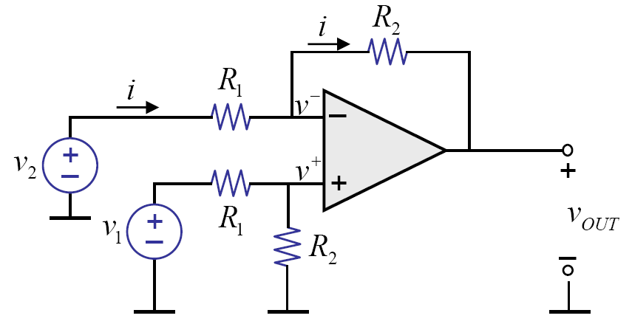
Subtracter

Slide 13
Exercise
R_{f}
R₁
A
+
-
-
+
+
v₀
₋
v₁
+
R₁
+
v₂
R_{f}

Slide 14
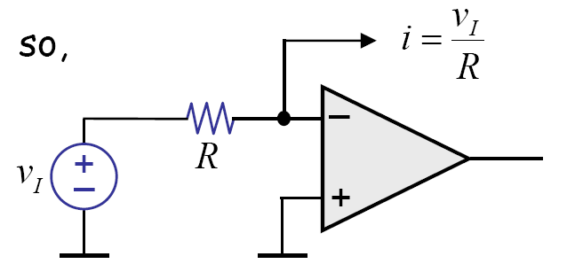
Current Source from OP AMP

Slide 15
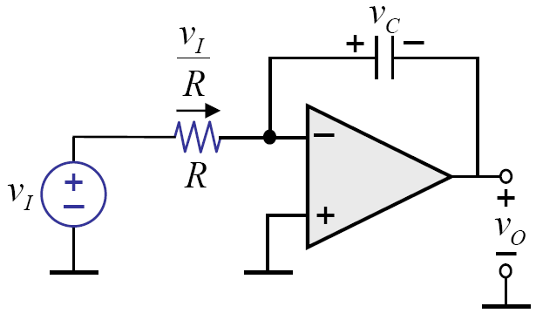
OP AMP Integrator

Slide 16
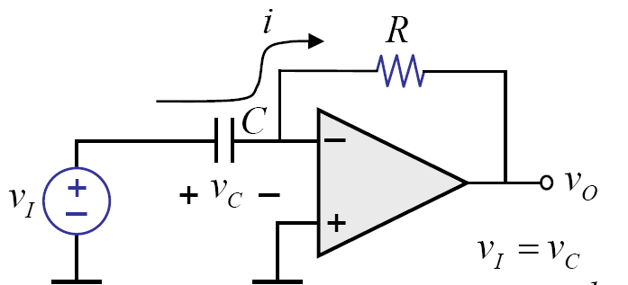
OP AMP Differentiator

Slide 17
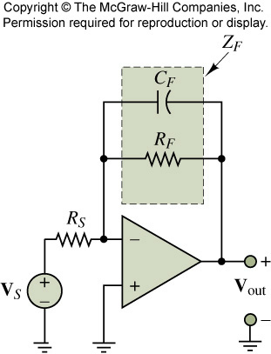
OP AMP Active Filter

Slide 18
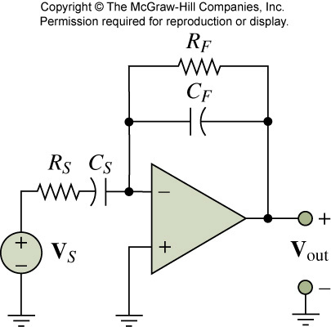
Exercise

Slide 19
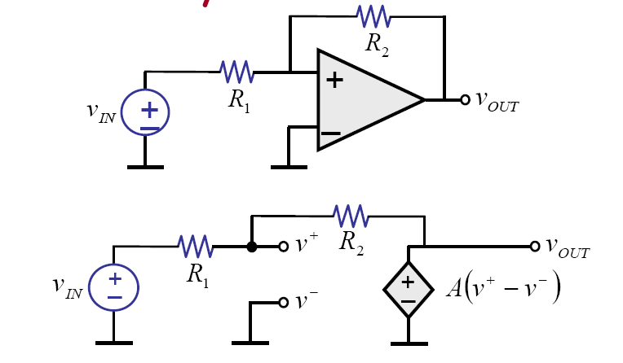
Positive Feedback

Slide 20
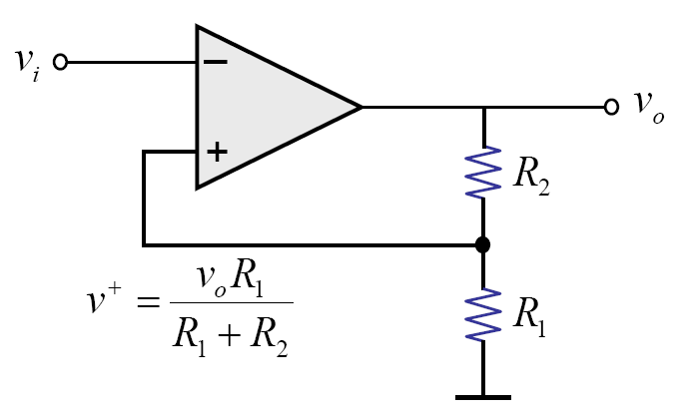
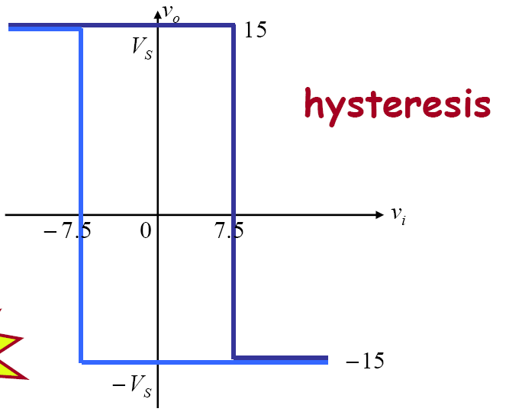
Voltage Characteristic

Slide 21
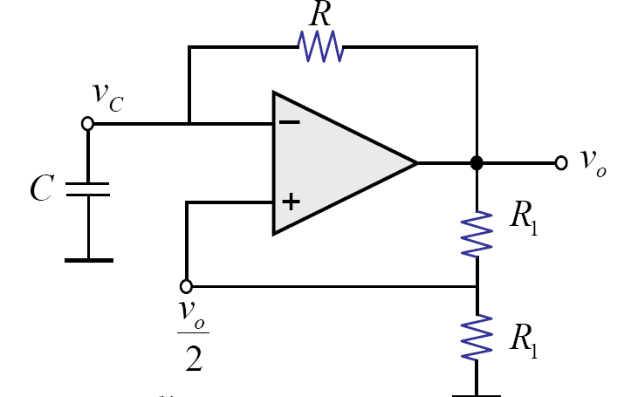
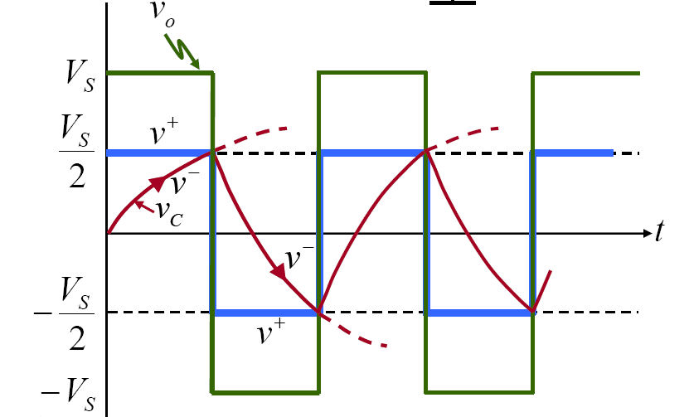
Oscillator

Slide 23
Summary
Ideal OP AMP
Comparator: OP AMP in saturation
Negative Feedback Circuits
Active Filters
Positive Feedback - oscillator

Slide 24
Chap. 16 Diodes
Diode Characteristics
Peak Detector
Clamping Circuit

Slide 25
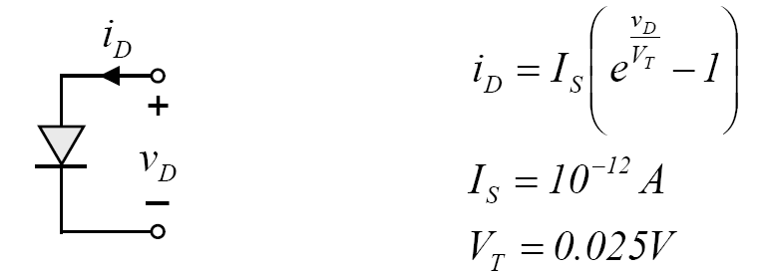
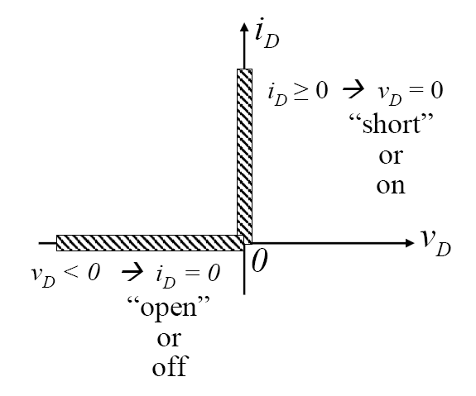
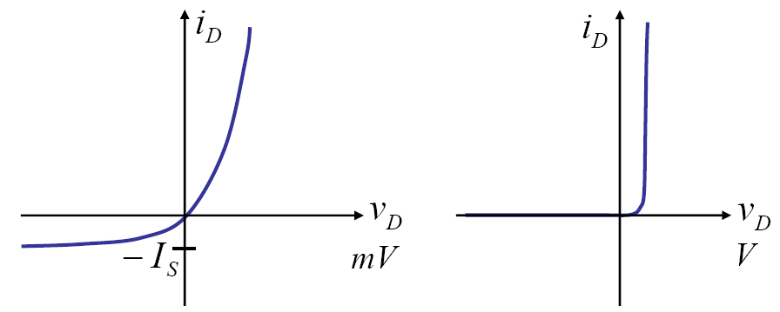
Reminder: Diode Characteristics

Slide 26
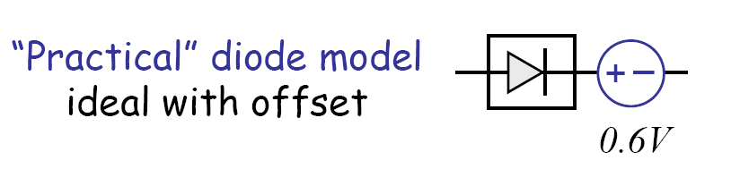
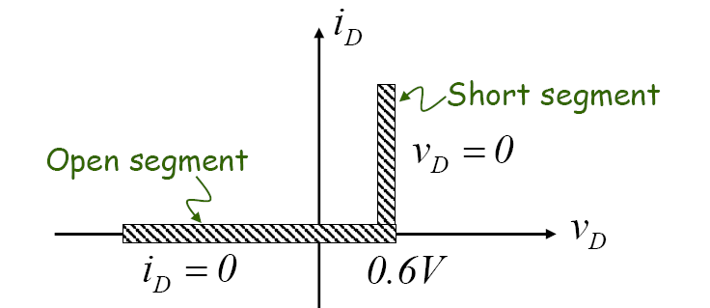
Ideal Diode and Practical Diode

Slide 27
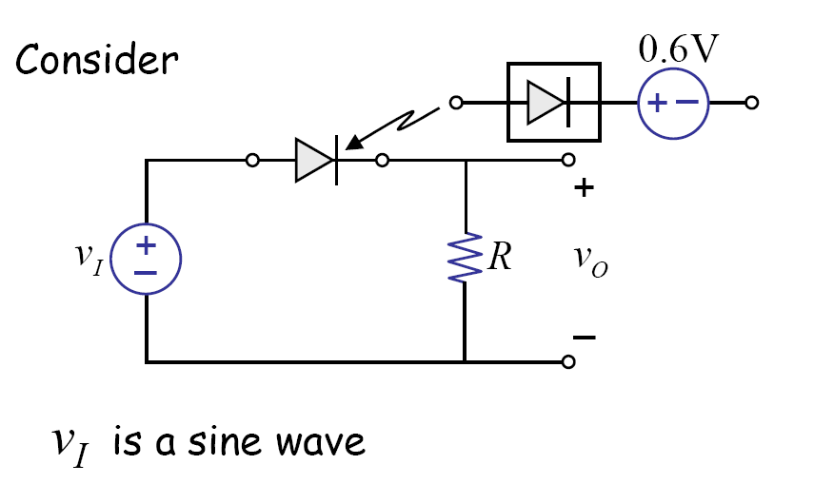
Half Wave Rectifier

Slide 28
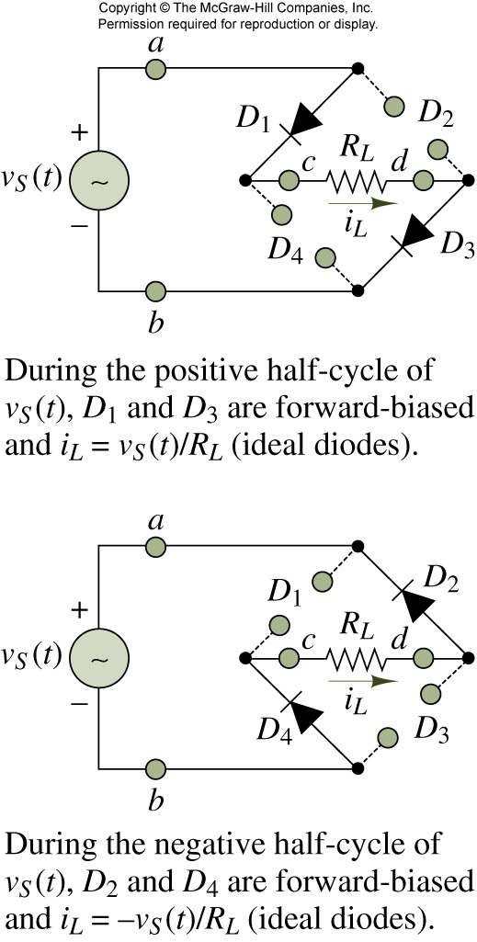
Bridge Rectifier
Do not need center-tapped transformer
Smaller PIV

Slide 29
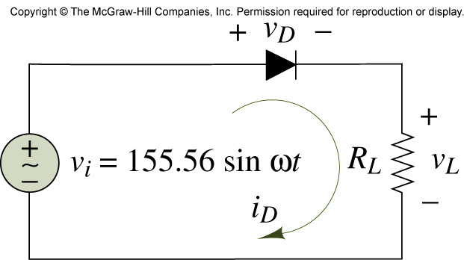

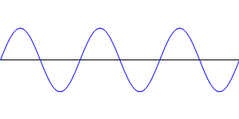
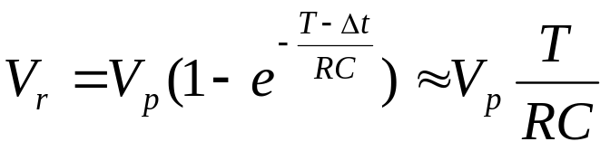
Peak rectifier
C
_{T}
Ripple voltage
What is the ripple voltage for a Bridge rectifier?

Slide 30
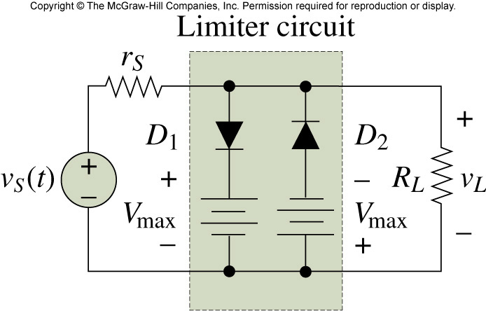
Exercise: Clipper or Limiter

Slide 31




Diode Claming Circuit
5
+
-
C
+
- 4
Sinusoidal input

Slide 32

More Diode Clamping Circuits
5
+
-
C
+
- 4
+
-
C
+
+

Slide 33
Diode Clamp with Resister
5
+
-
C
+
R
- 4

Slide 34
Summary: Diode Circuits
Rectifier
Peak Detector
Limiter
Clamping Circuits

Slide 35
THE END…

